Slide 1
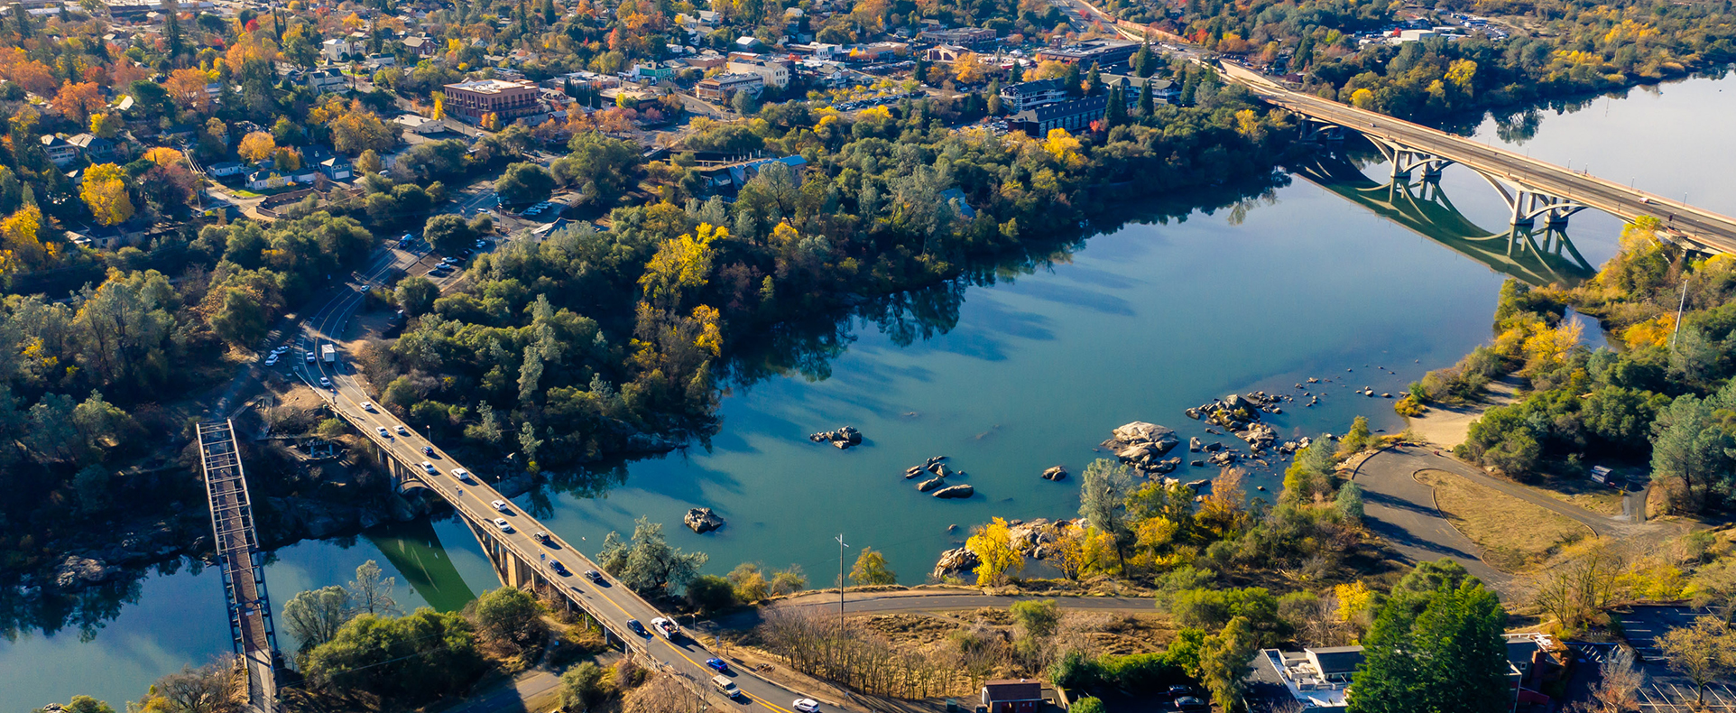
City Manager’s Proposed FY 2022-23 Operating and Capital Budgets
City Council Presentation – May 10, 2022

Slide 2
FY 2022-23 Proposed Budget

Slide 3
Balancing the Budget

Slide 4
General Fund Budget Additions
$993,678 Firefighter positions (7) – Folsom Plan Area
$425,862 Firefighter positions (3) – adjust limited-term to permanent
$254,875 Additional capital funding for Type 1 Fire Engine
$168,000 Police Officer position
$133,631 Dispatcher position
$120,116 Animal Control Officer position
$86,400 Geographic Information System (GIS) contract staffing
$51,000 Elections costs for 2022 election
$50,000 Additional funding for outside counsel
Included in General fund budget but funded from other source:
Municipal Landscape Services Maintenance Worker (CFD, L&L funded)
Public Works Boom Truck, Patch Truck and two flatbed trucks (Measure A, Gas Tax funded)

Slide 5
General Fund Appropriations

Slide 6
General Fund Appropriations

Slide 7
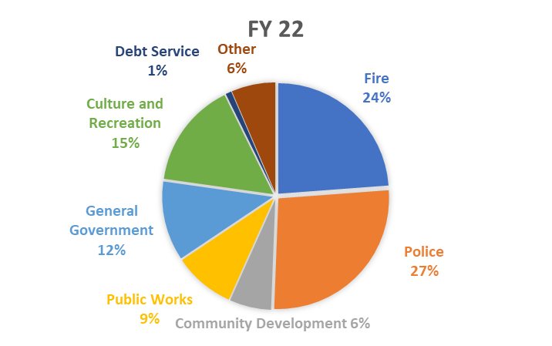
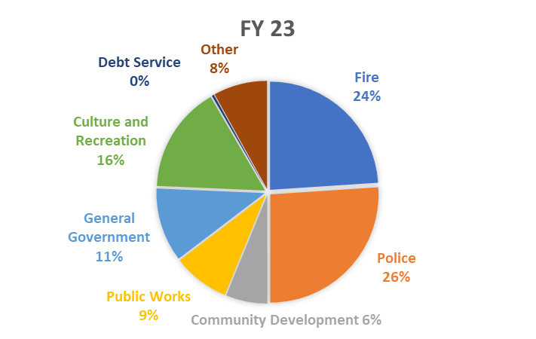
General Fund Appropriations

Slide 8
Authorized Positions

Slide 9
Revenue Summary

Slide 10
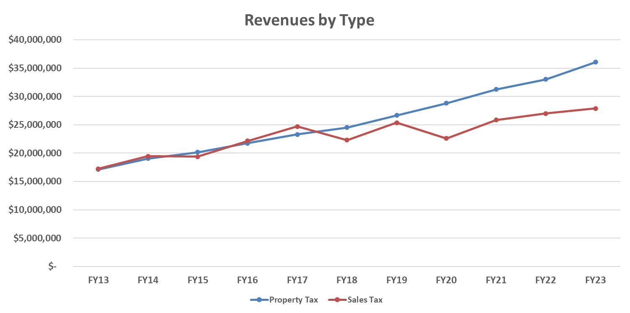
General Fund Tax Revenue Trends

Slide 11
Unassigned General Fund Balance
Total:
$6.2 million for FY 2022-23
Proposed

Slide 12
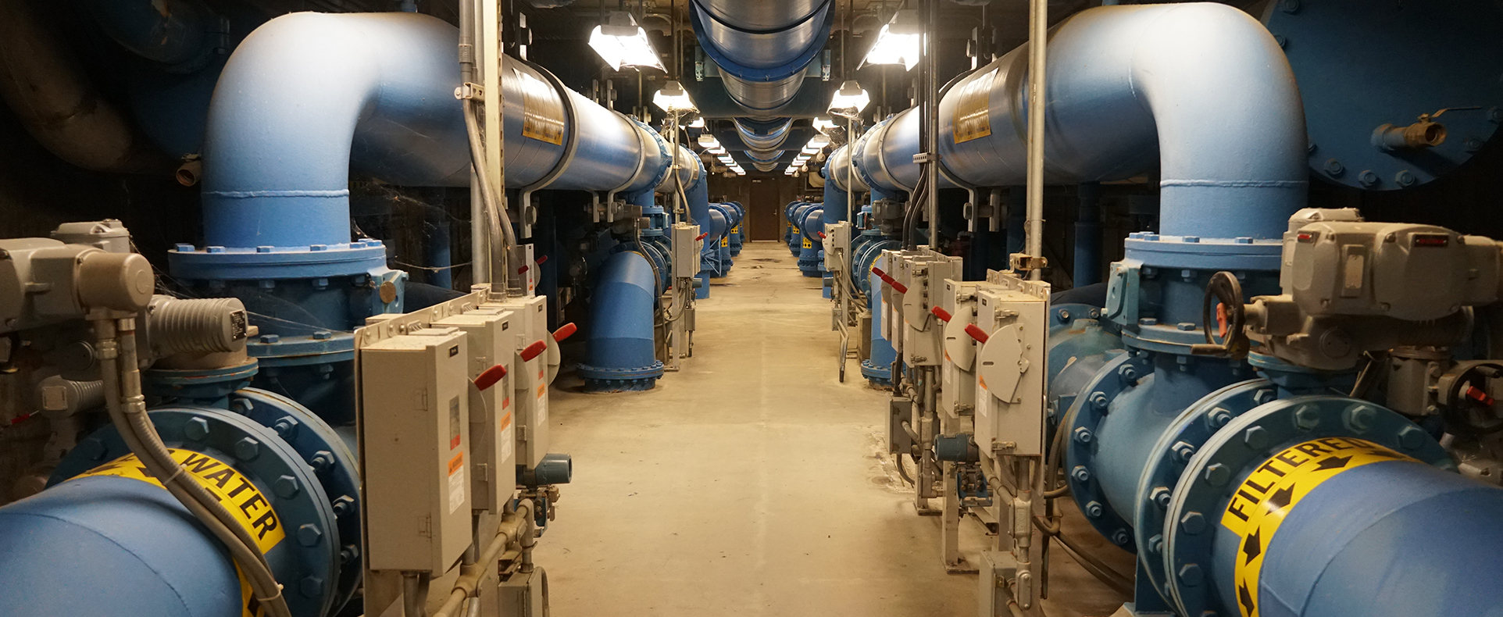
Enterprise Funds

Slide 13
Enterprise Fund - Water

Slide 14
Enterprise Fund - Wastewater

Slide 15
Enterprise Fund – Solid Waste

Slide 16

Capital Improvement Plan

Slide 17
CIP – Major Projects

Slide 18
CIP – Project Funding Sources

Slide 19
Appropriations by Fund

Slide 20

Five-year Budget Forecast

Slide 21
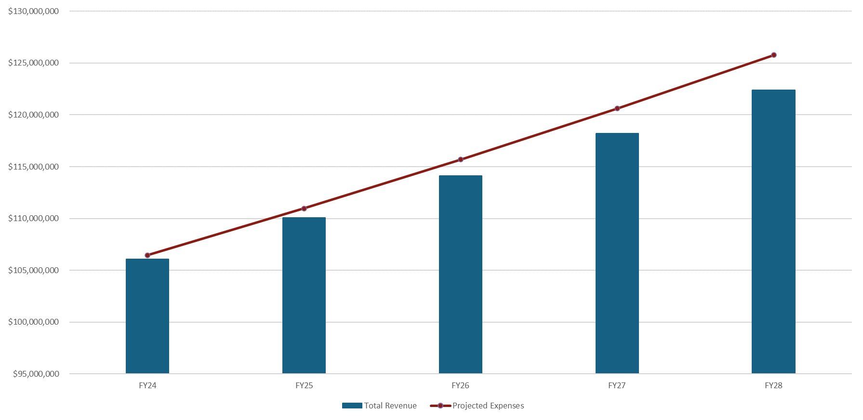
Five-year Forecast - General Fund
Grows to $3.4 million Annual Funding Gap
($3.4 million)
($2.4 million)
($1.6 million)
$3.4 million gap does not include $20 million of unfunded annual needs
($909k)

Slide 22
Major Budgetary Concerns – FY24 - FY28
The five-year forecast predicts an upcoming structural deficit as the cost to provide our current level of service grows at a faster pace than revenues
Although we are meeting all our current obligations, there are millions of dollars (estimated at $20 million annually) of unfunded or underfunded needs that the city has been deferring, year after year
Flattening trend for sales tax revenue
Uncertainty of future CalPERS contribution requirements

Slide 23
Major Budgetary Concerns – FY24 - FY28
Depletion of “one-time” funds with little ability to replenish funds in future years
Little ability to stay competitive in the region related to employee compensation
Ongoing need for consistent funding of the Capital Replacement fund and the establishment and funding of an IT Infrastructure fund
Growing service level needs in the Folsom Plan Area will require additions to future budgets

Slide 24

FY 22-23 Budget Summary
Structurally sound and balanced budget that maintains core essential services
Maintains the balance of expenditures by department
Budget does not draw upon the City’s unassigned, unreserved fund balance
Leaves millions of dollars in infrastructure, equipment repair and replacements, staffing needs and other items unfunded

Slide 25
Conclusion
Discussion, questions and direction to staff

