Slide 1
City Works Day 2022

Slide 2
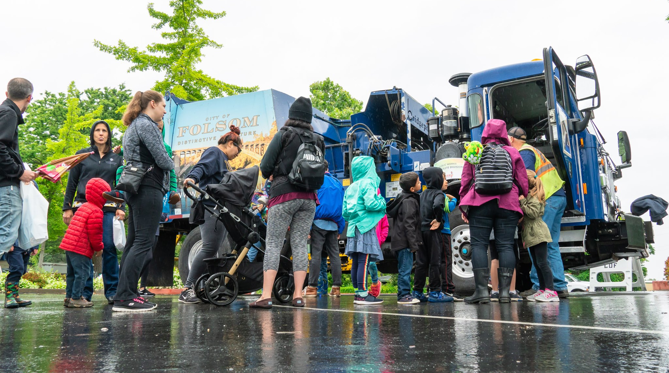
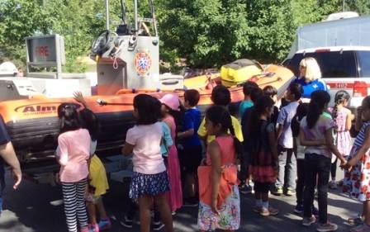
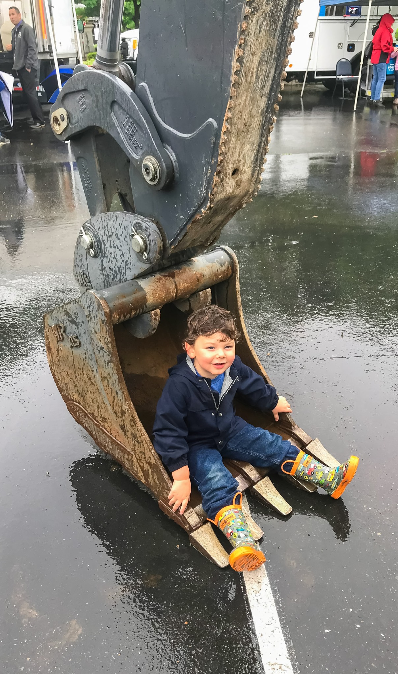
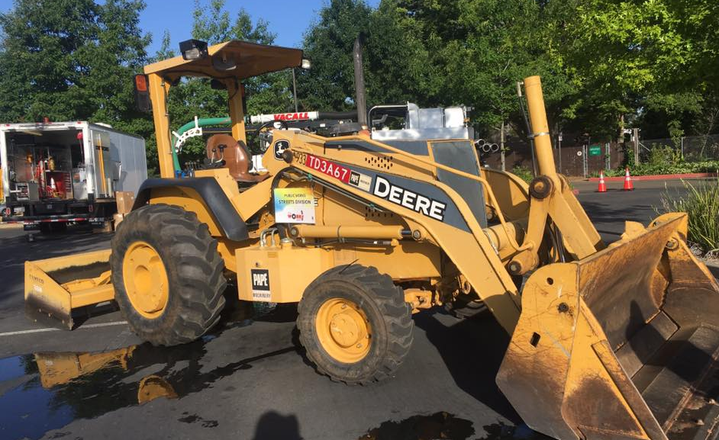
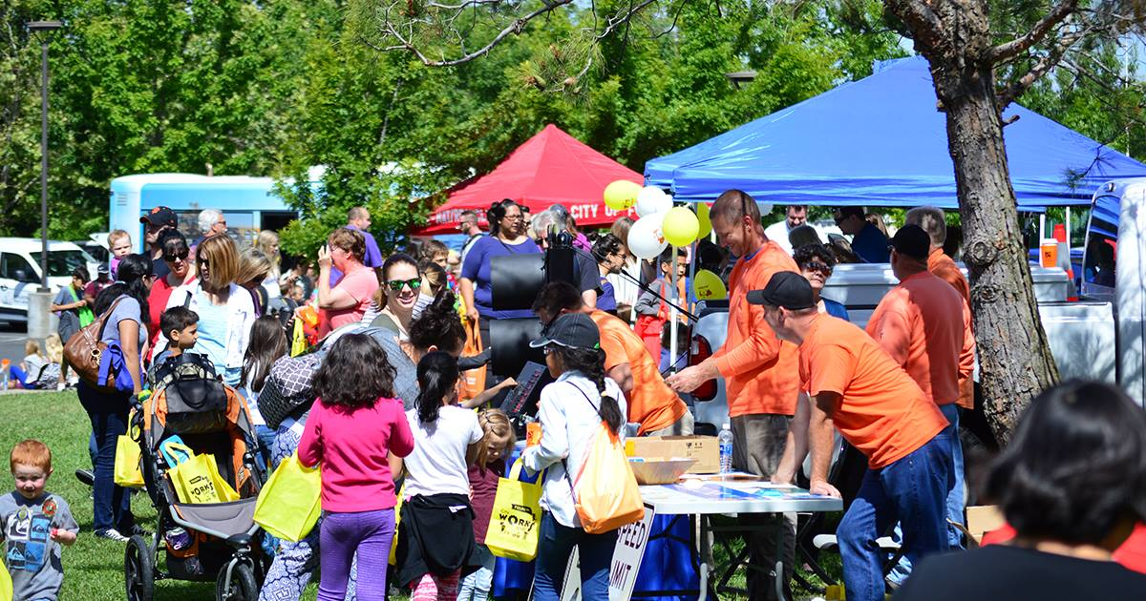
City Works Day 2022

Slide 3
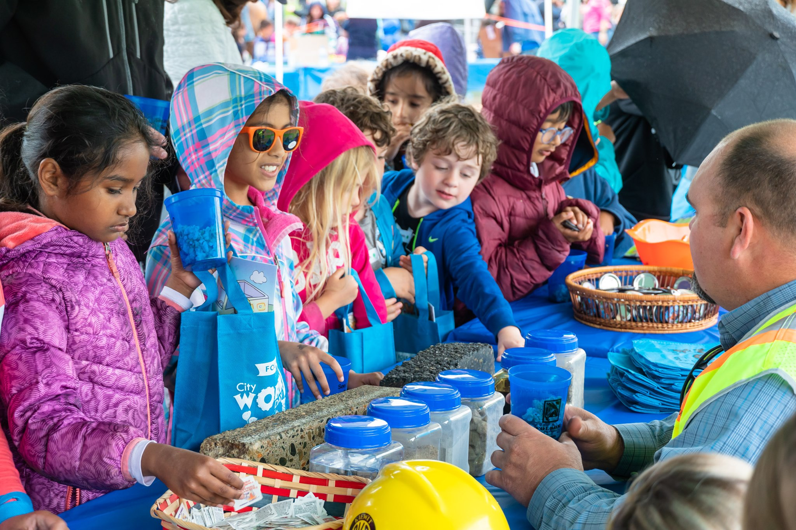
About City Works Day
Wednesday, May 18 9:30 a.m. to noon
City Lions Park
Free Admission

Slide 4
New Graphics

Slide 5
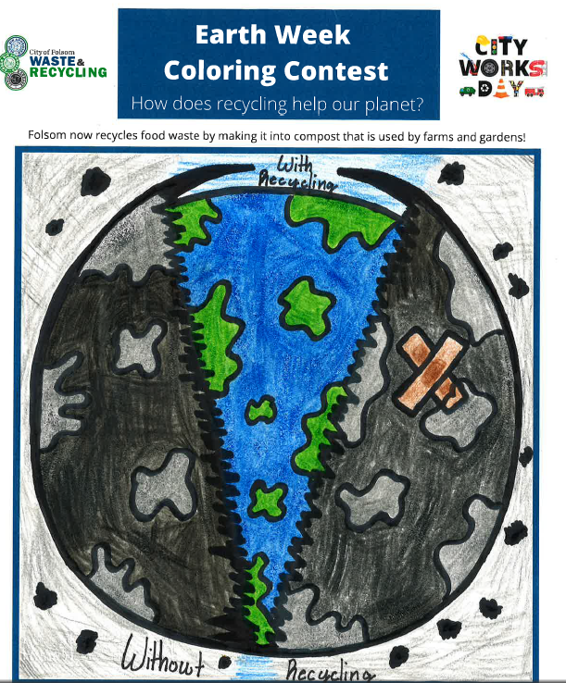
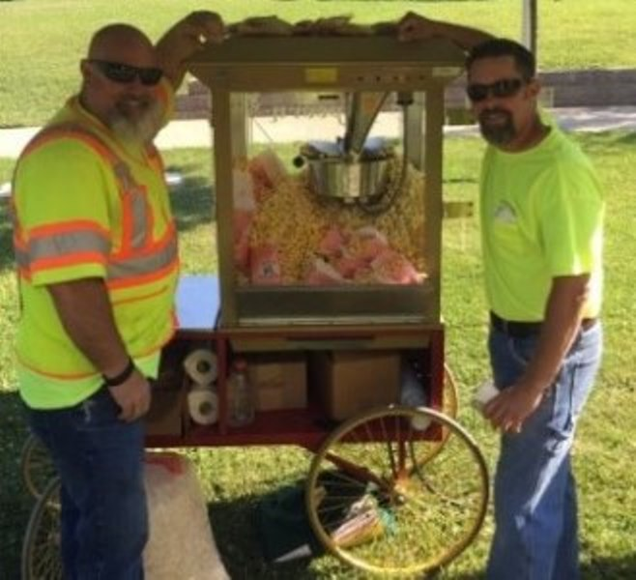
City Works Day Event Details

Slide 6
Learn More
www.folsom.ca.us/CityWorksDay 916-461-6702 pwdept@folsom.ca.us

