Slide 1
Resolution No. 10831
Bidwell Place Supplemental Loan

Slide 2
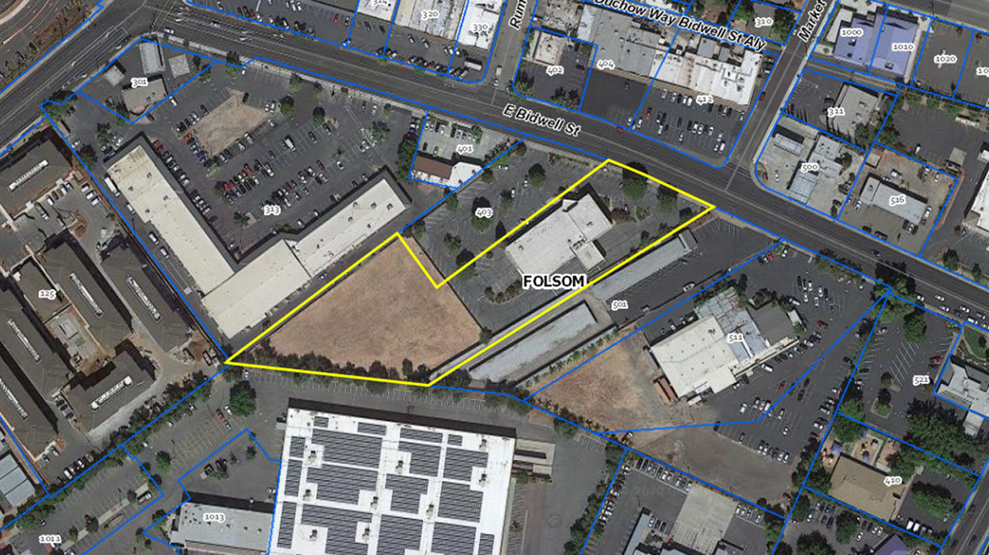
Project Vicinity

Slide 3
Project Funding
Previous Funding Approvals
$4.15 million affordable housing loan
$150,693 grant from the city to offset the loss of sewer fee credit
Additional Funding Request
$588,265 supplemental affordable housing loan to offset unanticipated Quimby fees

