Slide 1
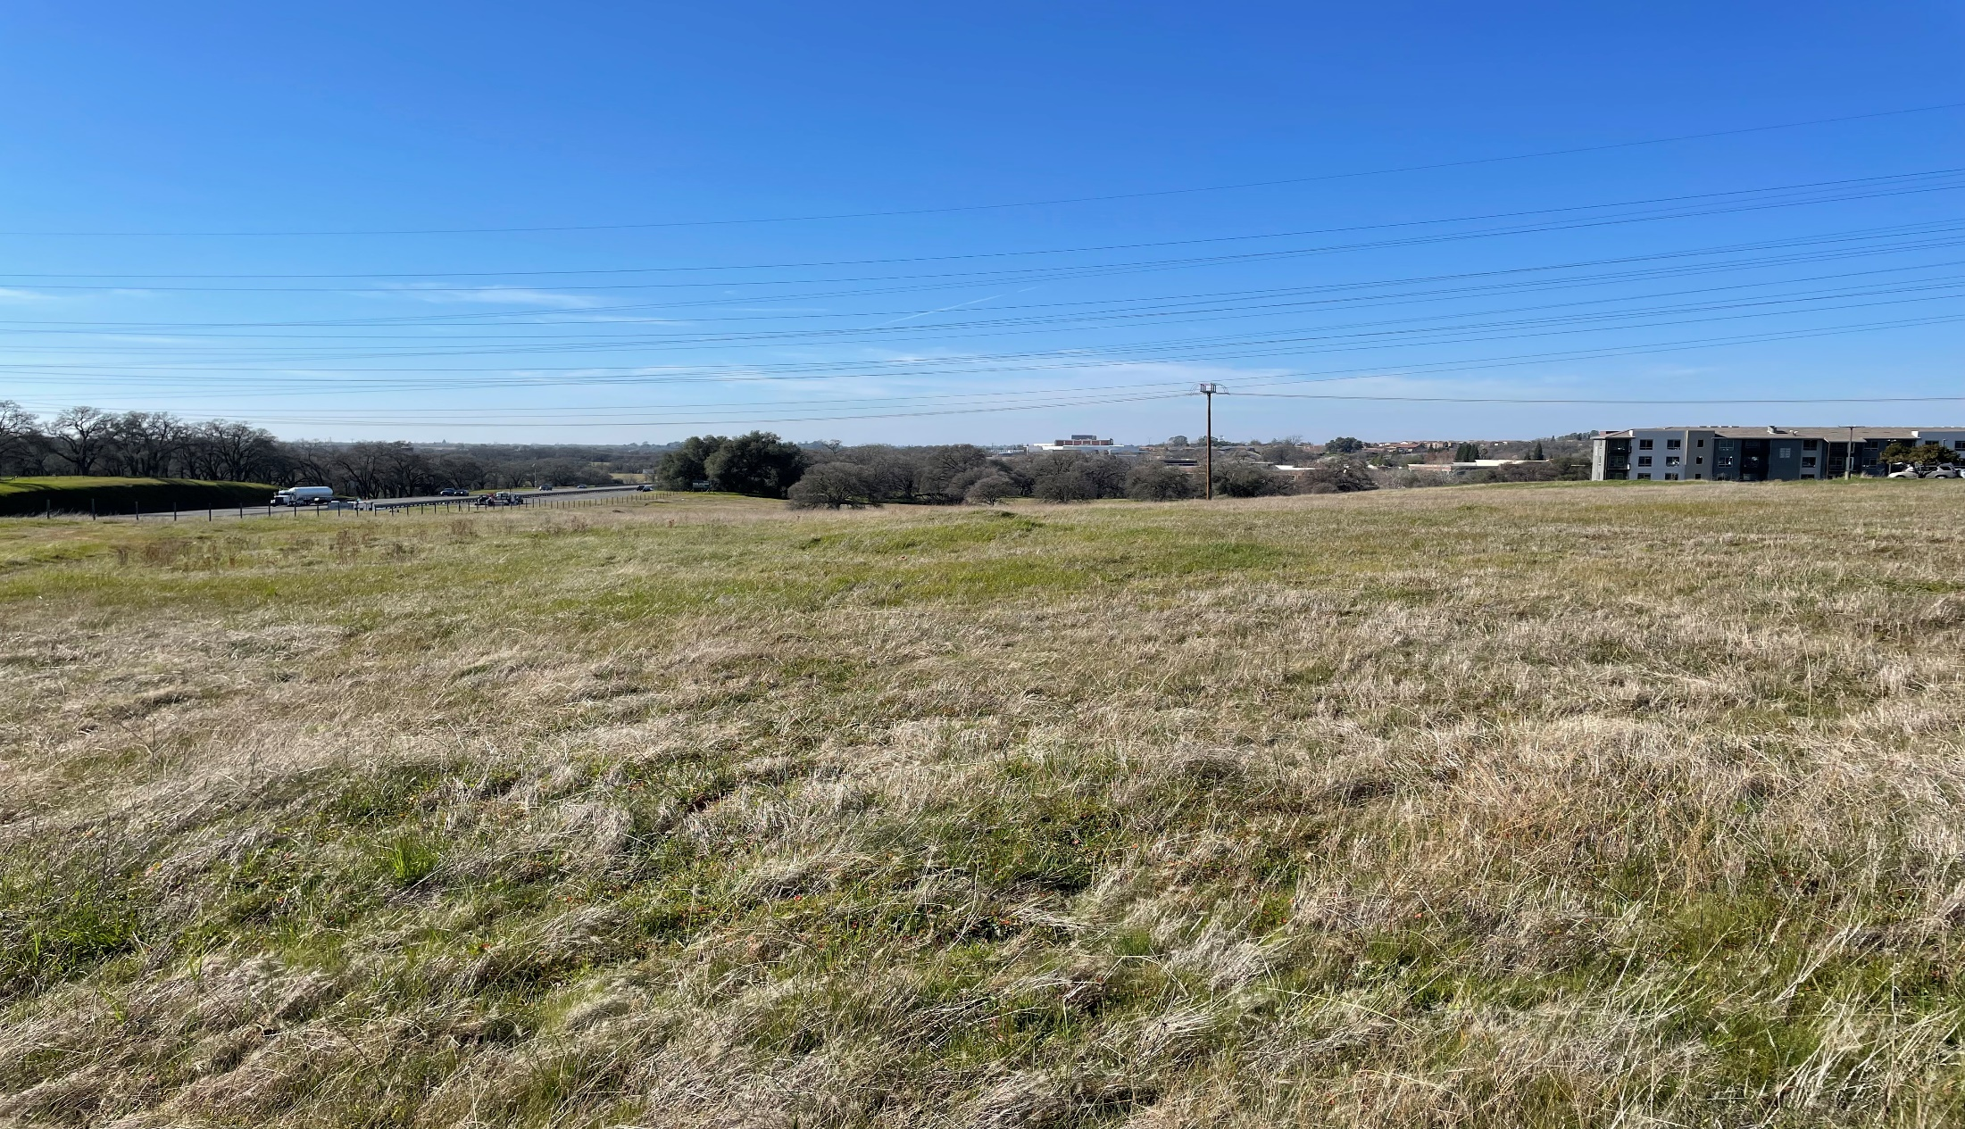
City Council Public Hearing May 10, 2022
Folsom Corporate Center Apartments
General Plan Amendment, Rezone, and Planned Development Permit Modification

Slide 2
Project Proposal
Folsom Corporate Center Apartment Community
253-Unit Market-Rate Apartment Community
Two Sites (Lot 1: 7.24-Acres and Lot 6: 4.68-Acres) off Iron Point Road within Folsom Corporate Center
General Plan Amendment
Change Land Use Designations (IND to MHD)
Rezone
Change Zoning Designations (ML-PD to R-4 PD and BP PD to R-4 PD)
Planned Development Permit
Established Project Specific Development Standards
Evaluate Site Design
Consider Architecture and Design
Establish Signage Standards

Slide 3
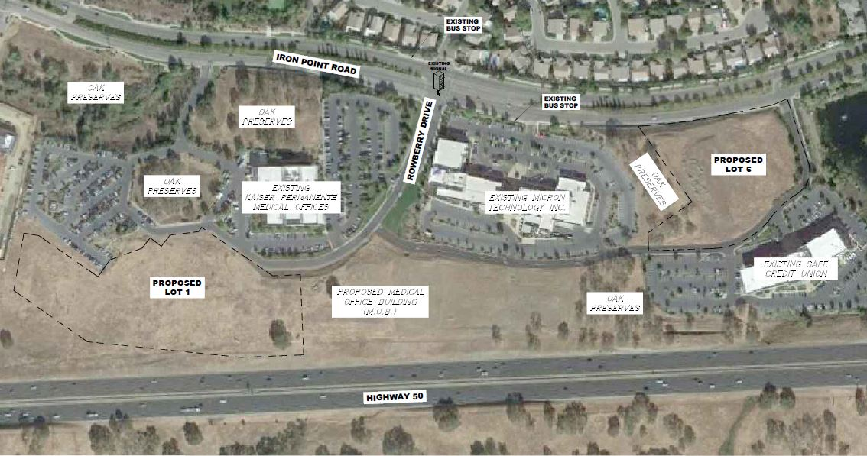
Vicinity Map

Slide 4
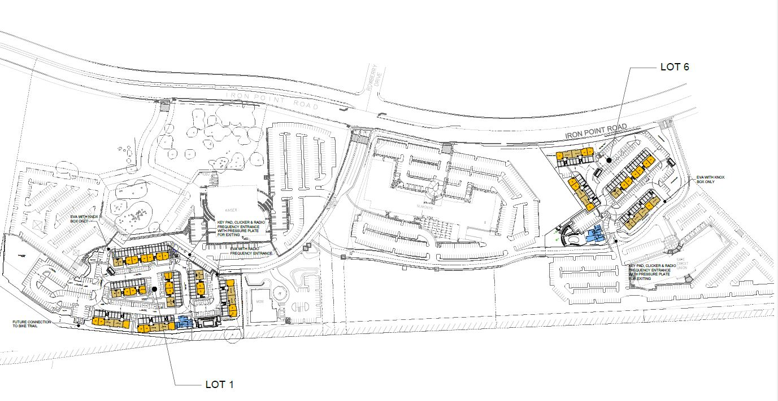
Overall Site Plan Exhibit
Lot 6:
4.68 acres, 100-units
4 x 3-story buildings with tuck-under garages
Clubhouse
Lot 1:
7.18 acres,153-units
7 x 3-story buildings with tuck-under garages plus clubhouse

Slide 5
General Plan/Rezone
General Plan Amendment
Existing General Plan Land Use Designations (IND)
Proposed General Plan Land Use Designation (MHD)
Rezone
Existing Zoning Designations (M-L PD and BP PD)
Proposed Zoning Designations (R-4 PD)
Analysis
Multi-Family Apartments are Permitted Land Use in R-4 Zoning District
Proposed Density (21.2-Units Per Acre) Consistent with Density Range
Community Benefits (Housing Supply and Housing Type)
Mix of uses and compatibility with surrounding uses
Changes in Market Dynamics

Slide 6
RHNA and Housing Update
Regional Housing Needs Allocation Process (2021-2029)
Income Level | RHNA Allocation by Income Level | 2021 | Total Units to Date | Total Remaining RHNA by Income Level
Very Low (<50%) | 2,226 | 34 | 34 | 2,192
Low (51-80%) | 1,341 | 61 | 61 | 1,280
Moderate (81-120%) | 829 | 5 | 5 | 524
Above Moderate (>120%) | 1,967 | 423 | 423 | 1,544
Total RHNA | 6,363
Total Units |  | 523 | 523 | 5,840

Slide 7
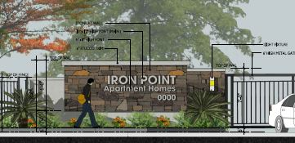
Planned Development Permit
Project conforms with development standards with two exceptions
Landscape Buffer Width (30 feet to average of 30 feet)
Signage (additional monument identification signs built into retaining and decorative walls)
Site Design Review
Building Architecture and Design
Development Standards Table Folsom Corporate Center Apartments
 | Lot Area | Lot Width | Front Yard Setback | Rear Yard Setback | Side Yard Setbacks | Building Height
Existing Standards | 0.5-Acres | NA | 30 Feet Iron Point Rd. | NA | 5 Feet | 60 feet
R-4 District Standards | 6,000 S.F. | 60 Feet | 20 Feet | 10 Feet | 5 Feet/10 Feet | 50 Feet
Proposed Standards | 0.5-Acres | 60 Feet | 40 Feet Iron Point Rd. 20 Feet | 15 Feet | 15 Feet | 41 feet

Slide 8
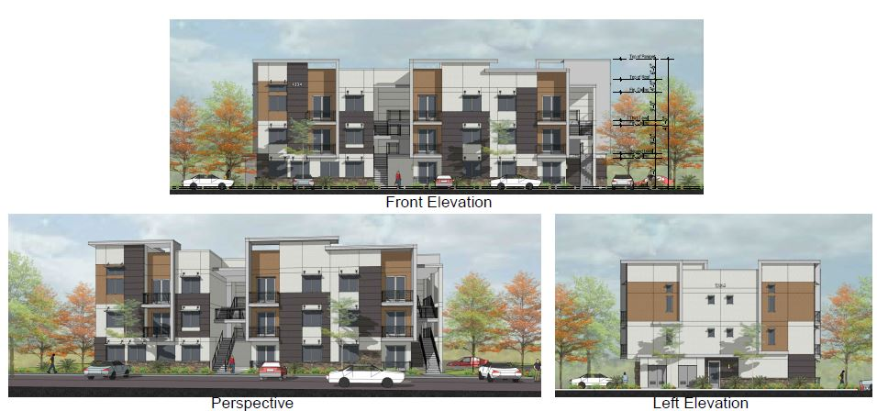
Building Elevations (16-Plex)

Slide 9
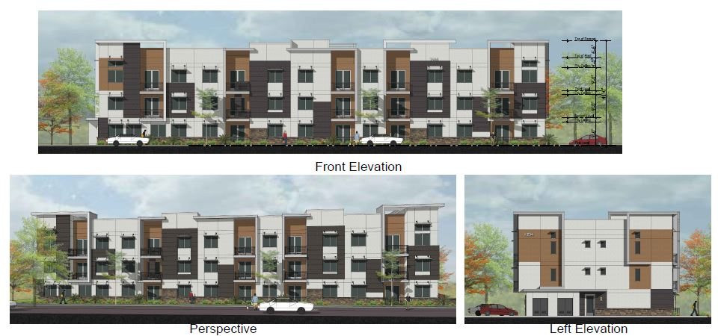
Building Elevations (26-Plex)

Slide 10
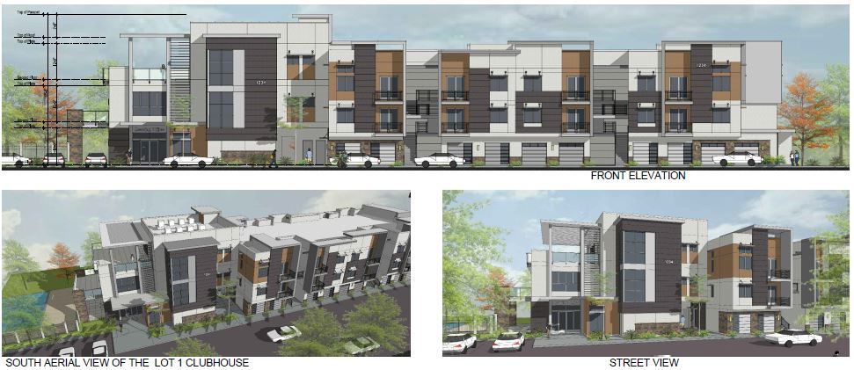
Clubhouse Elevations (Lot 1)

Slide 11
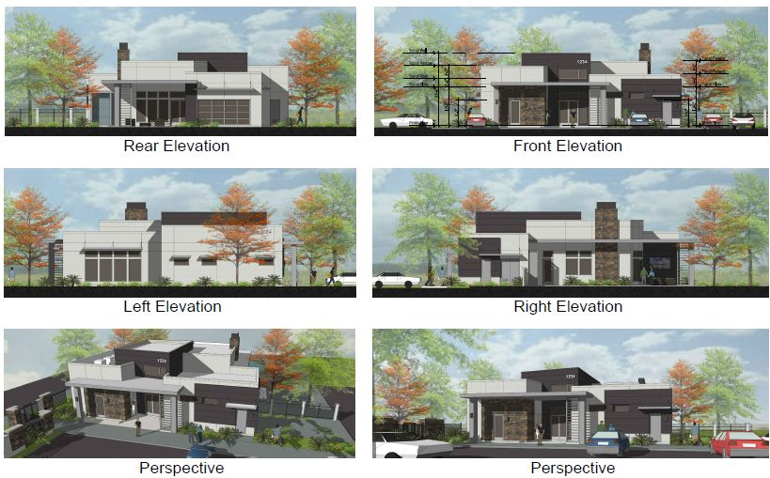
Clubhouse Elevations (Lot 6)

Slide 12
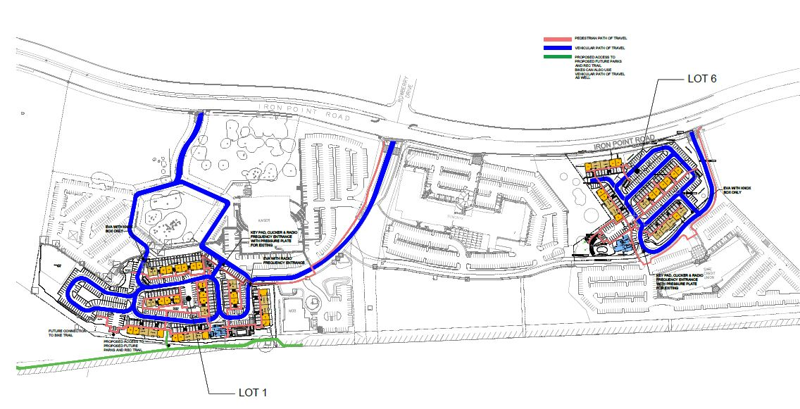
Issues/Analysis (Traffic)
Traffic Impact Analysis (February 2022)
Analyzed project impacts at 17 study intersections, 6 different scenarios
Study determine no significant impacts to level of service or VMT
Access and circulation evaluation and recommendations incorporated into project design and conditions (e.g., driveway throat depth, gate queuing)

Slide 13
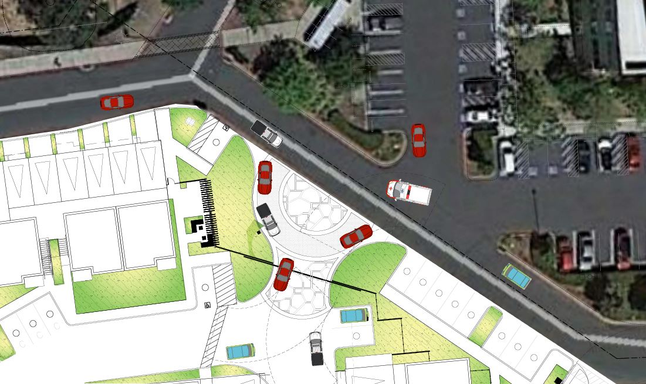
Driveway Entrance Lot 1

Slide 14
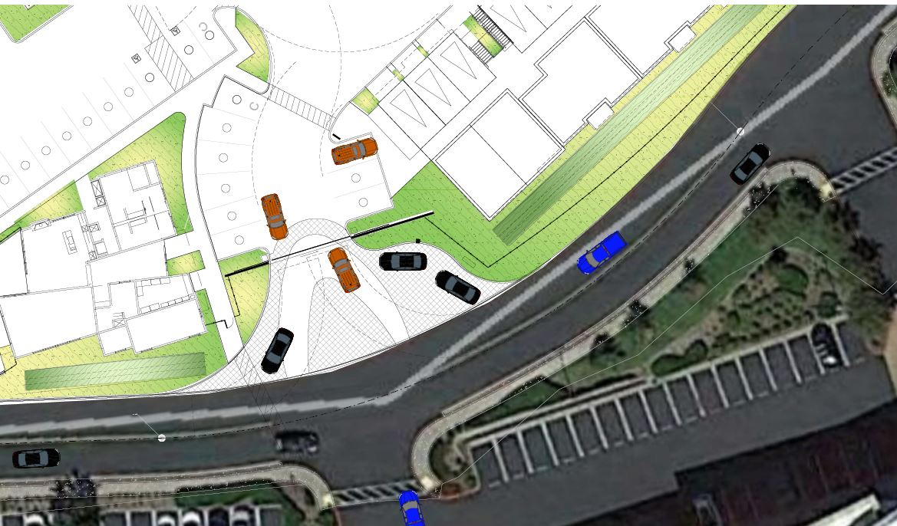
Driveway Entrance Lot 6

Slide 15
Traffic Safety Committee (TSC)
TSC reviewed the project January 27, 2022 and made two recommendations relative to vehicle and pedestrian circulation
Implement a traffic or r-o-w control solution (round-a-bout, stop-sign control) in the vicinity of the Lot 1 primary driveway and the two driveways across the private road on the Kaiser site
Evaluate potential to improve pedestrian access between Lot 1 and Iron Point Road in the vicinity of the westernmost Kaiser driveway
City Staff and Traffic Consultant evaluated recommendations
Traffic control solution is not warranted based on traffic volumes (LOS A-, B), traffic speed on private loop road is slow, improvements would be required on land not owned/controlled by the applicant
New pedestrian access would be required on private property (Kaiser) not owned or controlled by the applicant, significant grade changes would result additional impacts to open space and protected trees.

Slide 16
Issues/Analysis (Parking, Noise, Trees)
Vehicle Parking (on-site parking):
462 spaces required
491 spaces provided (garage, carport, and uncovered)
Bicycle Parking:
51 spaces required
55 spaced provided (interior and exterior) + garage storage
Potential Noise Impacts Mitigated with Conditions
Apartments adjacent to Highway 50/Iron Point Road require construction mitigation to comply with interior noise standards
Oak Tree Preservation/Removal
11 protected oak trees (1 removed for poor condition, 3 preserved, 7 proposed for removal
Mitigation proposal to plant 35 oak trees on lots 1 and 6, then pay in lieu fees for any outstanding mitigation requirement.

Slide 17
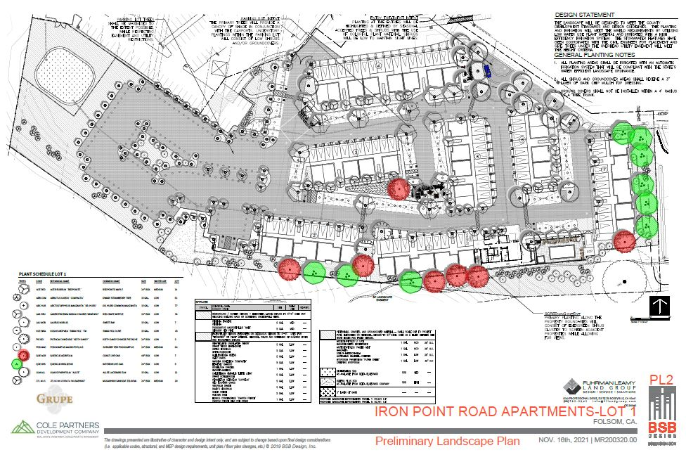
Oak Tree Mitigation Exhibit Lot 1

Slide 18
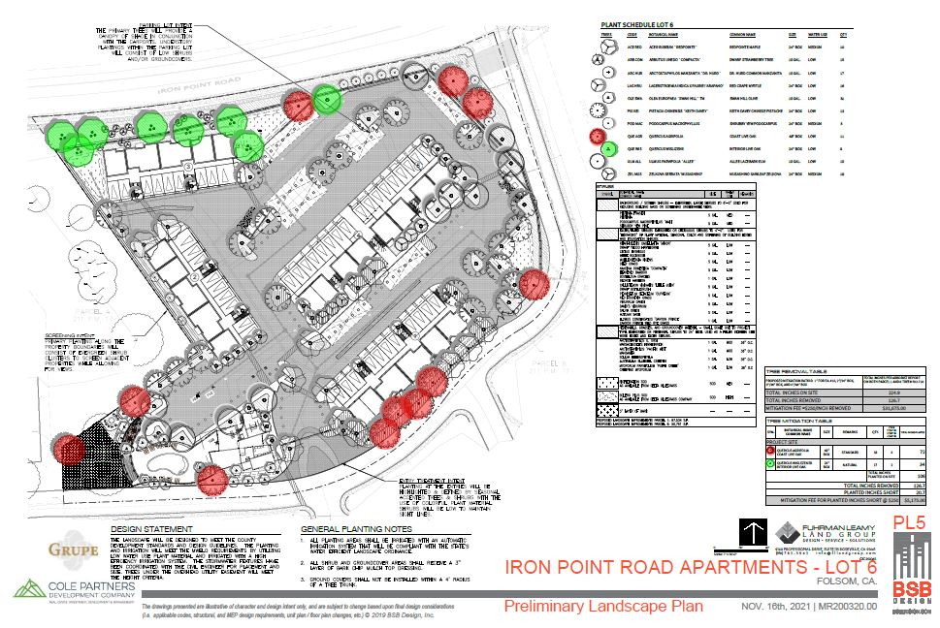
Oak Tree Mitigation Exhibit Lot 6

Slide 19
Environmental Review
Initial Study, Mitigated Negative Declaration, and Mitigation Monitoring Program prepared for the project
Mitigation measures included as conditions of approval (air quality, biological – habitat for nesting birds, cultural resources, greenhouse gas, noise, oak tree, and traffic)

Slide 20
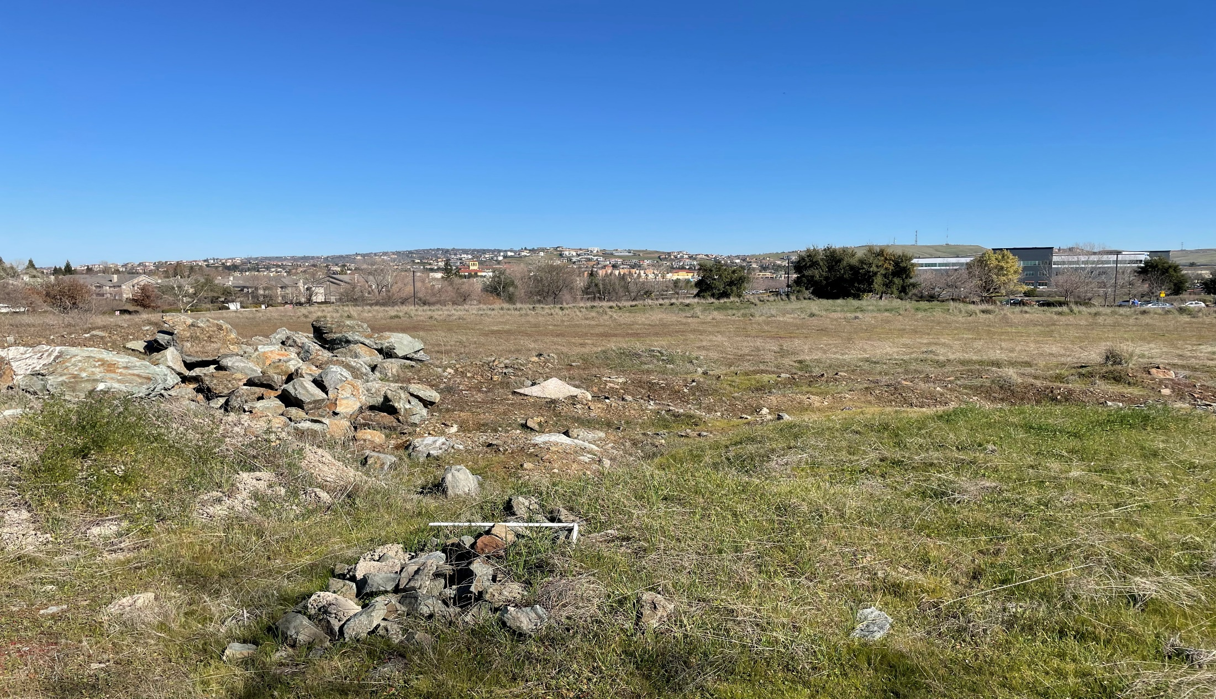
Staff and PC Recommendation
Move to Adopt Resolution No. 10849 - A Resolution to Adopt a Mitigated Negative Declaration, Approve a General Plan Amendment, and Approve a Planned Development Permit for the Folsom Corporate Center Apartments
And
Move to Introduce and Conduct First Reading of Ordinance No. 1327 - An Uncodified Ordinance to amend the zoning designation for a 7.24-acre parcel (Lot 1) from M-L PD to R-4 PD and to amend the zoning designation for a 4.68-acre parcel (Lot 6) from BP PD to R-4 PD for the Folsom Corporate Center Apartments project (Introduction and First Reading)

Slide 21
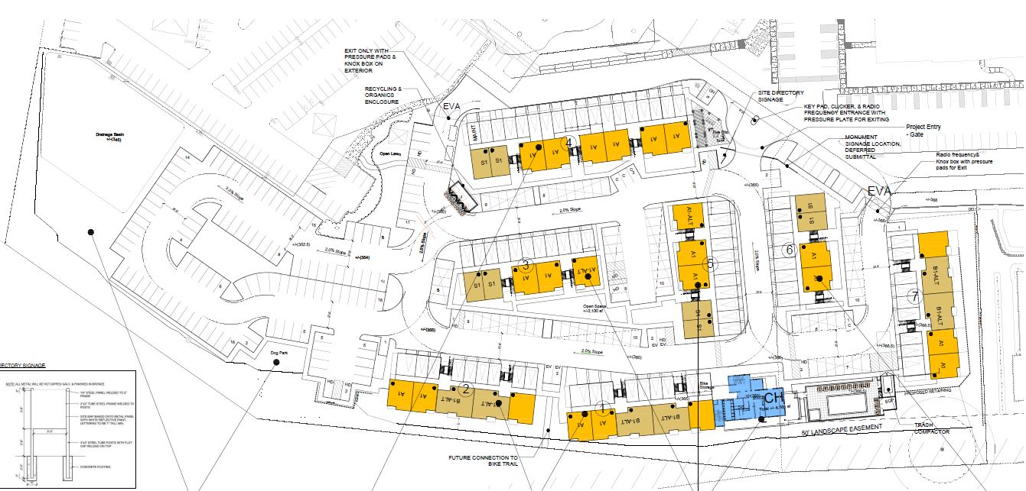
Lot 1 Site Plan Exhibit

Slide 22
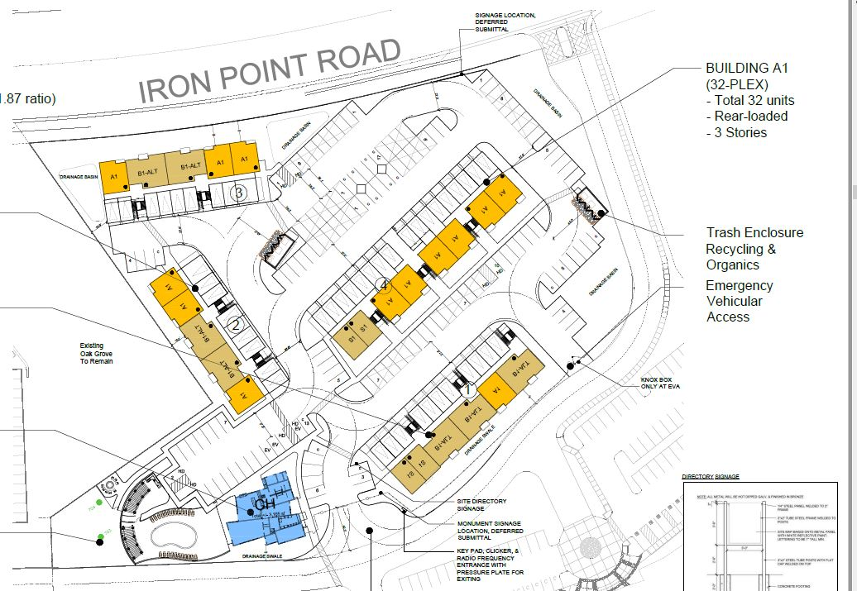
Lot 6 Site Plan Exhibit

Slide 23
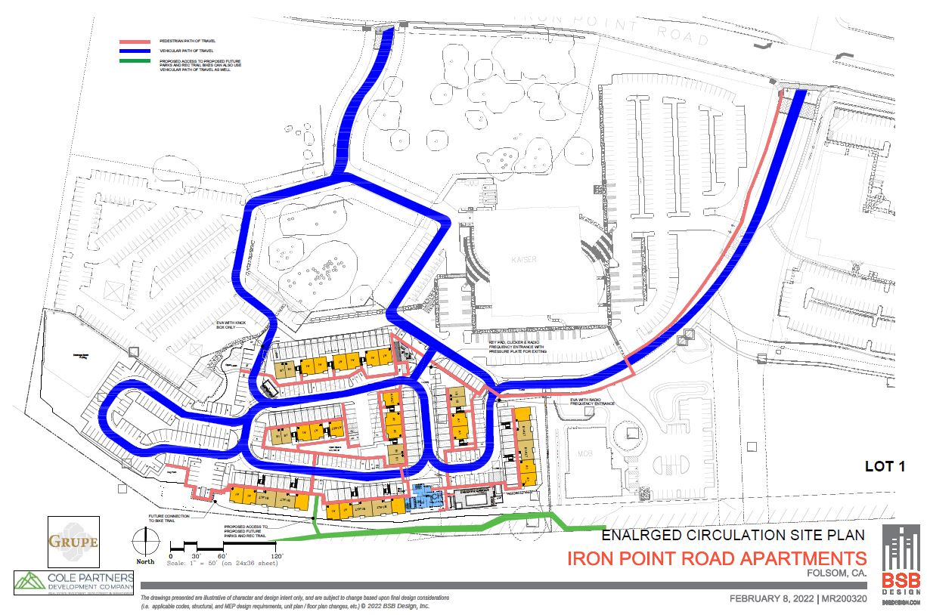
Lot 1 Circulation Exhibit

Slide 24
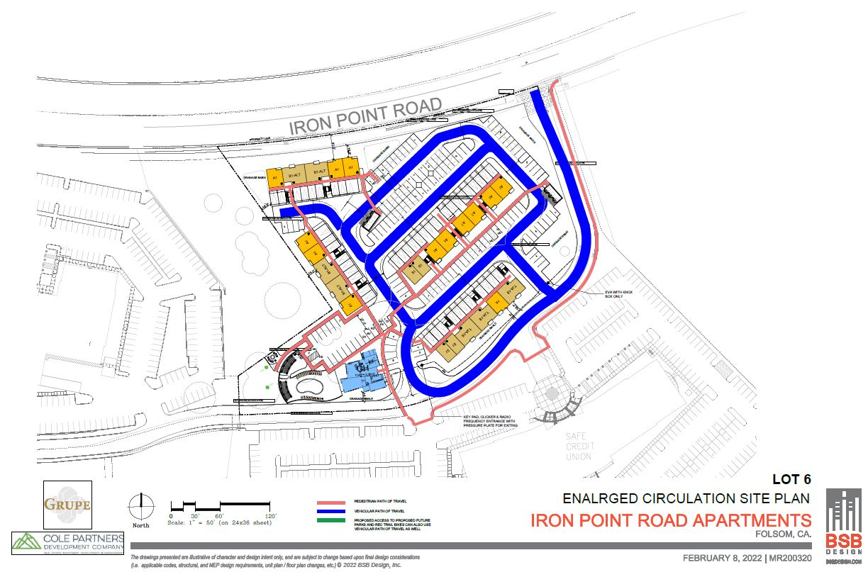
Lot 6 Circulation Exhibit

