Slide 1
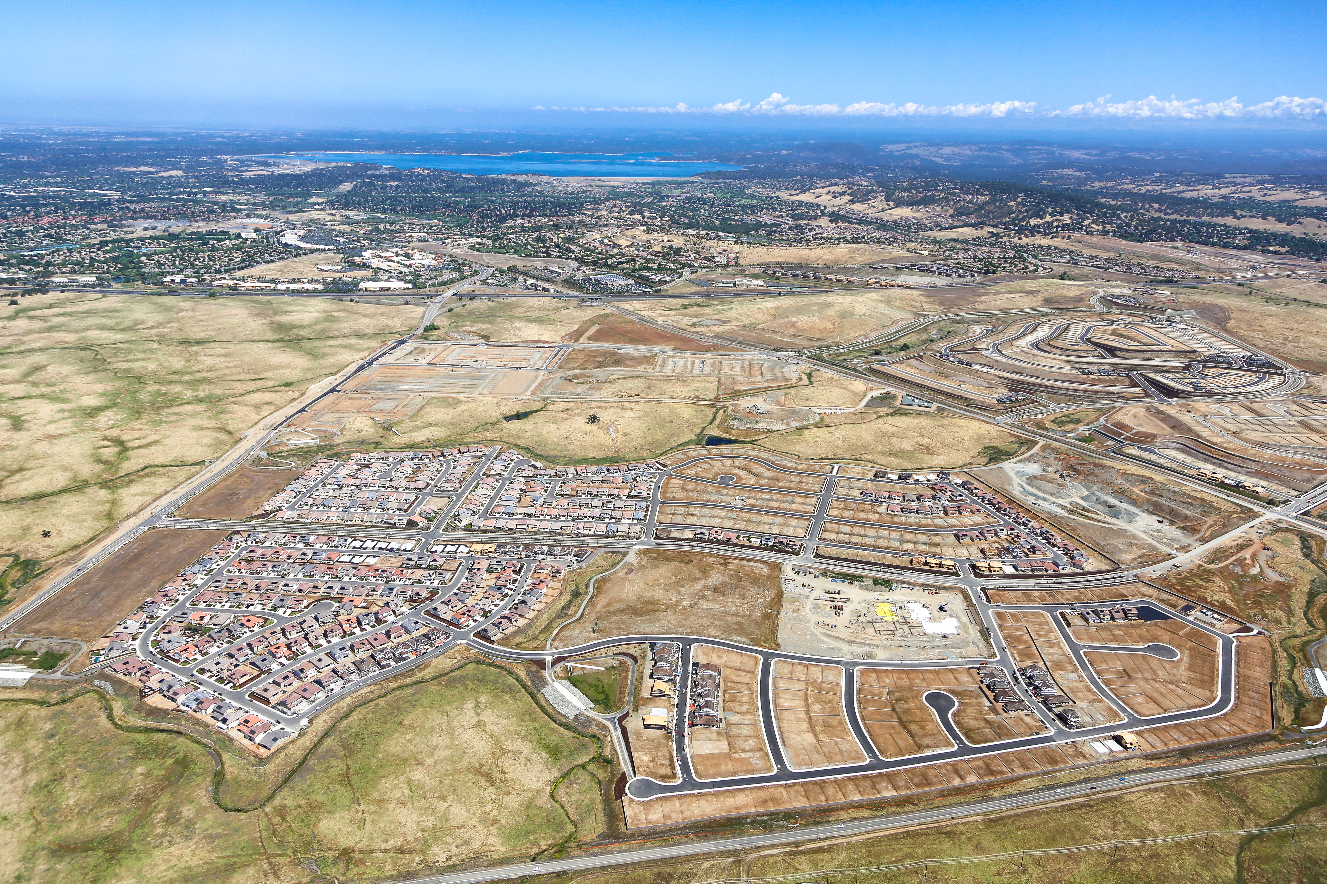
Folsom Plan Area
Semi-Annual Update Q2/Q3 2022

Slide 2
FPA Semi-Annual Update Outline
Planning Activity
Infrastructure and Site Engineering Activity
Map Activity
Building Activity
Public Information/City Website
Notes:
Brief overview of Folsom’s Specific Plan history, reminder of Folsom Plan Area approvals, and update on community building south of 50

Slide 4
Planning Activity (last 180 days)
New Development Applications (now pending)
New Development Applications Submitted
Mangini Ranch Phase 2 Villages 3-3A Residential Design Review
Toll Brothers PD Permit Modification and Design Review
Signature Homes Small-Lot Vesting TSM, Design Review, and Minor Administrative Modification

Slide 5
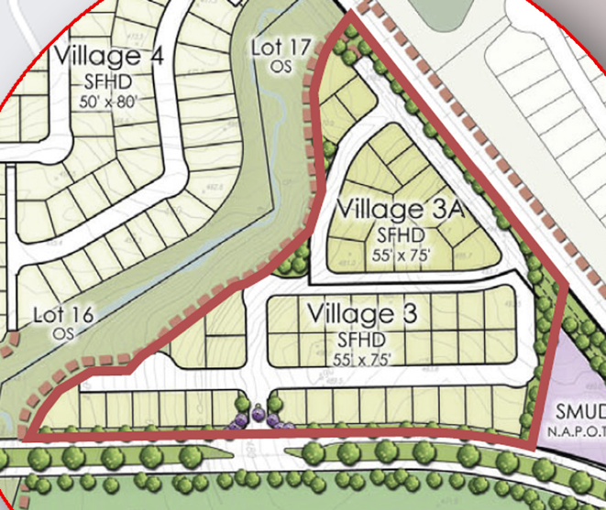
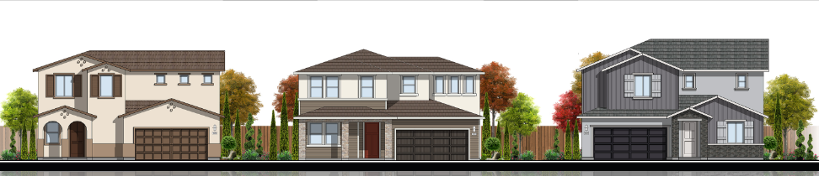
Development Applications Submitted/Pending
Mangini Ranch P2 V3-3A Residential Design Review
Beazer Homes is requesting design review approval for 53 homes in Mangini Ranch Phase 2, Villages 3 and 3A

Slide 6
Development Applications Submitted/Pending
Toll Brothers P3 PD Permit Modification and Design Review
Phase 3 of Toll Brothers requesting that the outdoor living area be excluded from lot coverage calculation

Slide 7
Development Applications Submitted/Pending
Mangini Ranch Ph1 VTSM, Design Review, and MAM
Signature Homes is requesting approval of subdivision map for 65-unit subdivision on 5.35 acres, design review and density transfer

Slide 8
Planning Activity (last 180 days)
City Actions/Entitlement Decisions
Planning Commission Actions on Development Applications
Russell Ranch Phase 2 & 3 Design Guidelines Modification, Design Review
City Council Actions on Development Applications
Toll Brothers Small-Lot TSM and Minor Administrative Modification
Folsom Heights Vesting TSM Extension
Broadstone Estates Vesting TSM Extension
Russell Ranch TSM Amendments, DG and DA Amendment, Design Review

Slide 9
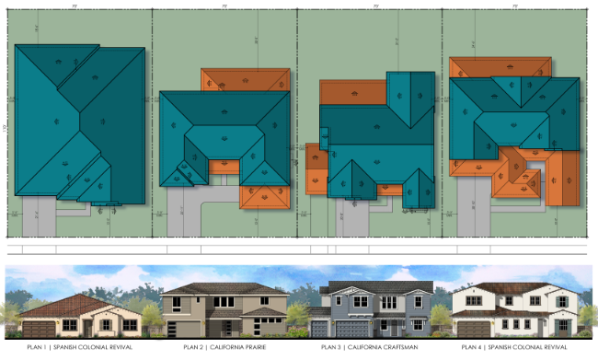
PC Approved 10/6/21
Russell Ranch Phase 2 & 3 Design Guidelines Modification, Design Review
Lennar Homes requested modifications to garage standards and design review for 305 homes in Russell Ranch Phases 2 and 3

Slide 10
PC Recommended/CC Approved 1/11/22
Toll Brothers Phase 2 VTSM and Minor Administrative Modification
Phase 2 Subdivision includes 329 single family lots on 64.7 acres:
Gated
Age-restricted
Open space, landscape lots, private recreation
Includes transfer of 92 units to other FPA areas

Slide 11
PC Recommended/CC Approved 12/14/21
Broadstone Estates VTSM Extension
Request to extend the Vesting Tentative Subdivision Map for Broadstone Estates

Slide 12
PC Recommended/CC Approved 12/14/21
Folsom Heights VTSM Extension
Request to extend the Vesting Tentative Subdivision Map for Folsom Heights

Slide 13
PC Recommended/CC Approved 1/25/22
Russell Ranch Phase 2 Map Amendments and Design Review
Request to modify previous TSM approval to remove active adult designation (no change to lot number) and design plans

Slide 14
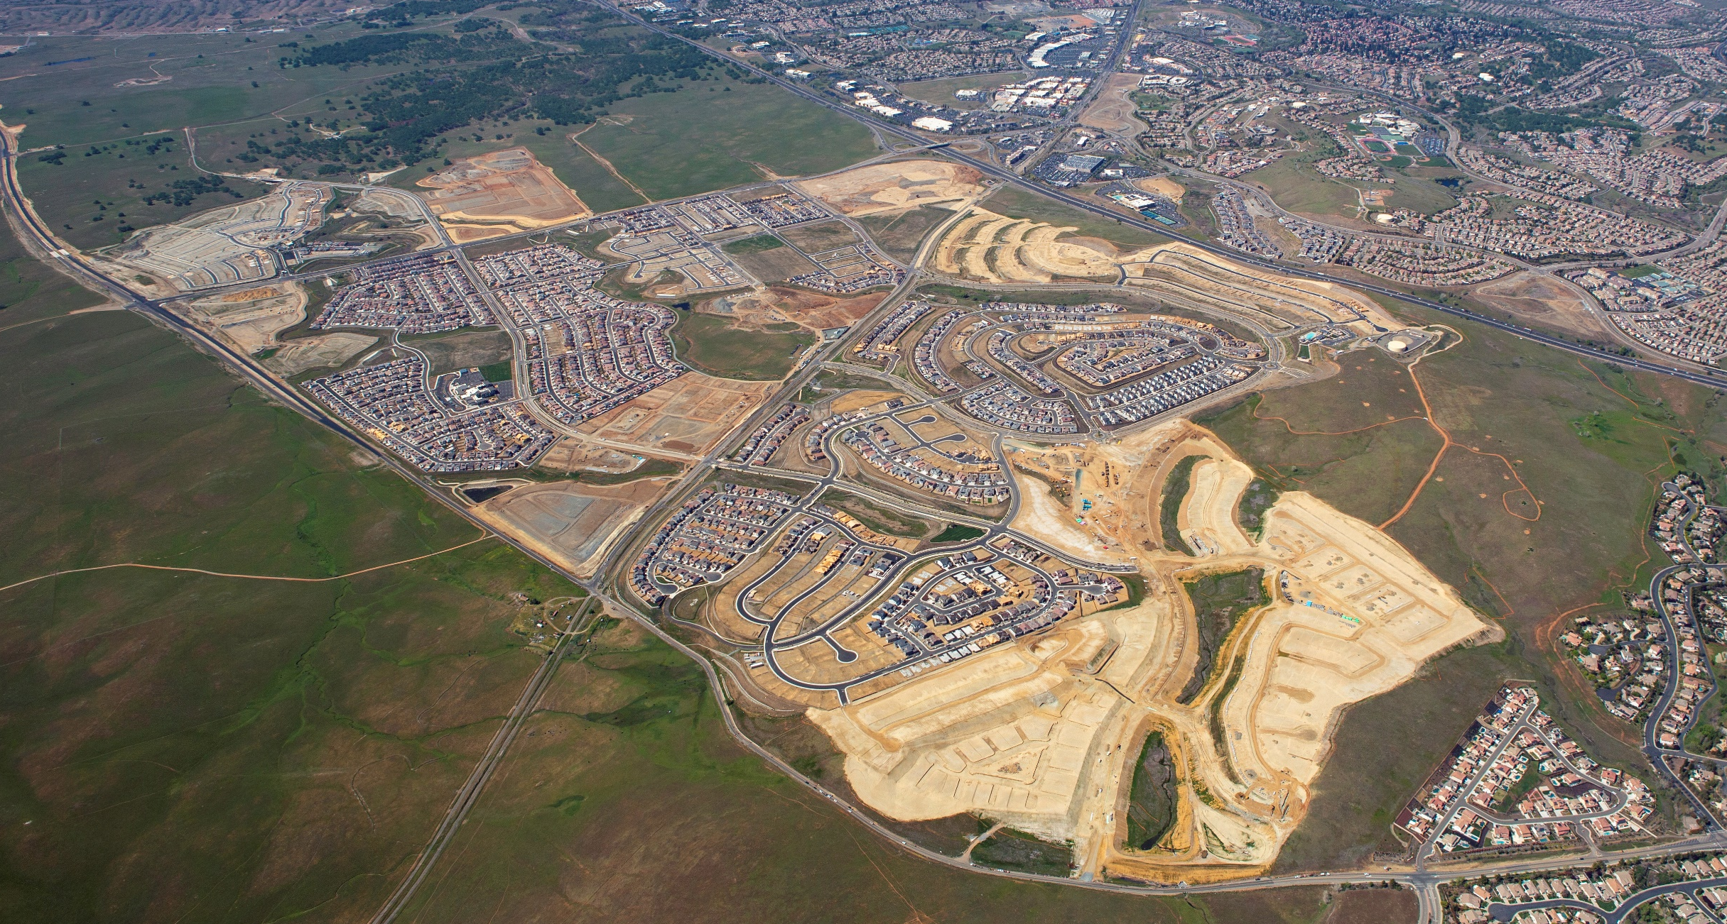
Infrastructure/Site Engineering Activity
(Last 180 Days)
Mangini Ranch Phase 3
Mangini Ranch Phase 2 Villages 1 and 2
Parcel 85 Dignity
Toll Brothers
Phase 1
Russell Ranch Phase 3
East Bidwell Street
Alder Creek Pkwy
Van Daele Apartments
Old Placerville Road
Van Daele Bungalows
White Rock Road
Mangini Parkway
Mangini Ranch Phase 1C North
Russell Ranch Phase 2
White Rock Springs Ranch
Villages 2 - 7

Slide 15
FOLSOM PLAN AREA SMALL LOT FINAL MAP ACTIVITY
Tentative Maps Approved by City Council | Final Maps Approved by CC | Small Lot Final Maps Submitted
Mangini Ranch Phase 1 (833 dwelling units) Creekstone Subdivision (71 dwelling units) | Villages 1, 2, 8, and 9 (2018) Villages 5, 6 and 7 (2019) Village 4 and Creekstone (2020) Village 3 (2021)
Mangini Ranch Phase 1C (291 dwelling units) | Villages 1, 2, & 3 | Village 4
White Rock Springs Ranch (395 dwelling units) | Villages 1, 8 and 9 (2019) Villages 2, 3, 4, 5, 6, and 7 (2020)
Carr Trust (28 dwelling units) | Carr Trust (2019)
Russell Ranch Phase 1 (394 dwelling units) | Villages 1 through 8 (2019)
Russell Ranch Phase 2 (389 dwelling units) |  | Villages 1, 2 & 4, Village 3
Russell Ranch Phase 3 (242 dwelling units) | Phase 3A and 3B (2021)
Enclave at Folsom Ranch (111 dwelling units) | Enclave (2020)
Mangini Ranch Phase 2 (545 dwelling units) Rockcress Subdivision (118 dwelling units) | Village 7 (2019) Villages 4 and 8 (2020) Rockcress and Villages 1 and 2 (2021) | Village 3
Toll Brothers at Folsom Ranch (804 dwelling units) | Phase 1B and IC, ID | Phase 1A and 1E
Mangini Ranch Phase 3 (260 dwelling units) |  | Villages 1, 2 & 3, 4
Total SF Lots Ready for Permits | 3,003 lots mapped | 963 lots pending

Slide 16
Building Permit Tracking
FPA total permits 2119 (Q421/Q122: Oct-March = 513)
2018 permits issued: 159
2019 permits issued: 300
2020 permits issued: 395
2021 permits issued: 925
2022 permits issued (January – March): 340
Total FPA Permits thru Q1 2022: 2,119
Total homes occupied: 1,292
Estimated # residents (homes x 2.6 pph) = 3,359 persons

Slide 17
Russell Ranch Phase 3
Russell Ranch Phase 2
Russell Ranch Phase 1
Mangini Ranch Phase 2
Mangini Ranch Phase 3
White Rock Springs Ranch
Mangini Ranch Phase 1
Mangini Ranch Phase 1C
Toll Brothers Phase 1

Slide 18
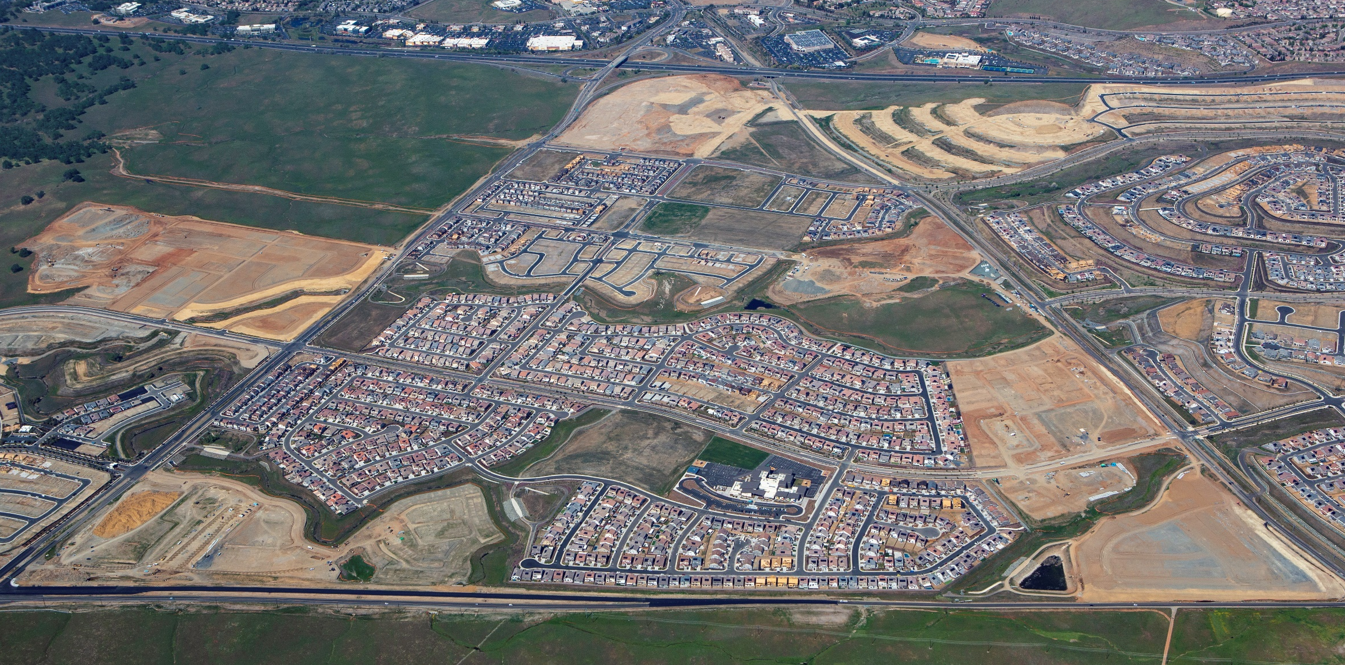
Mangini Ranch Phase 1 and 1C Neighborhoods
Placerville Road
East Bidwell Street
Tri-Pointe
Mangini Parkway
Placerville Road
Mangini Place Apts (St Anton)
Lennar
School Site
Park Site
Taylor Morrison
White Rock Road
White Rock Road

Slide 19
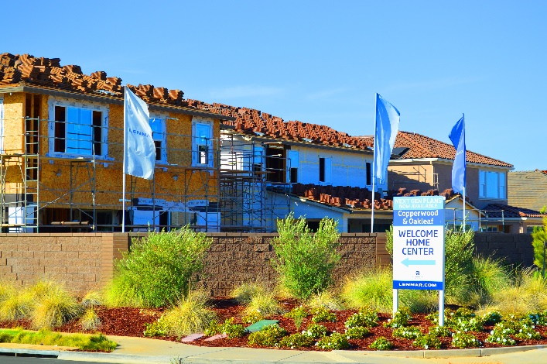
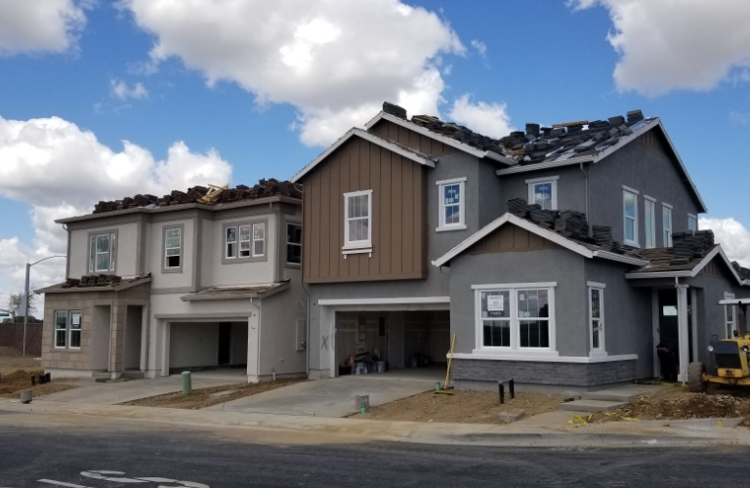
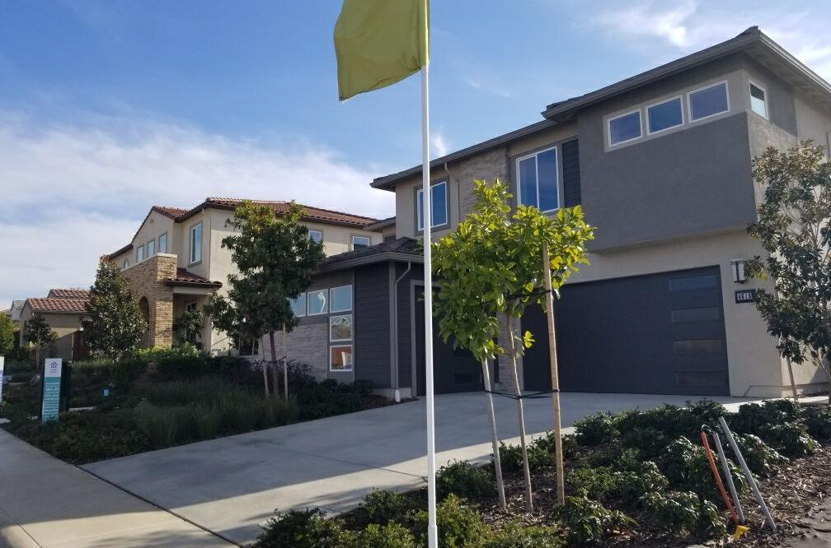
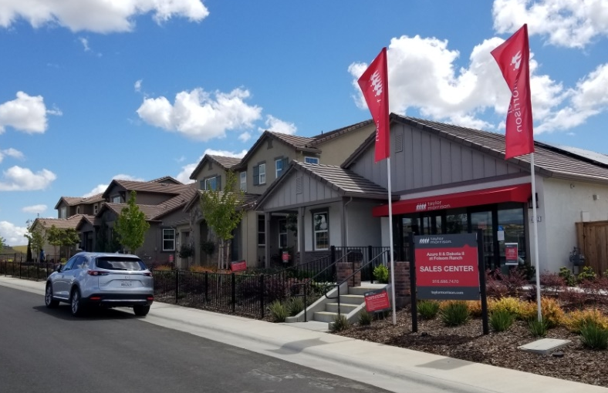
Building Activity
Mangini Ranch Phase 1 Builders
      Taylor Morrison (Villages 6, 7)
      Lennar (Villages 8, 9)
      Tri Pointe Homes (Villages 3 – 5)
      Tri-Pointe Homes (Creekstone)
Lennar: Villages 8 and 9
Tri-Pointe Homes: Creekstone
Tri-Pointe Homes: Villages 3 - 5
Taylor Morrison: Villages 6 - 7

Slide 20
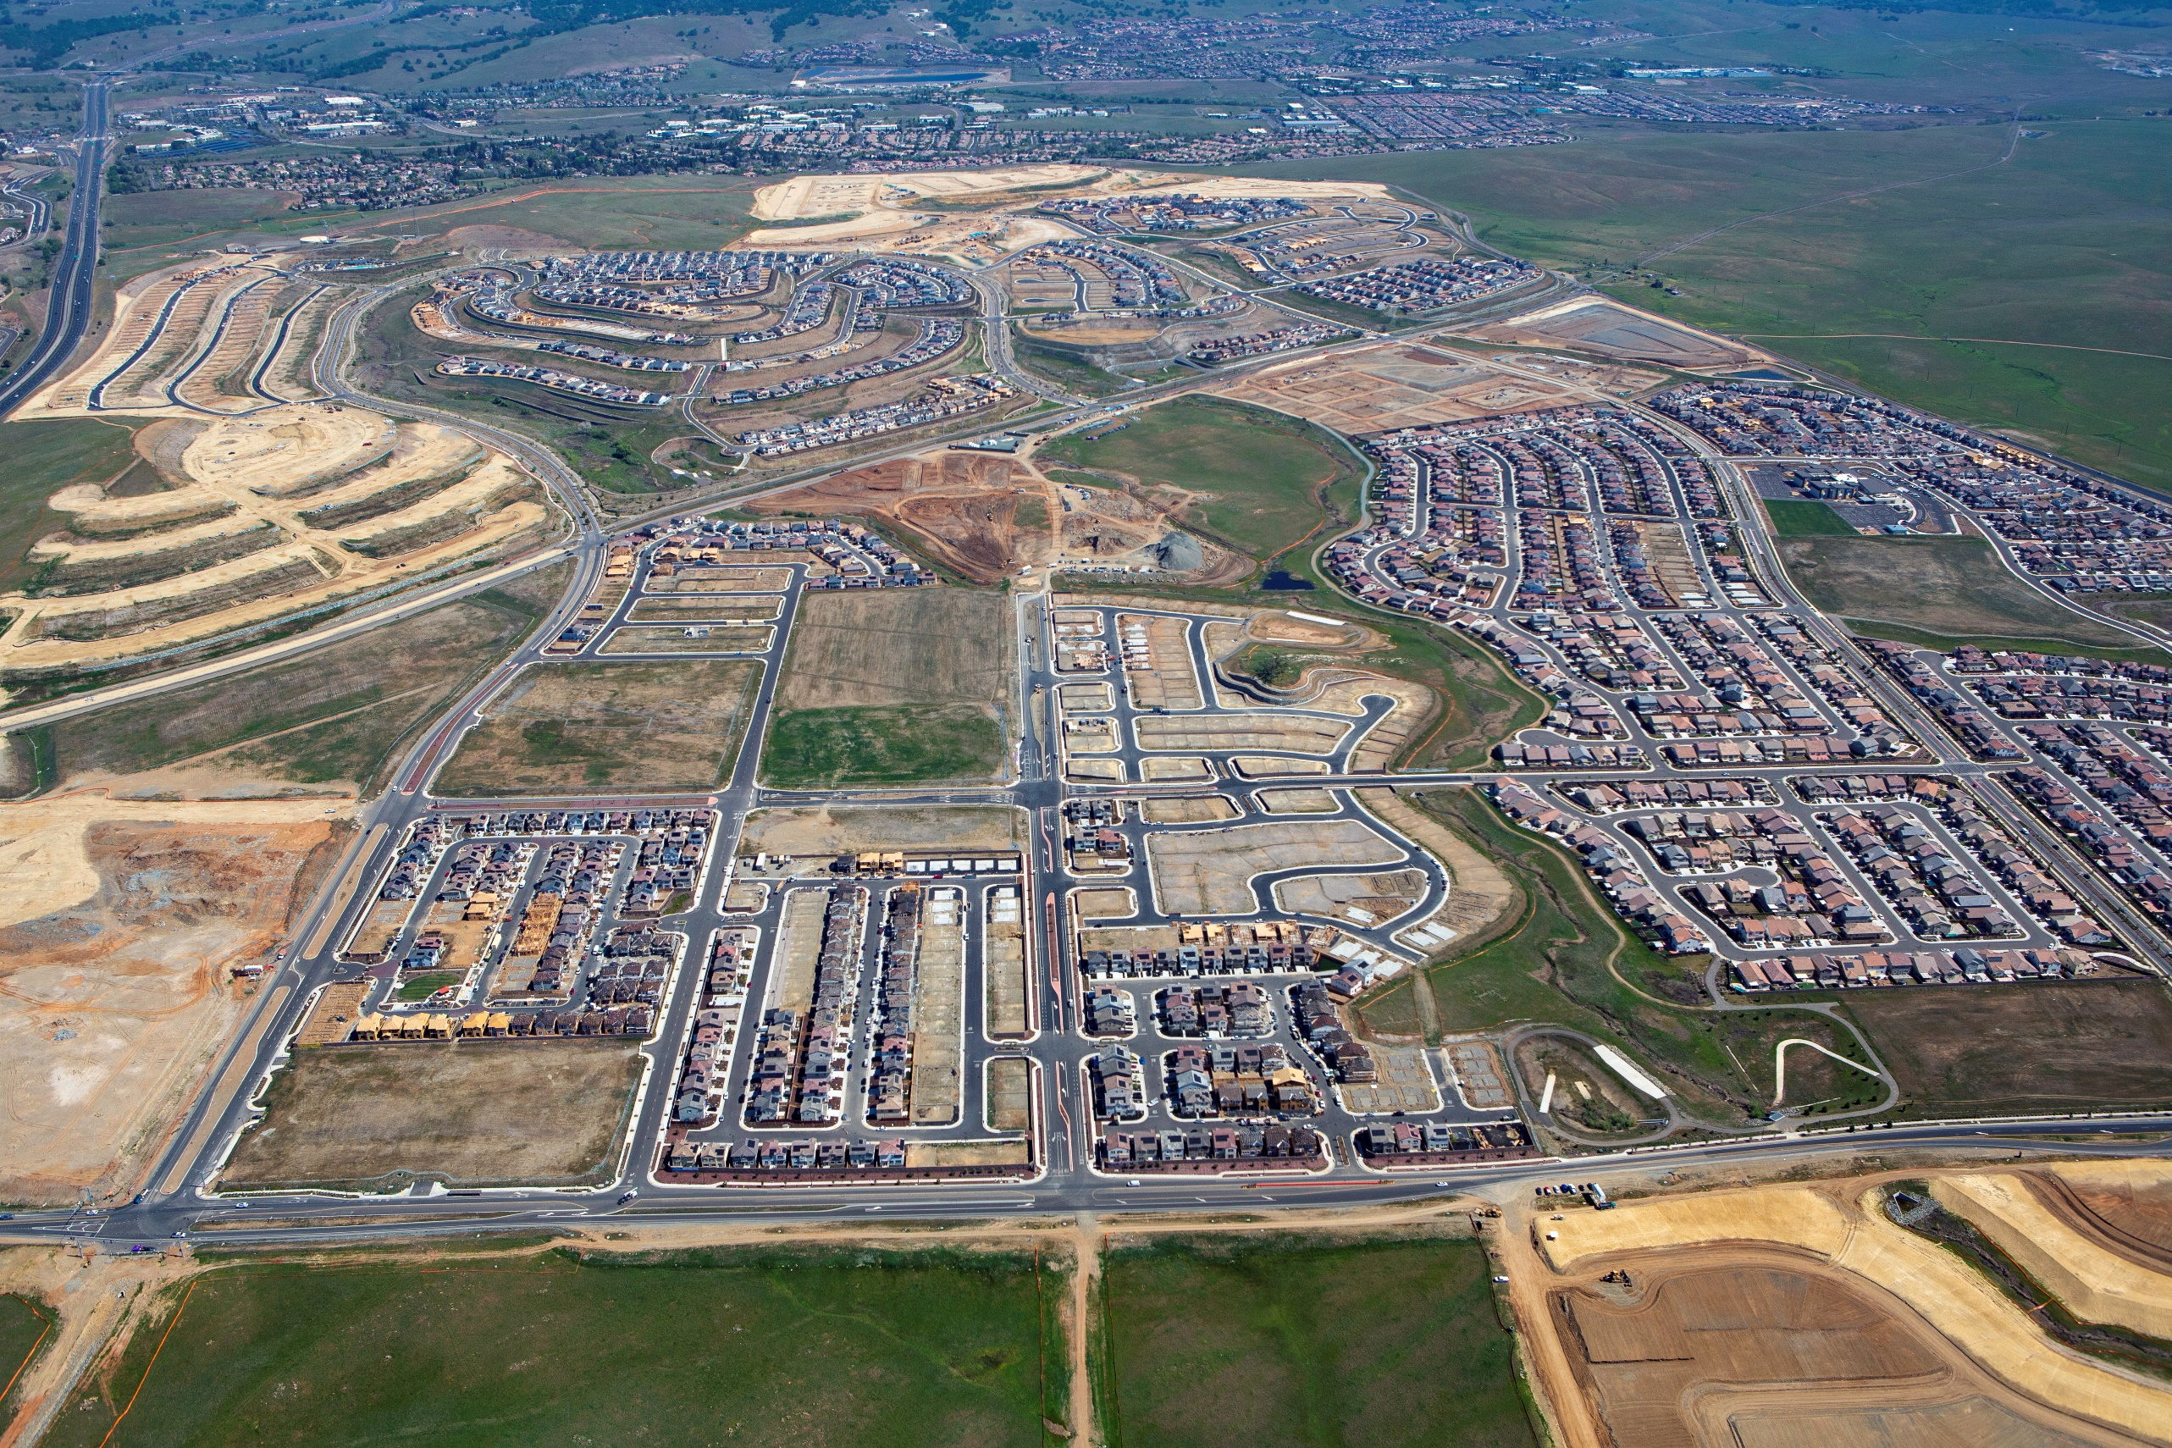
Mangini Ranch Phase 2 Neighborhoods
Placerville Road
Villages 1 and 2
Tri Pointe
Placerville Road
KB Homes
(Soleil)
Savannah Parkway
School Site
Park Site
Fire Station
Alder Creek Parkway
East Bidwell Street
Lennar Homes (Rockcress)
Signature Homes
(Village 7)
White Rock Road

Slide 21
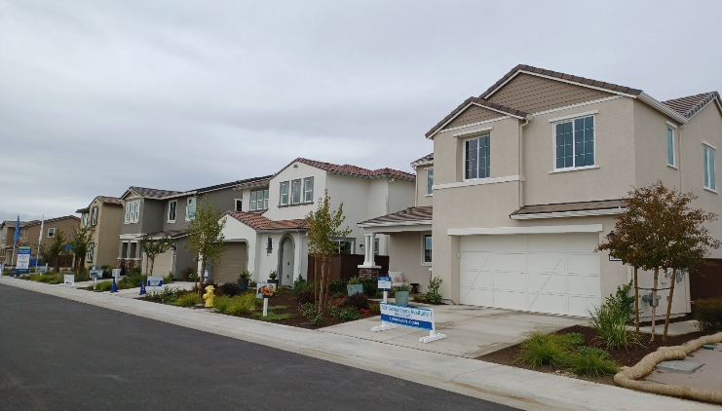
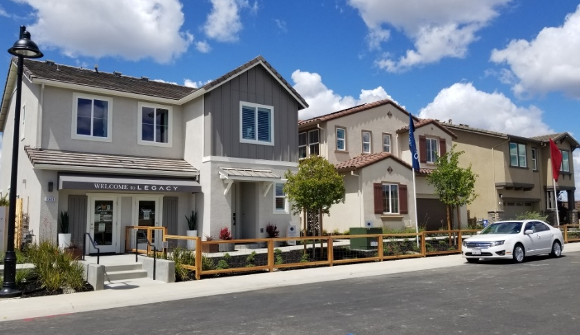
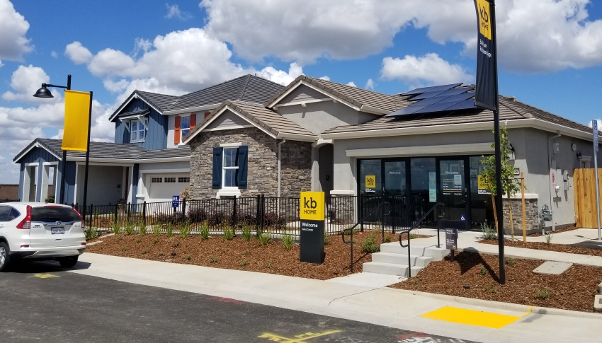
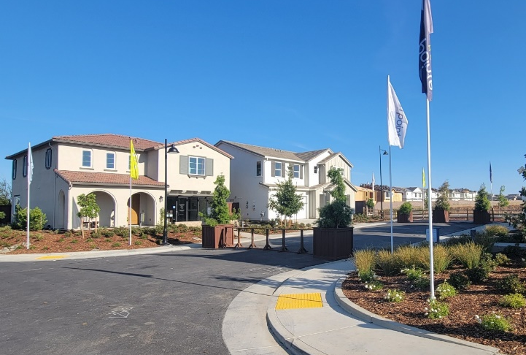
Building Activity
Mangini Ranch Phase 2 Builders
      KB Homes (Soleil)
      Signature Homes (Village 7)
      Lennar Homes (Rockcress)
      Tri-Pointe (Eastwood)
Lennar Homes:
Rockcress
Signature Homes: Village 7
KB Homes: Soliel
Tri-Pointe: Eastwood

Slide 22
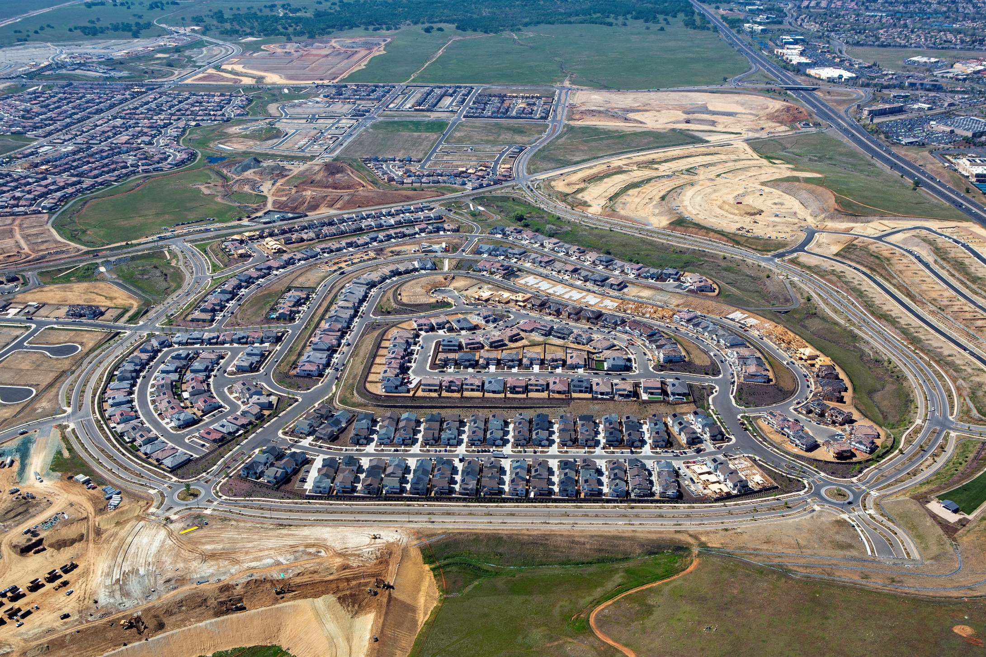
Russell Ranch Phase 1 Neighborhoods
The New Home Company Villages 1, 2, 3, 5, 7
Placerville Road
Anthem United Villages 6, 8
Alder Creek Parkway
Meritage Homes Village 4
Grand Prairie Road

Slide 23
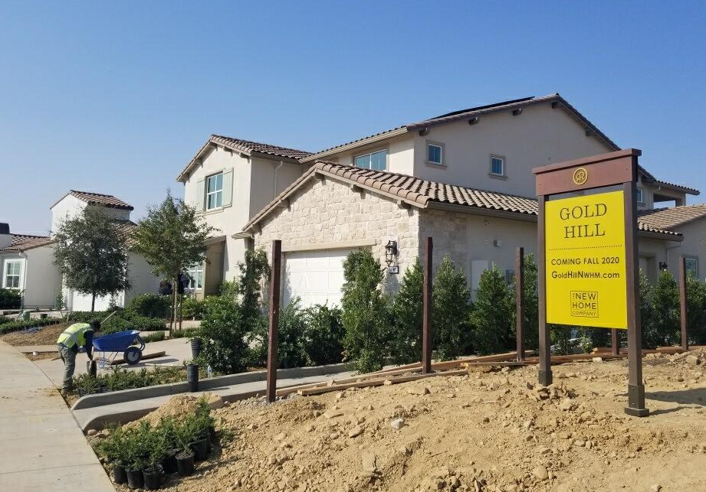
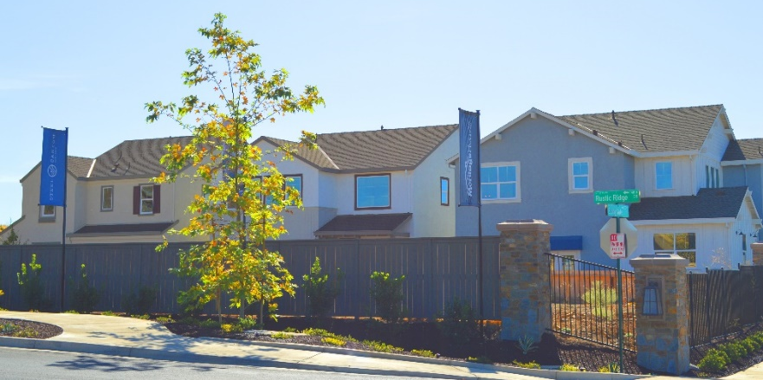
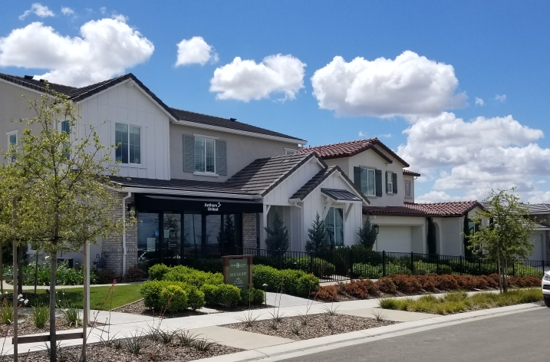
Building Activity
Russell Ranch Phase 1 Builders
  The New Home Company (Villages 1, 2, 3, 5, 7)
  Meritage Homes (Village 4)
  Anthem United (Villages 6 and 8)
New Home Company: Village 1
Meritage: Village 4
Anthem United: Villages 6 and 8

Slide 24
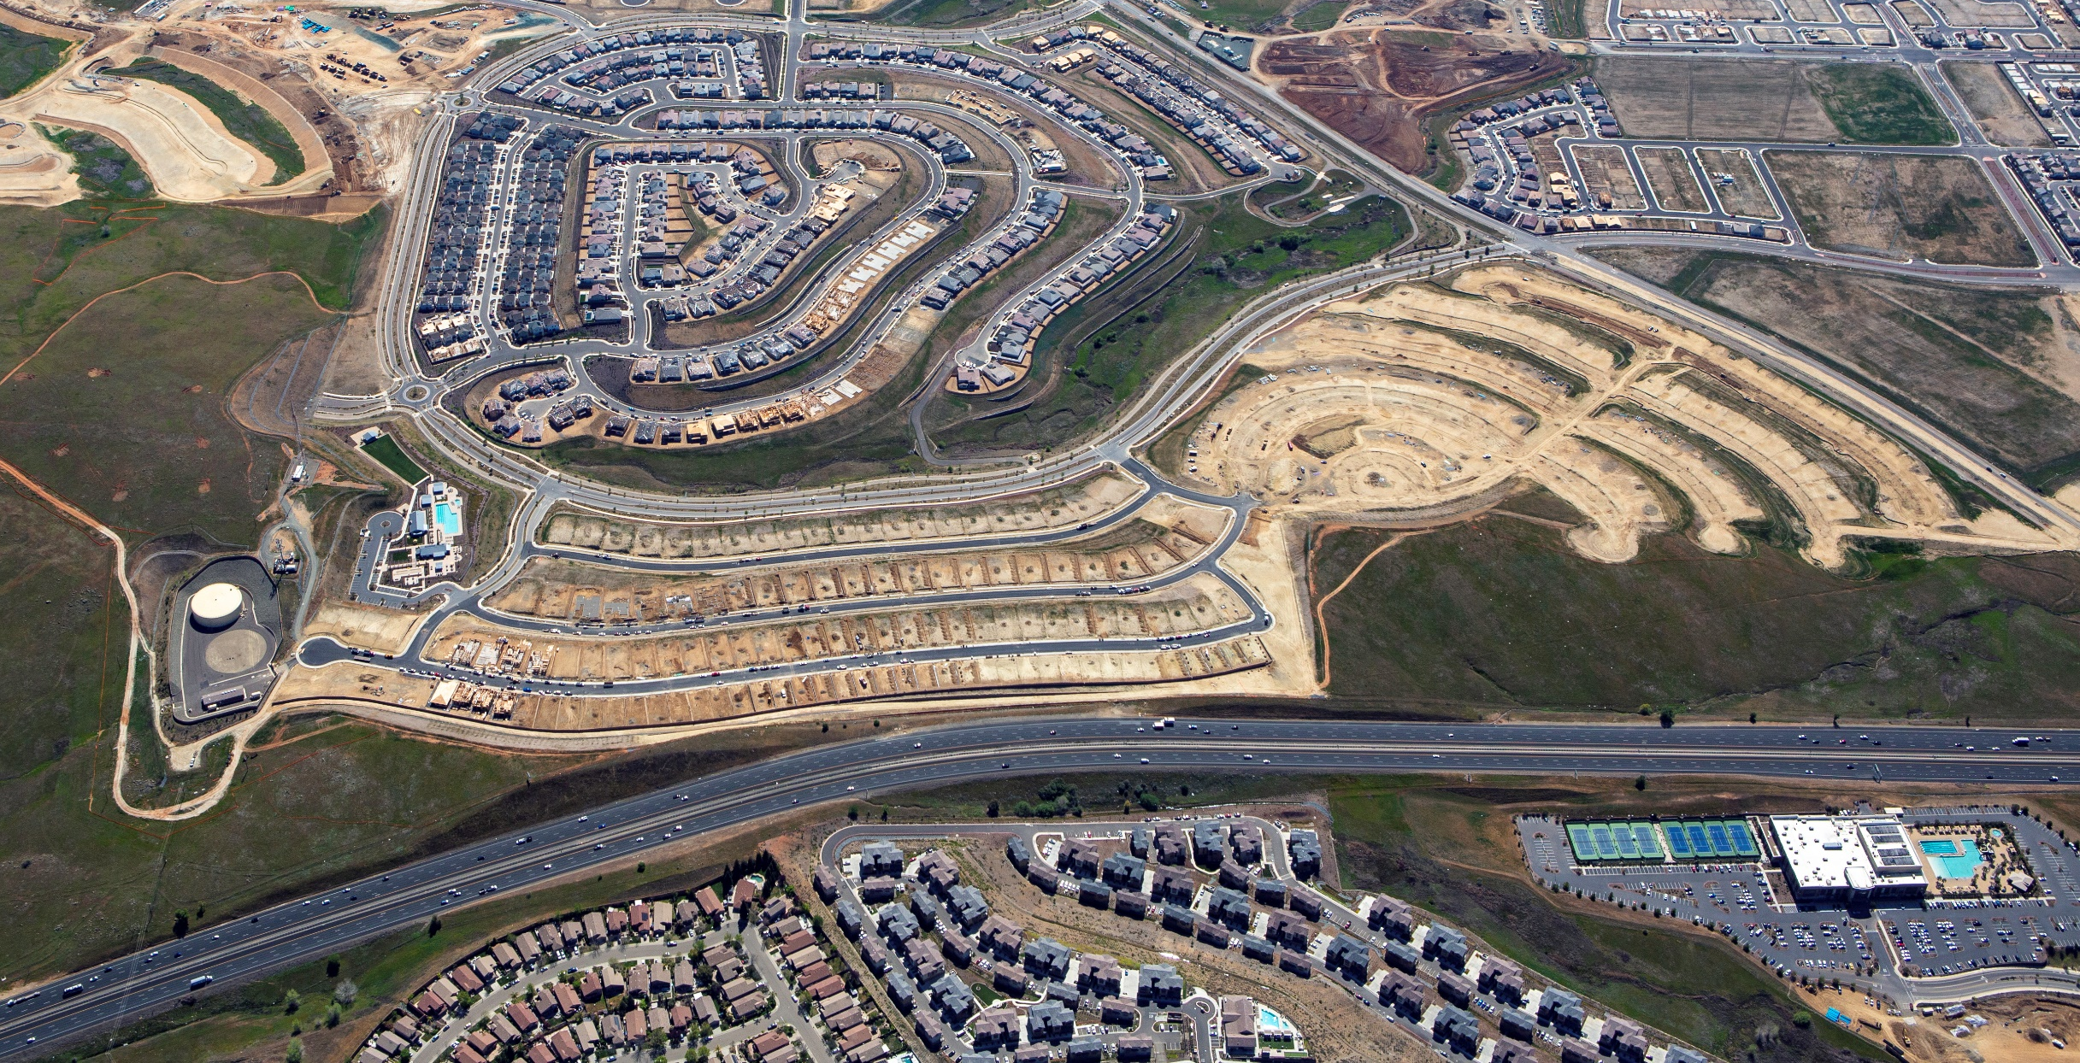
Russell Ranch Phase 3 Neighborhoods
Grand Prairie Road
Placerville Road
Alder Creek Parkway
U.S. Highway 50
Lennar Homes

Slide 25
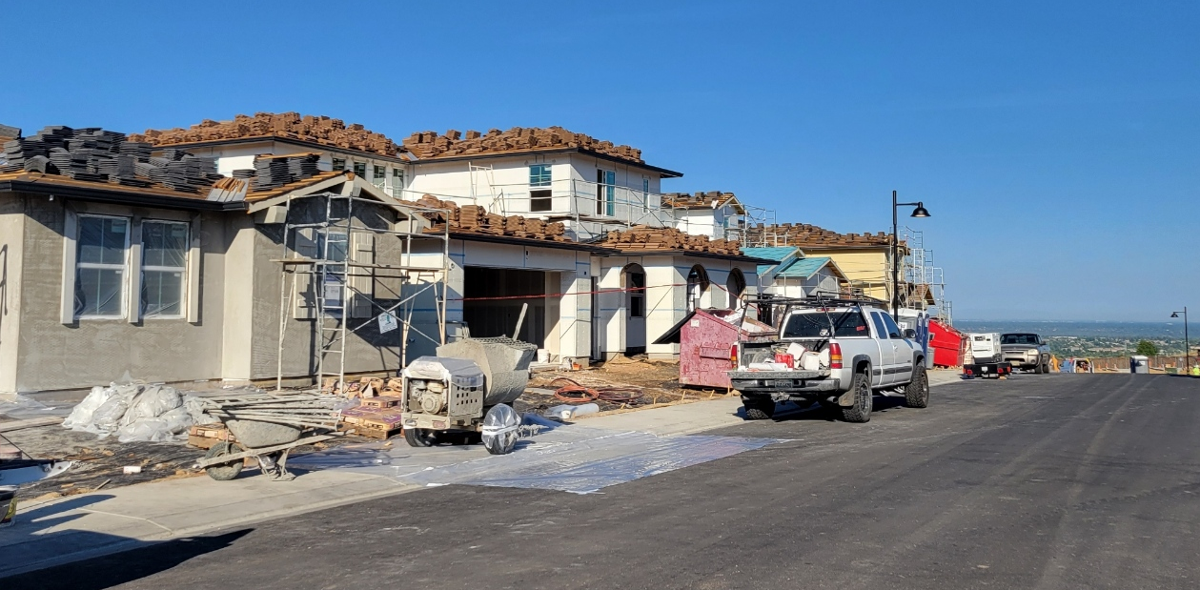
Building Activity
Russell Ranch Phase 3 Builders
  Lennar Homes (Phase 3A)
Lennar Homes: Phase 3A

Slide 26
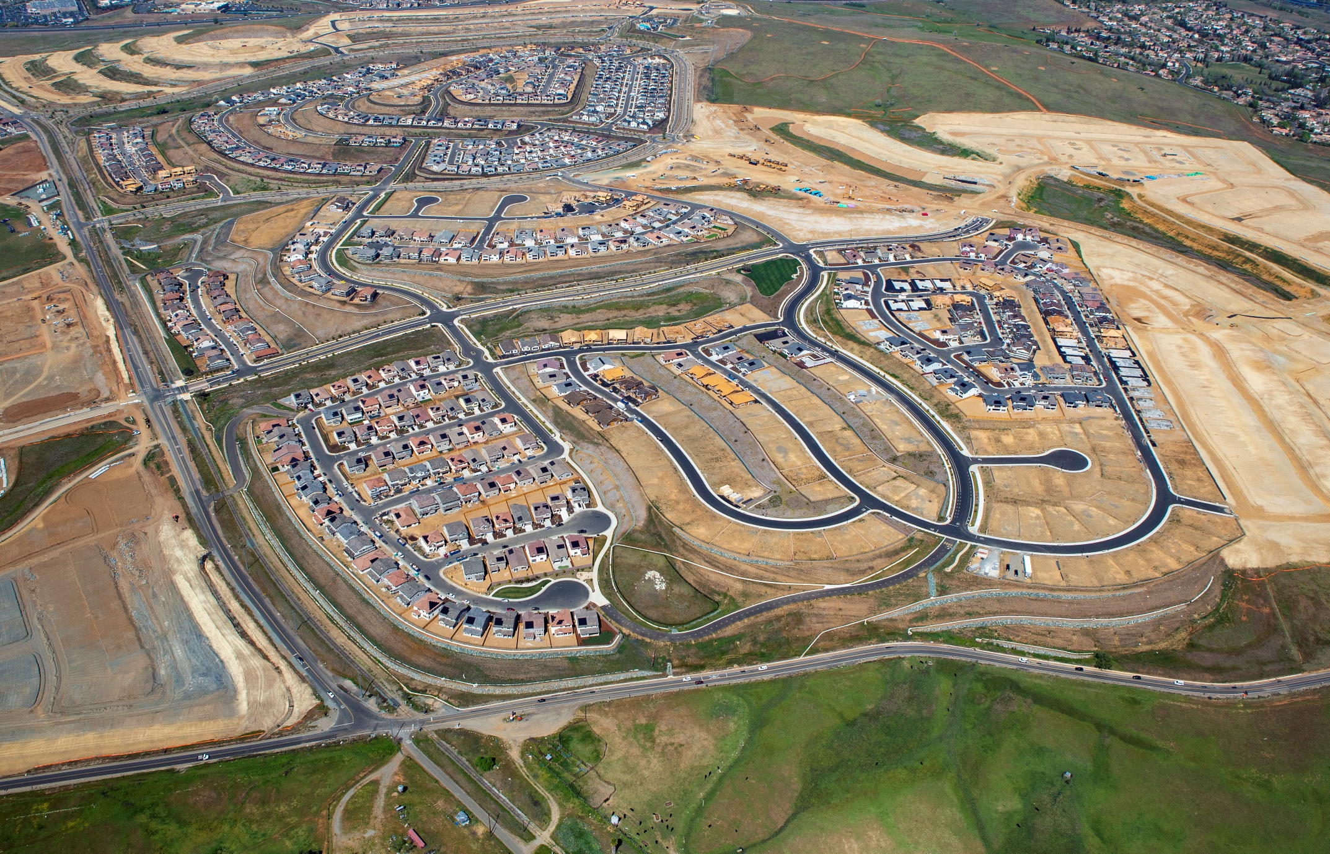
White Rock Springs Ranch Neighborhoods
JMC Homes
Village 8
Lennar Villages 4 - 7
Highway 50
Placerville Road
Alder Creek Parkway
Grand Prairie Road
Mangini Parkway
Placerville Road
Grand Prairie Road
Richmond American
Villages 1 – 3, 9
White Rock Road

Slide 27
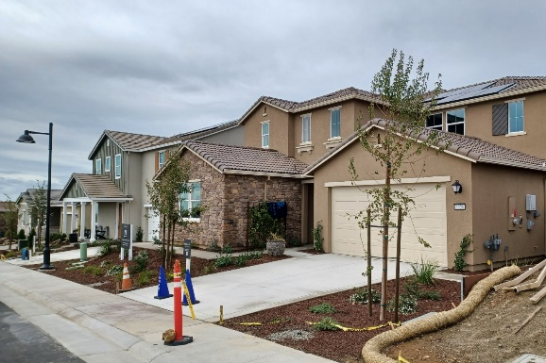
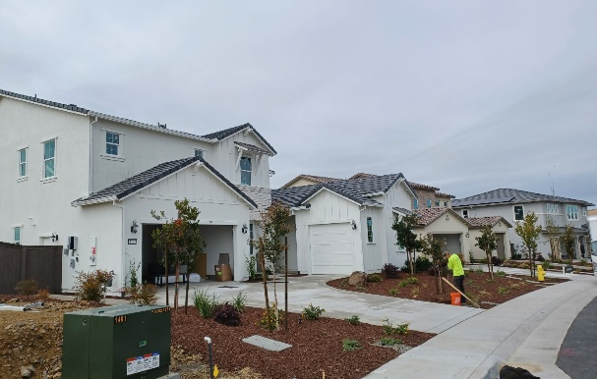
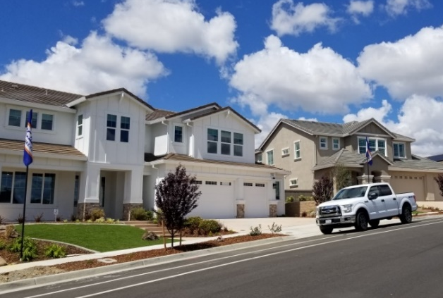
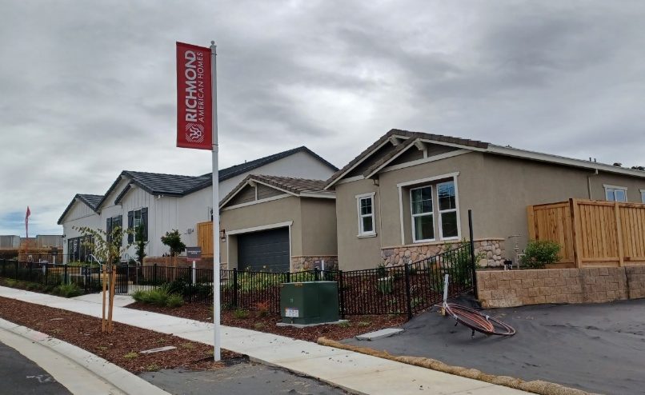
Building Activity
White Rock Springs Ranch Builders
  Richmond American (Villages 1 – 3, 9)
  JMC Homes (Village 8)
  Lennar (Village 4 – 7)
Lennar: Villages 4 - 7
JMC Model Home Sites: Village 8
Richmond American: Villages 1 – 3, and 9

Slide 28
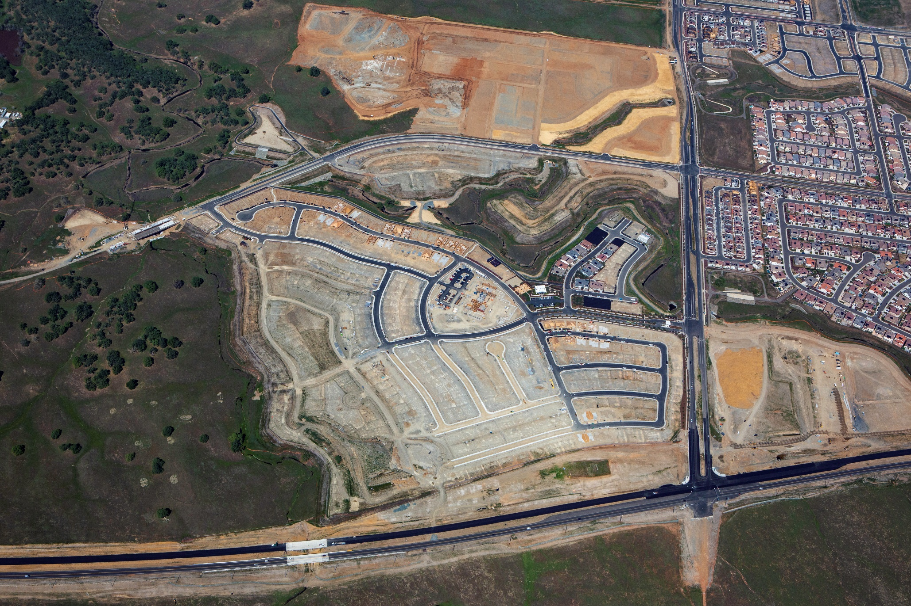
Toll Brothers at Folsom Ranch Neighborhoods
Toll Brothers
Phase 1A Models
Toll Brothers
Phase 1B and 1C
Highway 50
Mangini Parkway
Placerville Road
Alder Creek Parkway
Grand Prairie Road
East Bidwell Street
Toll Brothers
Phase 1D
Grand Prairie Road
White Rock Road

Slide 29
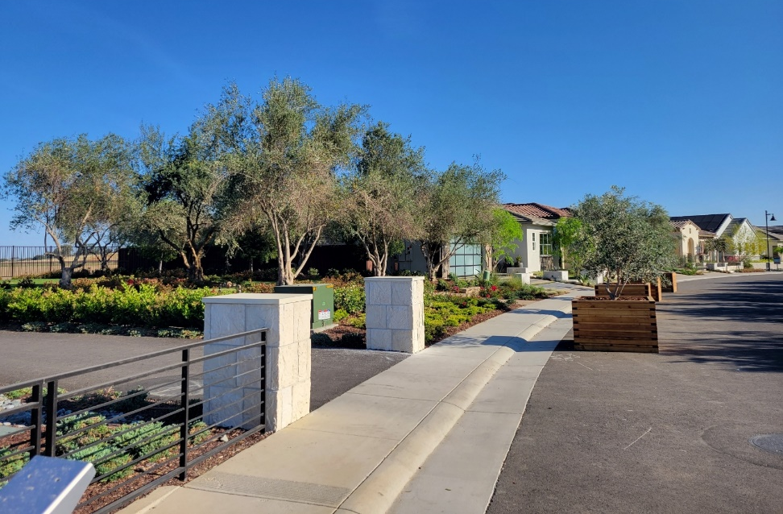
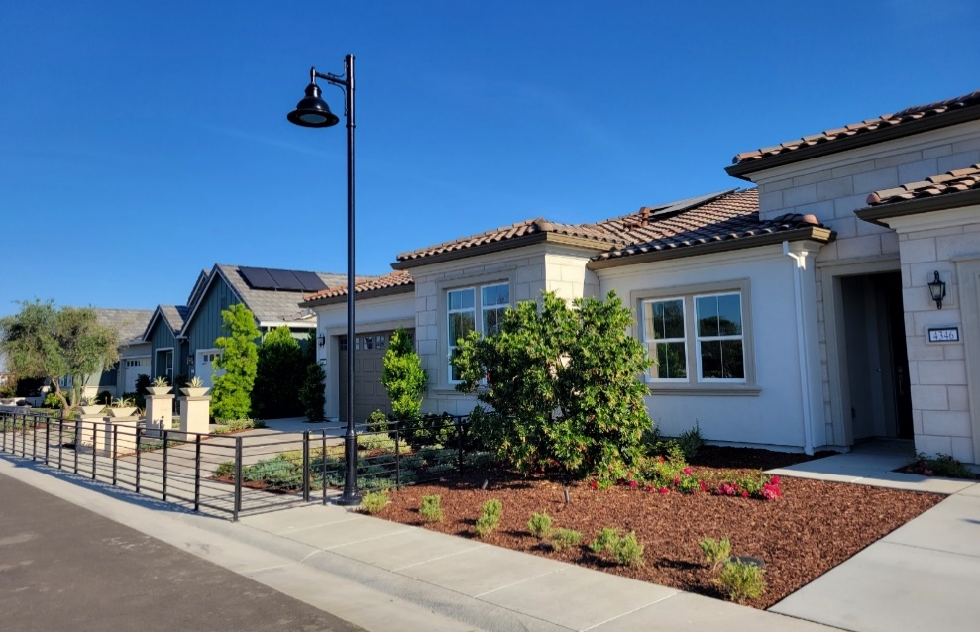
Building Activity
Toll Brothers Builders
  Toll Brothers Phase IA, IB, IC, and ID

Slide 30
Questions?
Quarterly presentations and additional project information can be found on the City’s website:
www.folsom.ca.us/FolsomPlanArea

