Slide 1
Folsom City Council Meeting
Tuesday, March 28, 2023

Slide 2
Excerpt from Letter from Sabelhaus & Strain, LLP 2/13/2023
Valid Reasons to Deny Affordable Housing Projects
……
The city has adopted a housing element in compliance with state law and the development project is not needed to meet its share of the regional housing need for very low, low, or moderate-income housing.
The development project as proposed would have a specific, adverse impact upon the public health or safety, and there is no feasible method to satisfactorily mitigate or avoid the specific adverse impact without rendering the development unaffordable to low and moderate income households
The denial of the project or imposition of conditions is required in order to comply with specific state or federal law, and there is no feasible method to comply without rendering the development unaffordable to low and moderate-income households
The development project is proposed on land zoned for agriculture or resource preservation that is surrounded on at lest two sides by land being used for agricultural or resource preservation purposes, or which does not have adequate water or wastewater facilities to serve the project
In limited circumstances, the development project is inconsistent with both the jurisdiction’s zoning ordinance and general plan land use designation as of the date the application was deemed complete, and the jurisdiction has adopted a housing element in substantial compliance with the Housing Element Law.
…..

Slide 3
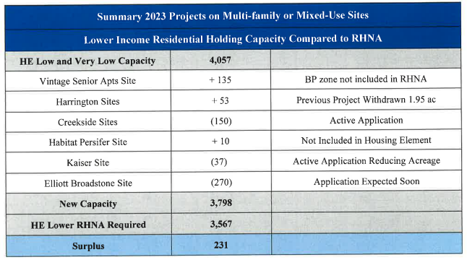

Slide 4
Excerpt from Letter from Sabelhaus & Strain, LLP 2/13/2023
Valid Reasons to Deny Affordable Housing Projects
……
The city has adopted a housing element in compliance with state law and the development project is not needed to meet its share of the regional housing need for very low, low, or moderate-income housing.
The development project as proposed would have a specific, adverse impact upon the public health or safety, and there is no feasible method to satisfactorily mitigate or avoid the specific adverse impact without rendering the development unaffordable to low and moderate income households
The denial of the project or imposition of conditions is required in order to comply with specific state or federal law, and there is no feasible method to comply without rendering the development unaffordable to low and moderate-income households
The development project is proposed on land zoned for agriculture or resource preservation that is surrounded on at lest two sides by land being used for agricultural or resource preservation purposes, or which does not have adequate water or wastewater facilities to serve the project
In limited circumstances, the development project is inconsistent with both the jurisdiction’s zoning ordinance and general plan land use designation as of the date the application was deemed complete, and the jurisdiction has adopted a housing element in substantial compliance with the Housing Element Law.
…..

Slide 5
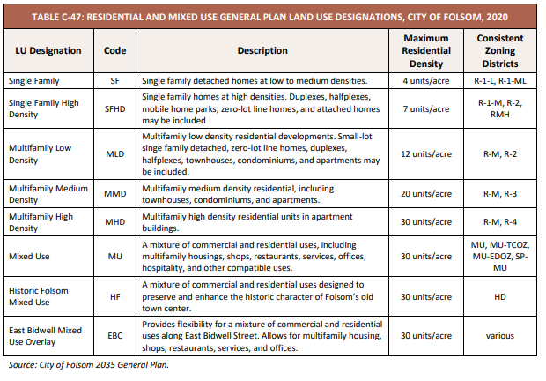
General Plan Designations that permit Residential Development up to 30/units/acre

Slide 6
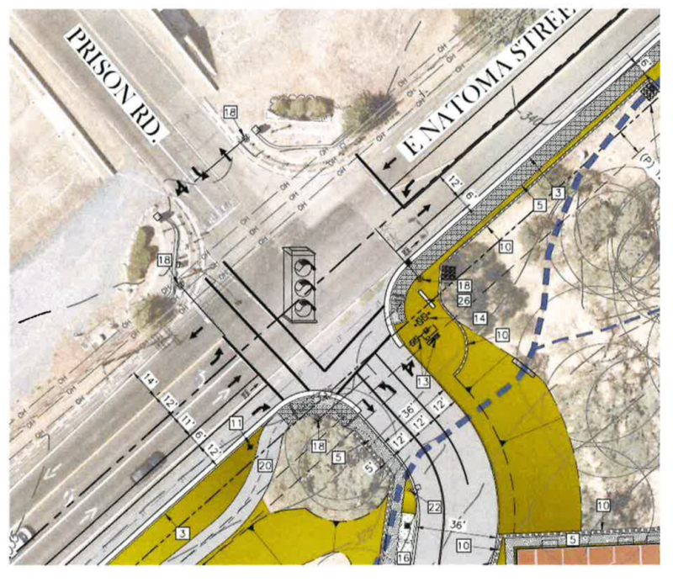

Slide 7
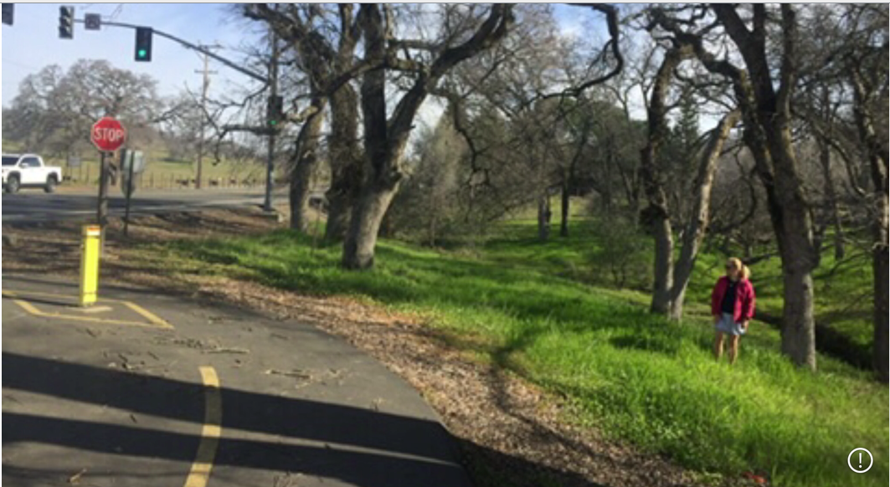

Slide 8
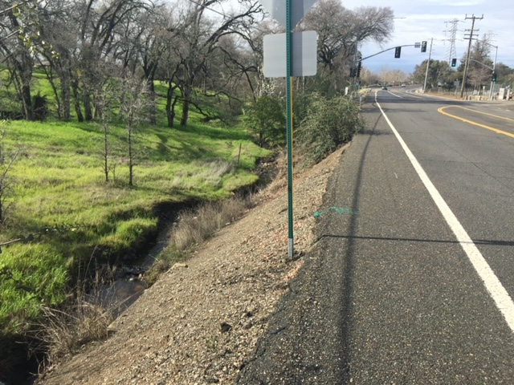

Slide 10
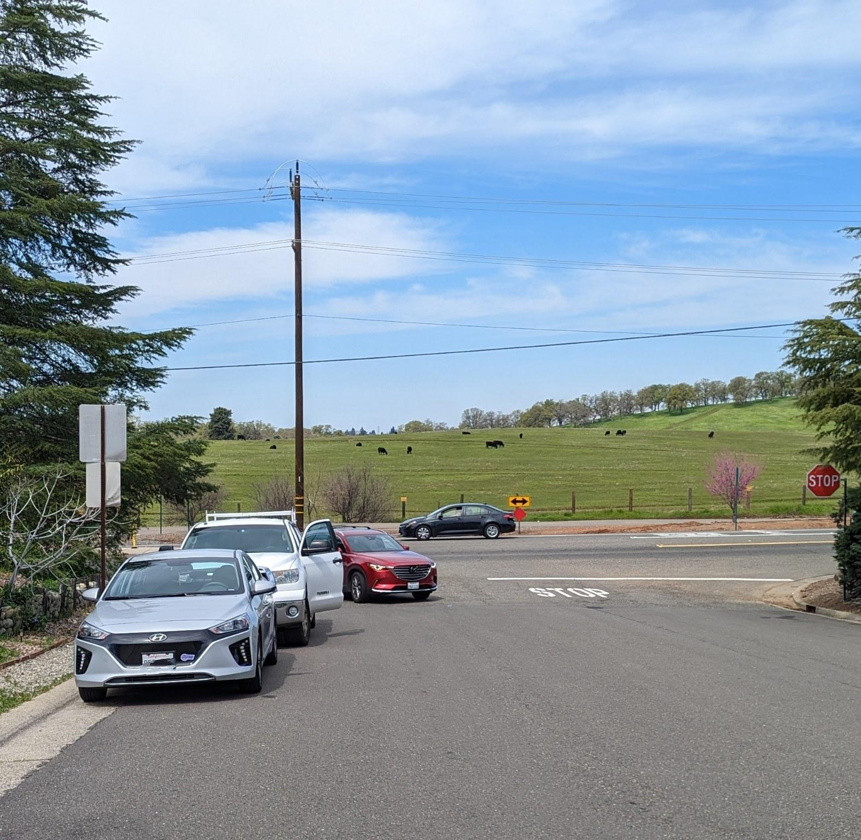

Slide 11
