Slide 1
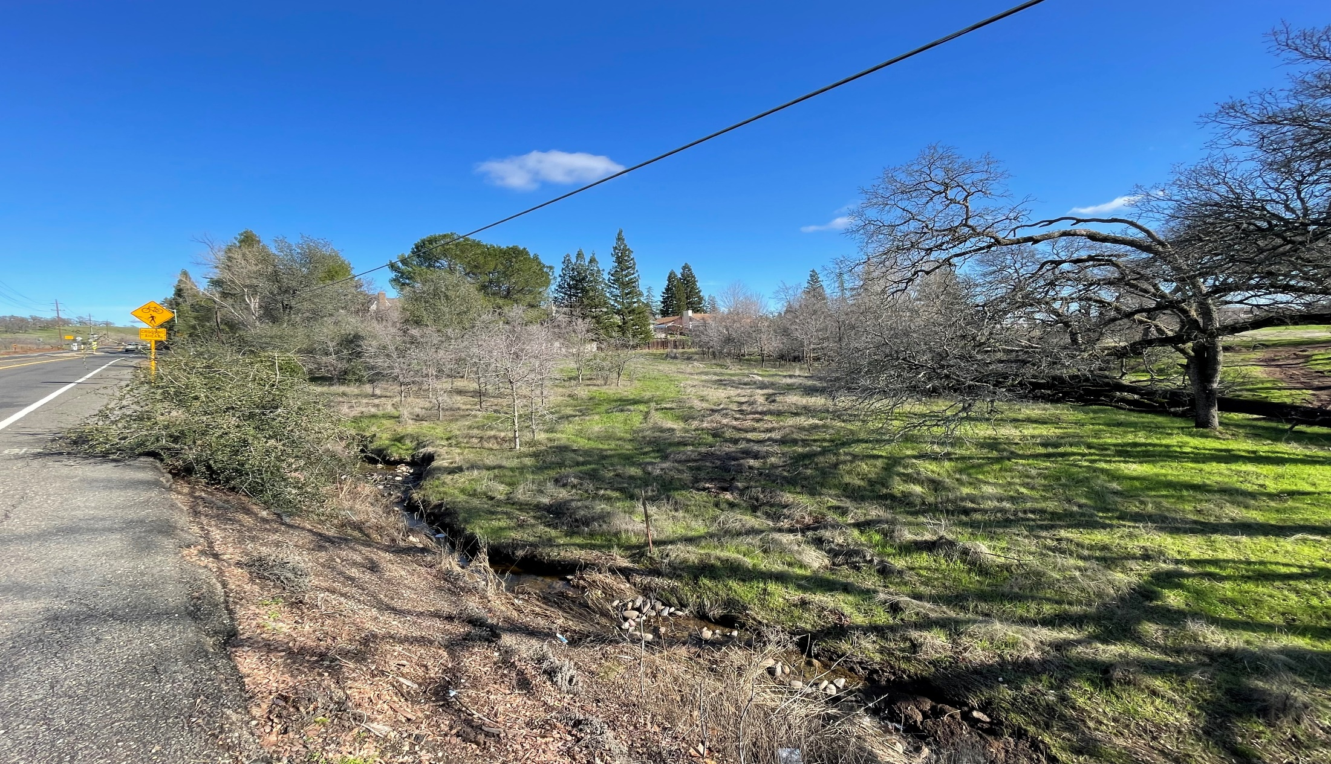
Vintage Senior Apartments Appeal
Vintage Senior Apartments Appeal
Appeal of Planning Commission Decision Approving 136-Unit Senior Affordable Apartment Project at 103 East Natoma Street

Slide 2
Appeal Hearing Protocol
Mayor Opens Hearing
City Staff Presentation
Appellant Presentation (10 minutes)
Project Applicant Presentation (10 minutes)
Public Comments (3 minutes per person)
Appellant Closing Remarks (5 minutes)
Project Applicant Closing Remarks (5 minutes)
City Staff Questions from Council
Mayor Closes Hearing
City Council Deliberation and Decision

Slide 3
Key Project Details
Vintage Senior Apartments
136-Unit Senior Age-Restricted (55+) Affordable Apartment Community
4.86-Acre Site at Intersection of East Natoma Street and Prison Road
Conditional Use Permit
Allow for Development/Operation of Senior Affordable Apartment Project
Planned Development Permit
Establish Project Specific Development Standards
Evaluate Site Design and Architecture and Design
Density Bonus
Allow Development at a Residential Density of 28 Units Per Acre
Provide Three Incentives (Parking, Building Height, Building Stories)

Slide 4
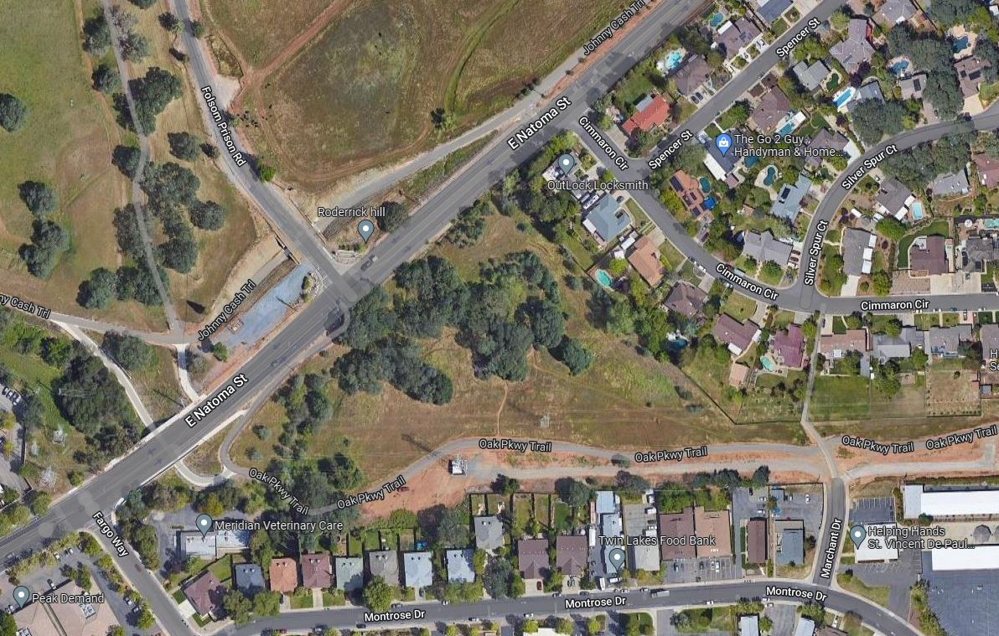
Project Setting
State Prison
Single-Family Residential
Site
City Offices
Office
Single and Multi-Family Residential
Hospital

Slide 5
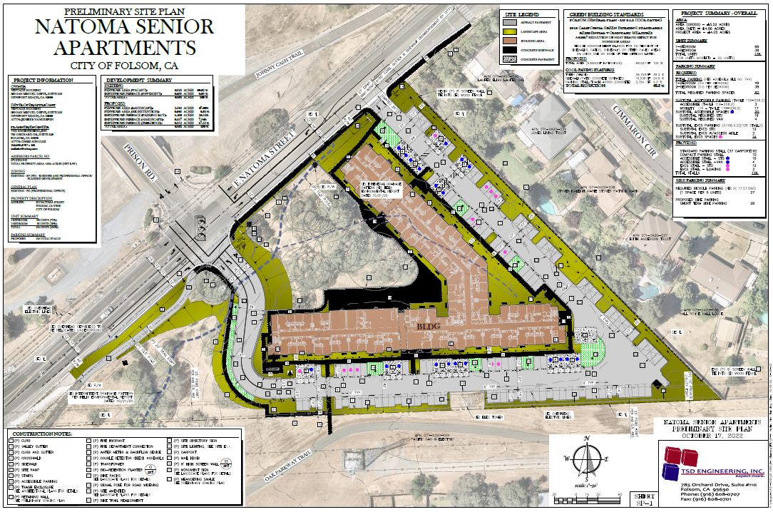
Site Plan

Slide 6
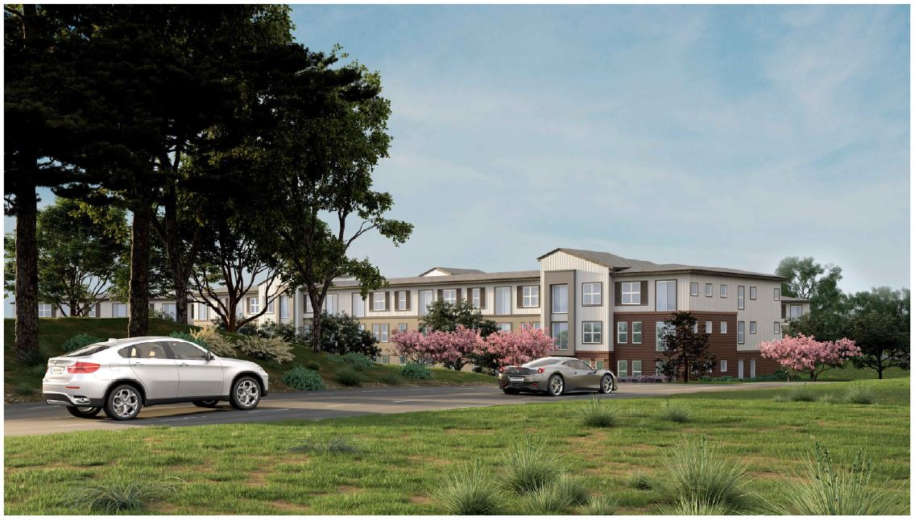
Building Rendering

Slide 7
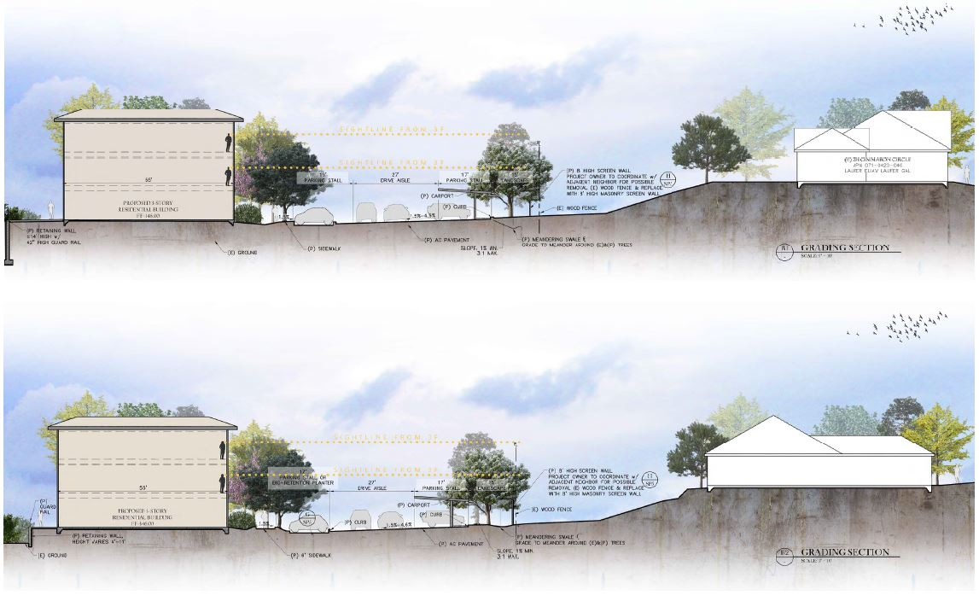
Building Site Sections (North)

Slide 8
Site Cross Section Apartments

Slide 9
Traffic/Access/Circulation
Traffic Impact Analysis (July-2022)
Two Study Intersections Analyzed
Two Different Scenarios (Existing Conditions With and Without Project)
Project-Related Impacts (441 Daily Vehicle Trips, 39 AM/41 PM Peak Hour Trips)
Study Determined No Significant Impacts (Level of Service)
Study Determined No Significant Impact Relative to Vehicle Miles Traveled
Traffic Safety Committee (February-2022)
Traffic Recommendations
Roadway Improvement Required to Meet City’s Standard Construction Specifications
and Design and Procedures Manual and Improvement Standards

Slide 10
Parking Analysis
FMC doesn’t have Parking Standard for Active-Adult Communities (Established through PD Permit)
Proposed Parking
136 On-Site Parking Spaces (Carport and Uncovered)
1.00 Parking Spaces Per Unit
Parking Evaluation
Parking Memorandum (Approved Projects, Other Jurisdictions, ITE Manual)
Parking Case Study (Evaluation of Existing Vintage Projects Parking)
Compared Industry Standard Parking Rates (ITE Parking Generation Rates)
NPA Shared Parking Model

Slide 11
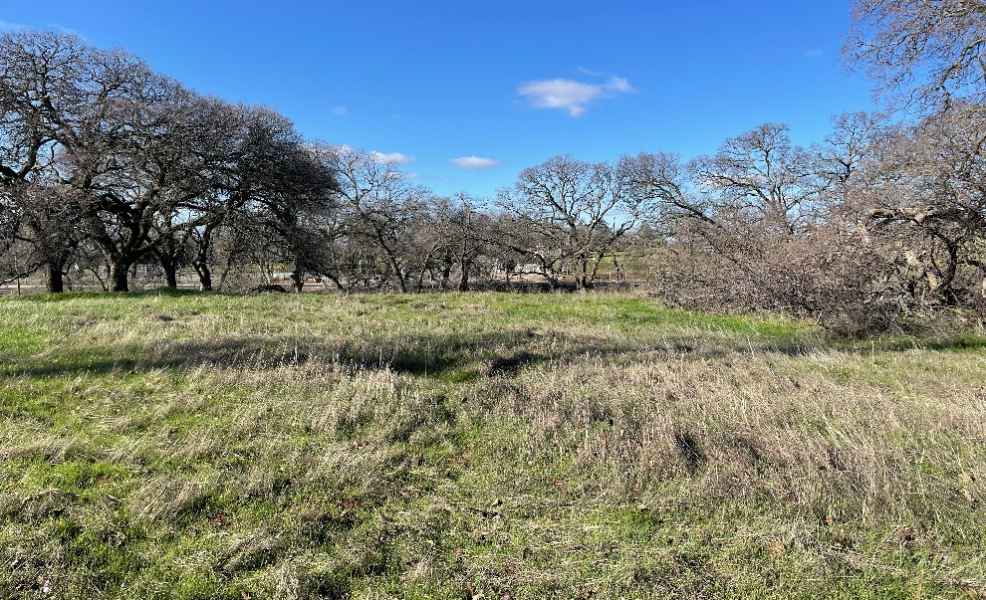
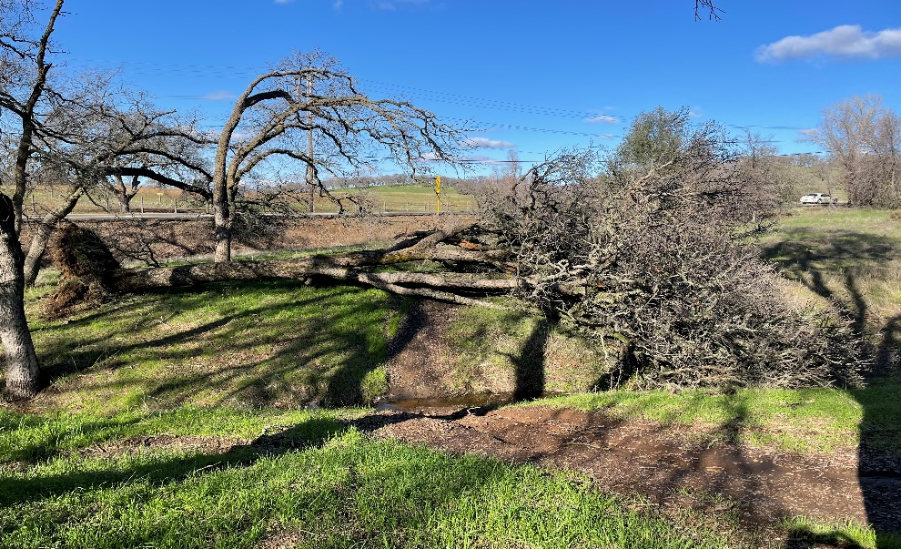
Oak Tree Preservation/Removal
Arborist Report and Oak Tree Inventory
78 Protected Oak Trees (6-Inch Diameter or Greater) Identified on Project Site
47 Oak trees proposed for removal (Mitigation Required)
31 Oak trees to be preserved
Oak Tree Mitigation
Applicant Proposing to Pay In-Lieu Fee (City’s Tree Mitigation Bank)
30 Oaks Trees Proposed to be Planted in Parking Lot Area (Not Mitigation)

Slide 12
Public Outreach and Noticing
Public Outreach Meeting Held on March 22, 2022
Public Outreach Meeting Held on June 29, 2022
Large Project Identification Sign Placed on Site on July 6, 2022
Public Notices Provided for January 18, 2023 PC Meeting
Public Notices Provided for February 15, 2023 PC Meeting
Public Notices Provided for March 28, 2023 CC Meeting

Slide 13
Environmental Review
California Environmental Quality Act (CEQA)
Initial Study, Mitigated Negative Declaration, and Mitigation Monitoring Program
Specific Subject Areas (Aesthetics, Agriculture, Air Quality, Biological Resources, Cultural Resources, Geology, Greenhouse Gas Emissions, Hazards, Hydrology, Land Use, Mineral Resources, Noise, Population and Housing, Public Services, Recreation, Transportation, Tribal Cultural Resources, Utilities, and Mandatory Findings of Significance
Mitigation Measures Included as Conditions of Approval (17 Measures)

Slide 14
Planning Commission Meetings
Planning Commission Meeting (January 18, 2023):
Resident Concerns (Density, Parking, Scale, Design, Oak Impacts, Traffic Safety)
Commission Concerns (Density, Architecture, Parking, Traffic Safety)
Commission Unanimous in their Opposition to Project
Housing Accountability Act (Enhanced Findings
Commission Unable to Make Findings to Deny Project to February 15, 2023)
Commission Voted to Continue Project (6-0-0-1)
Planning Commission Meeting (February 15, 2023):
Resident Concerns/Commission Concerns
Project Consistency Analysis (General Plan, Zoning Code, Standards, etc.)
Project Modifications Proposed by Applicant
Housing Accountability Act, Legal Implications, and Findings
The project would have a “specific, adverse impact upon the public health and safety and there is no feasible method to satisfactorily mitigate or avoid” said impact without making the project unaffordable. (Government Code § 65589.5(d)(2).)
Commission Voted to Approved the Proposed Project (4-3-0-0)

Slide 15
City Council Appeal
City Received One Timely Appeal (Appeal by Katherine Gray)
Reasons for Appeal
Project would have adverse effects on public health, safety, and welfare and would
be detrimental and injurious to property and improvements in the neighborhood
Initial Study and Mitigated Negative Declaration fails to fully evaluate, disclose,
and effectively mitigate environmental impacts. An Environmental Impact Report
(EIR) should be prepared for the Project
The Project is not feasible
The transportation wait times are too long

Slide 16
Appeal Analysis Item No. 1
Project would have adverse effects on public health, safety, and welfare and
would be detrimental and injurious to property and improvements in the
neighborhood
Project in compliance with all adopted plans and policies
Environmental review conducted in compliance with CEQA
Conditions of approval
Housing Accountability Act prohibits use of standard Use Permit finding
The use applied for will, under the circumstances of a particular case, be detrimental to the health, safety, and welfare of persons residing or working in the neighborhood
Housing Accountability Act Findings
The Project would have a significant, quantifiable, direct, and unavoidable impact, based on objective, identified written public health or safety standards, policies, or conditions and that those impacts cannot be mitigated without making the project unaffordable
Appeal did not identify and staff could not find and objective written public health and safety standards that the Project violates

Slide 17
Appeal Analysis Item No. 2
The Initial Study and Mitigated Negative Declaration fails to fully evaluate, disclose, and effectively mitigate environmental impacts. An Environmental Impact Report (EIR) should be prepared for the Project
Environmental review prepared by Helix Environmental in compliance with CEQA
Initial Study, Mitigated Negative Declaration and Mitigation Monitoring Program
Six resident letters (density, traffic, parking, oak tree impacts, etc.)
Four public agency letters (SMUD, CVRWQCB, SMAQMD, and PG&E)
No comments support a finding that the Project may have a significant effect on the environment, thus requiring preparation of an EIR, EIR only required when there is substantial evidence (in light of the whole record) that any aspect of the Project may cause a significant effect on the environment
Appeal did not provide any substantial evidence that the Project may have a significant impact on the environment

Slide 18
Appeal Analysis Item No. 3
The Project is not feasible
No information provided as to why the Project is not feasible and what this means
Absent additional information or substantial evidence, the simple claim that the Project is not feasible is not ground for approval of the appeal

Slide 19
Appeal Analysis Item No. 4
The transportation wait times are too long
No additional information provided to expand on this statement
Transportation Impact Study Prepared (not required)
39 AM Peak Hour Trips and 41 PM Peak Hour Trips
Project would not impact level of service (LOS) of two study intersections
Cumulative traffic impacts addressed through Traffic Studies associated with the City’s 2018 General Plan and updated in 2021 (1/2 vehicle trips as commercial use of site)
No geometric constraints or safety issues identified (vehicle, pedestrian, bicycle)
Driveway spacing, driveway throat depth, sight distance all adequate
Low number of traffic accidents in the Project area
No impact to bus rapid transit service (Route 30) with respect to access and wait times
Appeal does not provide any evidence to suggest the Project would result in exceedance of any City standard to vehicle or bus wait times nor was any evidence provided to suggest the Project would result in any traffic safety related impacts at nearby street intersections

Slide 20
Applicant Response Letter
Applicant Response Letter (Attachment 6)
Provides overview of Project and its appropriate for the proposed location
Disagrees with the assertion that the Initial Study and Mitigated Negative
Declaration
prepared for the Project are is inadequate (no evidence)
Disagrees that the Project would have an adverse impact on public health, safety,
and welfare and would detrimental or injurious to property and improvements in
the neighborhood (no evidence)
Disputes assertion that the Project is not feasible (no factual basis)
Disagrees with the comment that the wait times are too long (no evidence)
Objection to Delp and Sundermier Letters (no right of appeal)

Slide 21
Additional Comments/Letters
Multiple Letters of Support for Project
Roadway Design Requirements (East Natoma Street and Right-of Way)
Traffic Study and Cumulative Impacts (General Plan EIR Traffic Analysis)
Parking Mitigation
Pedestrian Circulation (Traffic Safety Committee)
Off-Site Sidewalk Extension
Secondary Access Driveway and Usage
Grading, Drainage, and Retaining Walls
Oak Tree Impacts (Tree Preservation Ordinance)
Sale of Subject Property
Adequacy of Initial Study, Mitigated Negative Declaration ,and Mitigation Mesaures

Slide 22
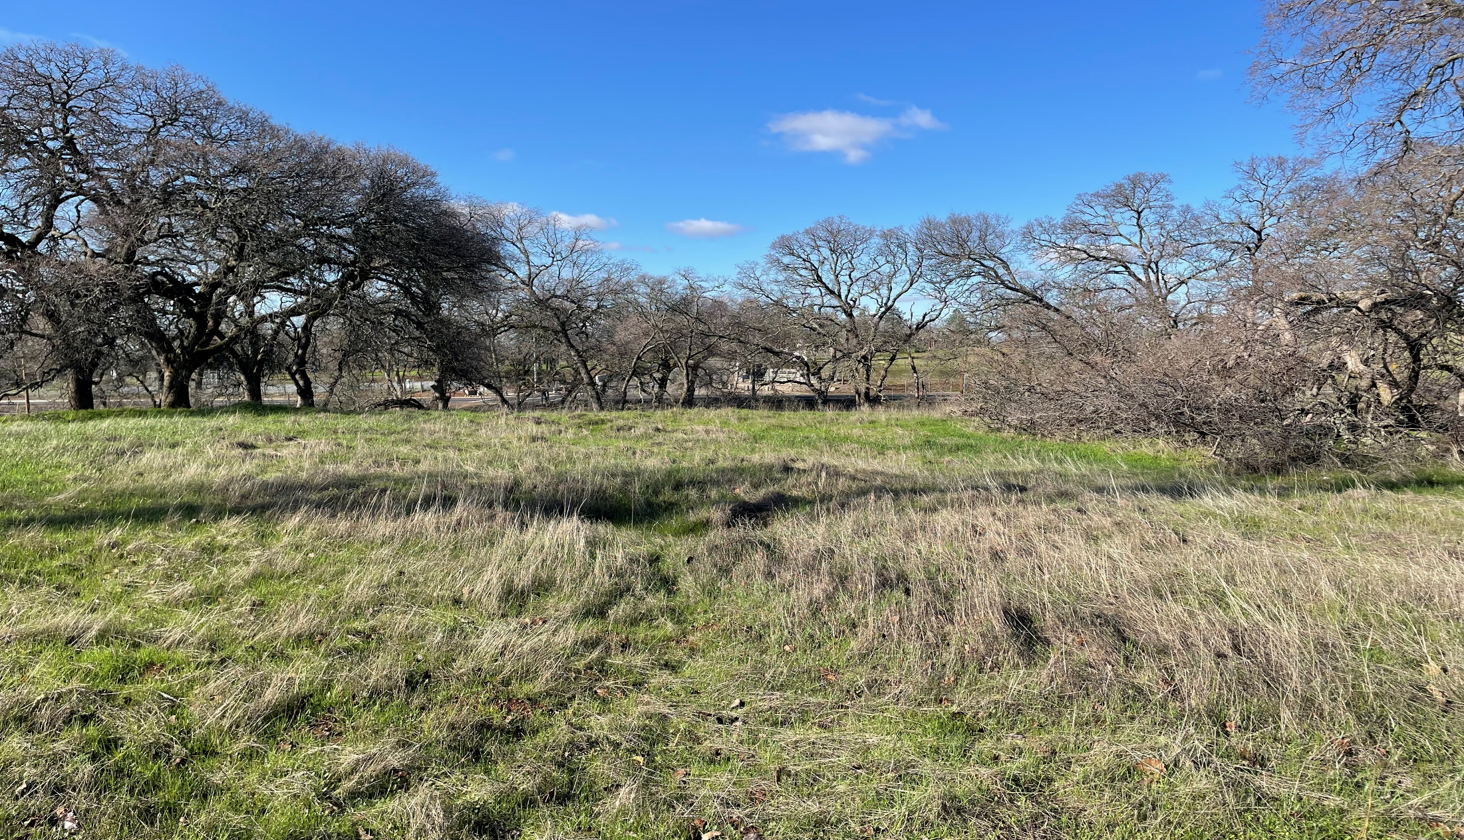
Staff Recommendation
Staff Respectfully Recommends
that the City Council Deny the Appeal by Katherine Gray of Decisions by the Planning Commission Approving the Vintage Senior Apartments Project

Slide 24
Site Cross Section Apartments

Slide 25
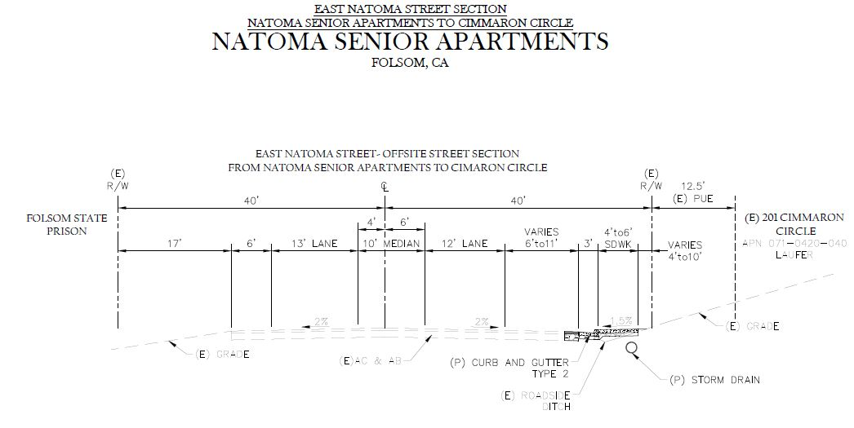
Site Cross Section Single-Family

Slide 26
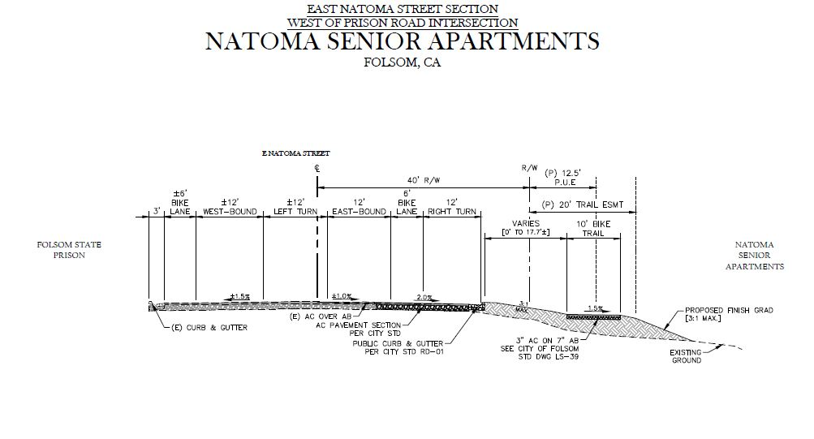
East Natoma Street Section West

Slide 27
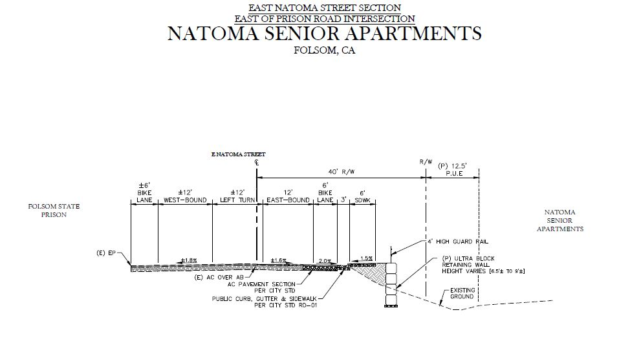
East Natoma Street Section East

Slide 28
Review of City Standards
Project Consistent with all Established City Standards
Folsom General Plan (2035)
Folsom Municipal Code
Development Standards for Business and Professional Zoning District (Setbacks, Height, Etc.)
Design Guidelines for Multi-Family Development (Not Objective Standards)
Stormwater Quality Program
Preliminary Drainage and Stormwater Quality Report (August-2022)
Complies with City’s Design Procedures Manual and Sacramento Stormwater Quality Design Manual
Drainage and Stormwater Conditions of Approval (Condition Nos. 15, 16, 28, 31, 32, 33, and 34)
Design Standards for Improvements and Construction
Folsom Fire Department Strategic Plan 2020 (6 Minute Response Time to Project Site)
Project Meets All Site Accessibility Requirements for Emergency Service Vehicles
Project Meets All Building Accessibility Requirements (Staircases and Elevators)
Project Required to Meet All Fire and Building Code Requirements for Construction

Slide 29
Project Modifications
Restrict Secondary Project Driveway to Emergency Service and Solid Waste Vehicle Access Only
Install sliding electronically active gate at Secondary Project Driveway
Install signage and pavement markings
Install Pedestrian-Actuated Rectangular Rapid Flashing Beacon (RRFB) System at Existing Pedestrian Crosswalk at East Natoma Street and Cimarron Circle
Install two rectangular-shaped yellow indicators with light emitting diode array
Install pedestrian-activated buttons on new poles
Parking Modifications and Restrictions
Parking Permit Program for Residents (Maximum of 130 Parking Permits)
Designate 6 Parking Spaces for Exclusive Use by Employees and Guests
Landscape Improvements
Require New Trees Planted along Eastern Project Boundary to be 36-Inch Box Trees
Require New Trees Planted along Eastern Project Boundary to be Minimum of 16 Feet Tall
Required Additional Measures to Ensure Success of Tree Plantings and Landscaping

Slide 30
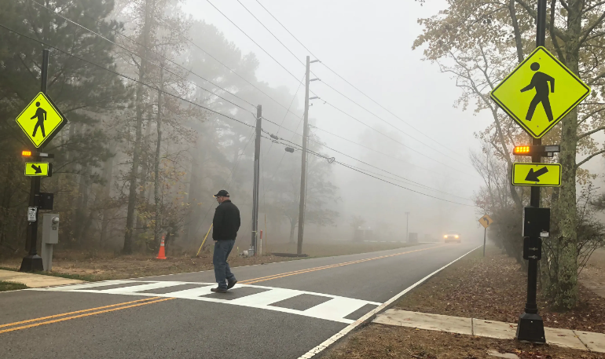
Project Modifications Site Plan

Slide 31
State Housing Law
Penalties for Failure to Comply with Housing Accountability Act
If the City denies a housing development project, reduces the density of the project, or imposes condition(s) of approval that render an affordable project unaffordable, the project applicant, a person who would be eligible to apply to live in the proposed project, or a “housing organization” may file suit against the City to enforce the Housing Accountability Act
The City must prove that its decision was based on one of the statutorily required findings, and that those findings are supported by substantial evidence in the record. In this context, the City has the burden of proof even though it is the one being sued
If the court determines that the City’s decision to deny the project, reduces the density of the project, or impose condition(s) of approval that render an affordable project unaffordable violated the Housing Accountability Act, it will order the City to comply with the HAA within 60 days. If the court finds that the City acted in bad faith, it can simply order the City to approve the project.
If the City does not comply within 60 days, the court “shall” impose a minimum fine of $10,000 per housing unit in the project at issue. If the court finds that the City acted in bad faith and the City failed to comply with the HAA within 60 days, the fine “shall” increase to a minimum of $50,000 per unit. Any successful plaintiff is entitled to recover attorney’s fees, which typically range from $100,000 to $500,000 in these kinds of cases. In a situation involving multiple plaintiffs, each plaintiff is entitled to recover its own attorney’s fees, so the City would be faced with multiple fee demands in the range stated above

Slide 32
Staff Recommendation
Staff Recommends
Planning Commission Approval of the Vintage Senior Apartments Conditional Use Permit, Planned Development Permit, and Density Bonus

Slide 33
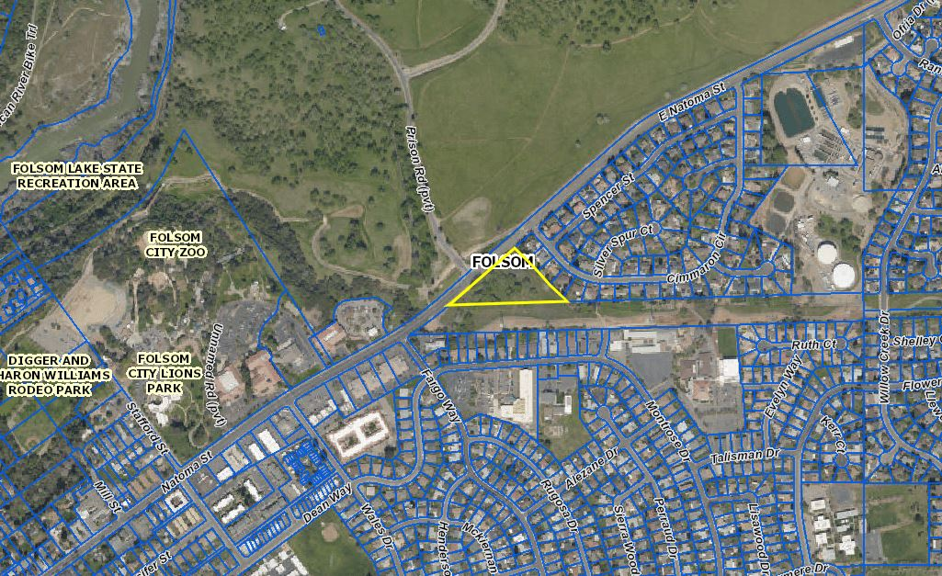
Vicinity Map
Project Site

Slide 34
Aerial View of Project Site
Site

Slide 35
Project Background
April 20, 2005:
Planning Commission Consideration of a General Plan Amendment, Rezone, Tentative Subdivision Map, and Planned Development Permit for Development of a 21-Unit Single-Family Residential Subdivision, Application Eventually Withdrawn
January 7, 2009:
Planning Commission Approval of a Tentative Parcel Map and Planned Development Permit for Development of a 32,000-Square-Foot Professional Office Park (Montara Grove), Application Eventually Withdrawn
March 11, 2021:
Community Development Department Review of Pre-Application for Development of a 150-Unit Senior Affordable Apartment Community

Slide 36
Key Project Details
Vintage Senior Apartments
136-Unit Senior (55+) Affordable Apartment Community
Units Restricted to Low (LI) and Very-Low Income (VLI) Households
No Request for Financial Participation from City
4.86-Acre Site at Intersection of East Natoma Street and Prison Road
Conditional Use Permit
Allow for Development/Operation of Senior Affordable Apartment Project
Planned Development Permit
Establish Project Specific Development Standards
Evaluate Site Design
Evaluate Architecture and Design
Density Bonus
Allow Development at a Residential Density of 28 Units Per Acre
Provide Three Incentives (Parking, Building Height, Building Stories)

Slide 37
Site Plan

Slide 38
Project Analysis
General Plan and Zoning Consistency
Conditional Use Permit
Planned Development Permit
Density Bonus
Traffic/Access/Circulation
Parking
Noise Impacts
Walls/Fencing
Site Lighting
Existing and Proposed Landscaping
Tree Preservation

Slide 39
General Plan/Zoning Consistency
General Plan/Zoning Designations
General Plan Land Use Designation: PO (Professional Office)
Zoning Designation: BP PD (Business/Professional District)
Analysis
Senior Apartments are Permitted Land Use in in BP Zoning District with
Approval of a Conditional Use Permit
Project Meets Established Development Standards for BP Zoning District
Lot Area
Lot Width
Building Height
Building Coverage
Building Setbacks
Parking Standard Established through Planned Development Permit Process

Slide 40
Conditional Use Permit
Conditional Use Permit
Land Use Compatibility
Adjacent and Nearby Land Uses
Traffic Impacts
Parking Impacts
Noise Impacts
Aesthetic Impacts
Lighting Impacts
Planning Commission Finding
In order to approve this request for a Conditional Use Permit, the Commission
must find that the “establishment, maintenance, or operation of the use or building applied for will not, under the circumstances of the particular case, be detrimental to the health, safety, peace, morals, comfort, and general welfare of persons residing or working in the neighborhood of such proposed use, or be detrimental or injurious to property and improvements in the neighborhood, or to the general welfare of the City.”

Slide 41
Land Use Compatibility
State Prison
Single-Family Residential
Site
City Offices
Office
Single and Multi-Family Residential
Hospital

Slide 42
Planned Development Permit
Conformance with Development Standards
Project Meets all Established Development Standards
Establishment of Project-Specific Parking Standards
Site Design
Building Architecture and Design
Development Standards Table Vintage Senior Apartments
 | Min. Lot Area | Min. Lot Width | Max. Building Coverage | Front Yard Setback | Rear Yard Setback | Side Yard Setbacks | Building Height limit
BP Zoning District | 6,000 s.f. | 60 | 60% | 20 feet | 20 feet | NA | 35 feet (two stories),(4 stories with CUP)
R-4 Zoning District | 6,000 s.f. | 60 feet | 60% | 20 feet | 20 feet | 5 feet and 10 feet | 50 feet (four-stories)
Proposed Project | 211,701 s.f. | 580 feet | 18% | 20 feet | 87 feet | 68 feet and 117 feet | 34 feet

Slide 43
Site Design

Slide 44
Architecture/Design
Proposed Architecture/Design
Three-Story Apartment Building (111,755-Square-Feet)
Contemporary Residential Design Concept
Rectangular-Shaped Building with Two Wings
Design Details (Rectilinear Forms, Recessed Elements, Balconies)
Earth Tone Colors (Shades of Brown) with more Vibrant Accent Colors
Design Guidelines for Multi-Family Development
Preservation of Existing Neighborhood Character
Promote Suitable Housing Types for all Residents Including Higher Densities
Creation of Interconnected and Livable Communities
Minimize the Impact of Parking within Existing Neighborhoods

Slide 45
Architecture/Design
Design Guidelines for Multi-Family Development
Variety and Distinctness are Desirable
Avoid Expanses of Uninterrupted Wall Area
Articulation Shall be Used to Break Up Visual Massing
Use of a Variety of Building Materials is Encouraged
Building Materials Shall Integrate with Design of Surrounding Neighborhood
Exterior Colors Shall be Compatible with Surrounding Neighborhood

Slide 46
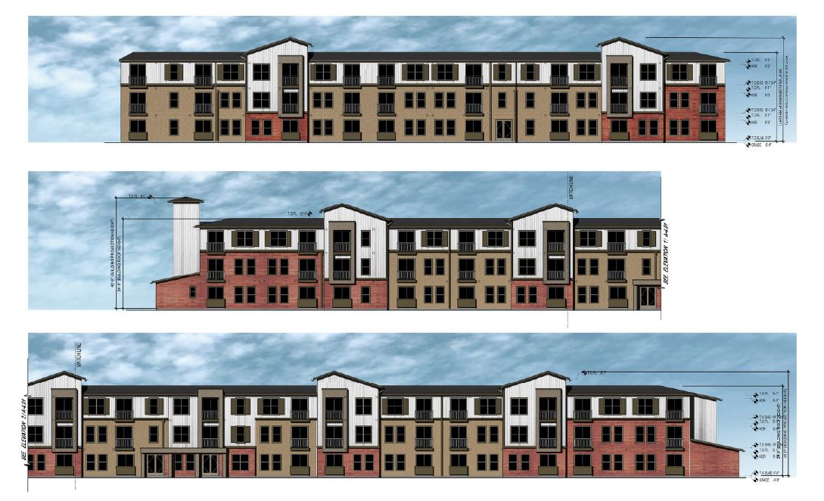
Building Elevations

Slide 47
Building Rendering (Northeast)

Slide 48
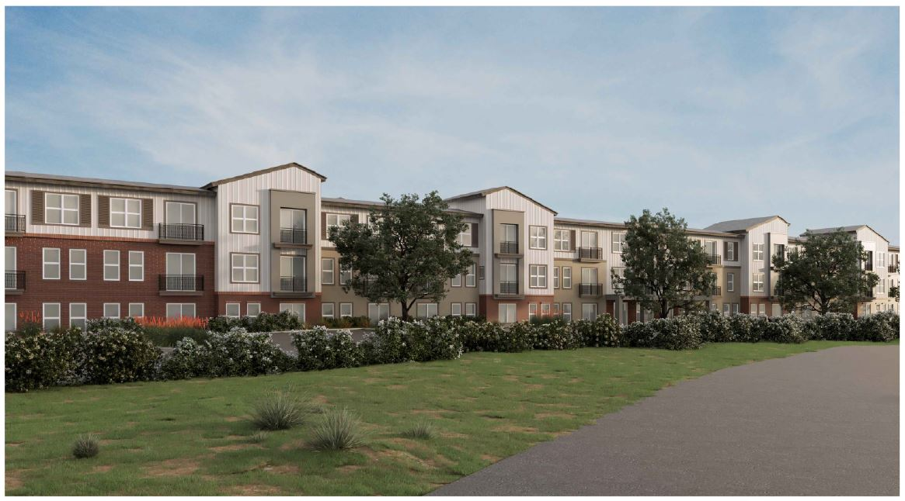
Building Rendering (Southwest)

Slide 49
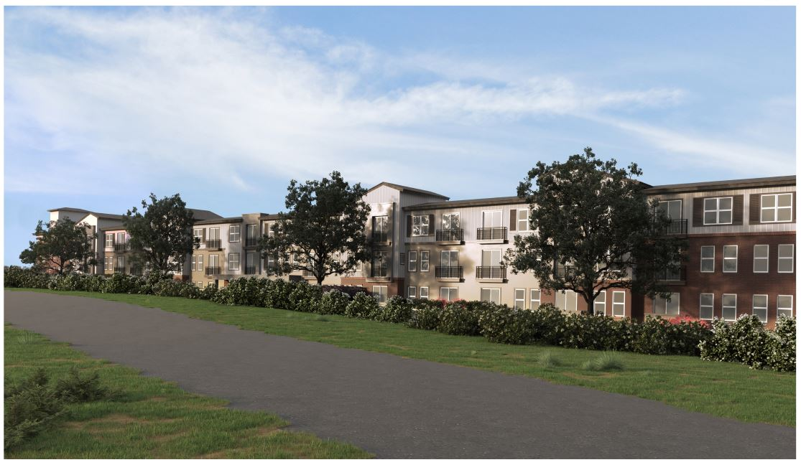
Building Rendering (Southeast)

Slide 50
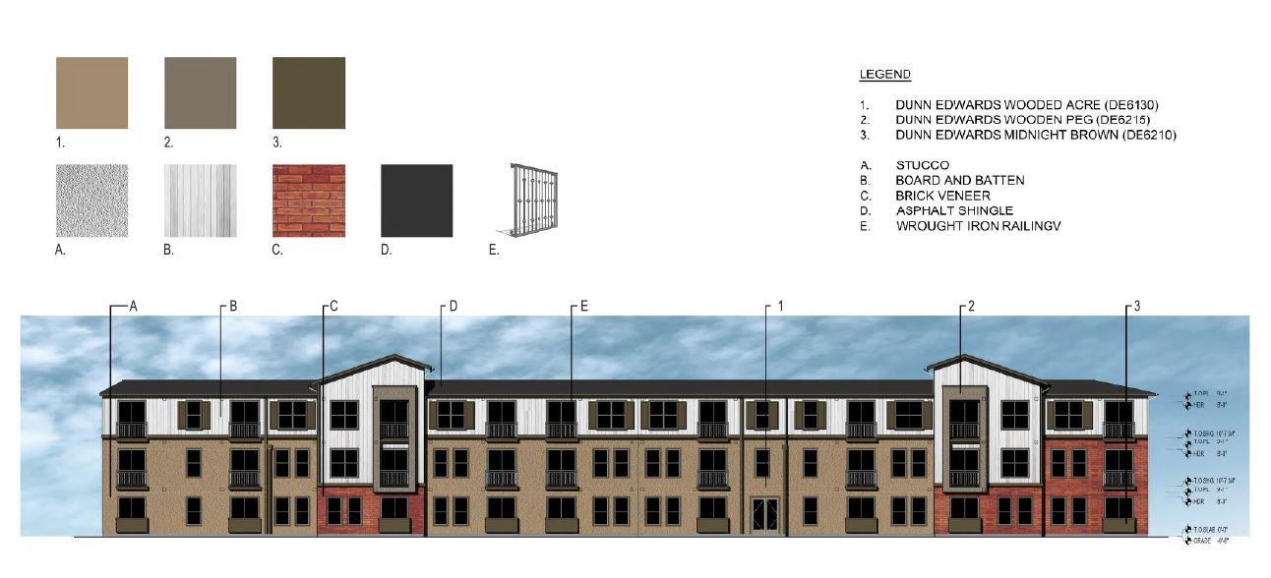
Color and Materials Board

Slide 51
Building Site Sections (North)

Slide 52
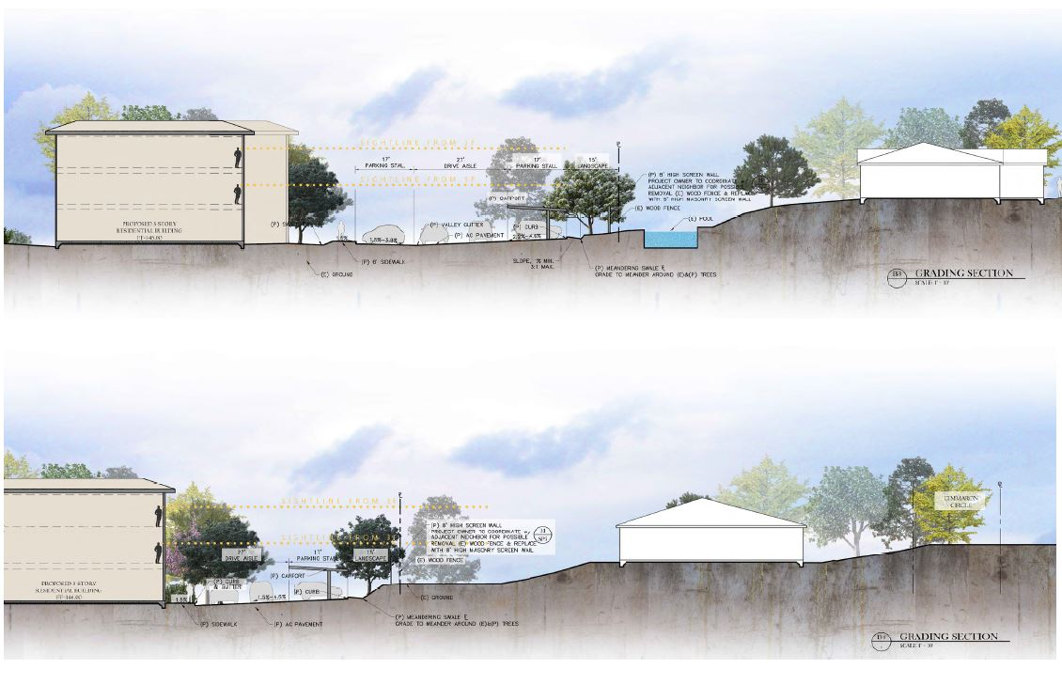
Building Site Sections (South)

Slide 53
Density Bonus
Density Bonus Request
Establish Residential Density of 28 Units Per Acre
Three Concessions
Established Parking Ratio of One Parking Space per Unit
Increase Maximum Building Height from 35 Feet to 42 Feet 6 Inches
Increase Number of Building Stories from Two-Stories to Three-Stories
City and State Density Bonus Law
Intended to Provide Incentives for Development of Affordable Housing Opportunities
Requires City to Grant Density Bonus if Consistent with Applicable Requirements
Ten Percent of Units Designated for Low-Income (LI) Households (or)
Five Percent of Units Designated for Very-Low Income (VLI) Households (or)
A Senior Citizen (55+) Housing Development
Project Complies with the State and City Density Bonus Requirements (Senior and Affordable)
Staff is Supportive of the Three Requested Concessions

Slide 54
Traffic/Access/Circulation
Traffic Impact Analysis (July-2022)
Two Study Intersections Analyzed
East Natoma Street/Prison Road
East Natoma Street/Eastern Project Driveway
Two Different Scenarios (Existing Conditions With and Without Project)
Project-Related Impacts
441 Daily Vehicle Trips
39 AM/41 PM Peak Hour Trips
Study Determined No Significant Impacts (Level of Service)
Study Determined No Significant Impact Relative to Vehicle Miles Traveled
State Mandated 15% Reduction in VMT Per Capita
Age-Restricted Housing has 32% Reduction in Vehicle Trip Generation
Traffic Recommendations
Construct 4th Leg of Intersection of East Natoma Street and Prison Road
Construct Raised Median in East Natoma Street to Restrict Turns at Eastern Project Driveway
Construct Right-Turn Channelization Taper at Eastern Project Driveway
Restripe Southbound Approach to East Natoma Street from Prison Road
Construct right-turns pockets, left-turns pockets, and tapers according to Site Plan

Slide 55
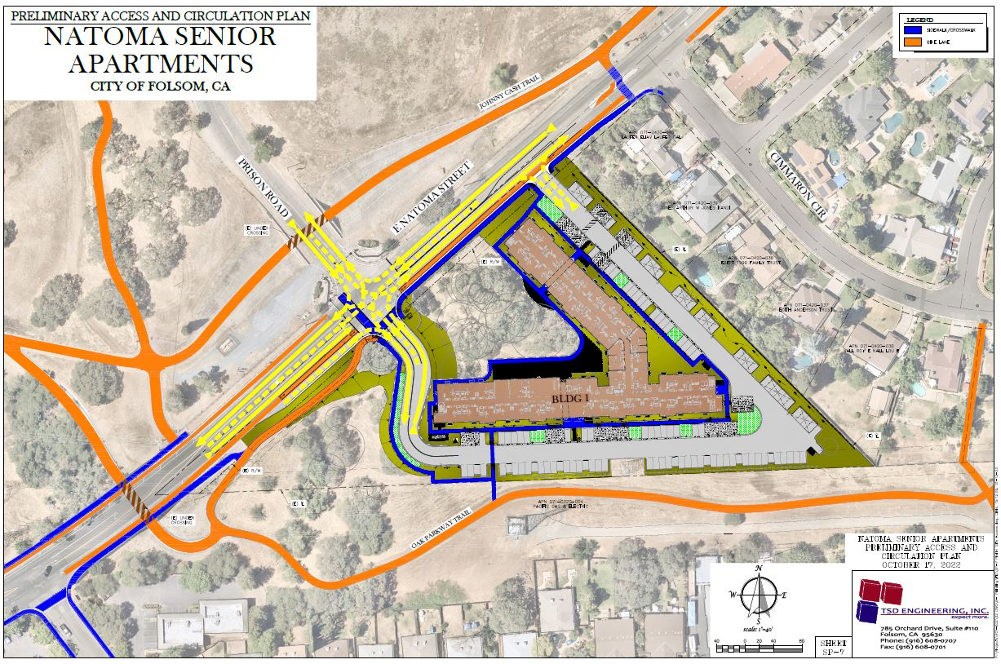
Traffic/Circulation Exhibit

Slide 56
Parking Analysis
Folsom Municipal Code Don’t Specify Parking Standard for Active-Adult Communities
Proposed Parking
136 On-Site Parking Spaces (Carport and Uncovered)
1.00 Parking Spaces Per Unit
14 Electric Vehicle Capable Parking Spaces
Parking Evaluation
Parking Memorandum (Approved Projects, Other Jurisdictions, ITE Manual)
Parking Case Study (Evaluation of Existing Vintage Projects Parking)
Compared Industry Standard Parking Rates (ITE Parking Generation Rates)
Average Weekday Predicted Parking Space Use of 83 Stalls (0.61 Ratio)
85th Percentile Predicted Parking Space Use of 92 Stalls (0.68 Ratio)
NPA Shared Parking Model
Appropriate Weekday Parking Ratio of 0.85 Parking Spaces Per Unit (116 stalls)
Appropriate Weekend Parking Ratio of 0.72 Parking Spaces Per Unit (98 stalls)

Slide 57
Parking Analysis
Public Transportation Options
Sacramento Regional Transit Bus Service (Route 30)
Sacramento Regional Transit SmarRT Ride On-Demand Microtransit Service
Electric Vehicle Parking
14 Electric Vehicle Capable Parking Spaces (Wired for Charging Stations)
Staff Recommends 7 Electric Vehicle Parking Spaces be Provided
Bicycle Parking
28 Bicycle Parking Spaces Provided

Slide 58
Noise Analysis
Construction-Related Noise Impacts
16 Month Construction Period
Construction Activities Subject to General Plan Noise Element Standards
Limit on Days and Hours Construction is Permitted
No Significant Impacts Identified
Operational-Related Noise Impacts
Vehicle Trips
Vehicle Parking
Mechanical Equipment
No Significant Impacts Identified

Slide 59
Walls/Fencing
Walls/Fencing
Retaining Walls (Decorative Masonry Construction)
Decorative Metal Guardrails
Decorative Masonry Screen Walls (Eastern Project Boundary)
Staff Recommends Decorative Stone Pilaster be Added to Wall
Staff Recommends Decorative Trim Cap be Added to Top of Wall
Final Location, Design, Height, Materials, and Colors of Walls and Fences Subject to Community Development Department Approval

Slide 60
Site Lighting
Site Lighting
Pole Mounted Parking Lot Lights
Recessed Carport Lighting
Building Attached Lighting
Bollard Lighting
Staff Recommendations
Pole Mounted Parking Lot Lights be Limited to 12 Feet in Height
All Lighting be Shielding and Directed Downward onto Project Site

Slide 61
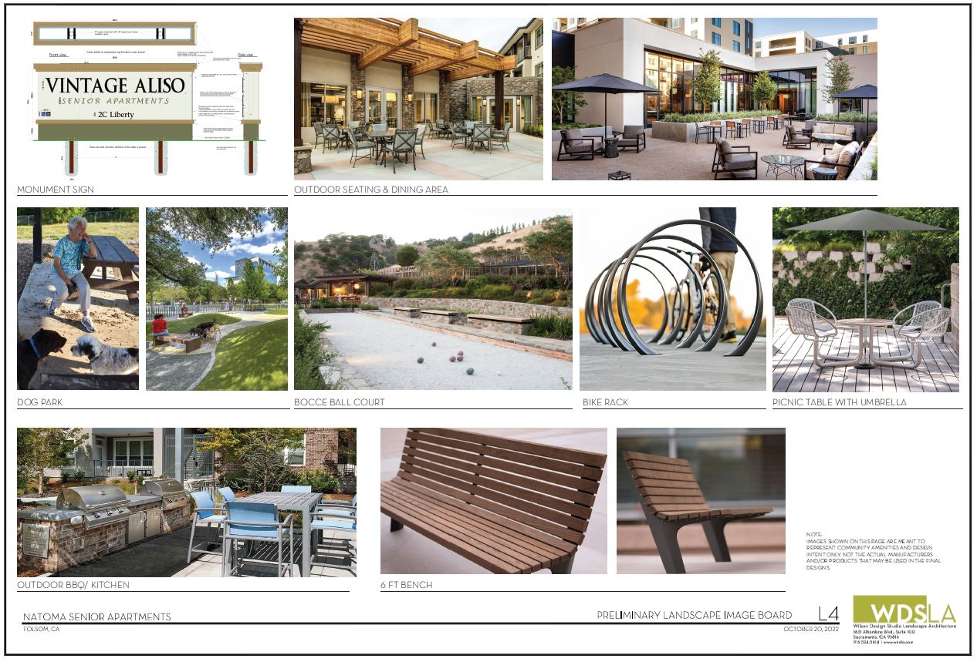
Site Details

Slide 62
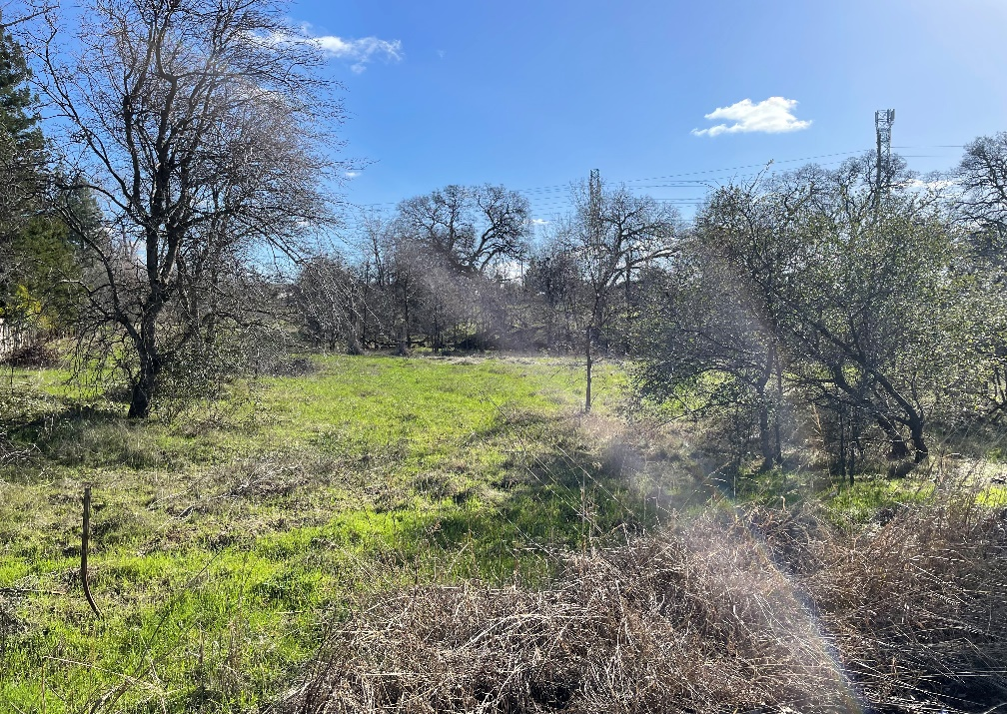
Existing/Proposed Landscaping
Existing Landscaping
Blue Oak Woodland with Non-Native Grasses
Proposed Landscaping
Combination of Drought-Tolerant Trees, Shrubs, and Groundcover
Project Meets Minimum Parking Lot Shade Requirements (51%)

Slide 63
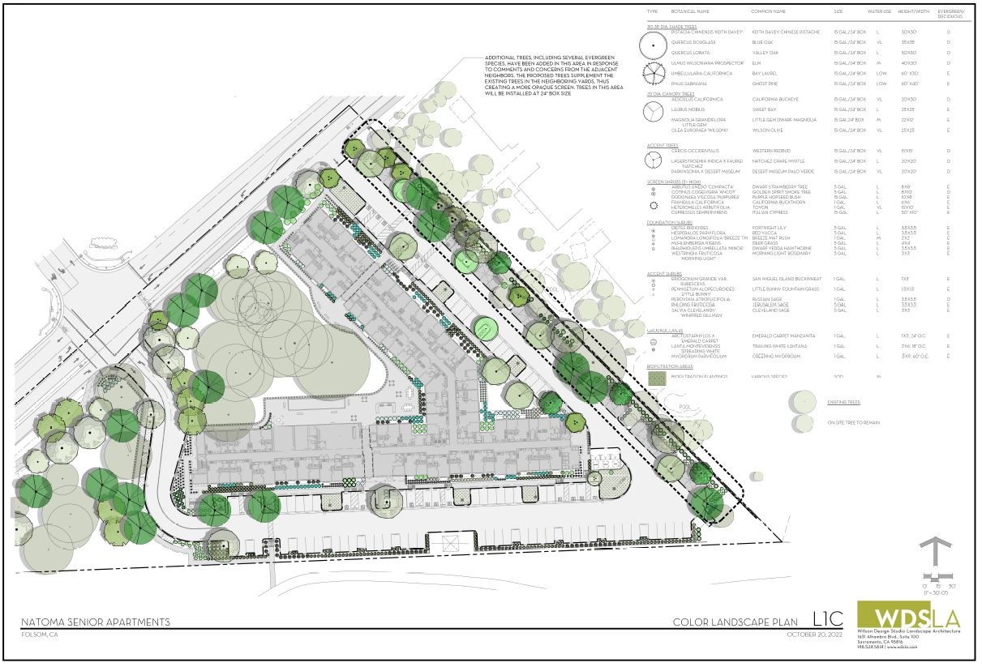
Proposed Landscape Plan

Slide 64
Oak Tree Preservation/Removal
Arborist Report and Oak Tree Inventory
78 Protected Oak Trees (6-Inch Diameter or Greater) Identified on Project Site
9 Oak Trees in Poor Health or Dead are Recommended for Removal
47 Oak Trees Proposed for Removal
31 Oak Trees to be Preserved
Oak Tree Mitigation
Applicant Proposing to Pay In-Lieu Fee (City’s Tree Mitigation Bank)
30 Oaks Trees Proposed to be Planted in Parking Lot Area (Not Mitigation)

Slide 65
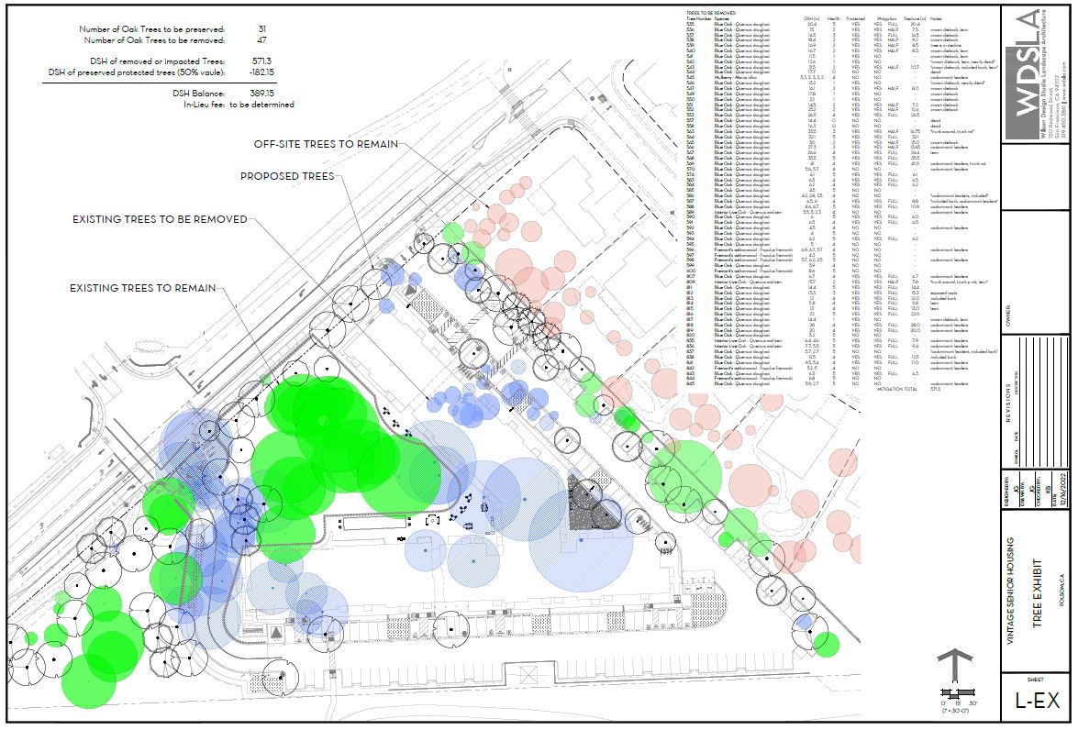
Oak Tree Preservation Plan

Slide 66
Public Outreach and Noticing
Public Outreach Meeting Held on March 22, 2022
Public Outreach Meeting Held on June 29, 2022
Public Notices Mailed on November 18, 2022 and December 1, 2022
Public Notice Published in Folsom Telegraph on November 10, 2022 and December 1, 2022
Large Project Identification Sign Placed on Site on July 6, 2022

Slide 67
Public Comments
Public Comments (Verbal and Written)
Increased Traffic and Traffic-Safety Related Impacts
Adequacy of Parking being Provided
Noise Impacts Associated with Emergency Service Vehicles
Noise Concerns Associated with Construction of Project
Trash/Recycling Collection and Potential Noise and Odor Impacts
Lighting and Glare Impacts
Low-Income Nature of Project and Potential Impact to Home Values
Oak Tree Impacts
Negative Visual Impacts
Impacts to Birds and Bird Habitat (Yellow Billed Magpie)

Slide 68
Environmental Review
California Environmental Quality Act (CEQA)
Initial Study, Mitigated Negative Declaration, and Mitigation Monitoring Program
Specific Subject Areas (Aesthetics, Agriculture, Air Quality, Biological Resources, Cultural Resources, Geology, Greenhouse Gas Emissions, Hazards, Hydrology, Land Use, Mineral Resources, Noise, Population and Housing, Public Services, Recreation, Transportation, Tribal Cultural Resources, Utilities, and Mandatory Findings of Significance
Mitigation Measures Included as Conditions of Approval (17 Measures)
Yellow-Billed Magpie
Does not have Special Species Status
Mitigation Prescribed Per Migratory Bird Protection Act (Included as Condition)
Magpie Habitat on Project Site is not Considered Protected (Vast Oak Woodland to North)

Slide 69
Environmental Review
Mitigation Measures
Avoid and Minimize Impacts to Nesting Birds
Avoid and Minimize Impacts to Jurisdictional Wetland and Waters
Avoid and Minimize Impacts to Protected Trees
Implement Recommendations of Geotechnical Engineering Survey
Identify Paleontological Resources During Construction
Construction Hours and Scheduling
Noise and Vibratory Roller
Limit Vehicle Access to Secondary Project Driveway (Eastern Driveway)
Unanticipated Discovery of Tribal Cultural Resources
Water Efficiency and Conservation Measures

Slide 70
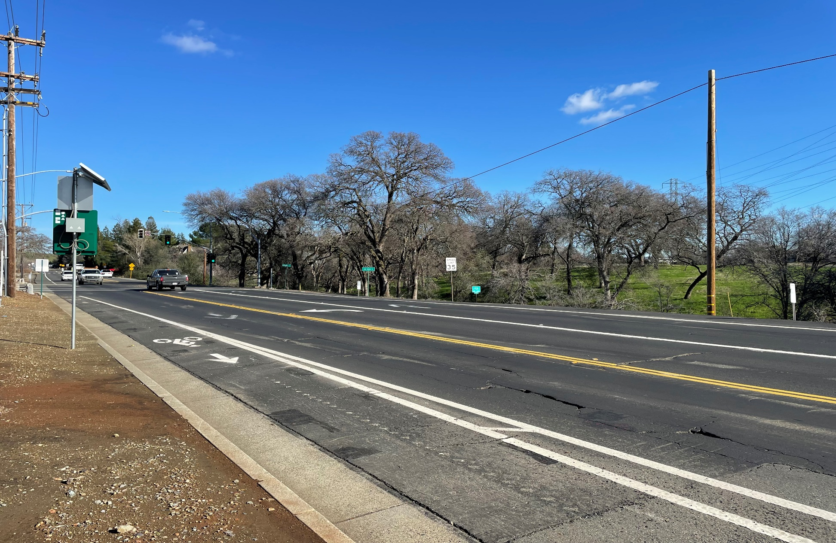
Site Photographs

Slide 71
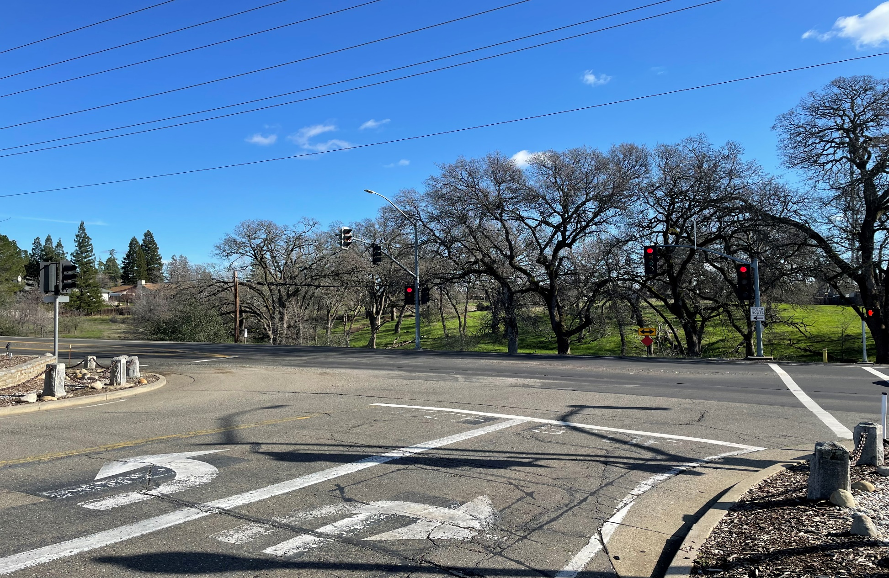
Site Photographs

Slide 72
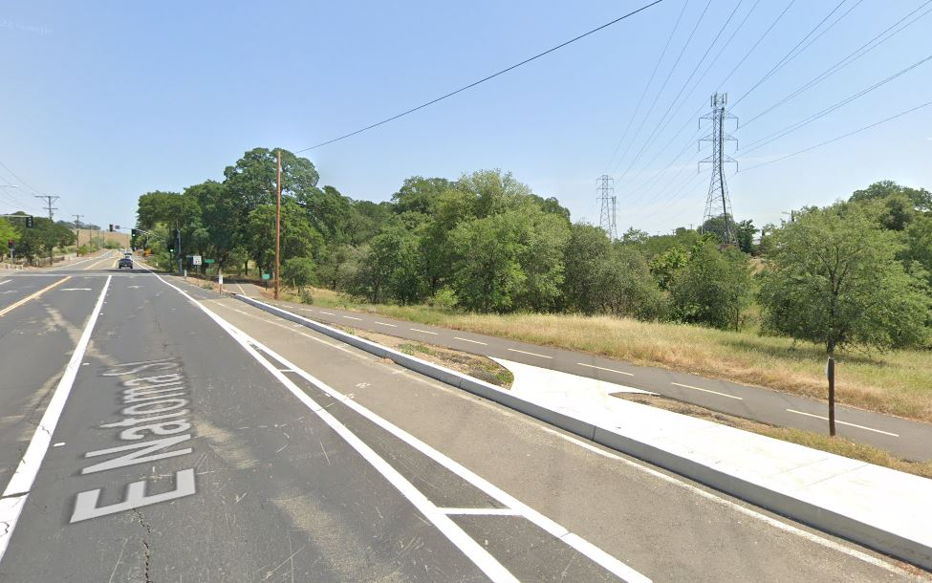
Site Photographs

Slide 73
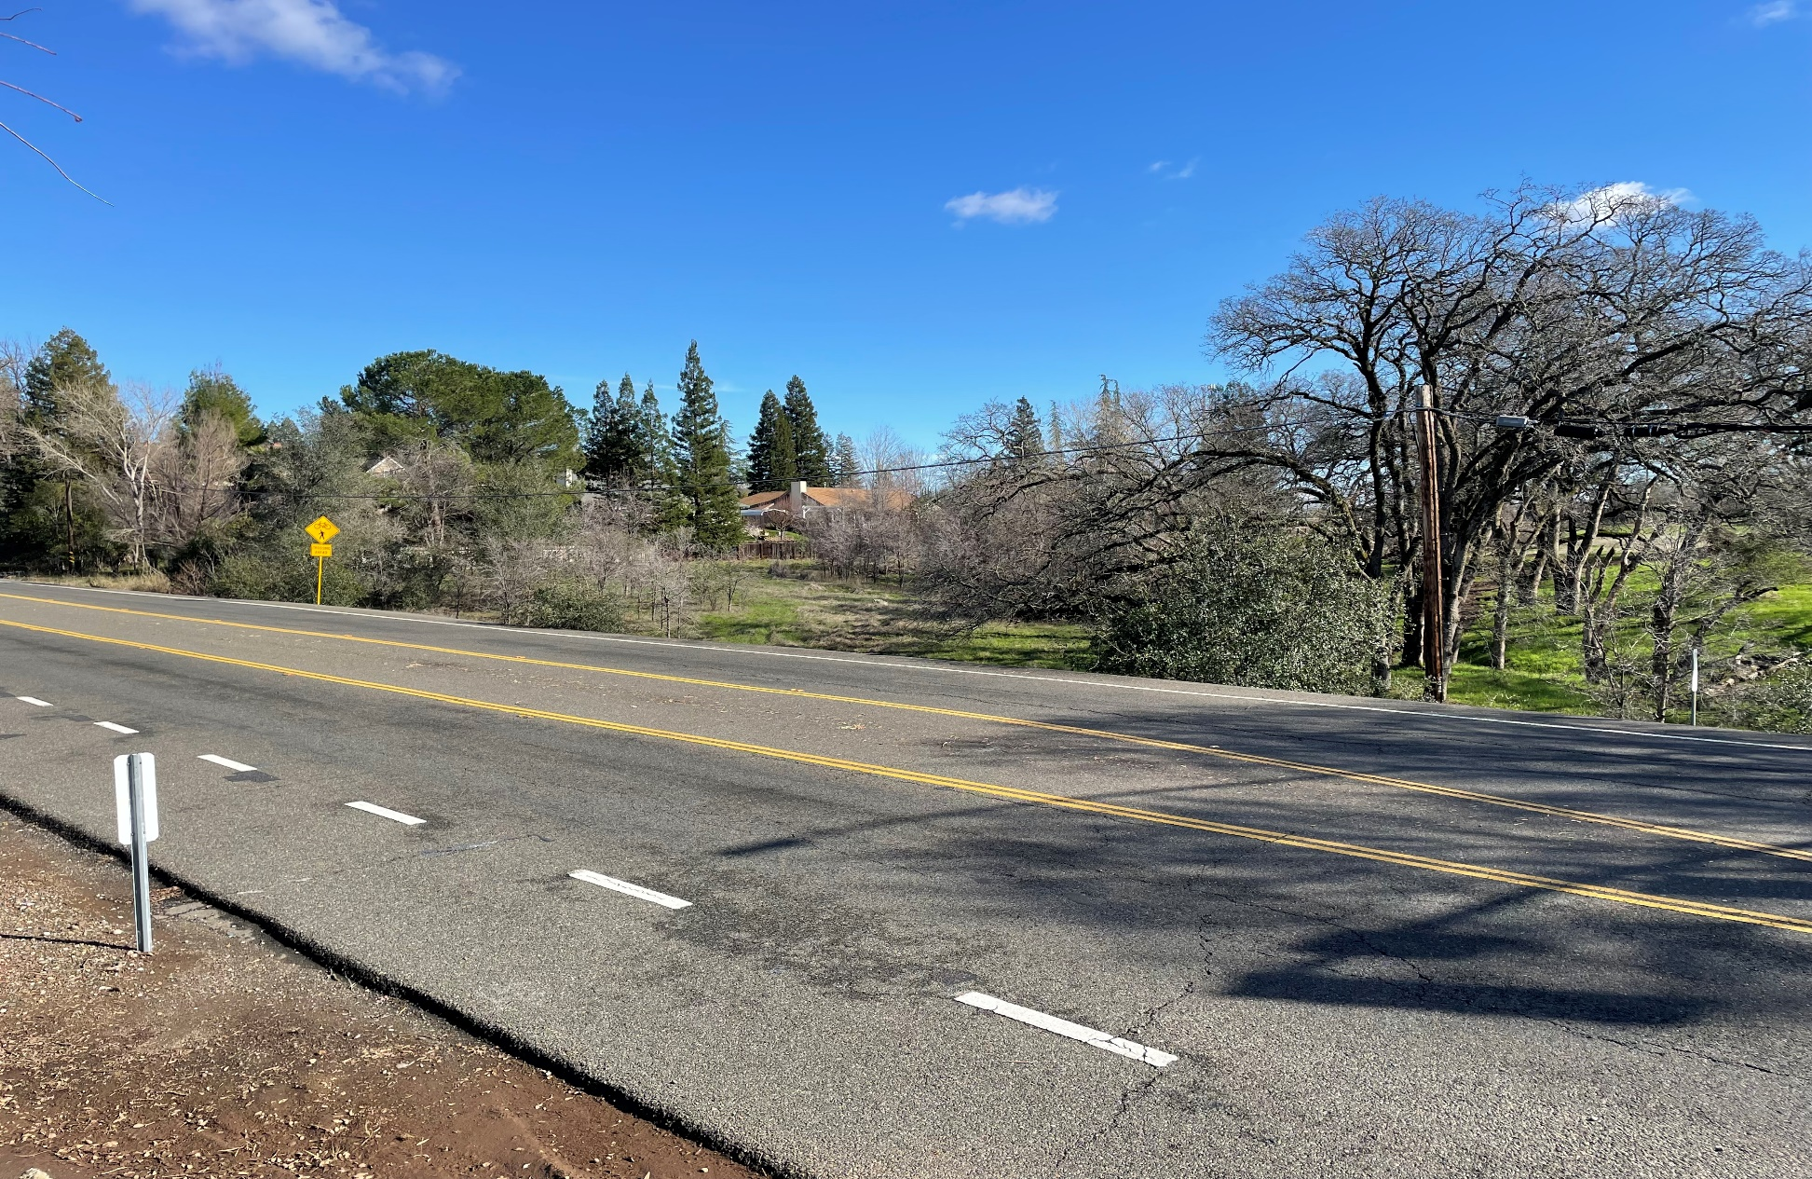
Site Photographs

Slide 74
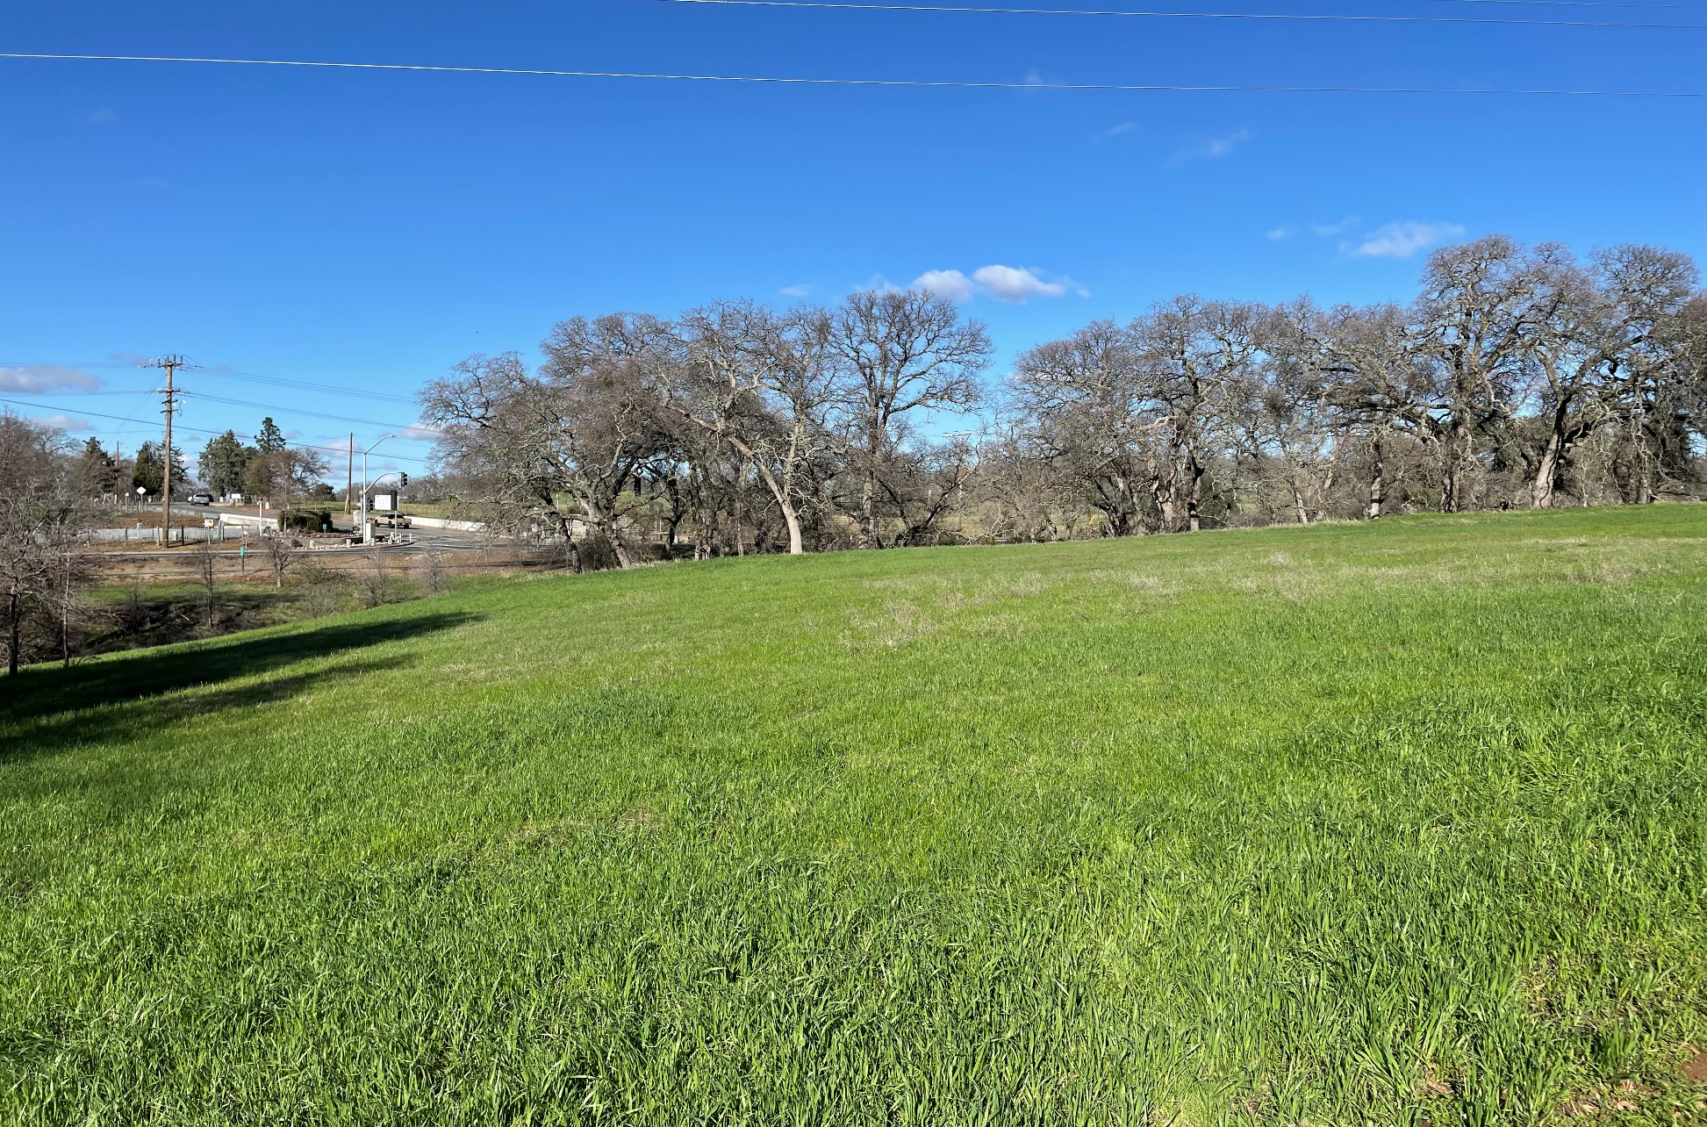
Site Photographs

Slide 75
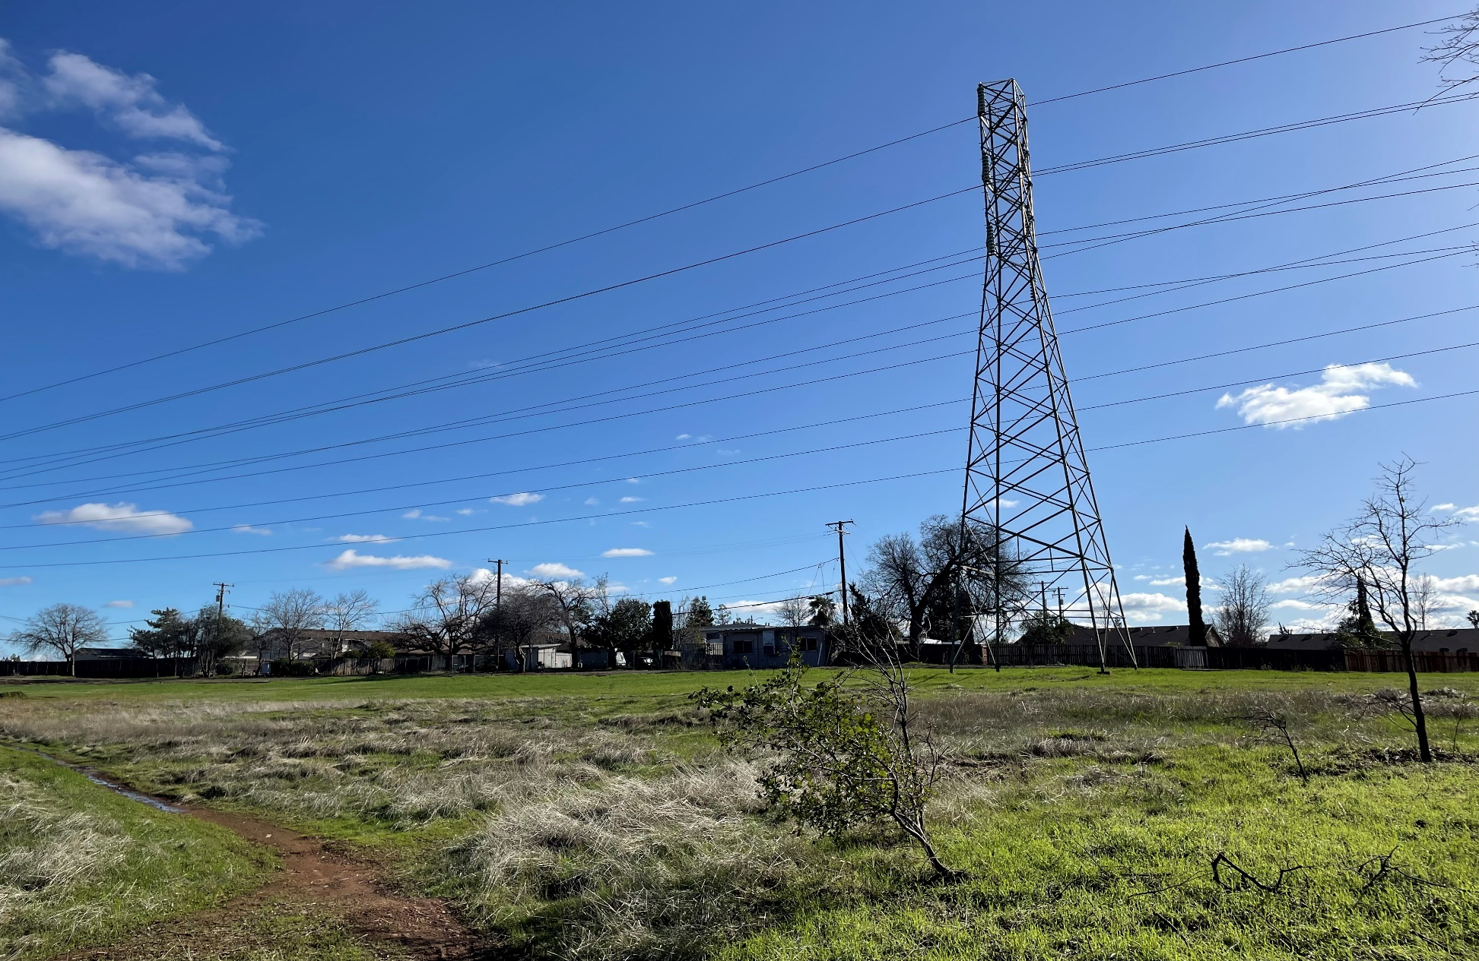
Site Photographs

Slide 76
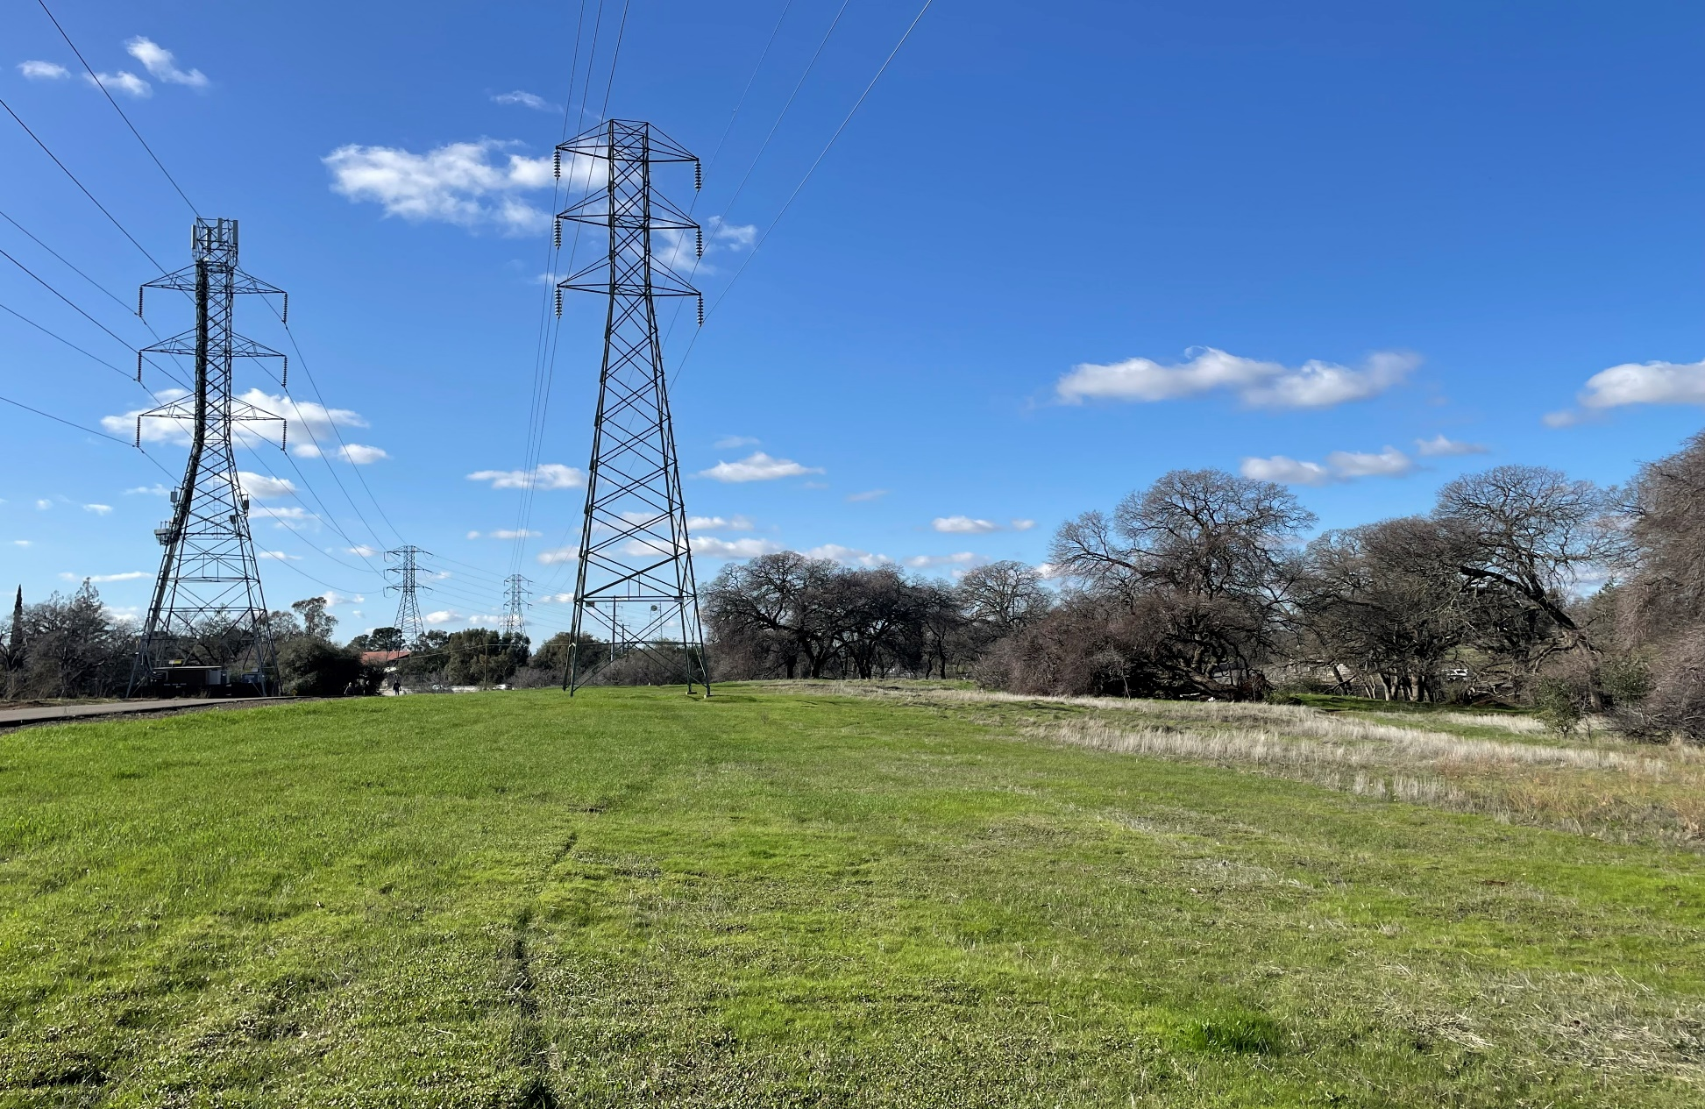
Site Photographs

Slide 77
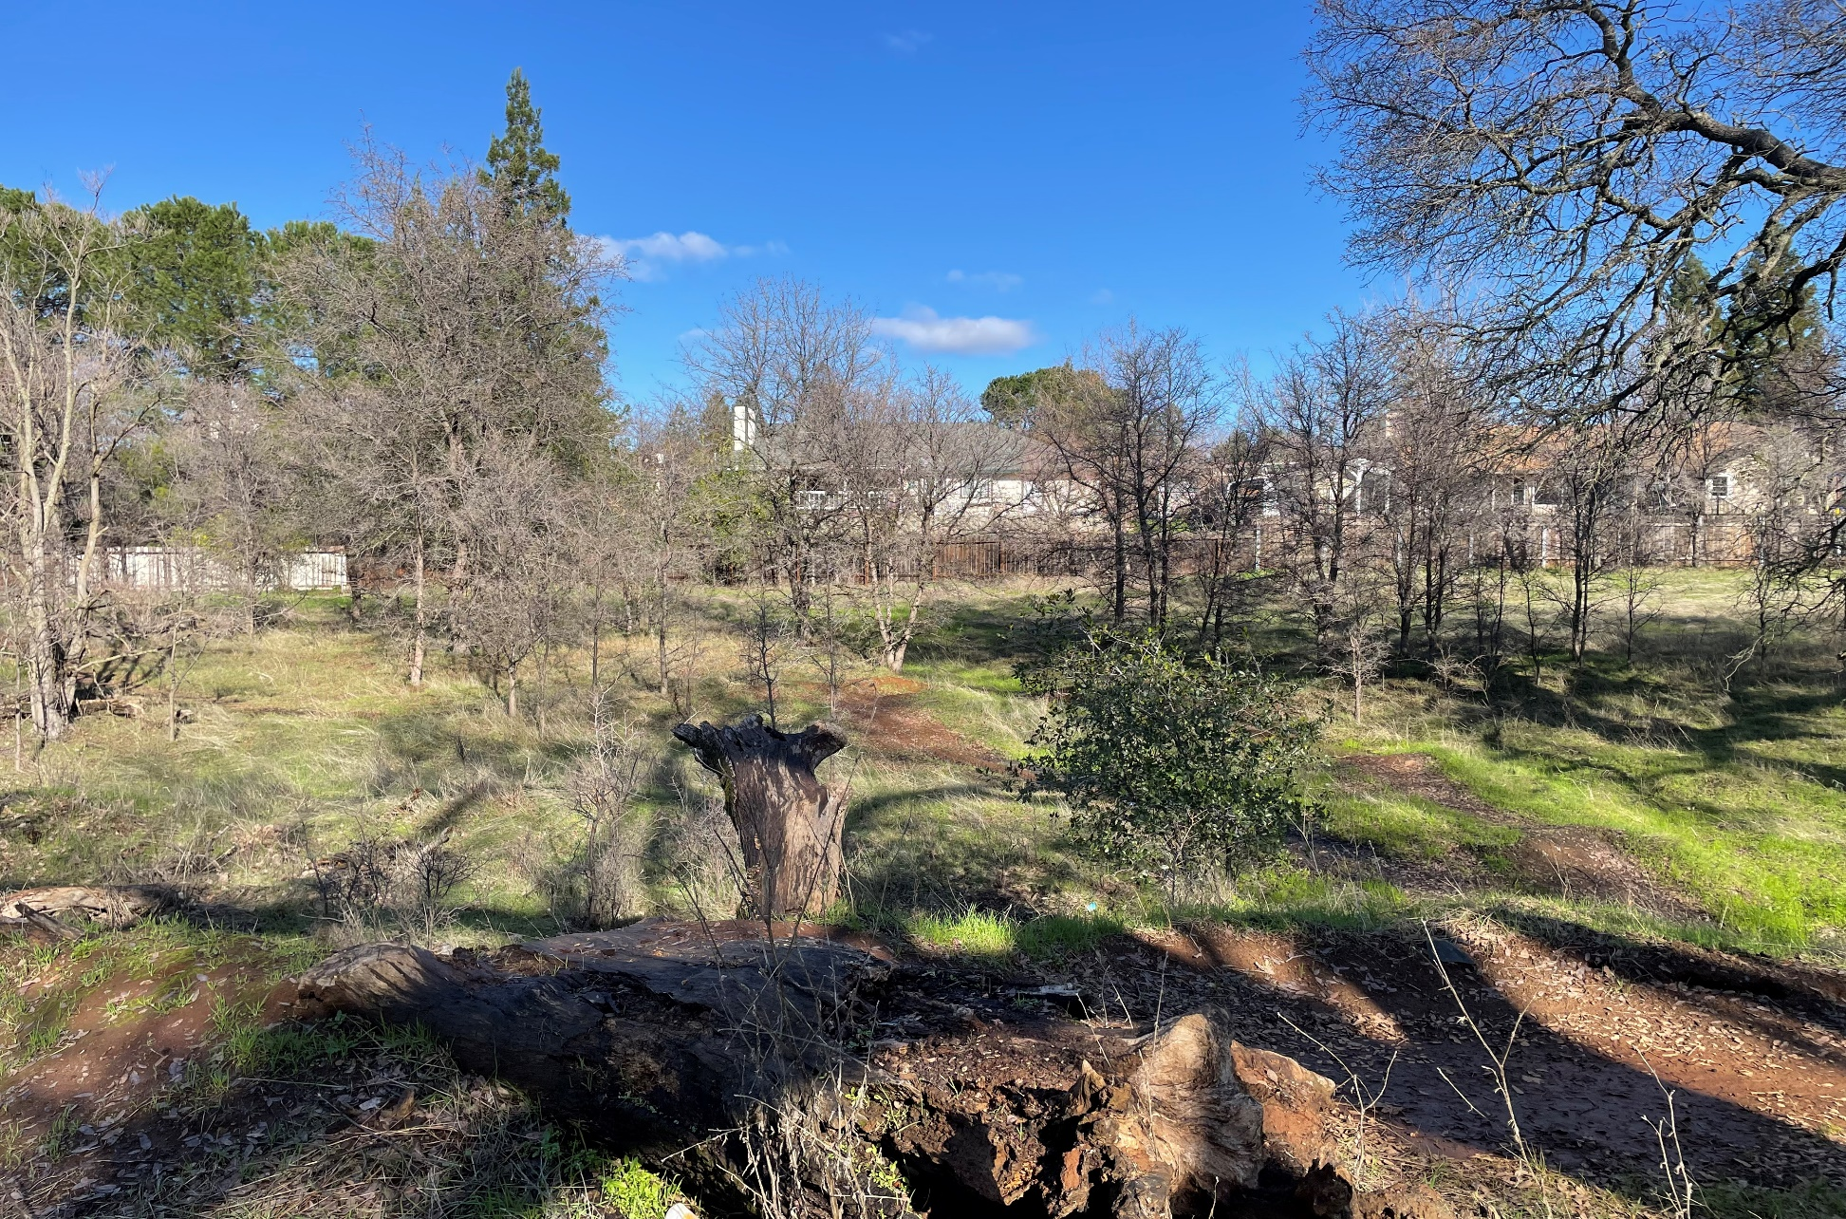
Site Photographs

Slide 78
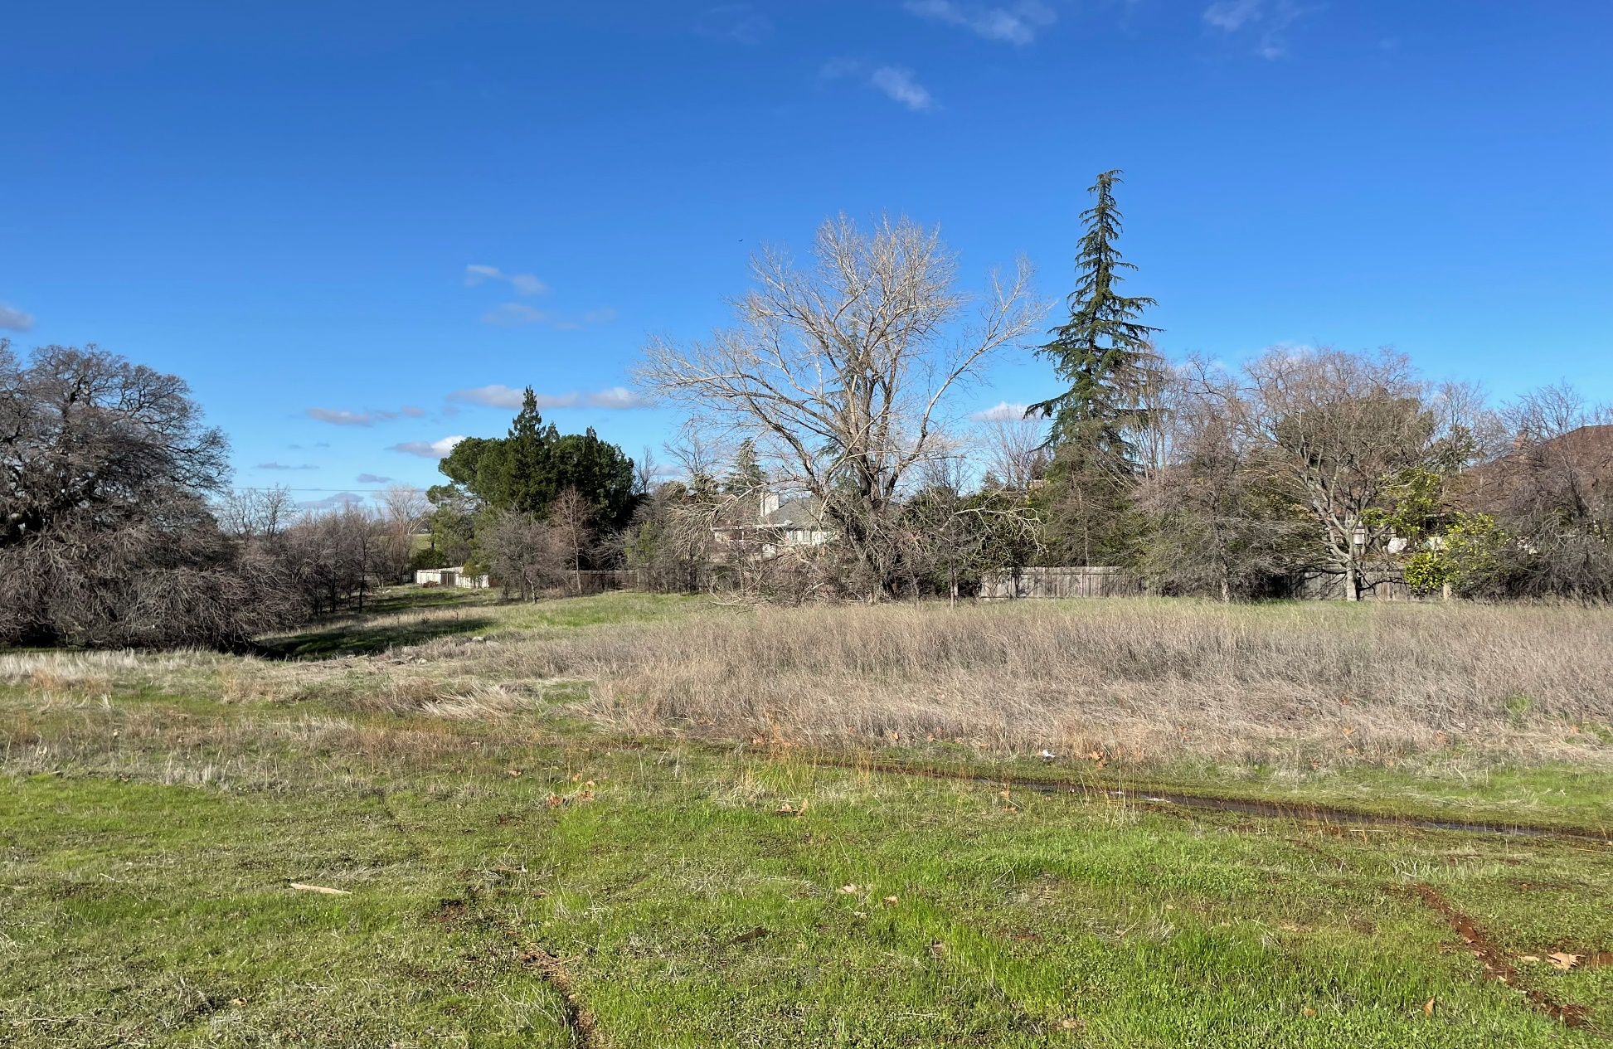
Site Photographs

Slide 79
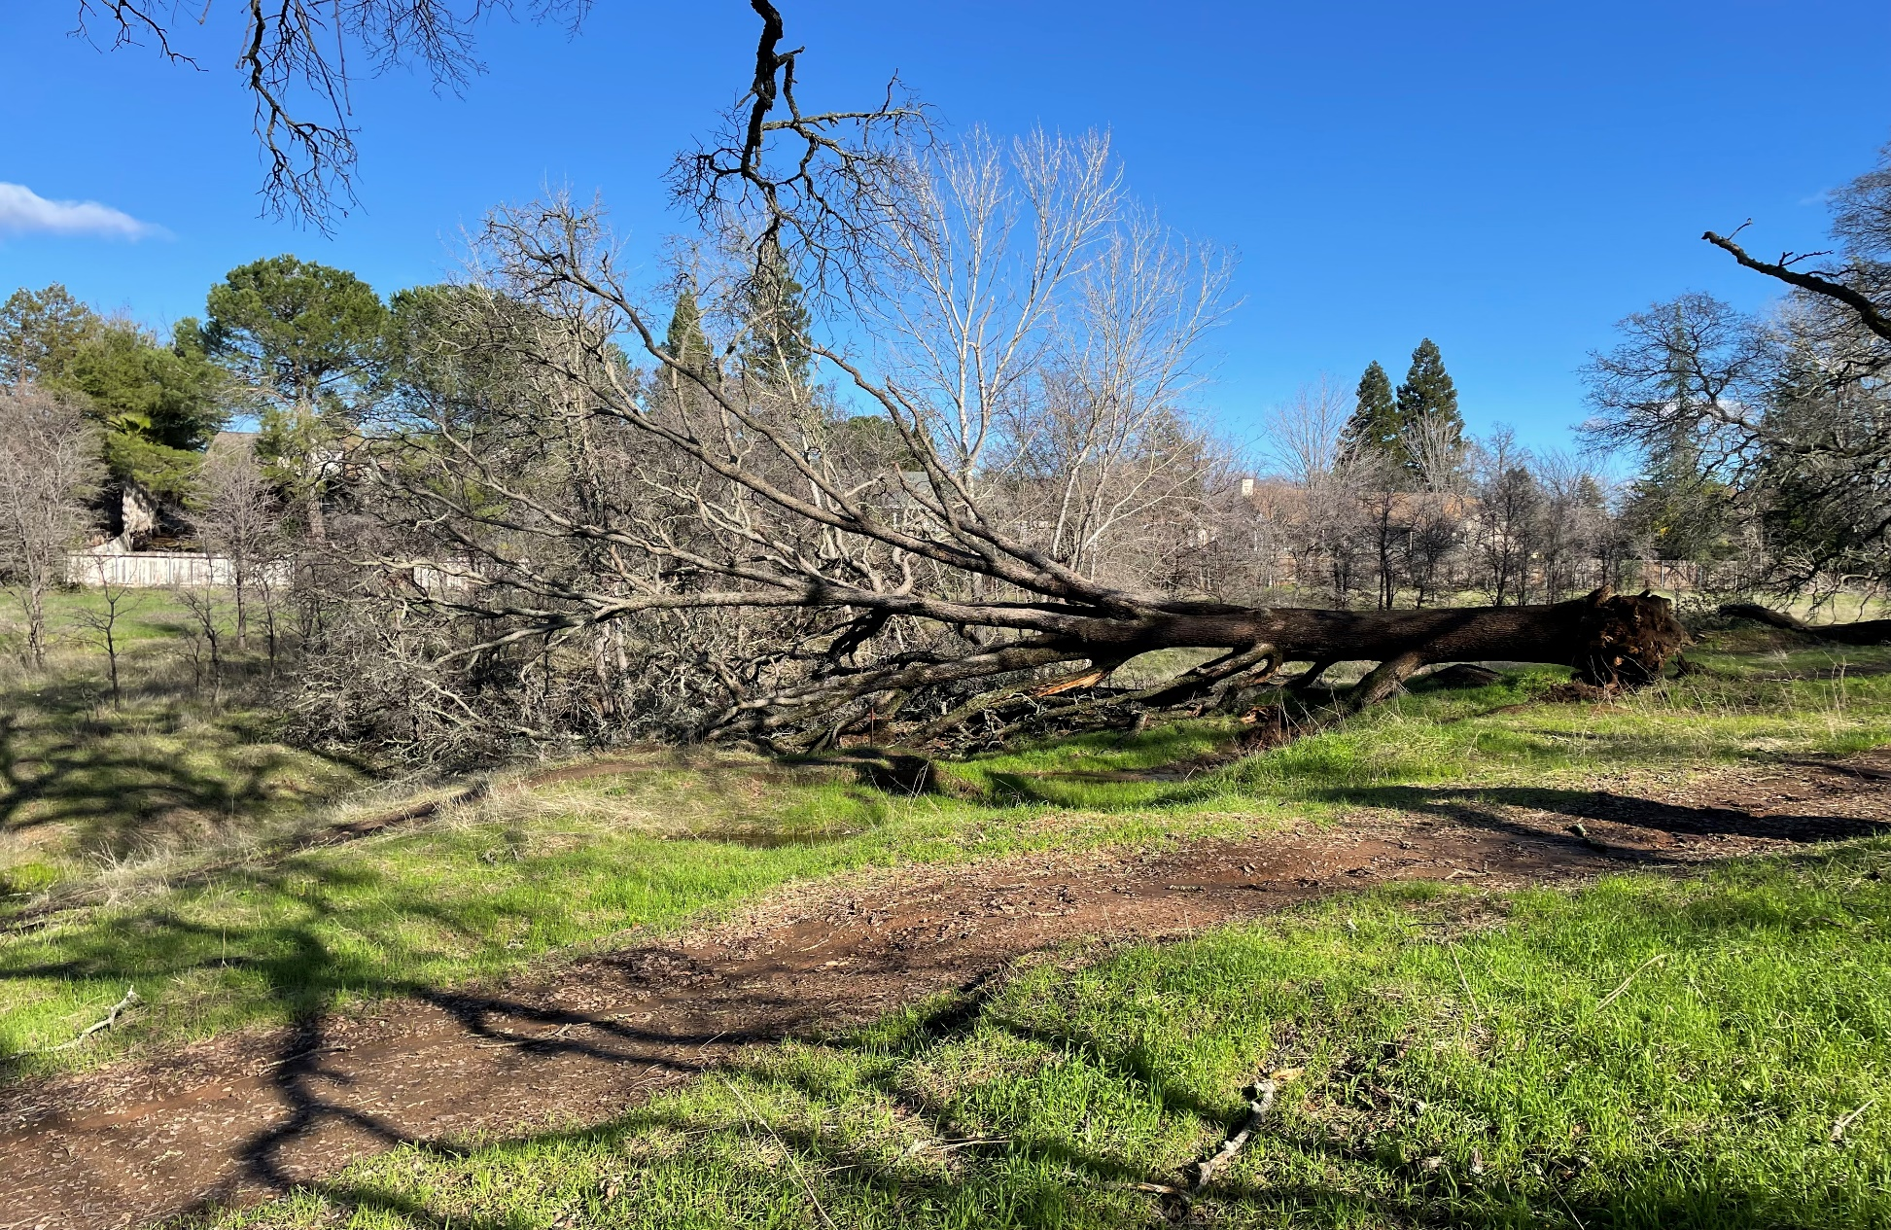
Site Photographs

Slide 80
Staff Recommendation
Staff Recommends
Planning Commission Approval of the Vintage Senior Apartments Conditional Use Permit, Planned Development Permit, and Density Bonus

Slide 81
Findings for Denial
Typical Finding for Denial for Conditional Use Permit
The establishment, maintenance or operation of the use or building applied for will, under the circumstances of the particular case, be detrimental to the health, safety, peace, morals, comfort and general welfare of persons residing or working in the neighborhood of such proposed use, or be detrimental or injurious to property and improvements in the neighborhood, or to the general welfare of the city because_______________
Two Additional Findings (Pursuant to Housing Accountability Act)
The housing development project as proposed would have a specific, adverse impact upon the public health or safety, because ______________________
There is no feasible method to satisfactorily mitigate or avoid the specific adverse impact without rendering the development unaffordable to low and moderate households because _________________________

Slide 82
Findings for Denial
Pursuant to the Housing Accountability Act, Government Code § 65589.5(d)(2), “specific adverse impact” means a significant, quantifiable, direct, and unavoidable impact, based on objective, identified written public health or safety standards, policies, or conditions as they existed on the date the application was deemed complete. The following shall not constitute a specific adverse impact upon the public health or safety:
Inconsistency with the zoning ordinance or general plan land use designation.
The eligibility to claim a welfare exemption under Revenue and Taxation Code section 214(g).

