Slide 1
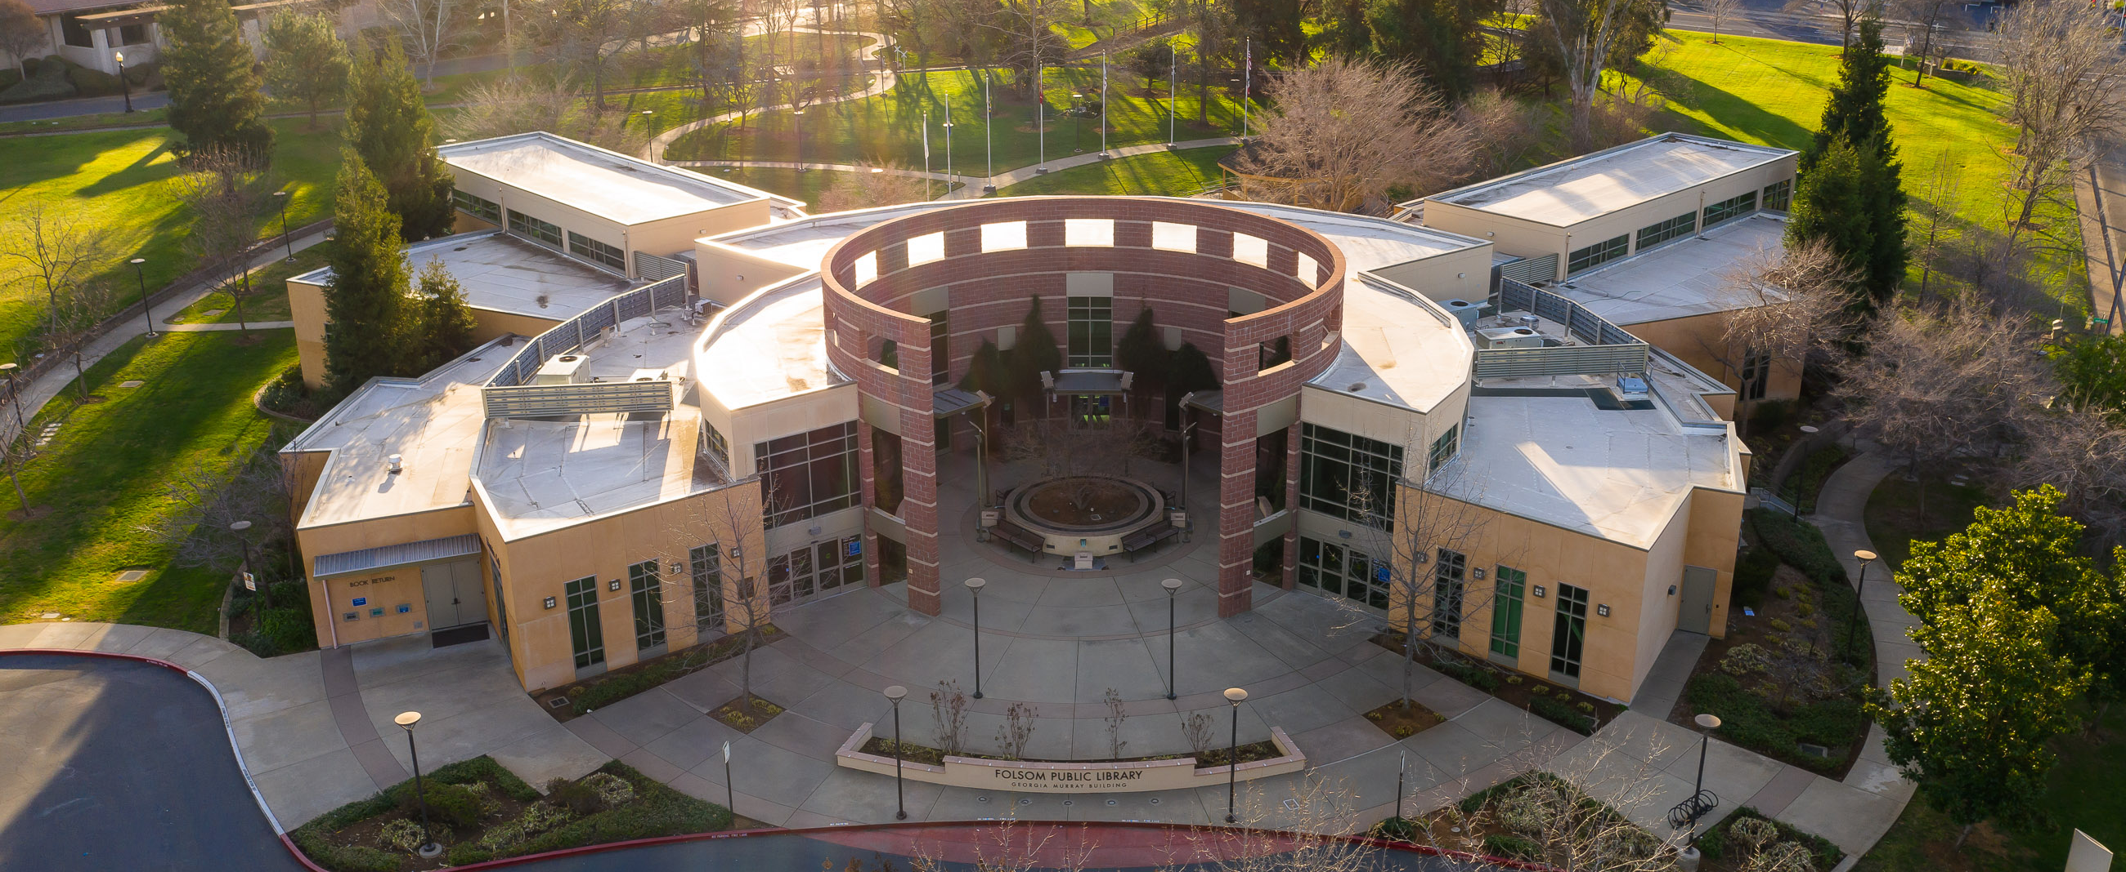
Fee Schedule Update: FPL Fine Free
Presentation to the Folsom City Council – July 11, 2023

Slide 2
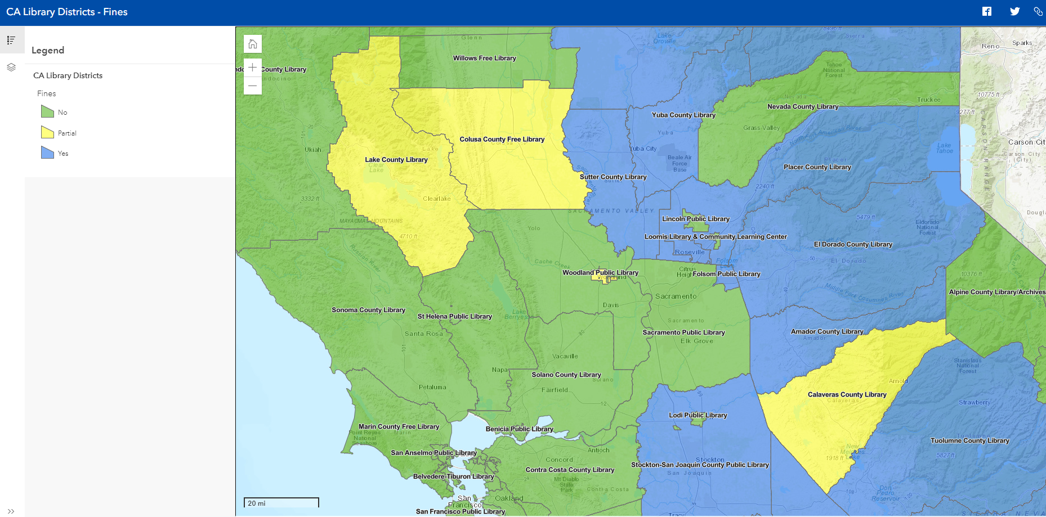
Regional Best Practice Adoption
Notes:
CA Library Districts - Fines (folsom.ca.us)
ALA CD 38 RESOLUTION ON MONETARY LIBRARY FINES AS A FORM OF SOCIAL JUSTICE Revised 1_27_0.pdf

Slide 3
Fine-Free Results
Equivalent overdue activity
Higher return rate for overdue items
Increase in number of new library patrons
Increase in circulation of library materials
Improved patron relationships
Optimized staff time and efficiencies
Notes:
Removing Barriers (state.co.us)
sfpl.org/sites/default/files/2020-02/Fine-Free-Report011719.pdf

Slide 4
Local Impact of Fines

Slide 5
Fine-Free Libraries in Sacramento
Arcade ✔ | Fair Oaks ✔ | Orangevale ✔
Arden-Dimick ✔ | Folsom X | Pocket-Greenhaven ✔
Belle Cooledge ✔ | Franklin ✔ | Rancho Cordova ✔
Carmichael ✔ | Galt ✔ | Rio Linda ✔
Central ✔ | Iselton ✔ | South Natomas ✔
Colonial Heights ✔ | Martin Luther King, Jr. ✔ | Southgate ✔
Courtland ✔ | McKinley ✔ | Sylvan Oaks ✔
Del Paso Heights ✔ | N. Highlands-Antelope ✔ | Valley Hi-N. Laguna ✔
Elk Grove ✔ | North Natomas ✔ | Walnut Grove ✔
Ella K. McClatchy ✔ | N. Sacramento-Hagginwood ✔

Slide 6
Questions?

