Slide 1
Landmark Tree Designations
Urban Forester Recommendations- Groves
Notes:
This is a follow up presentation on staff recommendations previously provided to council in October of last year on efforts to resurrect the city’s landmark tree program

Slide 2
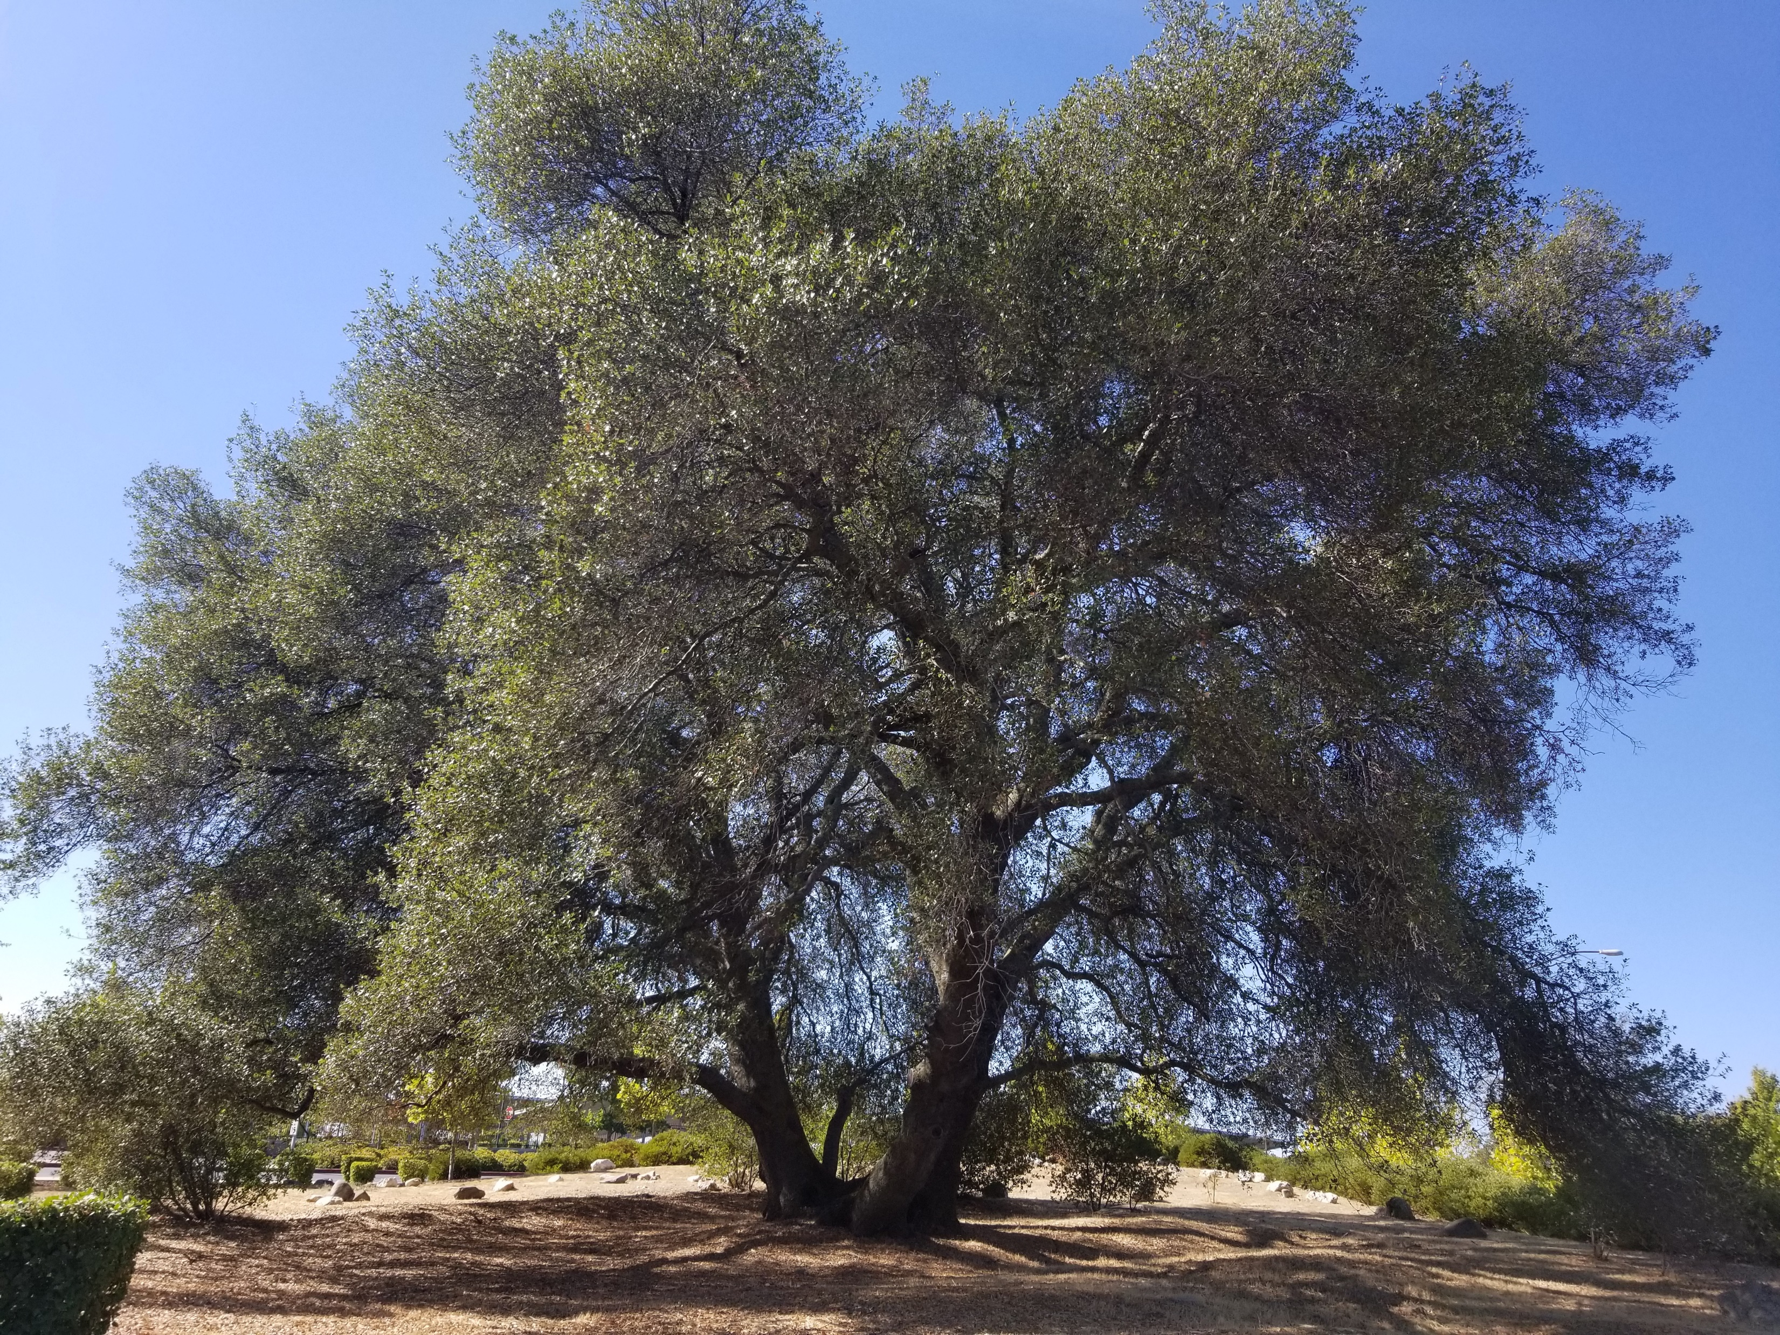
Current Landmark Tree Registry
Established in 1996
Recent revival effort after a 23-year dormancy
Interior live oak on CAISO Property (2022)
Valley oak on Sibley (2023)
Interior Live oak on Blue Ravine (2023)
Notes:
Quick recap on how this came about – Landmark Tree Registry began in 1996. Was active for a few years and then went dormant for more than 20 years. Recently there’s been a revival effort and in the last two years, we’ve added 3 new trees onto the registry.

Slide 3
What is a Landmark Tree?
FMC Chapter 12.16.170
Designated by City Council
Historical value
Outstanding habitat
Unusual species
Superior beauty
Notes:
As a reminder, a landmark tree is a tree designated by city council for being particularly remarkable, meeting one of these 4 findings.

Slide 4
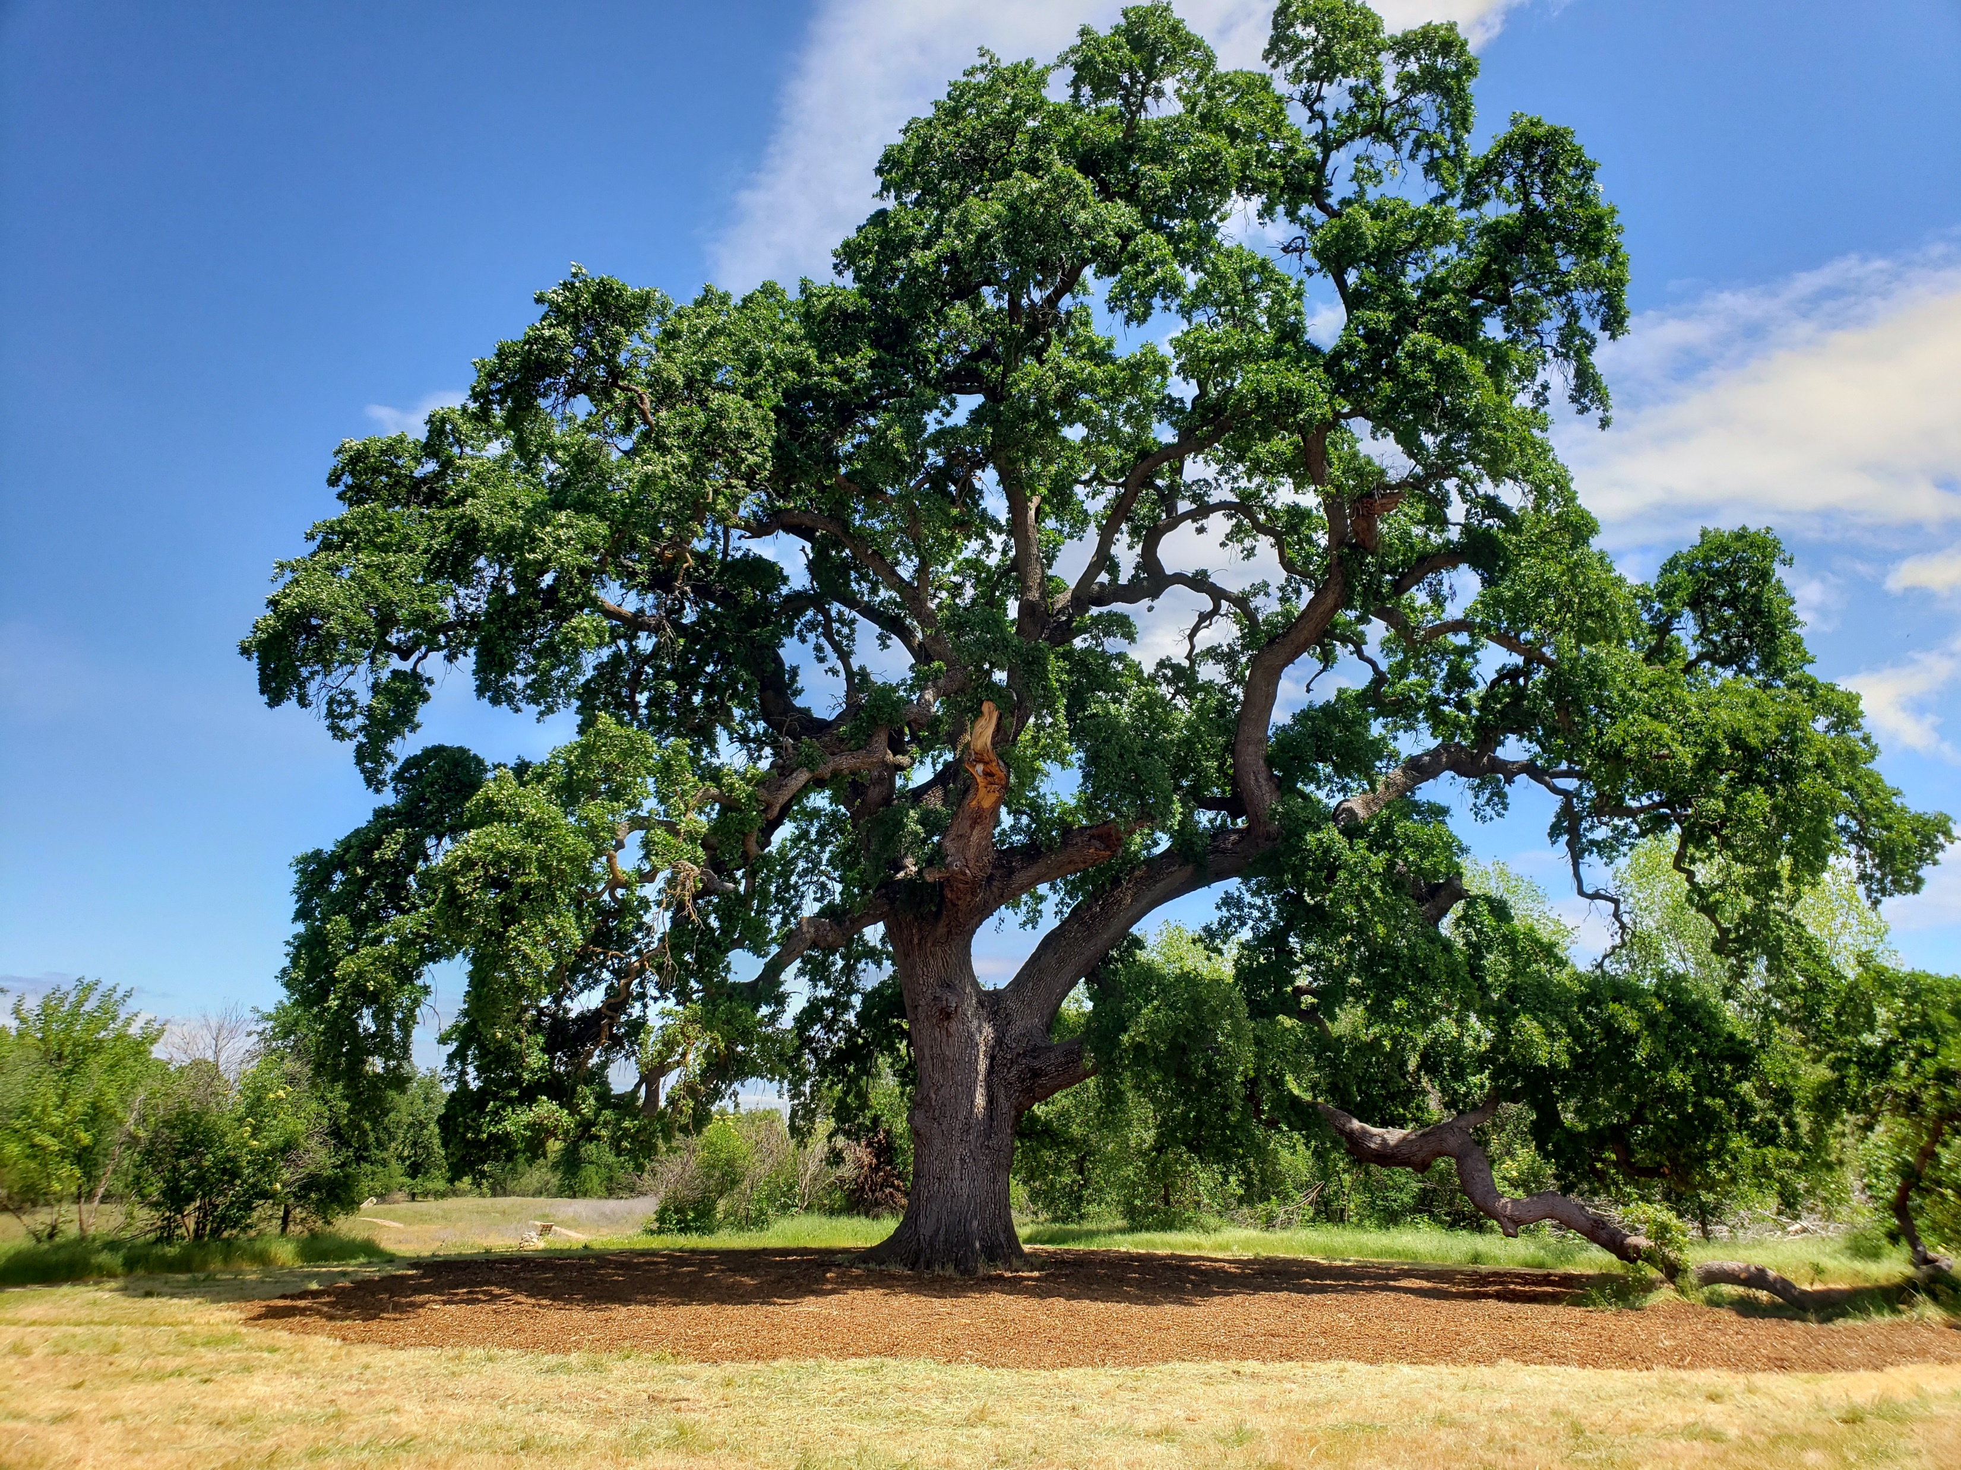
The Landmark Tree Program
Recognize ecological benefits
City Identity – “Distinctive by Nature”
Assessment and maintenance assistance from the city arborist using Tree Planting and Replacement Fund
Any request for removal requires declassification by the City Council
Notes:
Purpose of the program – recognize that large trees are quantifiable assets to the environment, property values and human health. The bigger the tree, the bigger the benefit… and the cost of maintenance. The LMT program sheds brings attention to the value of trees and also provides assistance to owners for maintenance costs if CC deems a tree worthy of the registry.

Slide 5
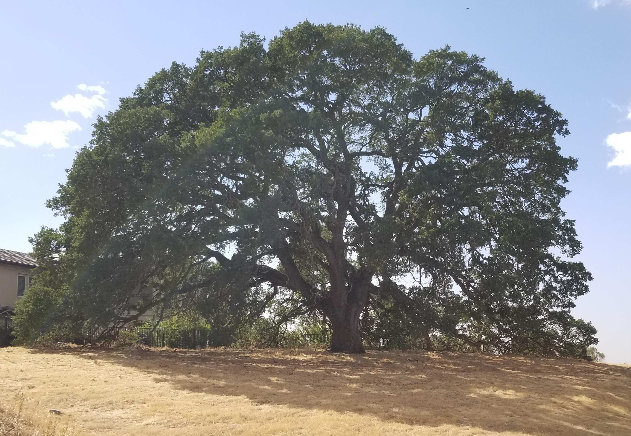
Application Process – Two Options
Owner submission of an application and $280 fee
OR
The City Council may on its own motion and without the payment of the application fee, commence the process of designating a landmark tree

Slide 6
Landmark Tree Candidates
Updates per City Council Request
Notes:
At request of CC, staff have been exploring the potential of 2 particular groves to add onto the landmark registry.

Slide 7
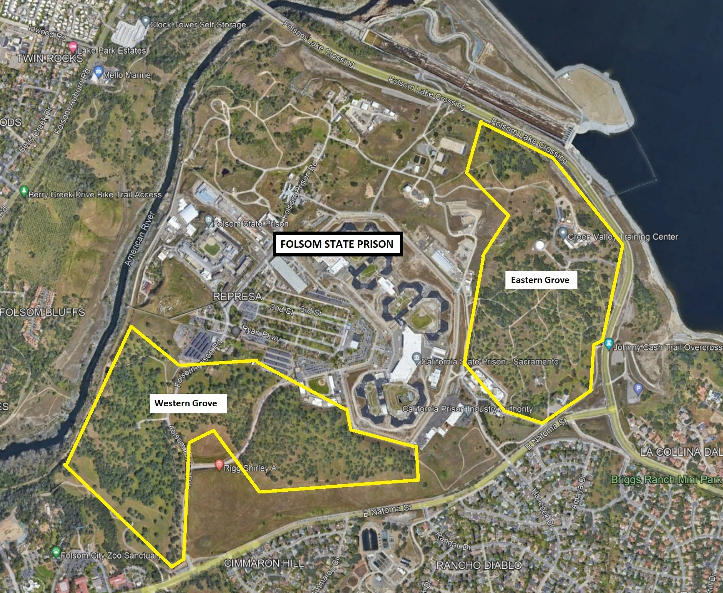
250 acres (cumulative)
Primarily oaks w/other natives
Considerations for Landmark Status:
Historical value
Outstanding habitat value
Superior beauty
Candidate #1 – The Folsom Prison Grove
Notes:
I would suggest that 3 of the 4 findings apply here.

Slide 8
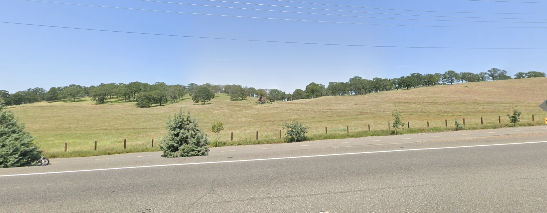
Candidate #1 – The Folsom Prison Grove

Slide 9
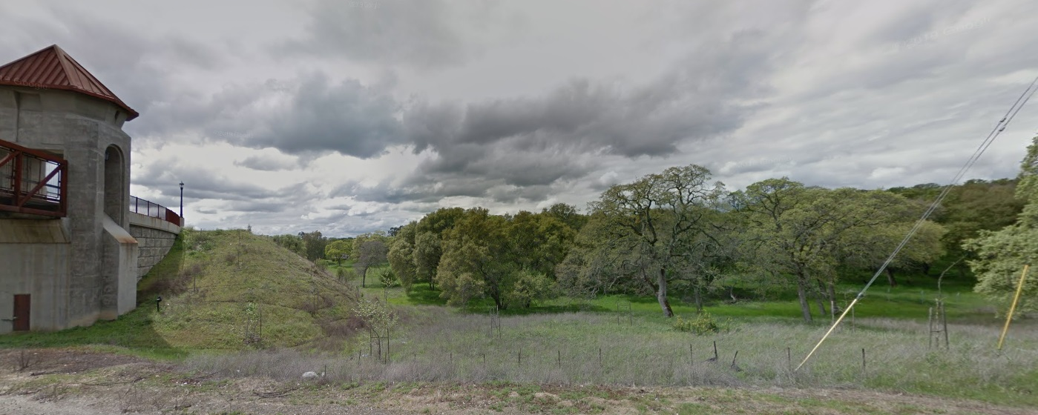
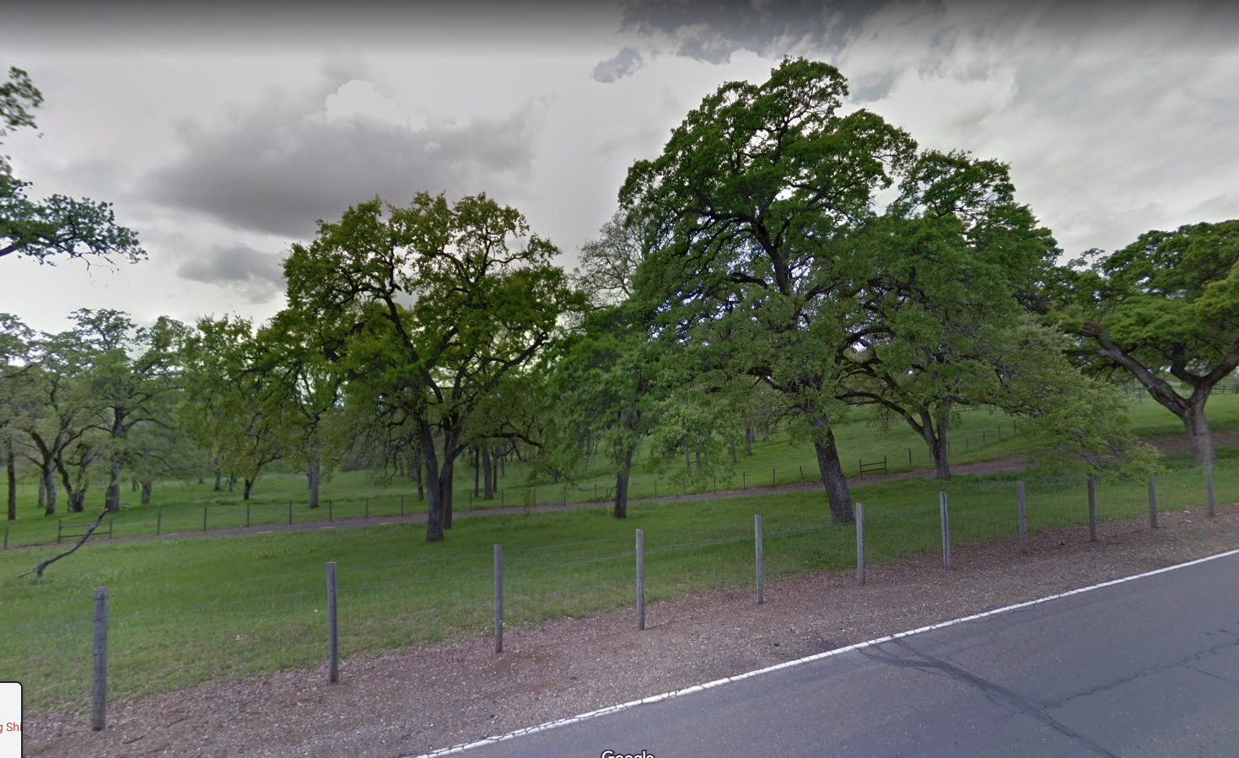
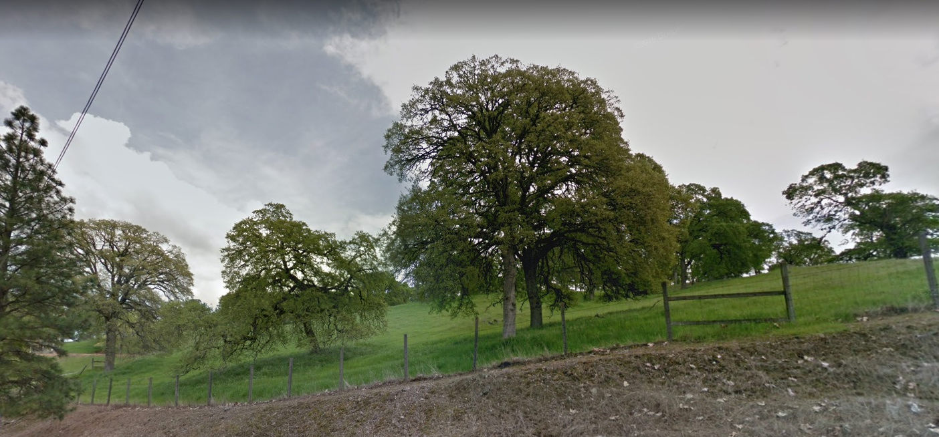
Candidate #1 – The Folsom Prison Grove

Slide 10
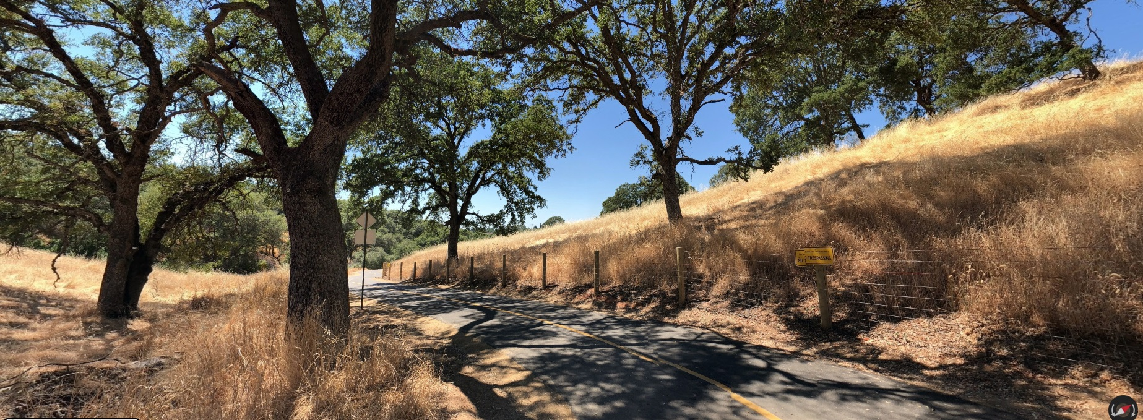
Candidate #1 – The Folsom Prison Grove

Slide 11
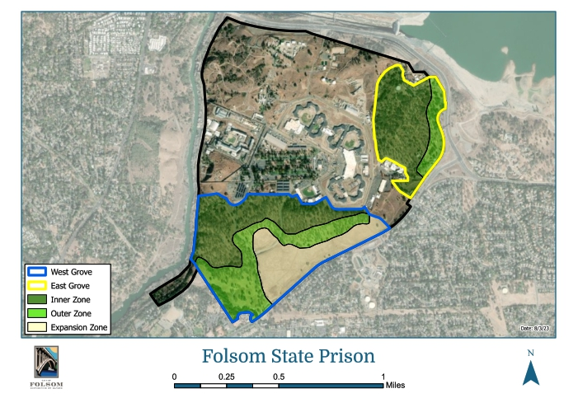
PRISON GROVE ZONES
Zone | Description | Opportunities?
Inner | Not visible from the ROW or along public trails, but contribute to the overall habitat value of the grove | Aerial canopy survey to identify and track overall size, species distribution, and health of the grove.
Outer | Trees visible from the public ROW and within 50’ of a public trail | Tree survey (either professional ($$$) or volunteer driven) City assistance with arboricultural consulting and pruning
Expansion | Open, non-treed area visible from E Natoma St where additional oaks could be planted to expand the grove | Volunteer tree planting events Partnerships with CDCR, community members and non-profits
Candidate #1 – The Folsom Prison Grove
Notes:
This here is just some fun I was having with Assistant Planner nathan Stroud.

Slide 12
Considerations
Owner consent
CDCR has expressed agreement for Council to execute FMC 12.16.170(A)(1) to commence a Landmark Grove designation
Applicable Findings
Historical Value
Outstanding Habitat
Superior Beauty
Financial Impact for the City
One time $280 application fee waived
Staff time (annual inspection by City Arborist at owner request)
Potential future tree plantings (volunteer involvement)
Notes:
California Department of Corrections and Rehabilitation

Slide 13
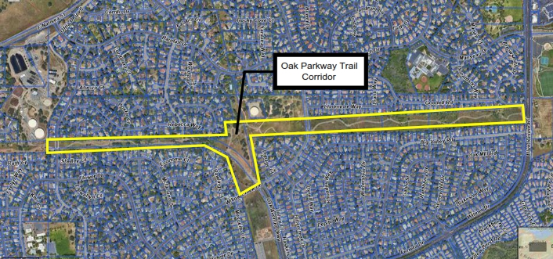
Blue and interior live oaks along the Oak Parkway Trail
Approximately 1.5 miles
Considerations for Landmark Status:
Habitat value
Superior beauty
Unusual species
Candidate #2 – The Oak Parkway Corridor

Slide 14
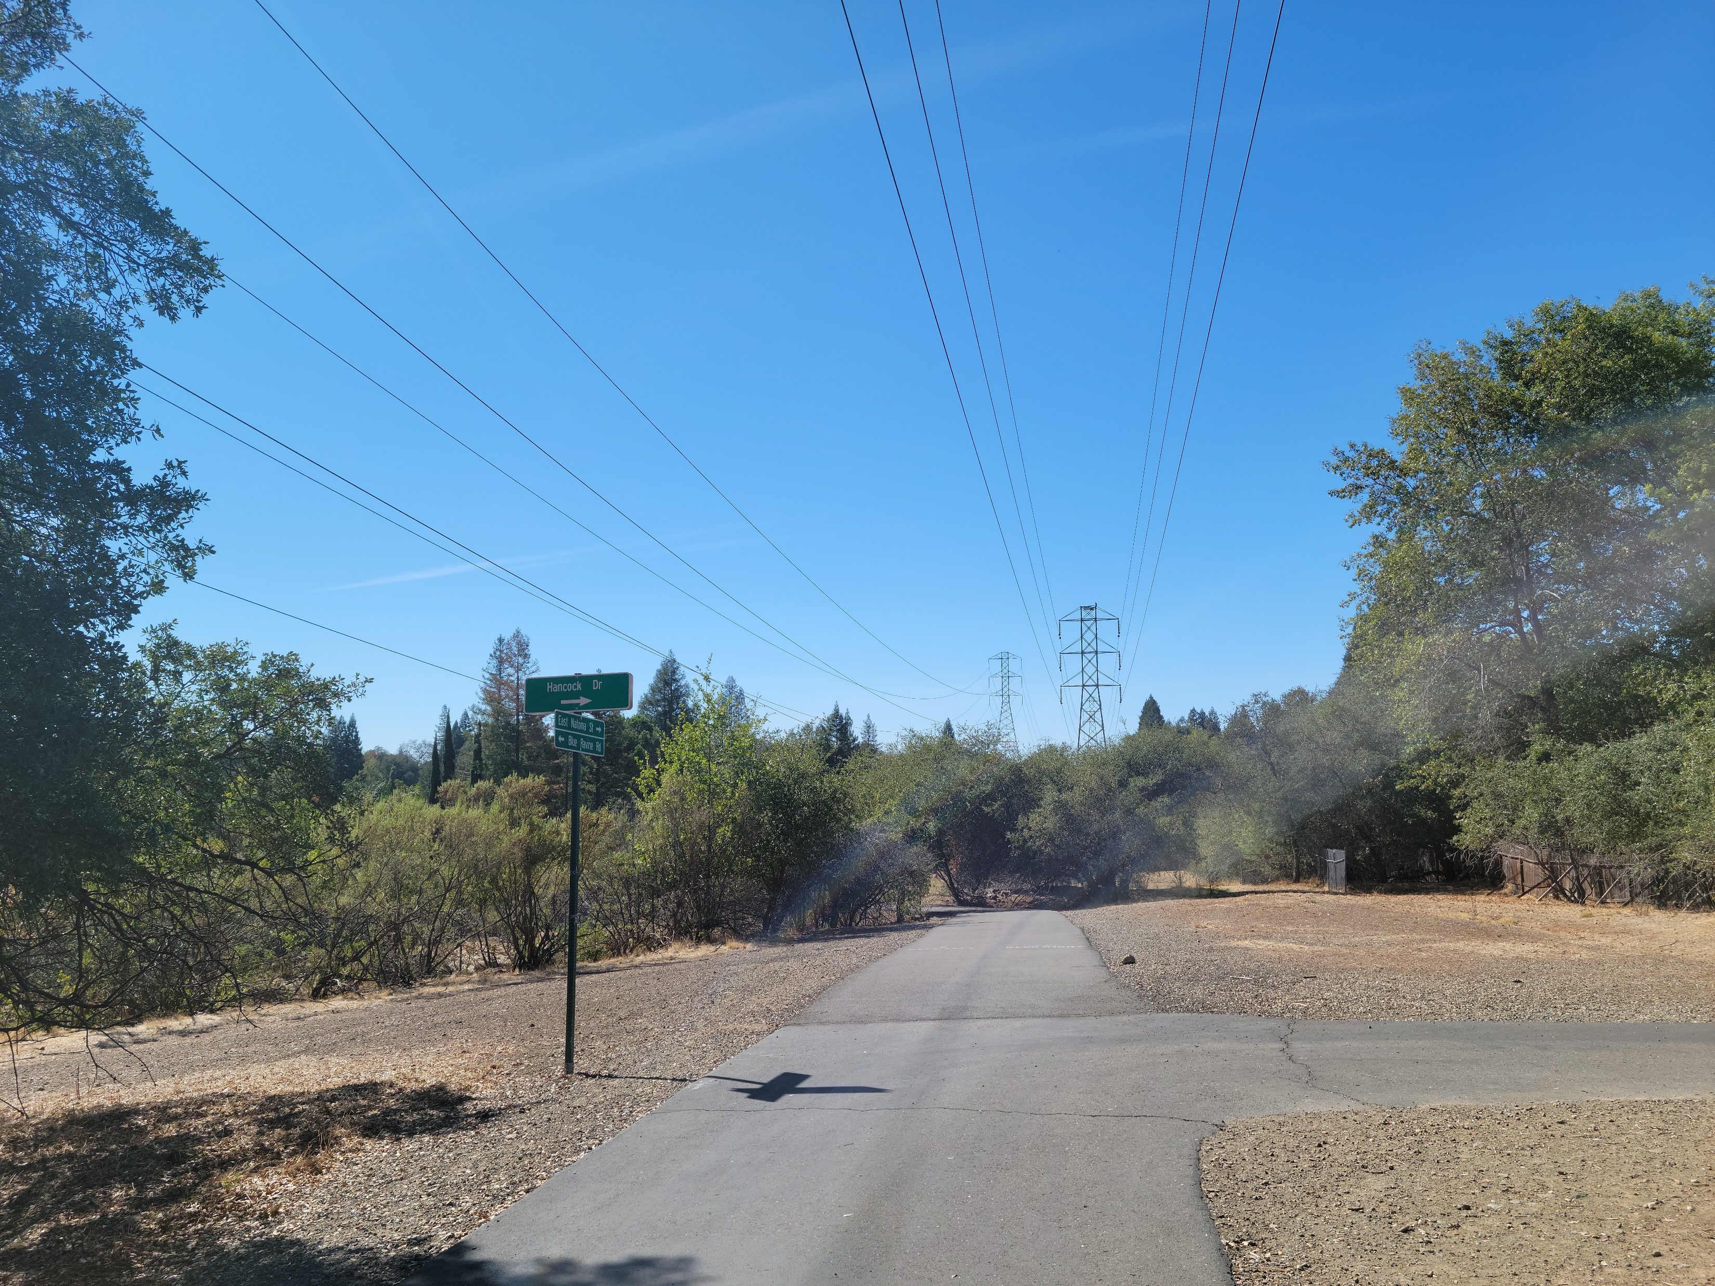
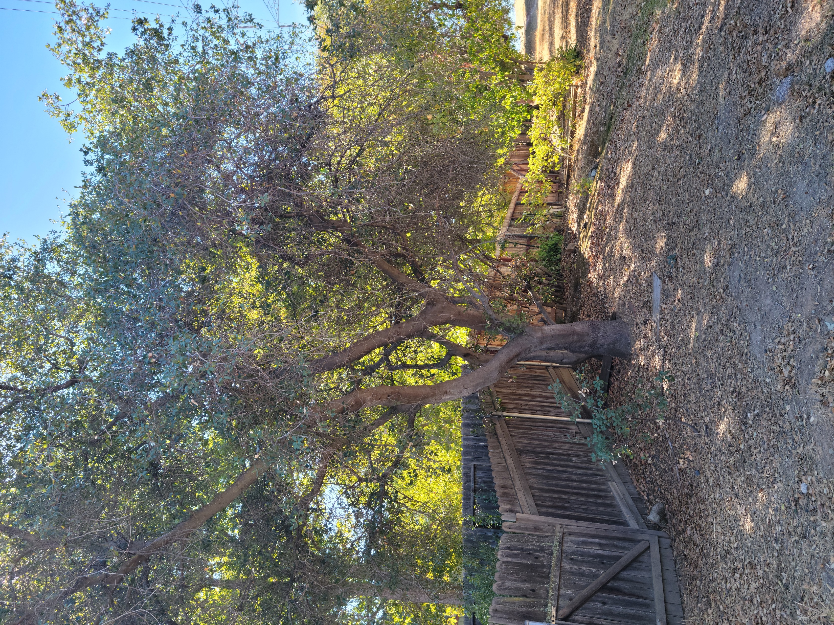
Candidate #2 – The Oak Parkway Corridor

Slide 15
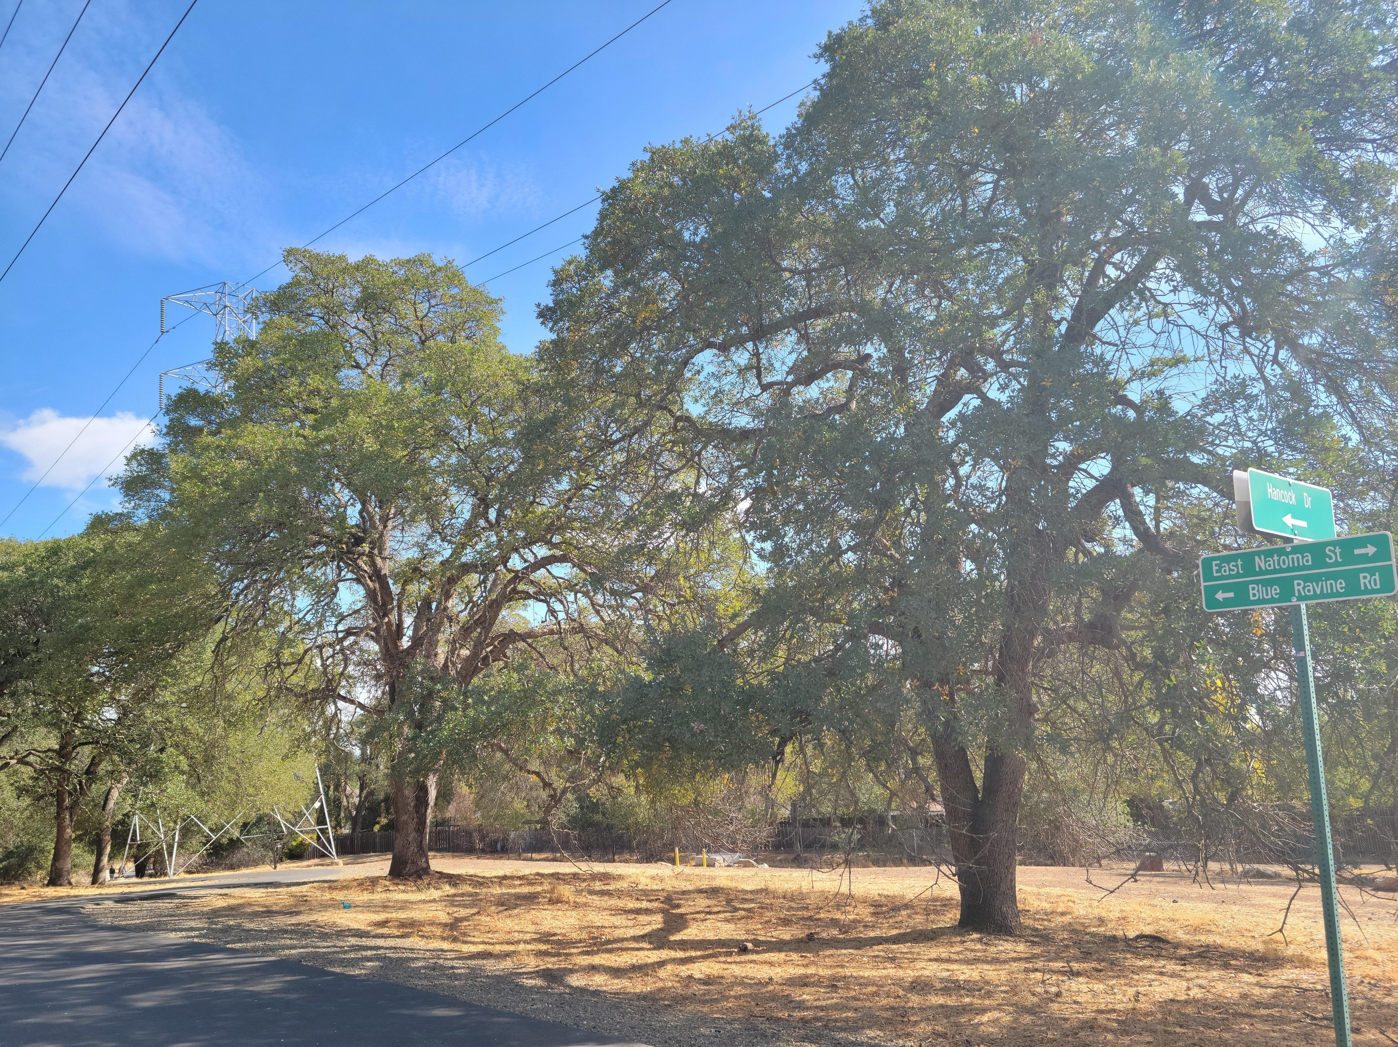
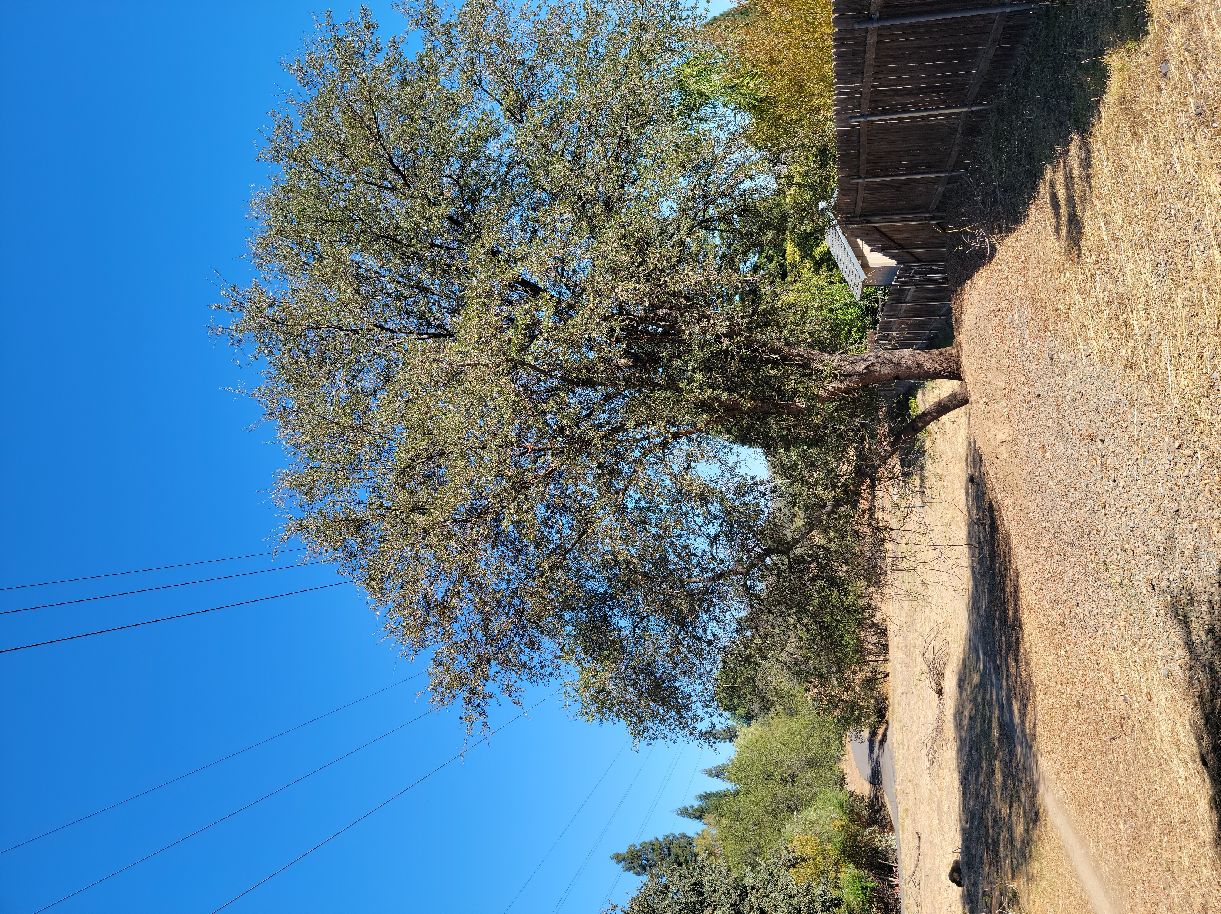
Candidate #2 – The Oak Parkway Corridor

Slide 16
Considerations
Multiple Stakeholders
Trail Users
PG&E and SMUD (have utility easements)
Tree Characteristics
Canopy is sporadic along corridor
Sizes range from brush to mature trees
Location – some directly under low-point sag of voltage transmission lines
Impact for the City
Application fee waived
Relationship with partners - *mutually beneficial parameters are needed
Staff time and resources
* Potential opportunities for community/volunteer engagement (inventory?)

Slide 17
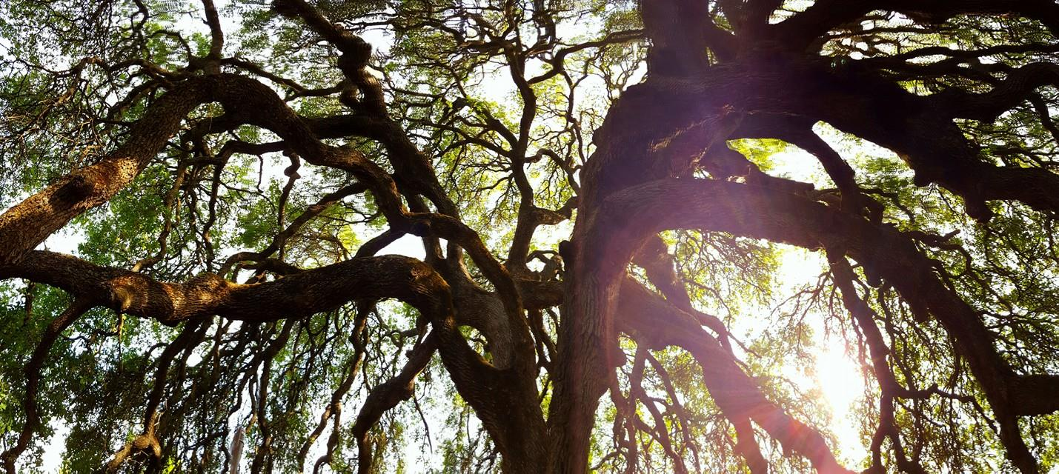
Staff Recommendation
Initiate the 30-day noticing period to commence the process of designating a landmark grove at the Folsom State Prison property and, barring any appeals, adopt a resolution at the October 24th City Council meeting to add the Folsom Prison grove onto the Landmark Tree Registry
Allow staff to continue analyzing the Oak Parkway Trail Corridor and working with stakeholders to develop parameters for the potential establishment of one or more landmark trees and return to City Council with a recommendation at a future date

