Slide 1
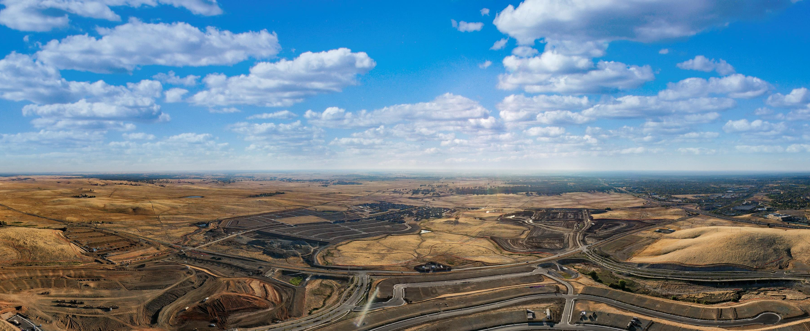
CFD No. 23 (Folsom Ranch)
Amended Improvement Area No. 6
City Council Presentation – September 12, 2023

Slide 2
CFD No. 23 IA No. 6:
Facilities Special Tax Amendment
Landowners within the Folsom Plan Area previously requested to form Community Facilities District No. 23 (Folsom Ranch) (CFD No. 23) in 2020.
CFD No. 23 includes seven separate Improvement Areas, designated as Improvement Area (“IA”) No. 1 through IA No. 7.
On July 26, 2022, an amendment to the Rate and Method of Apportionment for IA No. 6 was approved to remove the maximum facilities special tax rate for certain land uses.

Slide 3
CFD No. 23 IA No. 6:
Facilities Special Tax Amendment
Landowners have requested to further amend the Rate and Method of Apportionment for IA No. 6 to remove the maximum facilities special tax rate from the remaining taxable land use category.
Proposed development within IA No. 6 includes:
9.19 acres of multi-family medium density
8.54 acres of multi-family high density
9.99 acres of non-residential property

Slide 4
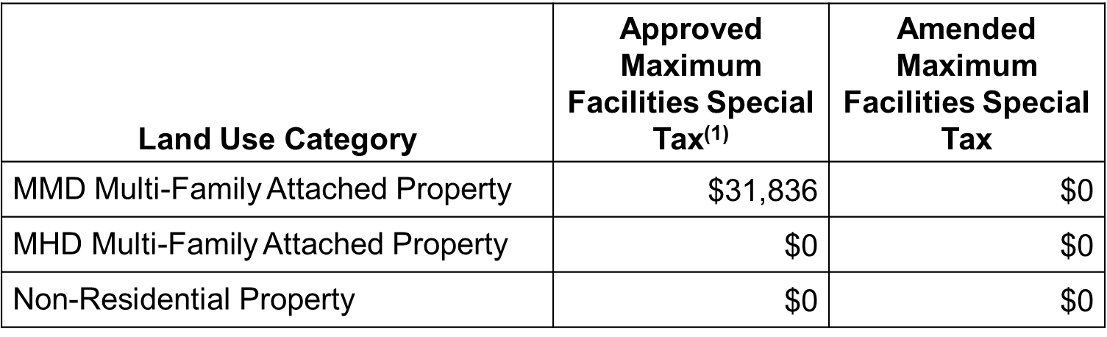
CFD No. 23 IA No. 6:
Facilities Special Tax Amendment
Proposed maximum facilities special tax rate amendment:
(1) Maximum Facilities Special Tax Rates from the 2022 Amendment.
There are no proposed amendments to the maximum services special tax rates.

Slide 5
CFD No. 23 IA No. 6:
Facilities Special Tax Amendment
Recommend approval of:
Resolution No. 11102 - A Resolution of Consideration of the City Council of the City of Folsom to Amend the Rate and Method of Apportionment for Improvement Area No. 6 within the City of Folsom Community Facilities District No. 23 (Folsom Ranch) and Related Matters

