Slide 1
Consideration of the Selection of Two City Council Members to Serve on the Economic Development Consultant Proposal Review Committee

Slide 2
FY2023-24 Budget Priority
The Folsom City Council unanimously approved the FY 2023-24 Budget on May 23, 2023.
Up to $100,000 allocated for an economic development consultant.
On June 27, the City Council provided direction on the economic development consultant goals and scope of work.

Slide 3
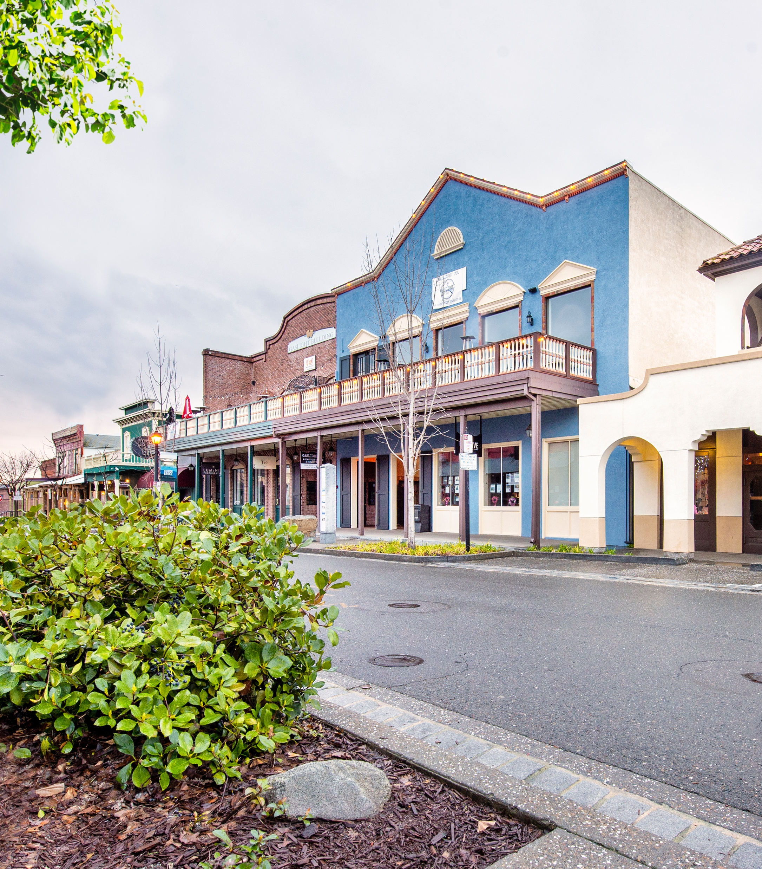
Request for Proposals (RFP)
RFP for economic development consulting services issued on August 9, 2023.
Submissions deadline: September 15, 2023, at 2 p.m.
RFP disseminated to a targeted list of economic development consultants and a database of approximately 100 consultants statewide.

Slide 4
Evaluation Criteria and Committee
The RFP advertised that the proposals would be evaluated by Friday, September 29, 2023.
Proposals will be evaluated based on qualifications, understanding, methodology, resources, timeline, and cost.
An Economic Development Consultant Proposal Review Committee will evaluate the proposals.

Slide 5
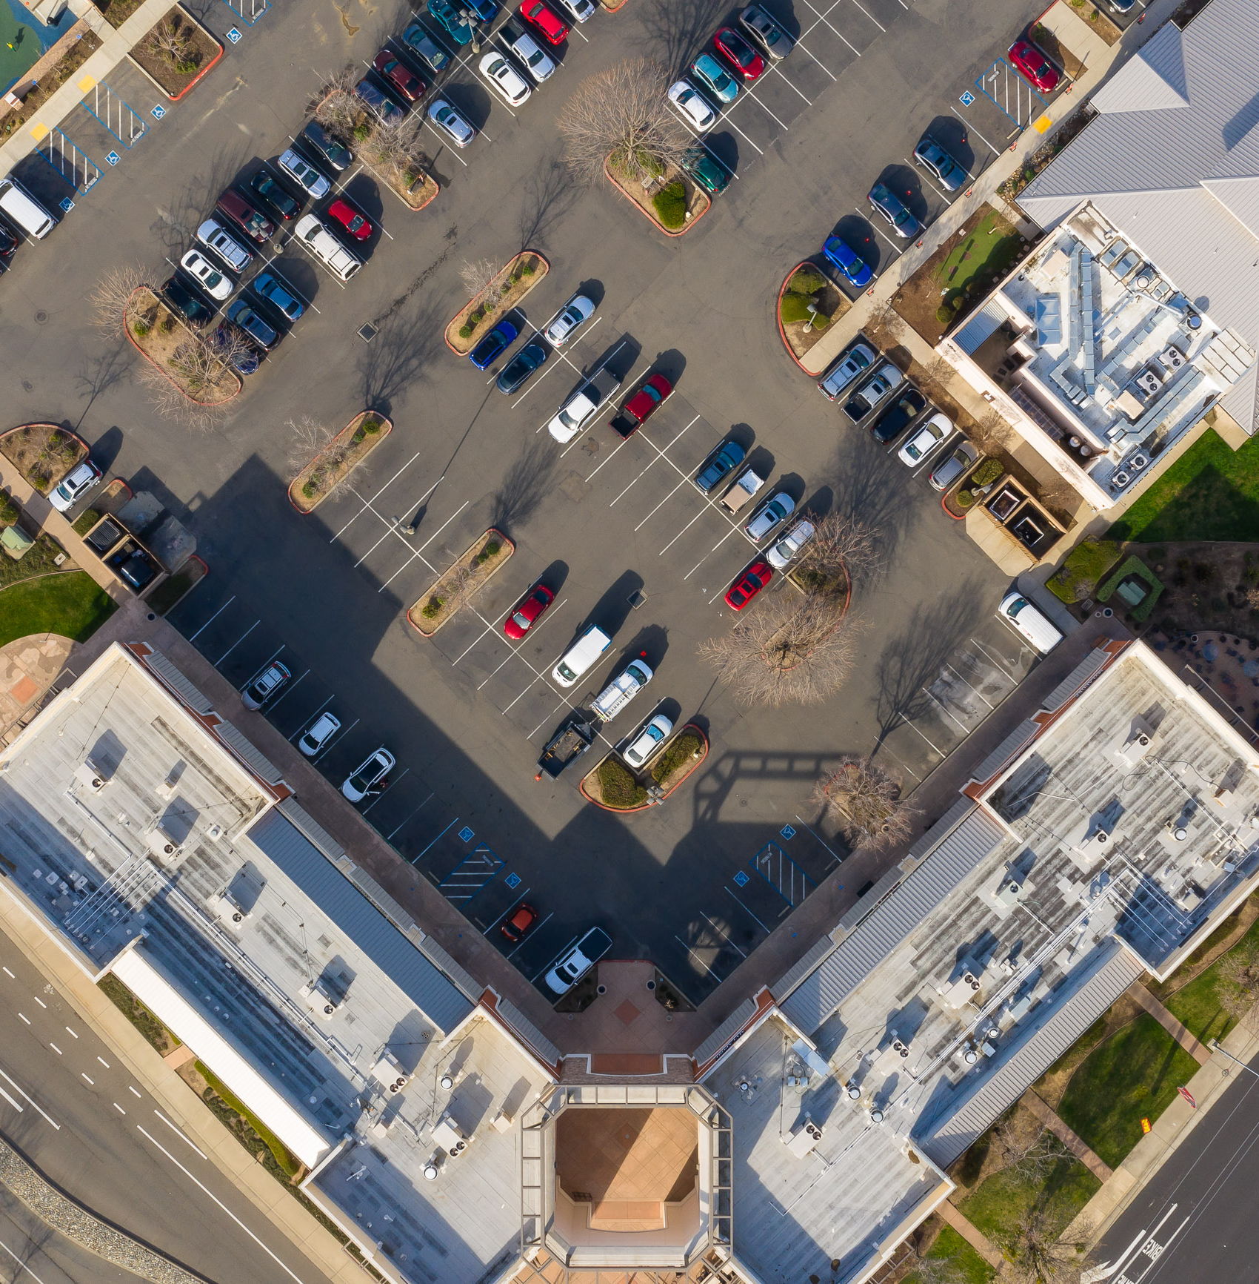
Recommended Action
City staff recommends that the City Council consider the selection of two of its members to serve on the Economic Development Consultant Proposal Review Committee to support the assessment and selection of a City economic development consultant.

