Slide 1
Folsom Plan Area
Quarterly Update June 2018

Slide 2
FPA Quarterly Update Outline
Folsom’s Specific Plan History
Specific Plan Implementation
Project Drivers
Folsom Plan Area Approvals
Engineering/Infrastructure Improvements
Building Homes and Community
Questions?
Notes:
Brief overview of Folsom’s Specific Plan history, reminder of Folsom Plan Area approvals, and update on community building south of 50

Slide 3
Folsom’s Specific Plan History
Folsom has 6 Specific Plan Communities:
  Willow Springs (1992)
  Empire Ranch (1992)
  Silverbrook (1993)
  Parkway (1993)
  Broadstone III (1995)
  Folsom Plan Area (2011)
Notes:
Since 1992, the City has adopted 6 Specific Plans. All 5 Specific Plans north of highway 50 were initially adopted in the early 1990s and all amended multiple times since then, often with General Plan amendments updating land use plans to adapt to the City’s maturing needs and desires.

Slide 4
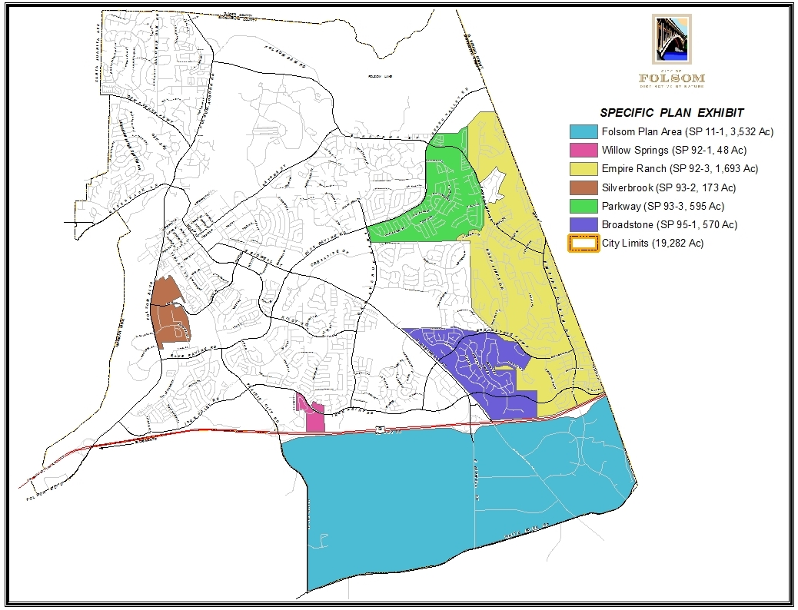
Notes:
This map shows the location of all 6 Specific Plans adopted in the City of Folsom over the last 25 years, which represent nearly 40% of the City’s land area. Prior to that time, the City approved several master planned communities (e.g., Natoma Station, Prairie Oaks) and large residential subdivisions (e.g., Briggs Ranch, Lexington Hills). All of these master planned areas built out over many years and decades.

Slide 5
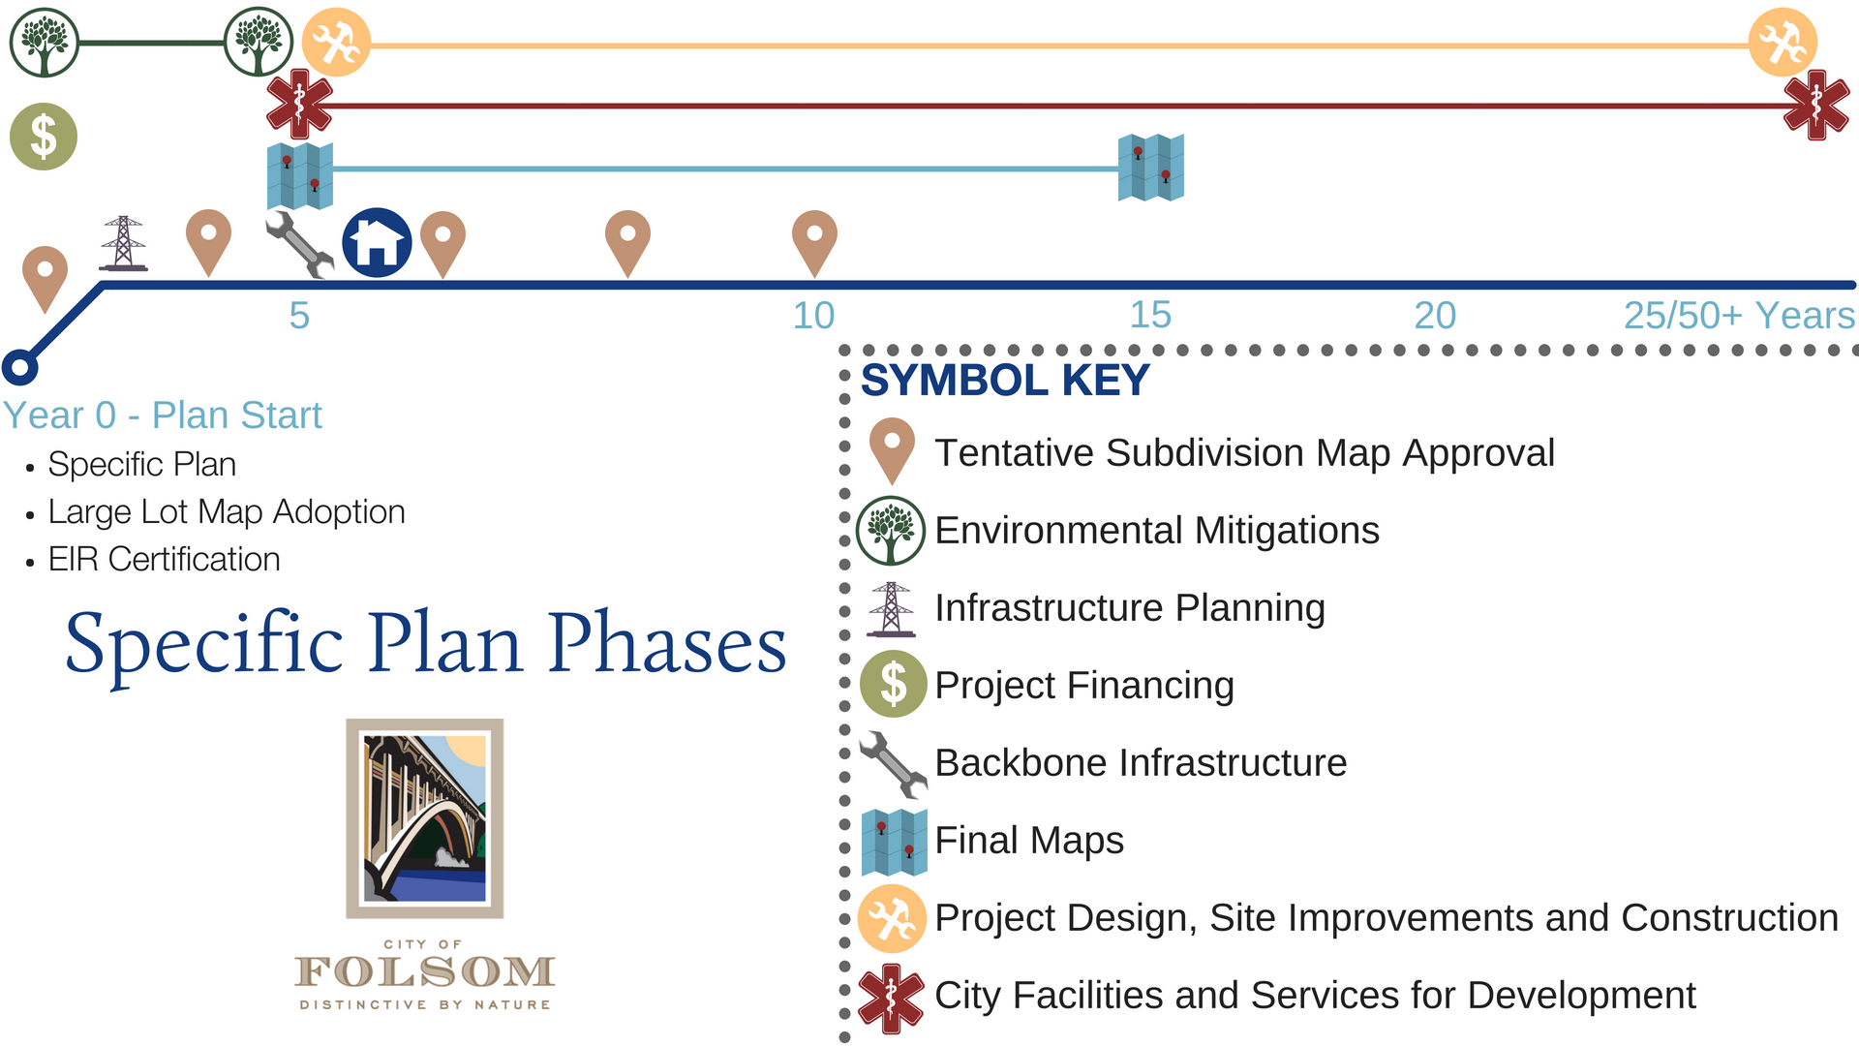
Specific Plan Implementation
First New Home
Notes:
The City’s Specific Plan’s range in size from 48 to 3500 acres with an average of 1,270 acres. With the exception of Willow Springs Specific Plan, Folsom’s master planned communities have and continue to build out over a 20+ year period.

Slide 6
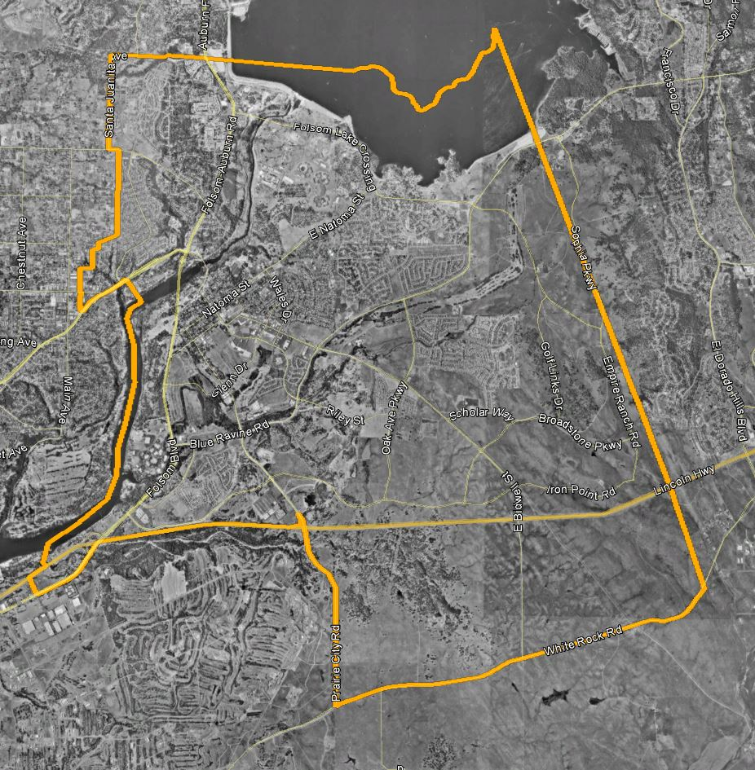
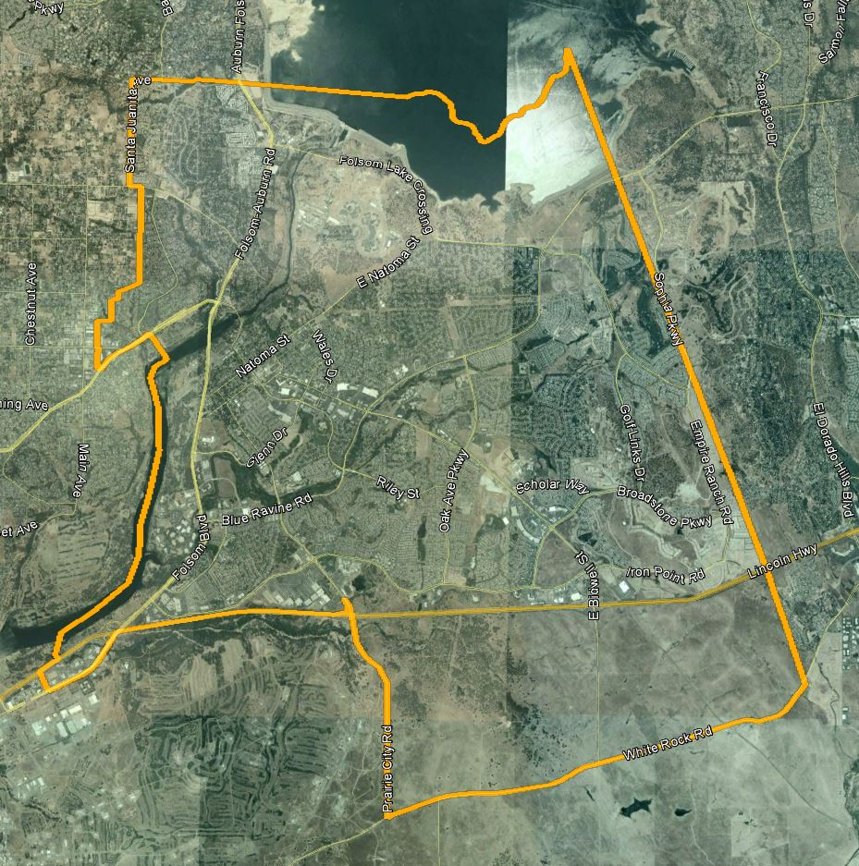
City of Folsom
1995 Aerial
City of Folsom
2005 Aerial
Notes:
Two aerial images 1995 on the left and 2005 on the right. Approximately half of the land area north of 50 was undeveloped – largely within the approved master plan and specific plan areas in the City’s east and southern areas. In 2005, you can see major roadways and grading work in most of those east and south areas with some residential homes and limited commercial and office development.

Slide 7
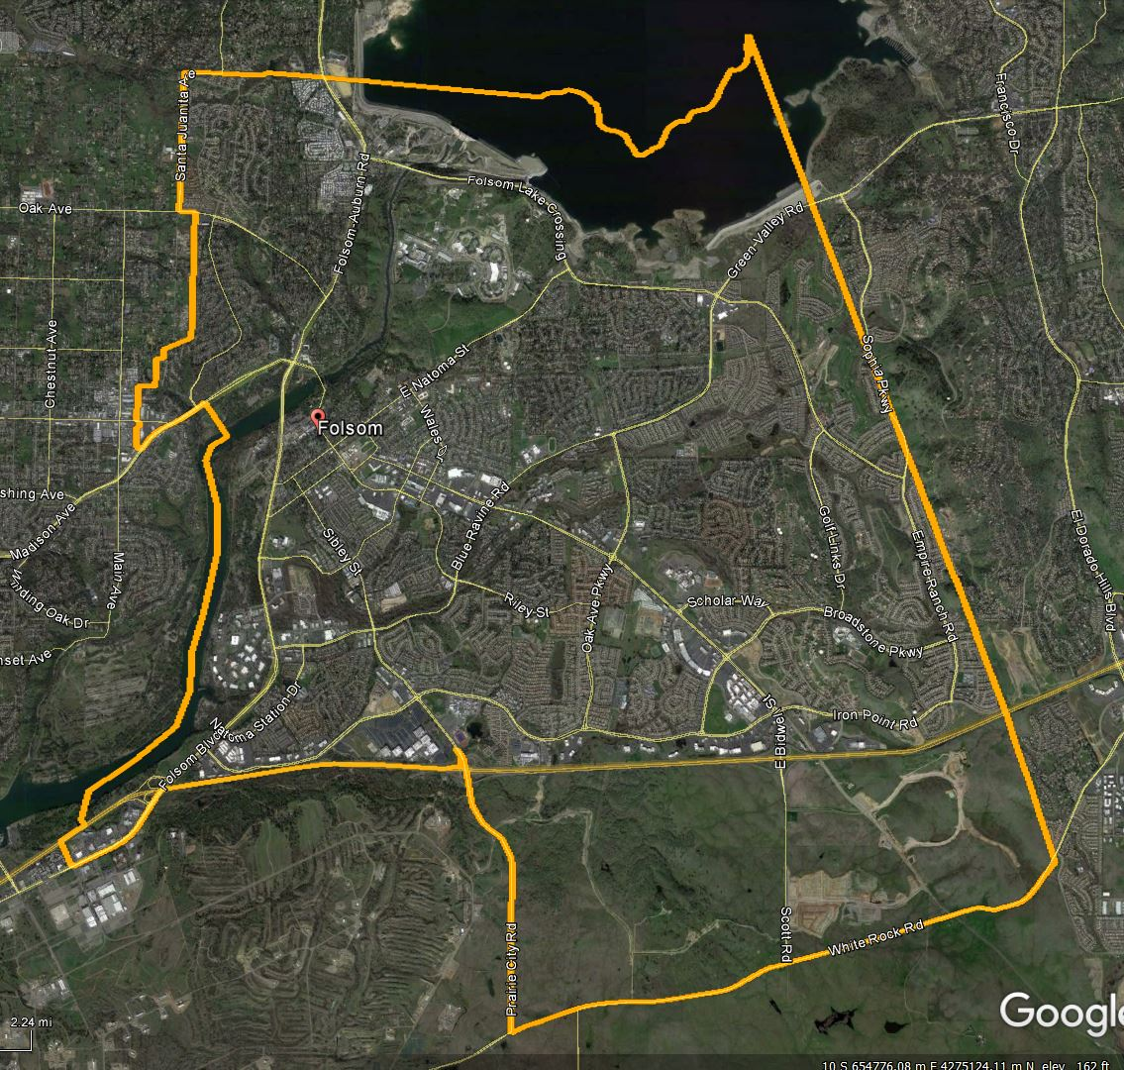
City of Folsom
2005 Aerial
City of Folsom
2018 Aerial
Notes:
Same 2005 image on he left, juxtaposed with a current aerial photo from Googlemaps showing much of the land north of 50 developed with homes, commercial services, and job centers, including the infrastructure and grading work south of 50 in the Folsom Plan Area.

Slide 8
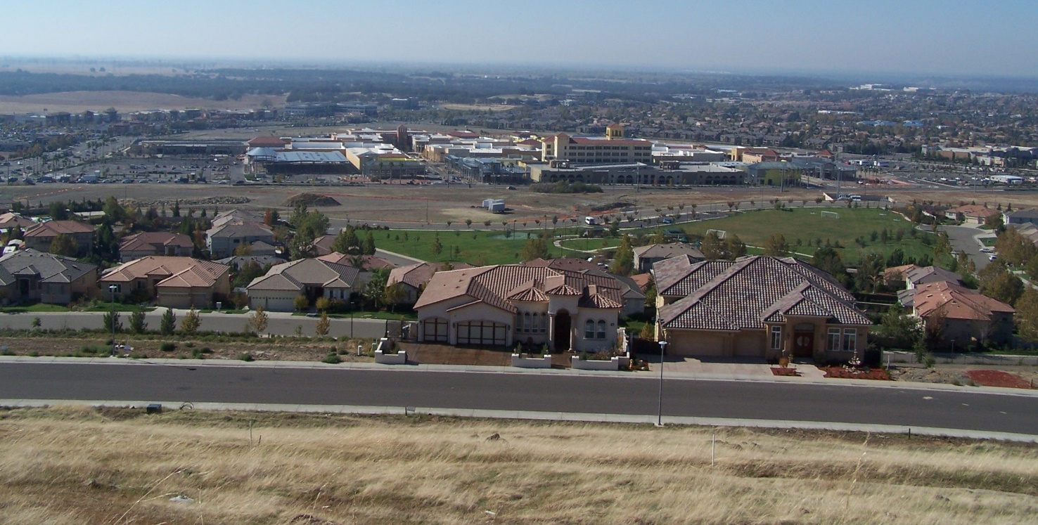
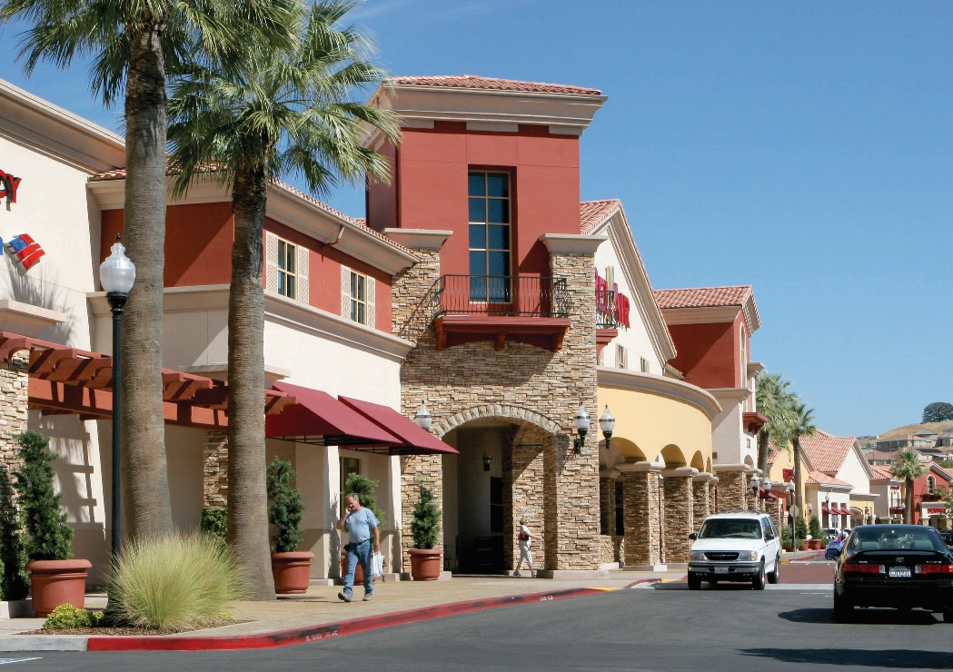
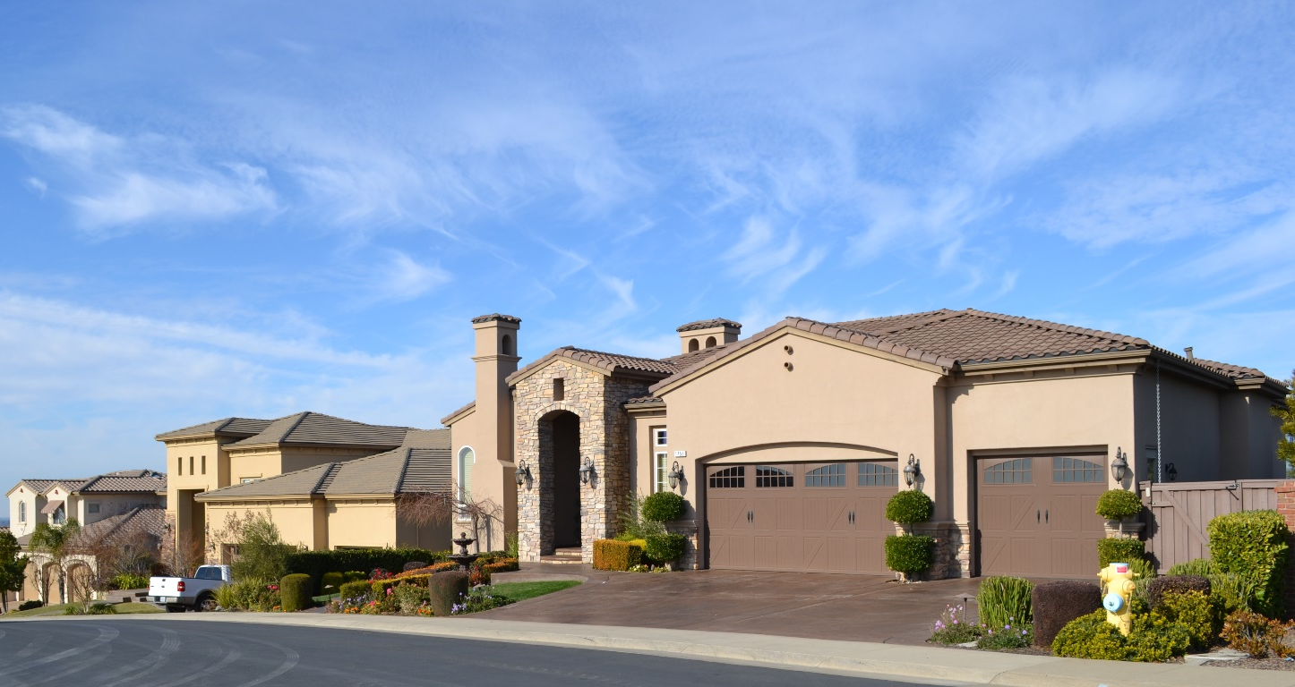
Notes:
These images represent new development in Folsom in the last 10+ years within Parkway Specific Plan, Empire Ranch Specific Plan, and Broadstone Specific Plan.

Slide 9
Project Drivers
Community Desirability
Demand (Housing, Retail Services, Jobs)
Site Readiness
Investment/Financing/Economy
Project Design and Construction
City Services and Facilities
Notes:
I talked briefly about the required phases for implementation of the Specific Plan, but there are key drivers influencing both commencement and pace of development. Folsom has community desirability in spades, as evidenced from the pace of community building north of 50. The quality neighborhoods, natural setting, amenities and services continue to keep Folsom ranked #1 place to raise a family. There’s significant interest from Folsom residents and next generation to continue to live in Folsom AND there’s strong interest in Folsom from the region and Bay Area (as evidenced by rate of new home sales and interest in future homes south of 50. FPA owners group and individual builders have interest lists of 100s strong and approximately half of those folks on the list are existing Folsom residents.

Slide 10
Folsom Plan Area Approvals
Project Conception (2004 – 2005)
  Measure W
  Vision/Land Planning Concepts
Specific Plan Approval (2011 - 2012)
  Development Agreement
  Specific Plan Adoption/Certification of EIR
  Prezoning and Annexation
Refinements (2013 - present)
  Open Space Management Plan
  Public Facilities and Financing Plan
  Design Guidelines
  Specific Plan Amendments
  Tentative Subdivision Maps

Slide 11
Subsequent Planning Entitlements
Specific Plan Amendments | Tentative Subdivision Maps
Westland Eagle Russell Ranch Hillsborough Carr Trust Folsom Heights Broadstone Estates | Russell Ranch Mangini Ranch 1 and 2 White Rock Springs Carr Trust Enclave Broadstone Estates Folsom Heights

Slide 12
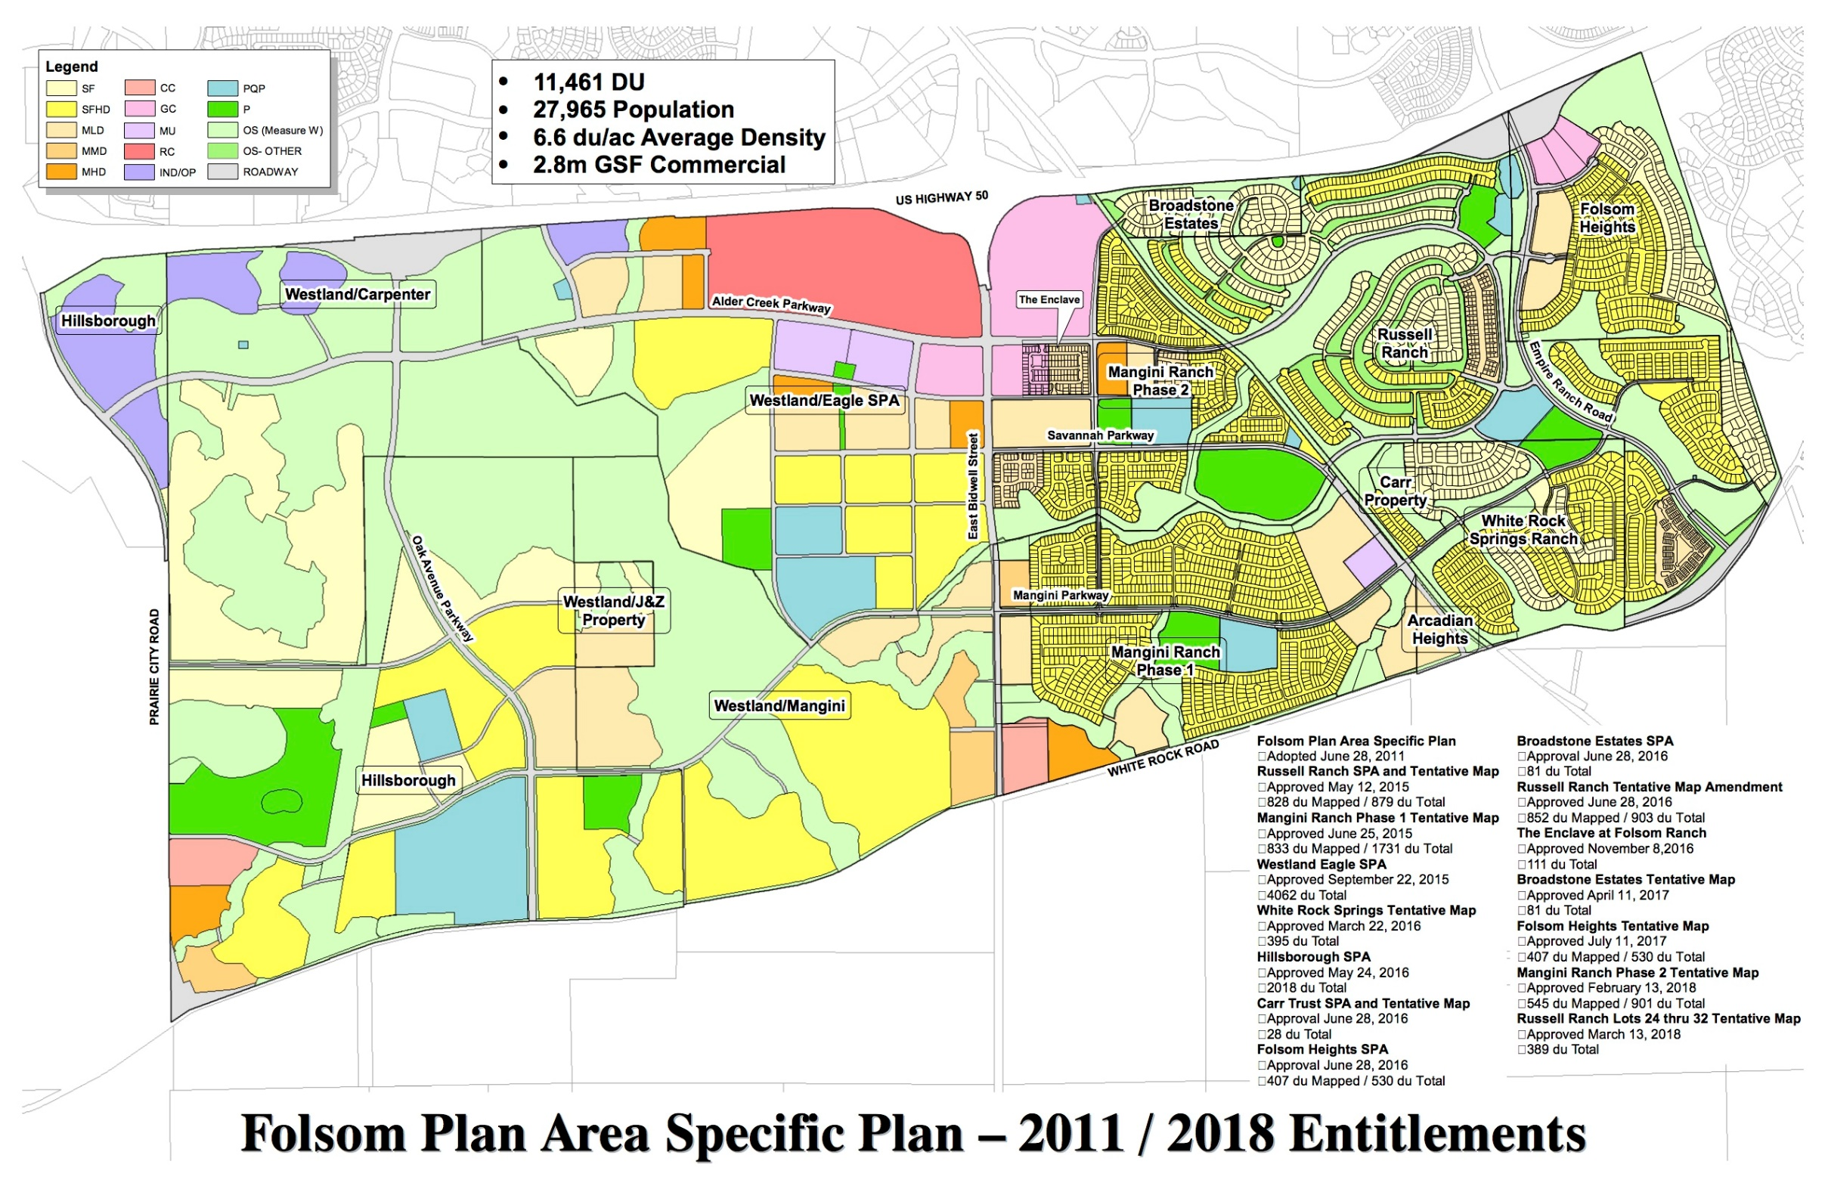

Slide 13
Engineering/Infrastructure Improvements
January 2018 report on backbone infrastructure
Completion of Phase 1 Infrastructure:
  Zone 4/5 Water Booster Pump Station
  Sewer Lift Station
  Zone 5/6 Water Booster Pump Station
  Zone 5 Water Tank
  Roadway network

Slide 15
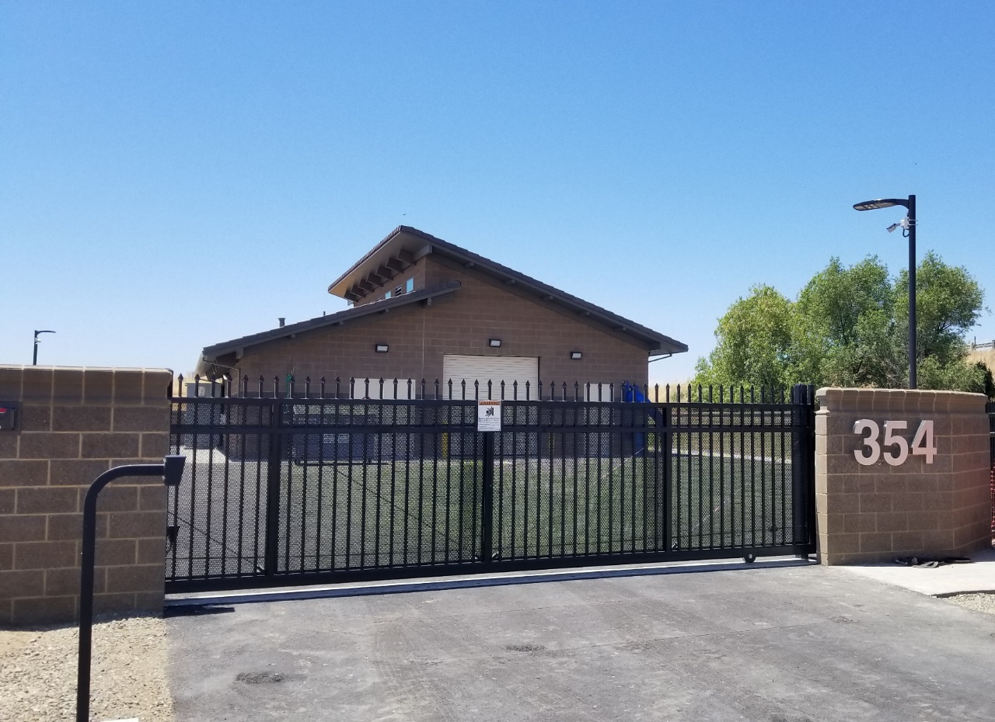
Zone 4/5 Water Booster Pump Station

Slide 16
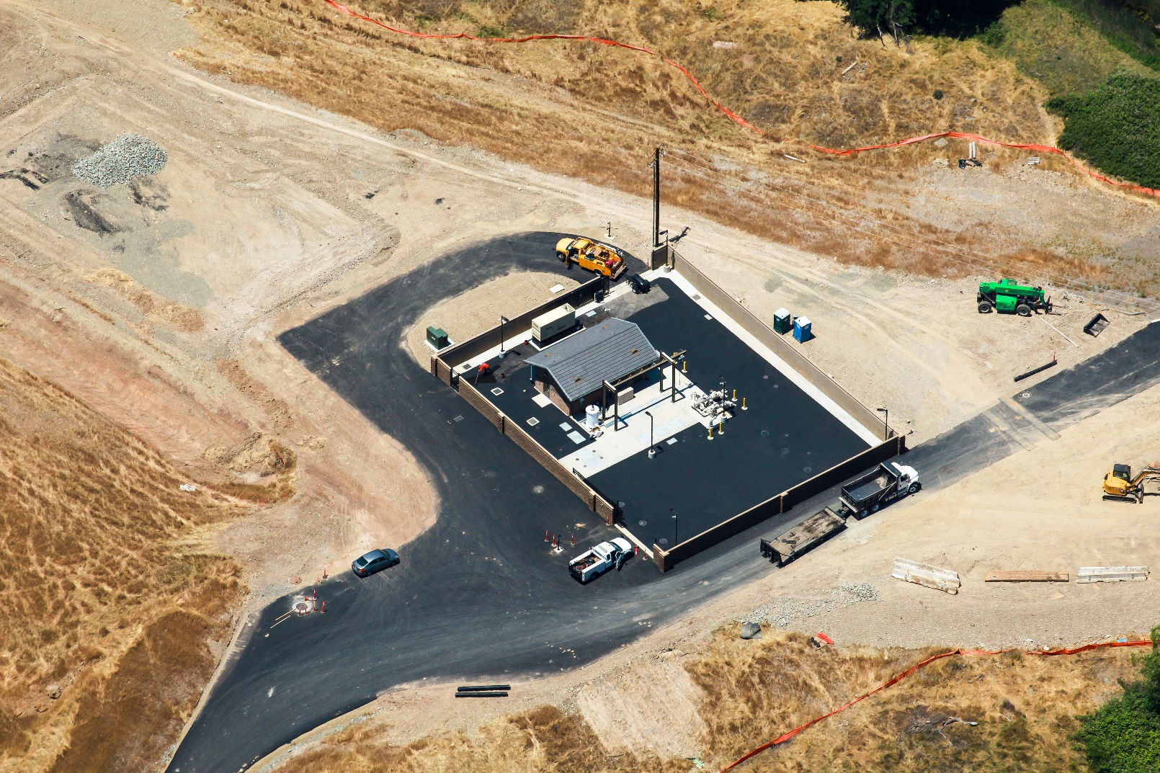
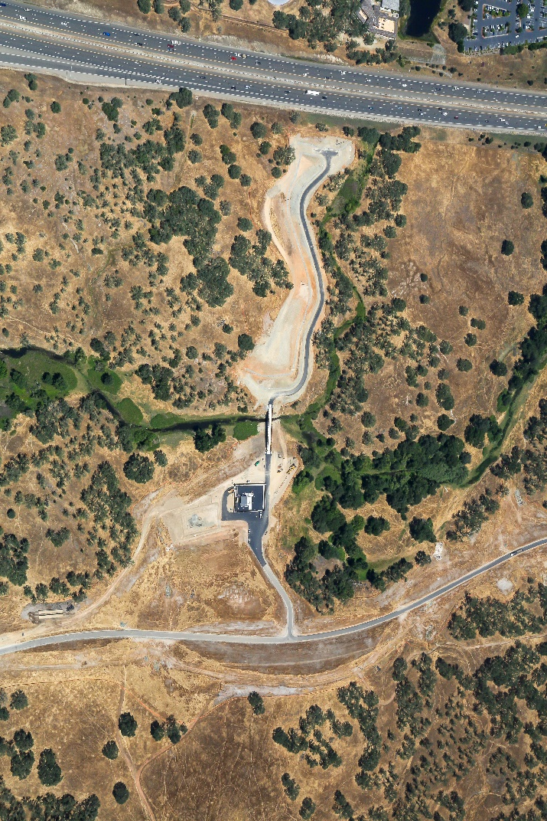
Sewer Lift Station

Slide 17
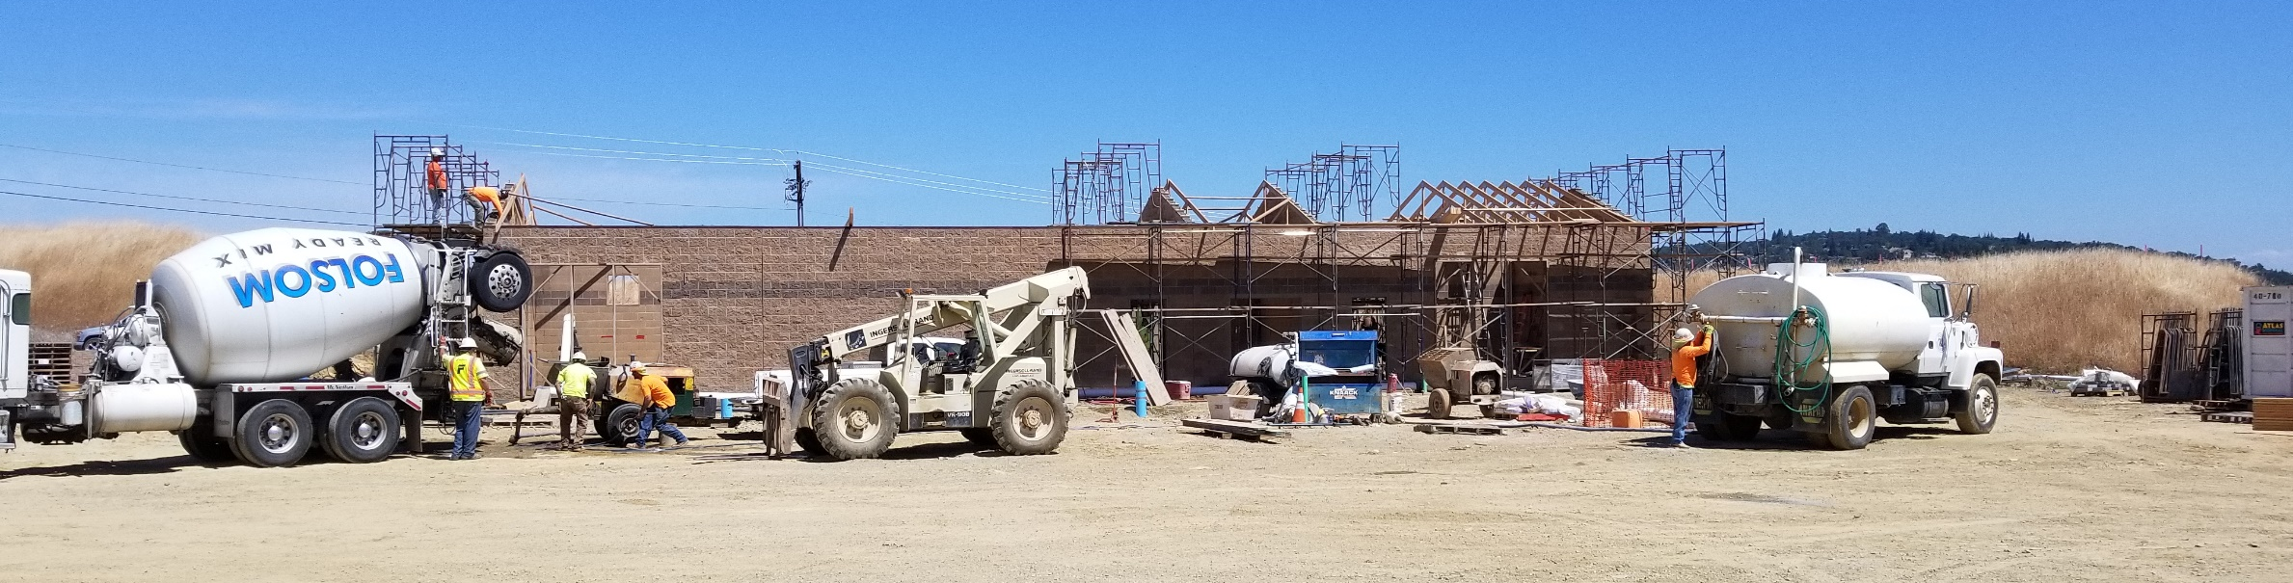
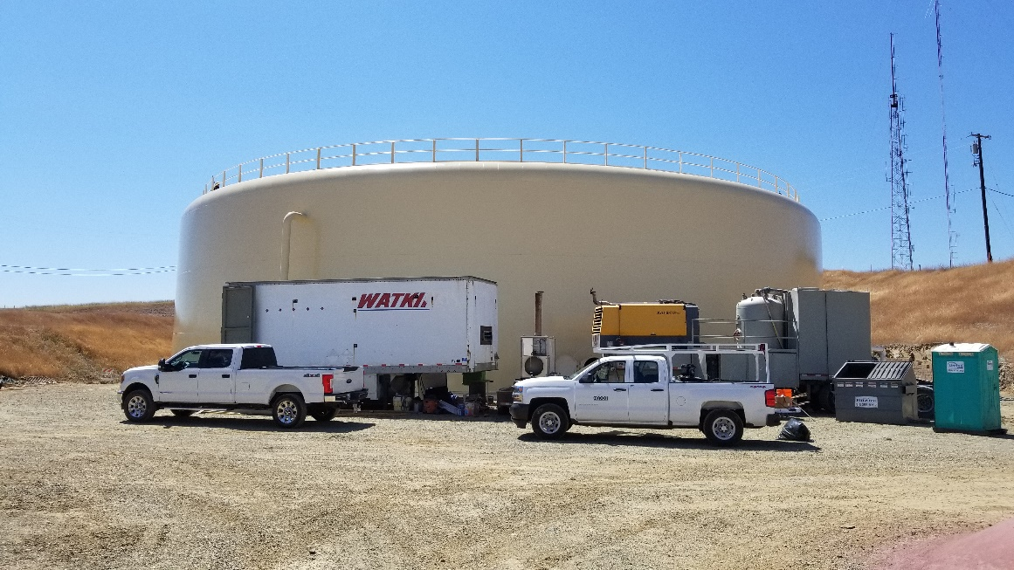
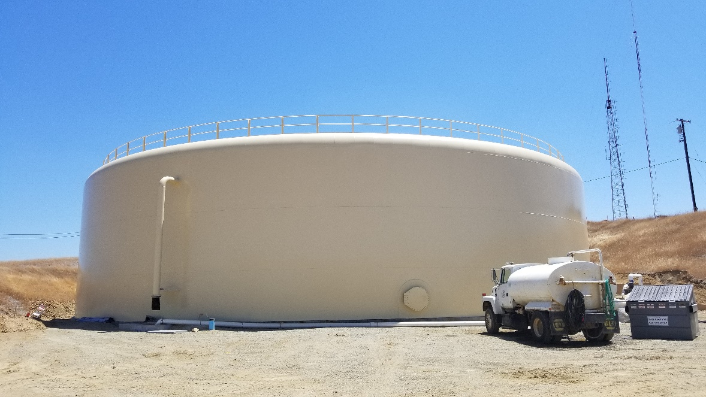
Zone 5/6 Water Booster Pump Station and Zone 5 Water Tank

Slide 18
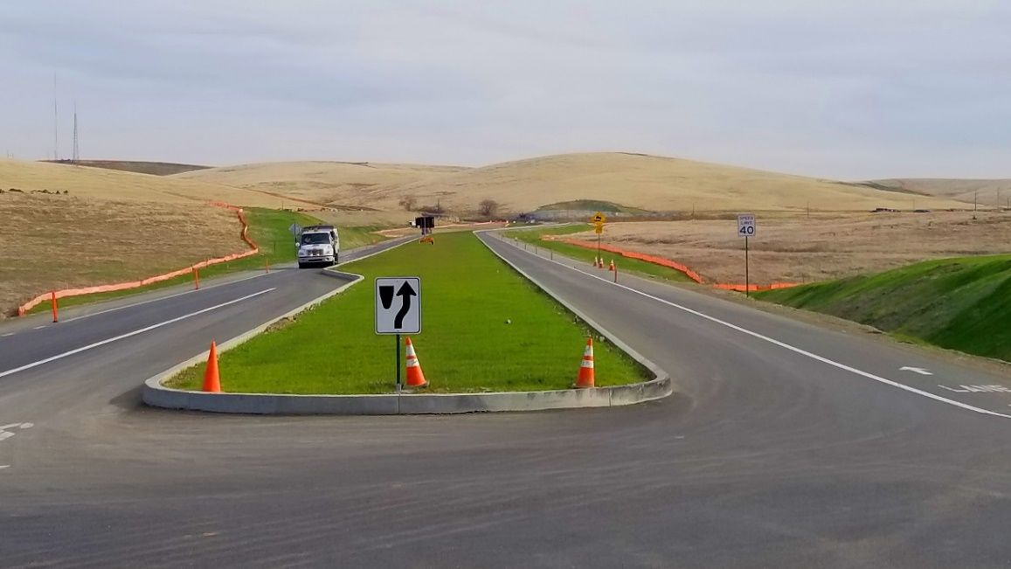
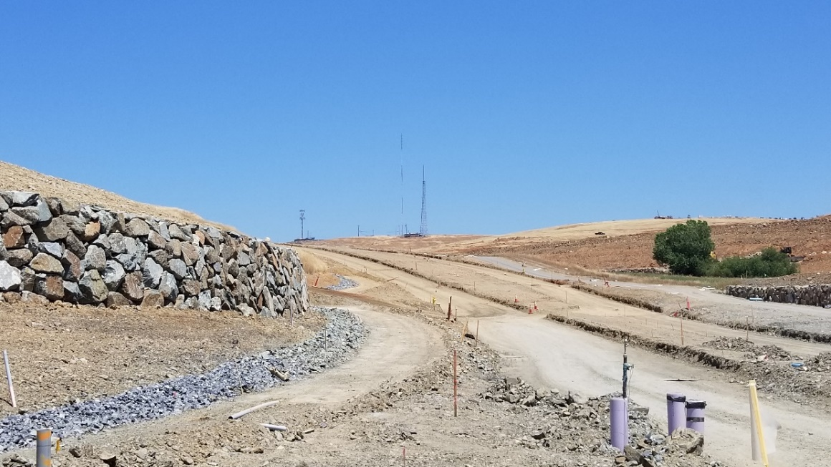
Roadway Network

Slide 19

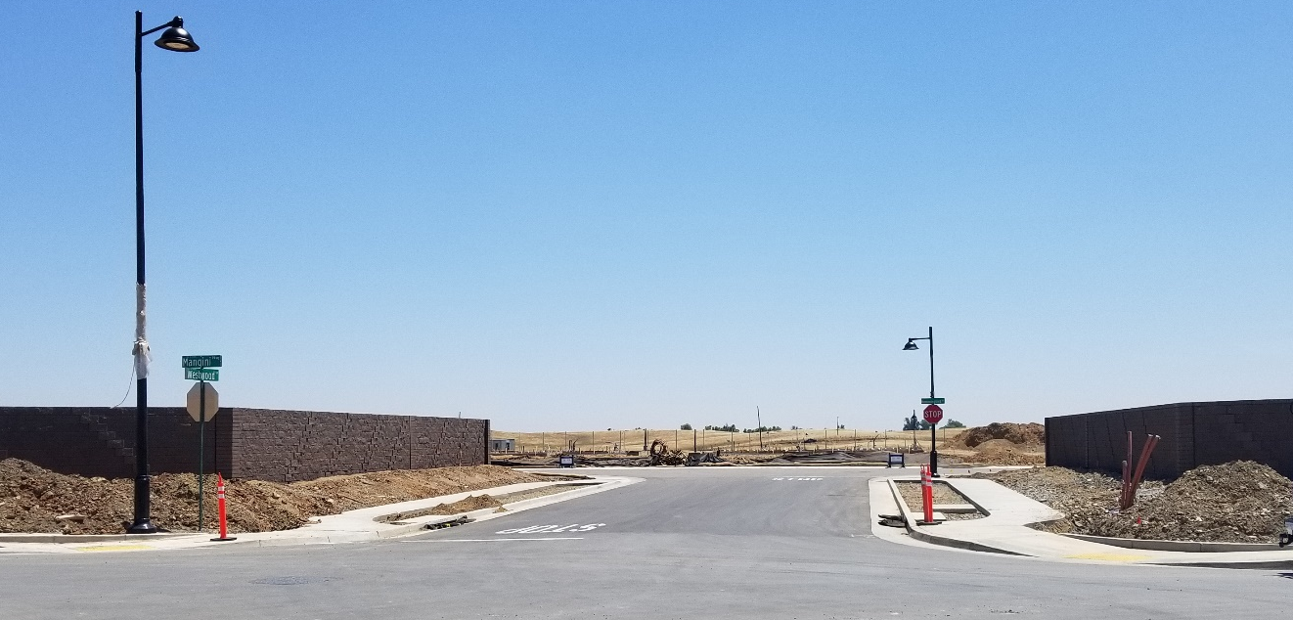
Roadway Network

Slide 20
Building Homes and Community
First Neighborhoods in FPA (starting in 2018)
  Mangini Ranch model home permits issued (under construction), production home permits issued in small batches thereafter
    Taylor Morrison (Villages 1 and 2)
    Lennar/Cal Atlantic (Villages 8 and 9)
Next phase of construction (starting in 2019)
  Russell Ranch
  Enclave
  White Rock Springs

Slide 21
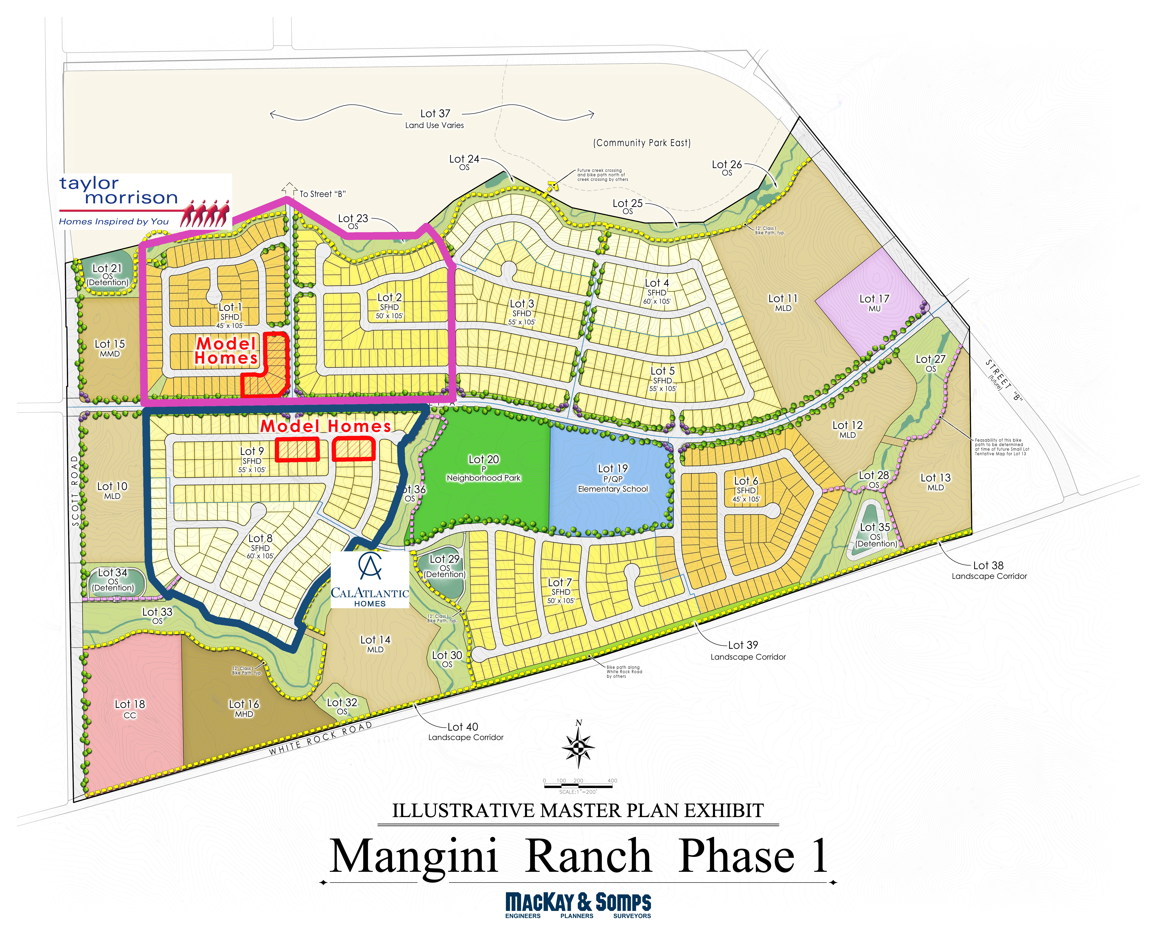
2018 Folsom Plan Area Neighborhoods

Slide 22
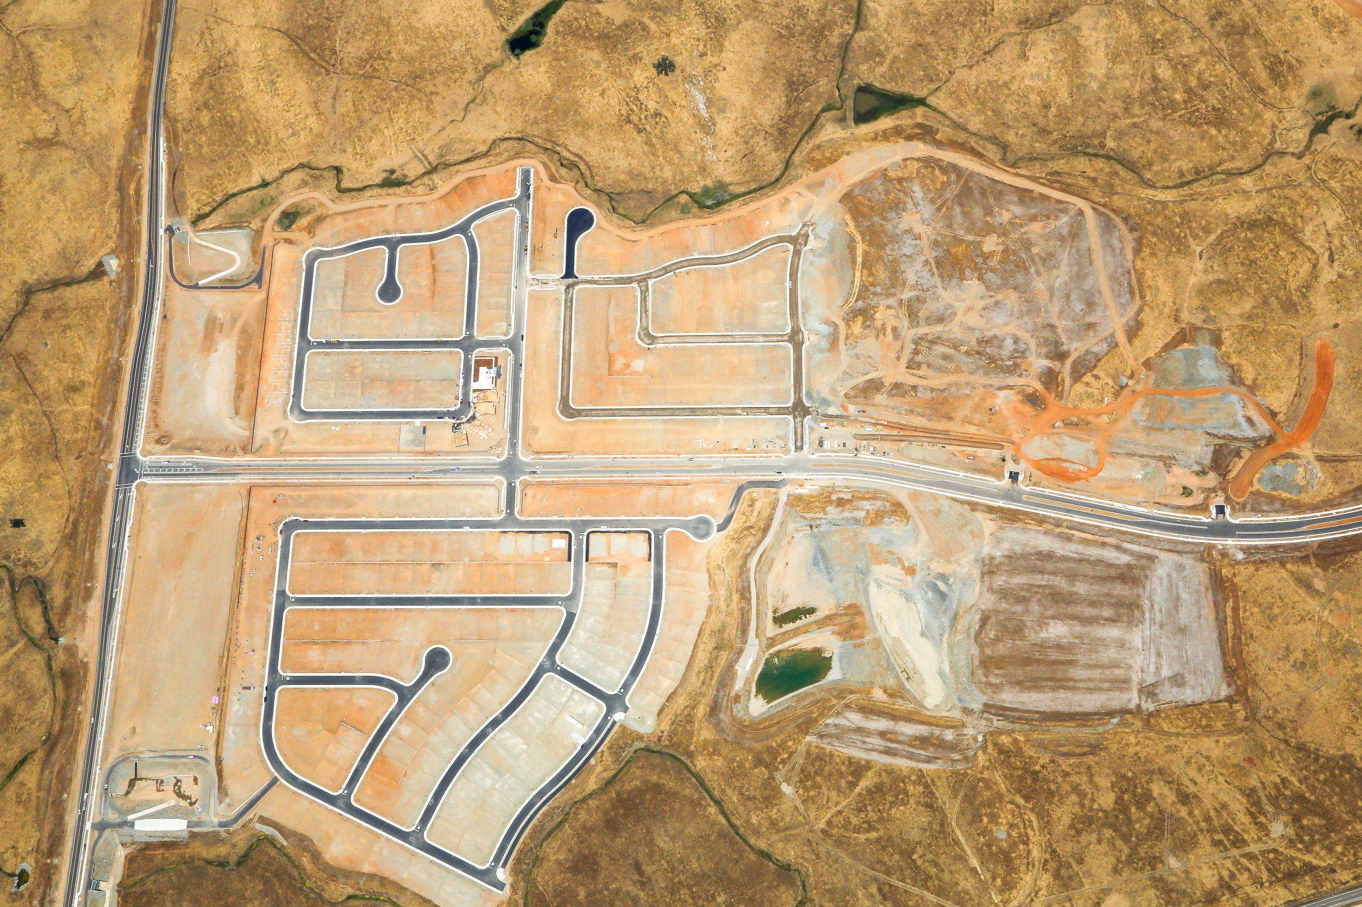
Taylor Morrison
Lennar/Cal Atlantic

Slide 23
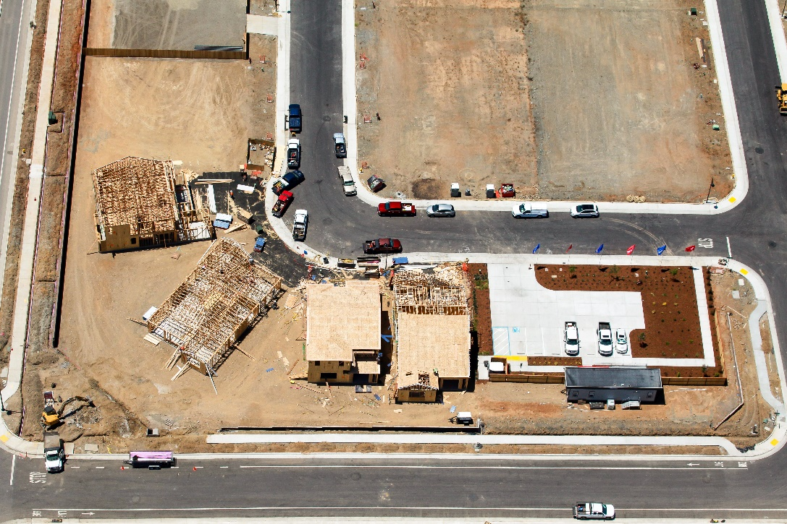
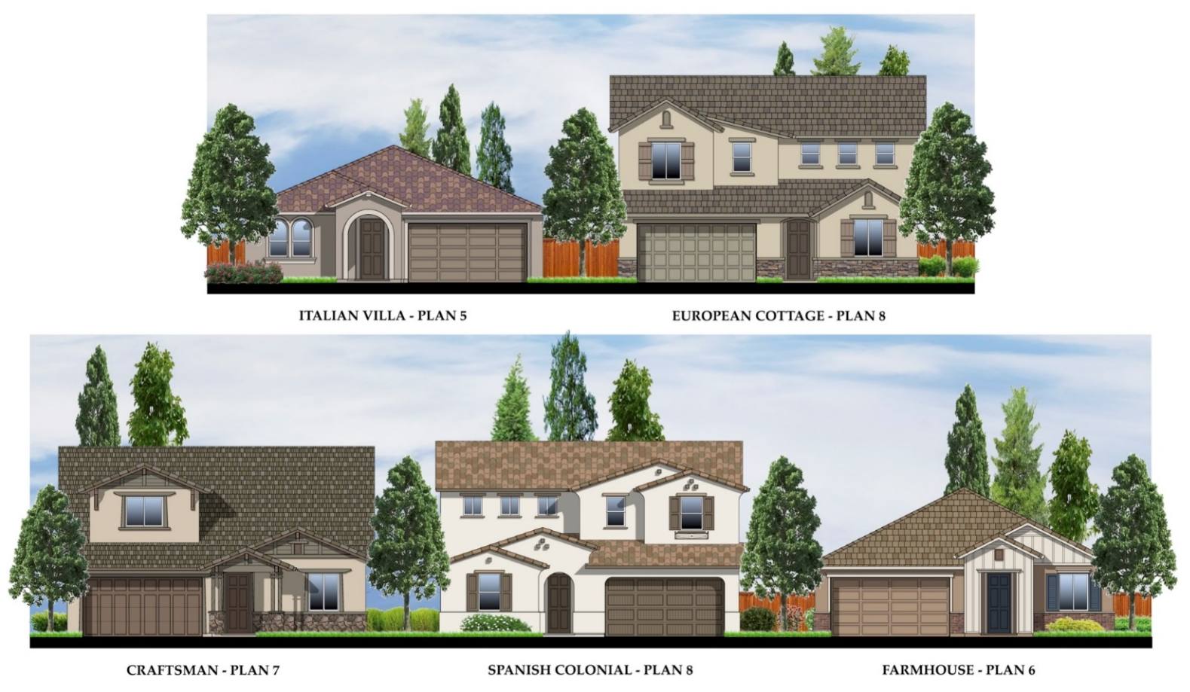
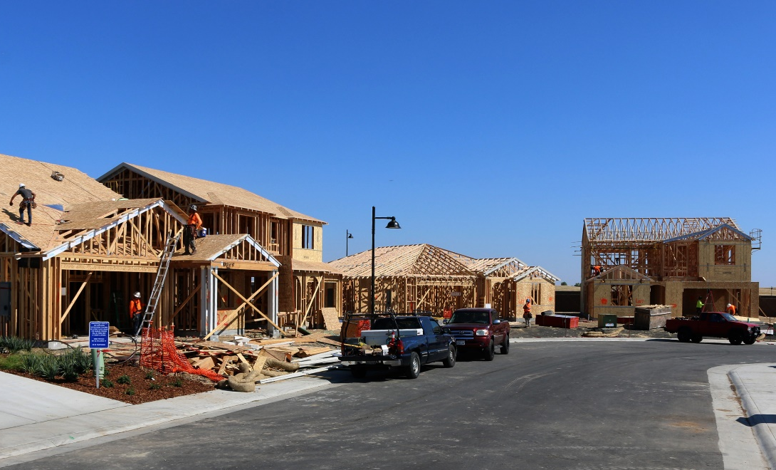
Taylor Morrison
(Villages 1 and 2)

Slide 24
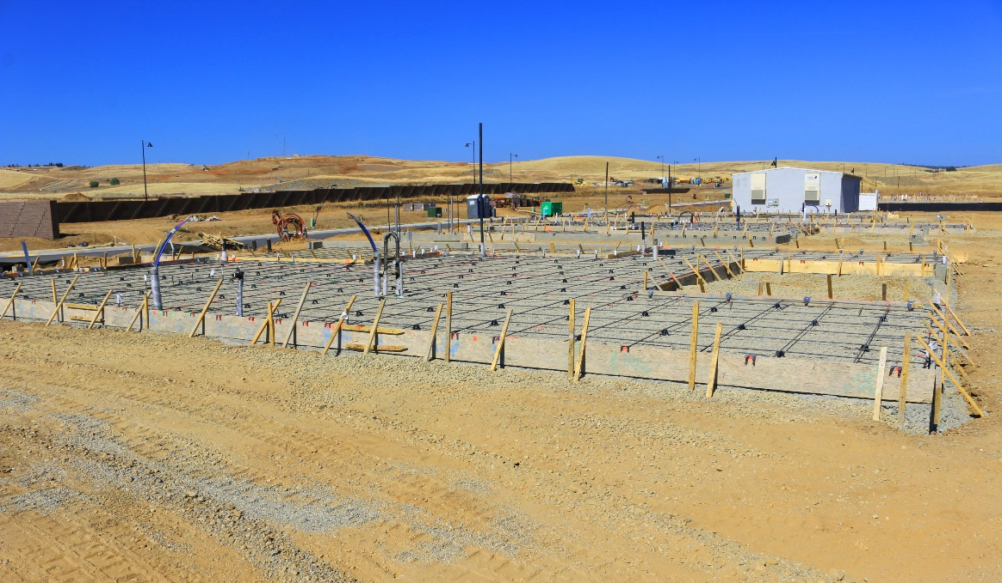
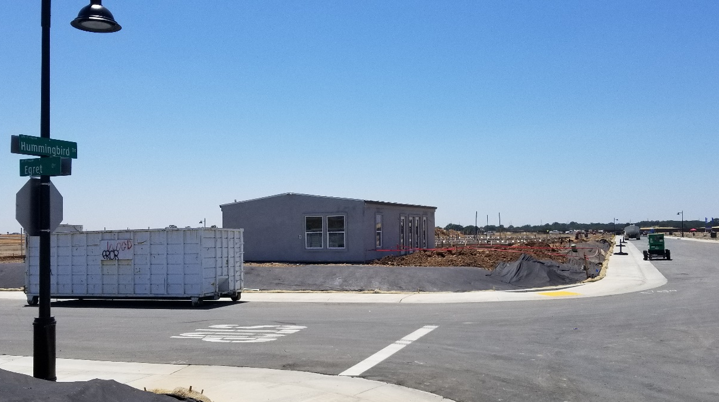
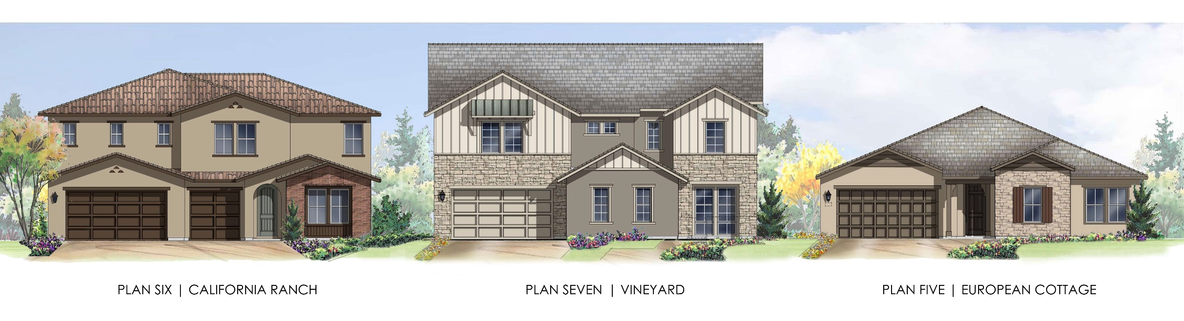
Lennar/Cal Atlantic (Villages 8 and 9)

Slide 25
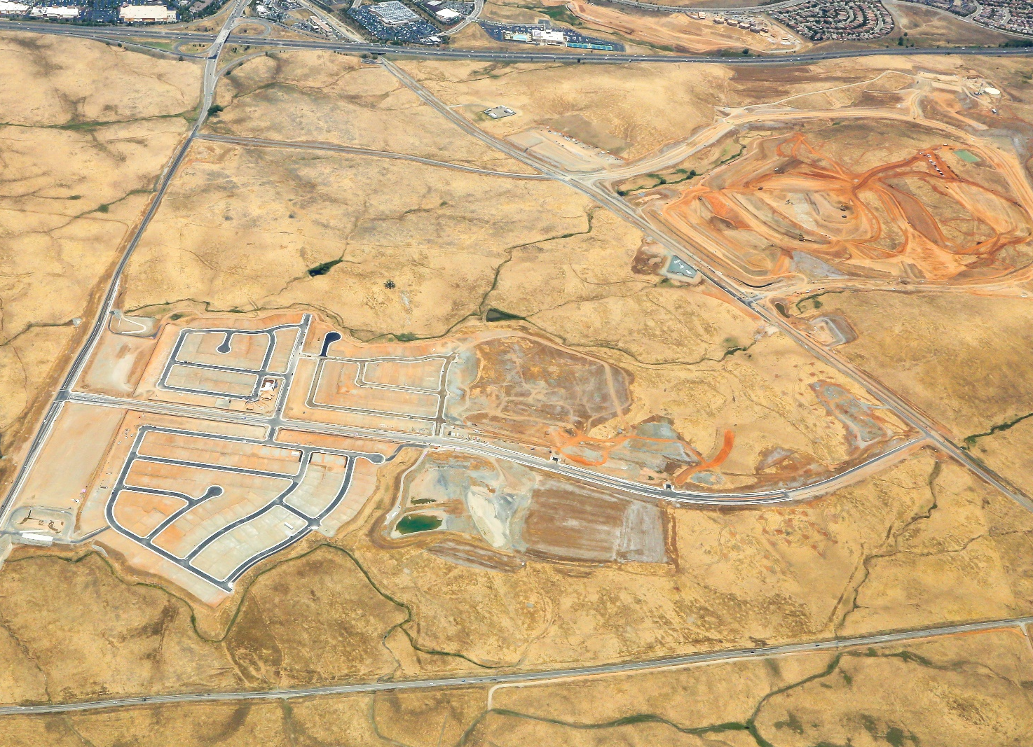
2019 Folsom Plan Area Neighborhoods
Enclave
Russell Ranch
White Rock Springs

Slide 26
Building Community:
Development Pipeline
17 Final Maps Submitted (Residential)
  City Council previously approved with conditions of approval
  Presented to Council for final map approval once staff confirms all conditions have been satisfied

Slide 27
Building Community:
Development Pipeline
Commercial development application (The Shops at Folsom Ranch)

Slide 28
Building Community:
Services to Support Residents
City services and facilities for new residents
  Operations and maintenance (roads, landscaping, water/sewer/refuse service)
  Police and fire services
  Development and enforcement services
  Parks and recreation services
Other services and facilities for new residents
  SMUD
  Schools

Slide 29
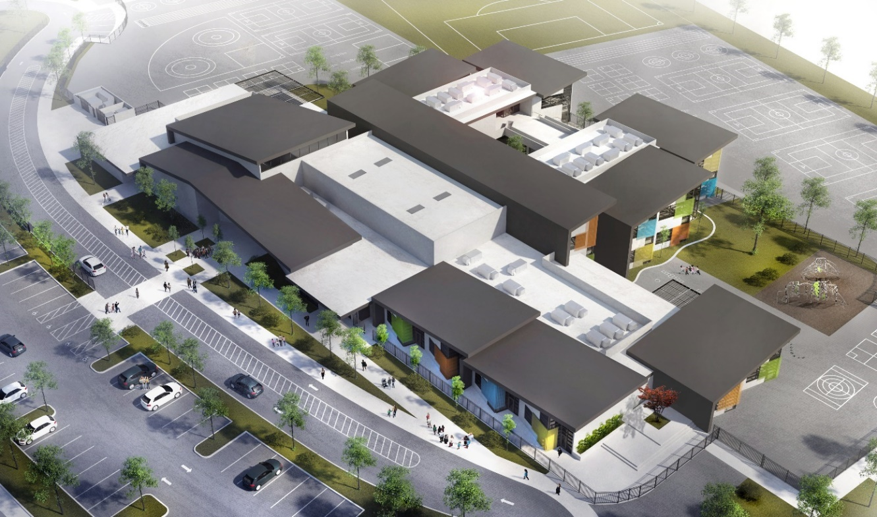
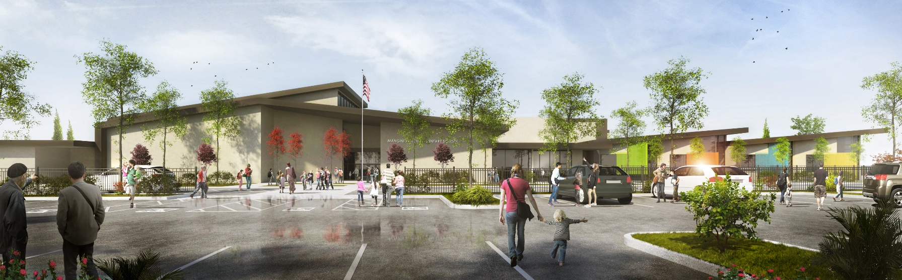
FCUSD
Folsom Plan Area
First Elementary School

Slide 30
Questions?

