Slide 1
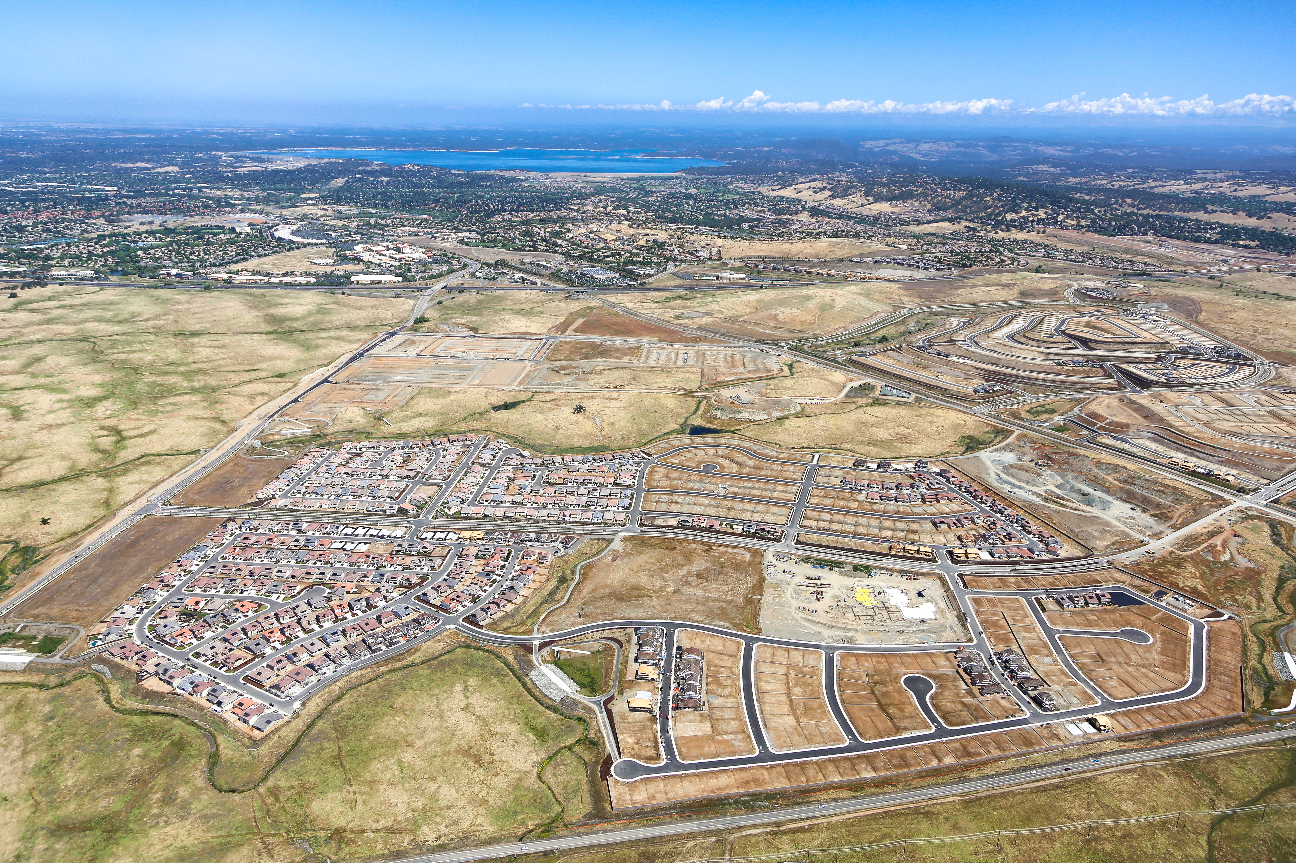
Folsom Plan Area
Quarterly Update Q2 2021

Slide 2
FPA Quarterly Update Outline
Planning Activity
Infrastructure and Site Engineering Activity
Map Activity
Building Activity
Public Information/City Website
Notes:
Brief overview of Folsom’s Specific Plan history, reminder of Folsom Plan Area approvals, and update on community building south of 50

Slide 4
Planning Activity (last 90 days)
New Development Applications (now pending)
New Development Applications Submitted
Mangini Ranch Ph. 1C South Vesting TSM & PD
Russell Ranch Ph. 2 TM Amendments & Design Review (Villages 1, 2, 4)
White Rock Springs Ranch Village 9 Master Plan Design Review
UCD Development Agreement Amendment

Slide 5
Development Applications Submitted/Pending
Mangini Ranch Phase IC South Vesting TSM and Planned Development
Request to subdivide 27 acres into 115 detached small lot single-family lots

Slide 6
Development Applications Submitted/Pending
Russell Ranch Phase 2 Map Amendments and Design Review
Request to modify previous TSM approval to remove active adult designation (no change to lot number) and design plans

Slide 7
Development Applications Submitted/Pending
White Rock Springs Ranch Village 9 Master Plan Review
Request for approval of Design Review by Richmond Homes for 42 homes

Slide 8
Development Applications Submitted/Pending
UCD Development Agreement Amendment
Request by UCDavis Health for Amendment to the Development Agreement

Slide 9
Planning Activity (last 90 days)
City Actions
Planning Commission Actions on Development Applications
Mangini Ranch Lot 16 Apartment Project
Mangini Ranch Lot 14 Bungalows Project
Parcel 61 and 77 Commercial Tentative Parcel Map and PD Permit
Dignity Health Medical Campus PD Permit and Conditional Use Permit
City Council Actions on Development Applications
Dignity Health Medical Campus Development Agreement Amendment
Mangini Ranch Phase 3 Large and Small Lot Subdivision Maps
Mangini Ranch Phase 1C North Subdivision Map and Design Review
Mangini Ranch Phase 1C 4-Pack Subdivision Map and PD Permit

Slide 10
PC Approved May 5, 2021
Mangini Place St Anton Affordable Apartments Design Review
152-unit income-restricted luxury family rental housing on 5-acre site

Slide 11
PC Approved June 2, 2021
Mangini Ranch Lot 14 Bungalows Parcel Map and Design Review
Multifamily Bungalows
160-unit multifamily rental community
2-, 3- and 4-bedroom units
Community clubhouse, outdoor amenities

Slide 12
PC Approved June 16, 2021
Commercial Parcels 61 & 77 Tentative Parcel Map and PD Permit
Parcel 66
Parcel 77
Request to subdivide 2 commercial parcels into 8 large lots for future sale and development (121.7 acres total)

Slide 13
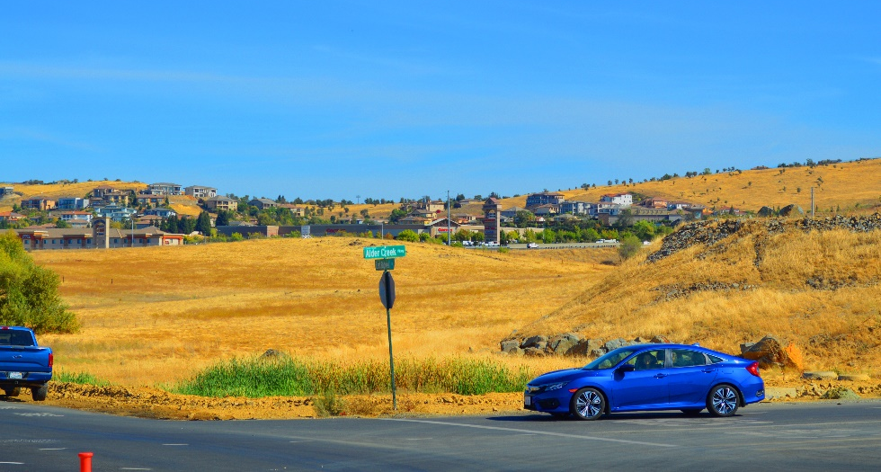
PC Recommended, CC Approved June 22, 2021
Dignity Health Development Agreement Amendment (PC approved PD Permit and CUP)
28-acre medical campus
2 medical office buildings
300 bed hospital
~530,000 square feet

Slide 14
PC Recommended, CC Approved June 22, 2021
Mangini Ranch Phase 3 Large and Small Lot Subdivision Maps
Large Lot Vesting TSM subdividing
173 acres into 14 large lots
Small Lot Vesting TSM subdividing
54.4 acres into 260 residential lots

Slide 15
PC Recommended, CC Approved June 22, 2021
Mangini Ranch Phase 1C (north) – Subdivision Map/Design Review
Residential Design Review
Large Lot Vesting TSM (32 acres)
Small Lot Vesting TSM subdividing 11 acres into 76 single family lots

Slide 16
PC Recommended, CC Approved June 22, 2021
Mangini Ranch Phase 1C (4-pack) – Subdivision Map/Planned Development
Planned Development
Small Lot Vesting TSM subdividing 11 acres into 100 single family small lots

Slide 17
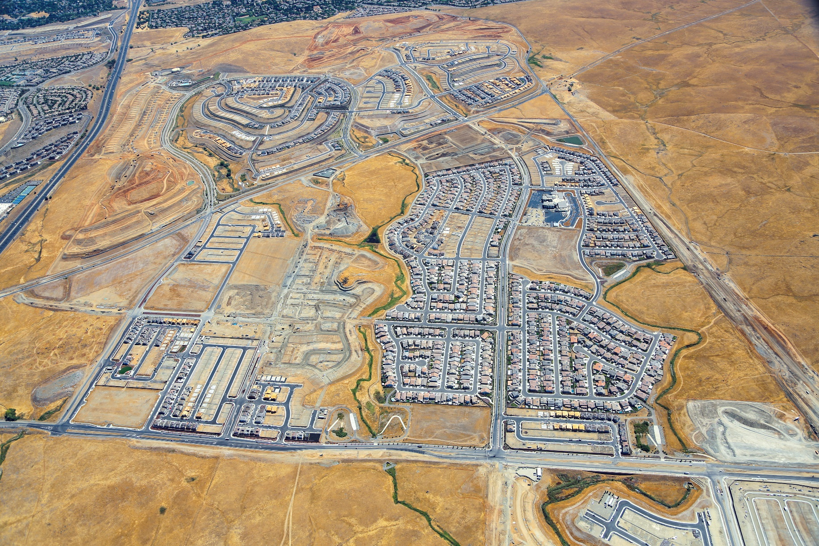
Infrastructure/Site Engineering Activity
(Last 90 Days)
White Rock Springs Ranch
Villages 2 - 7
Russell Ranch Phase 2
Russell Ranch Phase 3
Mangini Ranch Phase 2 Villages 4, 7, 8
Old Placerville Road
White Rock Road
Mangini Ranch Phase 2 Villages 1 and 2
Alder Creek Parkway
Mangini Parkway
Enclave
Subdivision
Creekstone Subdivision
Rockcress
Subdivision
East Bidwell Street
Toll Brothers
Phase 1

Slide 18
FOLSOM PLAN AREA SMALL LOT FINAL MAP ACTIVITY
Tentative Maps Approved by City Council | Final Maps Approved by CC | Small Lot Final Maps Submitted
Mangini Ranch Phase 1 (833 dwelling units) | Village 1 (May 2018) Villages 8 and 9 (May 2018) Village 2 (June 2018) Village 5 (September 2019) Villages 6 and 7 (November 2019) Village 4 (July 2020) Creekstone (December 2020) Village 3 (May 2021)
White Rock Springs Ranch (395 dwelling units) | Village 1 (July 2019) Villages 8 and 9 (October 2019) Villages 2 – 7 (December 2019)
Carr Trust (28 dwelling units) | Carr Trust (July 23, 2019)
Russell Ranch Phase 1 (394 dwelling units) | Village 6 (February 2019) Villages 1, 2, 3, and 7 (March 2019) Village 5 and 8 (May 2019) Village 4 (June 2019)
Russell Ranch Phase 3 (242 dwelling units) |  | Phase 3A and 3B
Enclave at Folsom Ranch (111 dwelling units) | Enclave (April 2020)
Mangini Ranch Phase 2 (545 dwelling units) | Village 7 (December 2019) Villages 4 and 8 (July 2020) Rockcress (Jan 2021) | Village 1 Village 2
Toll Brothers at Folsom Ranch (804 dwelling units) |  | Phase 1A, Phase 1B and 1C
Total SF Lots Ready for Permits | 2,130 lots mapped | 644 lots pending

Slide 19
Building Permit Tracking
FPA total permits 1399 (Q2: April – June 2021 = 321)
2018 permits issued: 159
2019 permits issued: 300
2020 permits issued: 395
2021 permits issued (January - June): 545
Total FPA Permits thru Q2 2021: 1399
Total homes occupied: 741
Estimated # residents (homes x 2.6 pph) = 1,926 persons

Slide 20
Russell Ranch Phase 1
Enclave
Mangini Ranch Phase 2
Carr Trust
White Rock Springs Ranch
Mangini Ranch Phase 1
Toll Brothers Phase 1

Slide 21
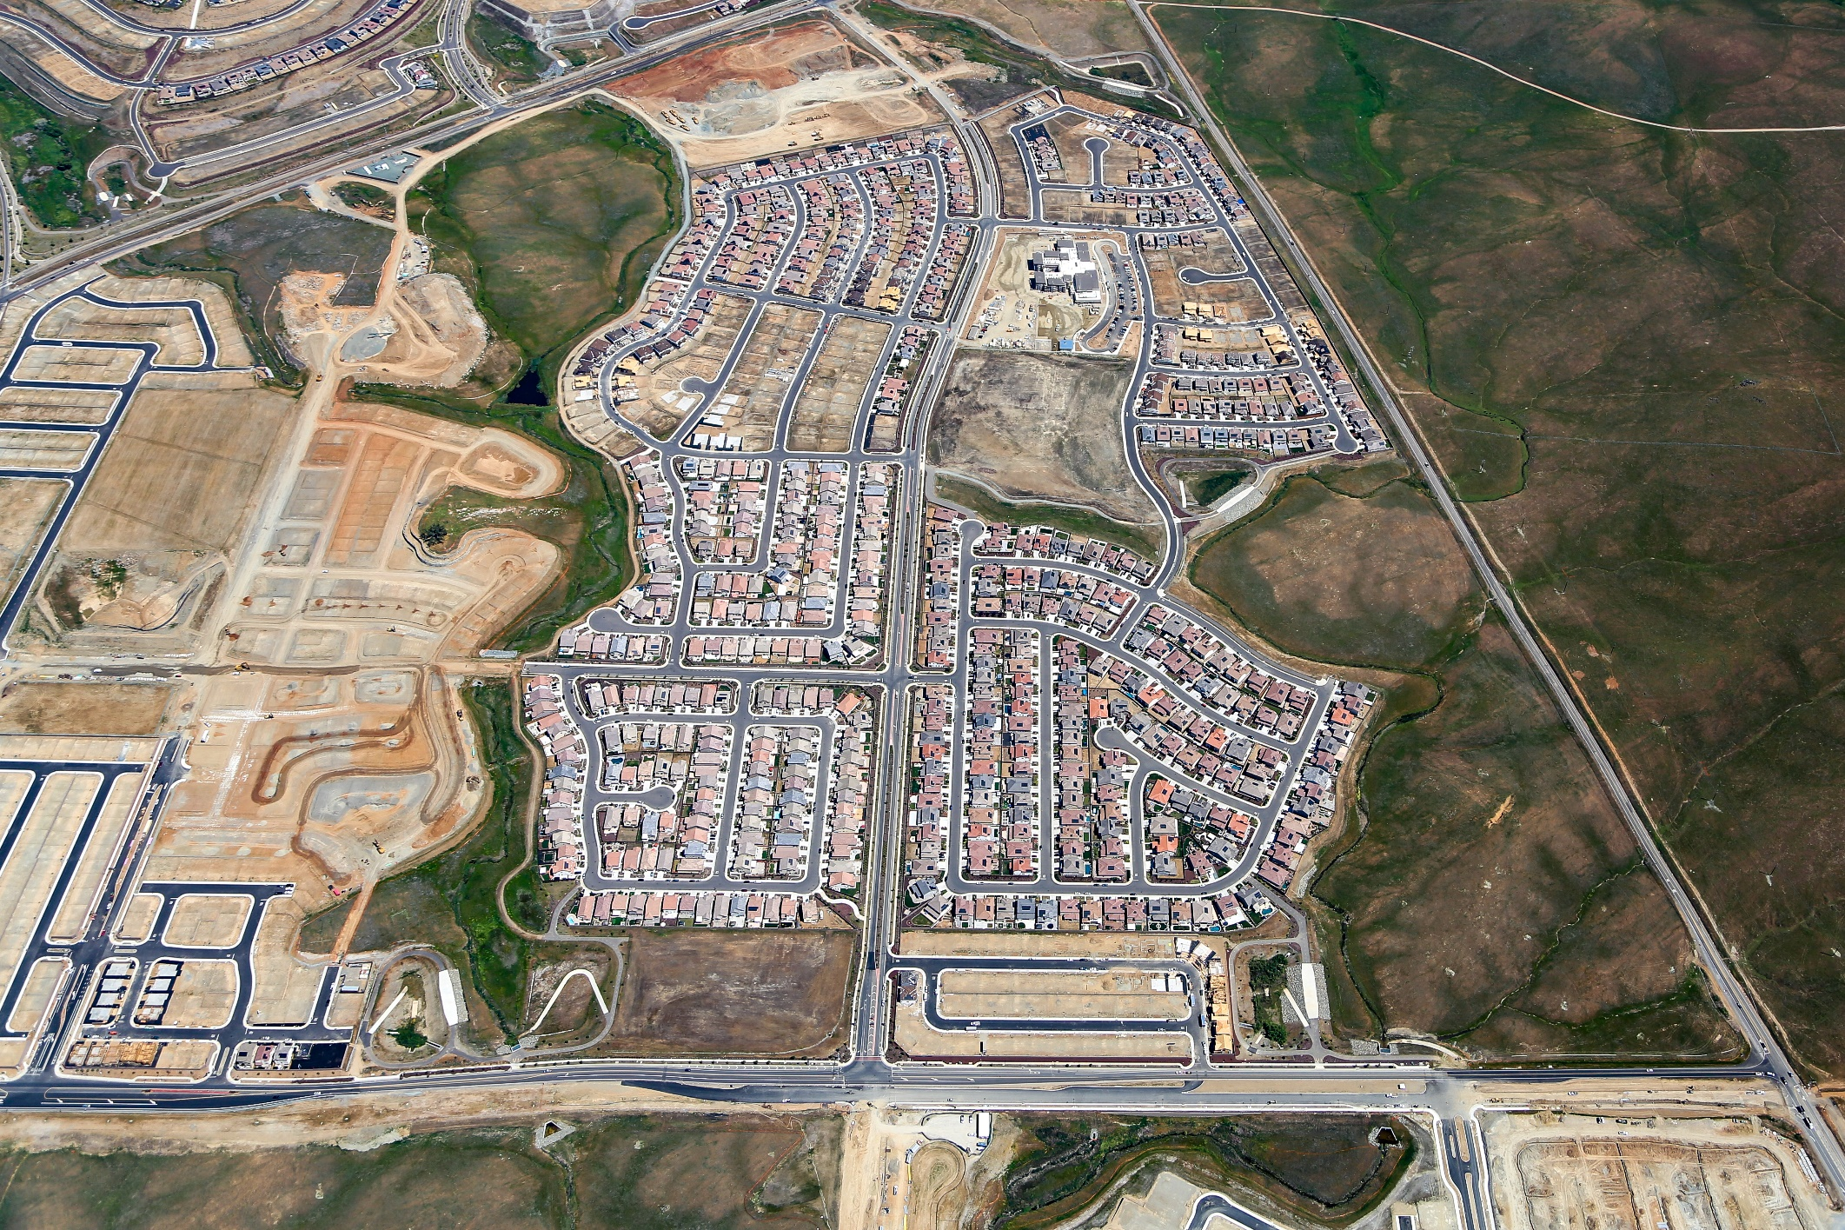
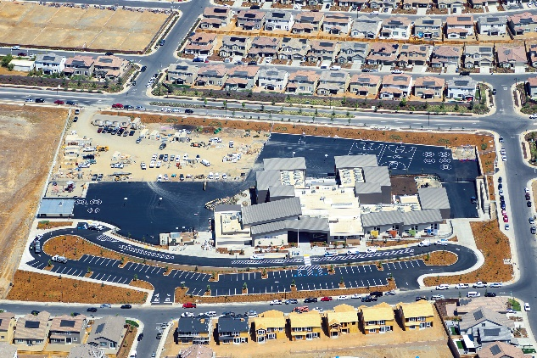
Mangini Ranch Phase 1 Neighborhoods
Taylor Morrison
Placerville Road
Placerville Road
Tri-Point
Park Site
School Site
Taylor Morrison
White Rock Road
Mangini Parkway
Lennar
Tri-Point
White Rock Road
East Bidwell Street

Slide 22
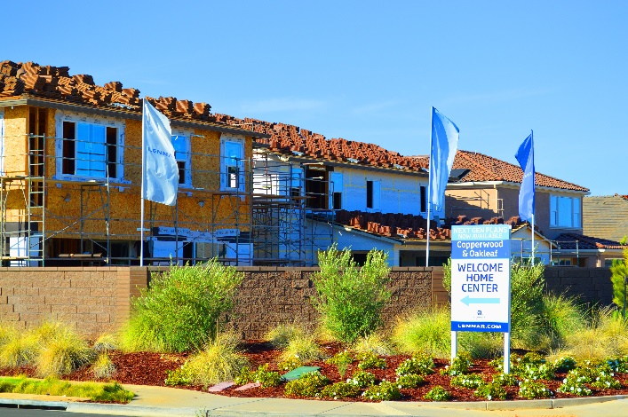
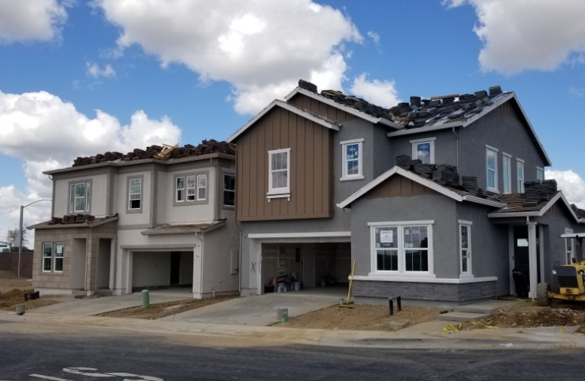
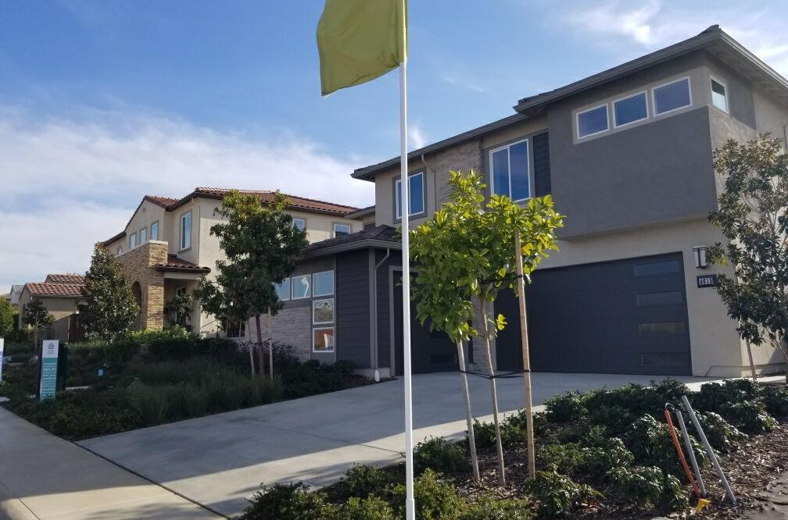
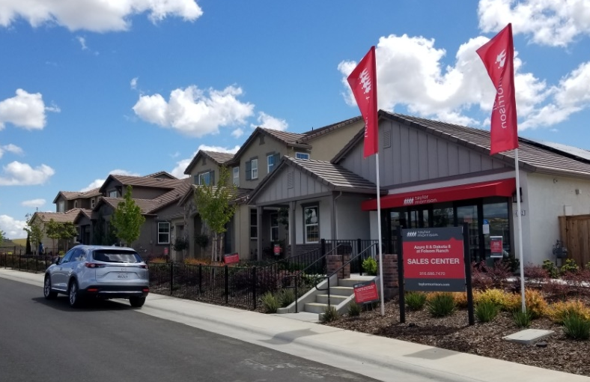
Building Activity
Mangini Ranch Phase 1 Builders
      Taylor Morrison (Villages 6, 7)
      Lennar (Villages 8, 9)
      Tri Pointe Homes (Villages 3 – 5)
      Tri-Pointe Homes (Creekstone)
Lennar: Villages 8 and 9
Tri-Pointe Homes: Creekstone
Tri-Pointe Homes: Villages 3 - 5
Taylor Morrison: Villages 6 - 7

Slide 23
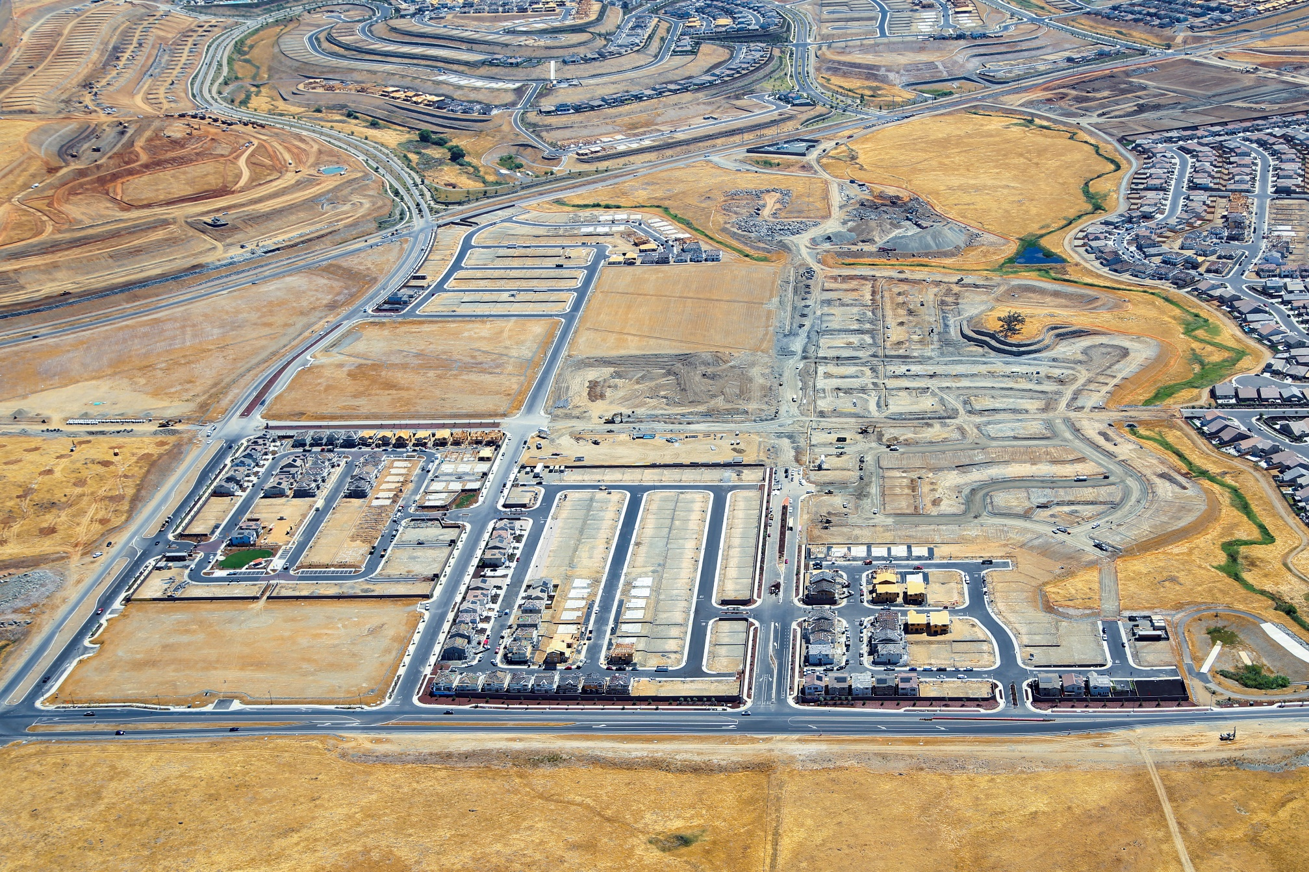
Mangini Ranch Phase 2 and Enclave Neighborhoods
KB Homes
(Soleil)
Placerville Road
Villages 1 and 2
Tri Point
Placerville Road
School Site
Park Site
Alder Creek Parkway
Savannah Parkway
Fire Station
KB Homes (Enclave)
Lennar Homes (Rockcress)
White Rock Road
East Bidwell Street
Signature Homes
(Village 7)

Slide 24
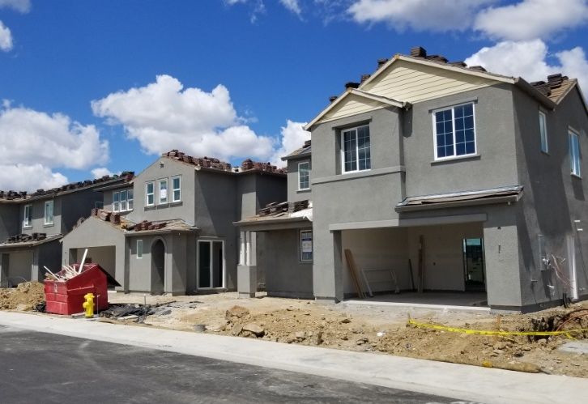
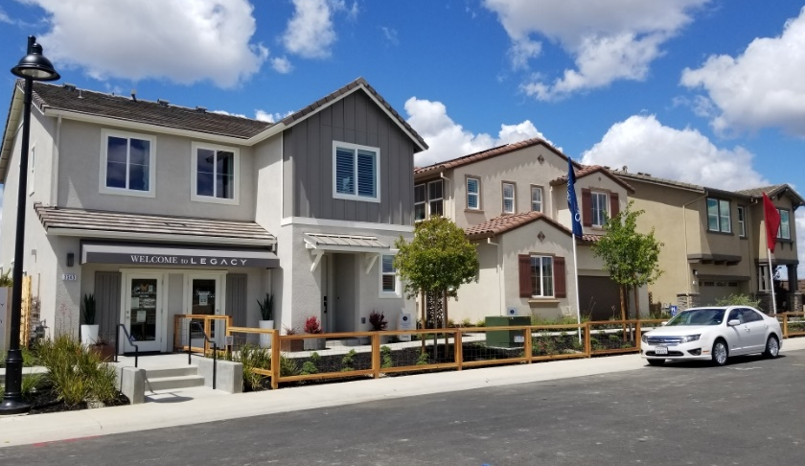
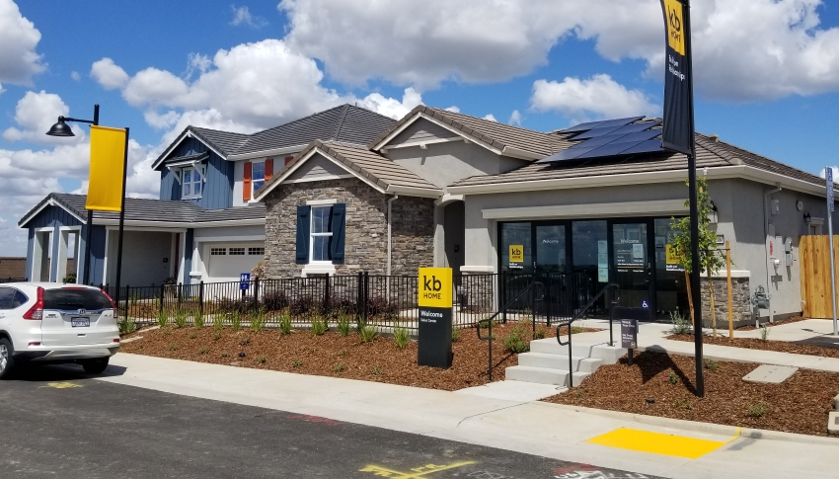
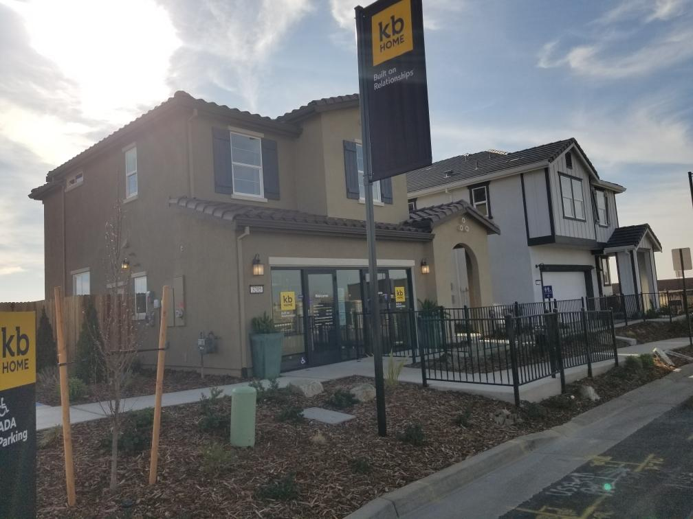
Building Activity
Mangini Ranch Phase 2 and Enclave Builders
      KB Homes (Enclave)
      KB Homes (Soliel)
      Signature Homes (Village 7)
      Lennar Homes (Rockcress)
Lennar Homes:
Rockcress
Signature Homes: Village 7
KB Homes: Soliel
KB Homes: Enclave

Slide 25
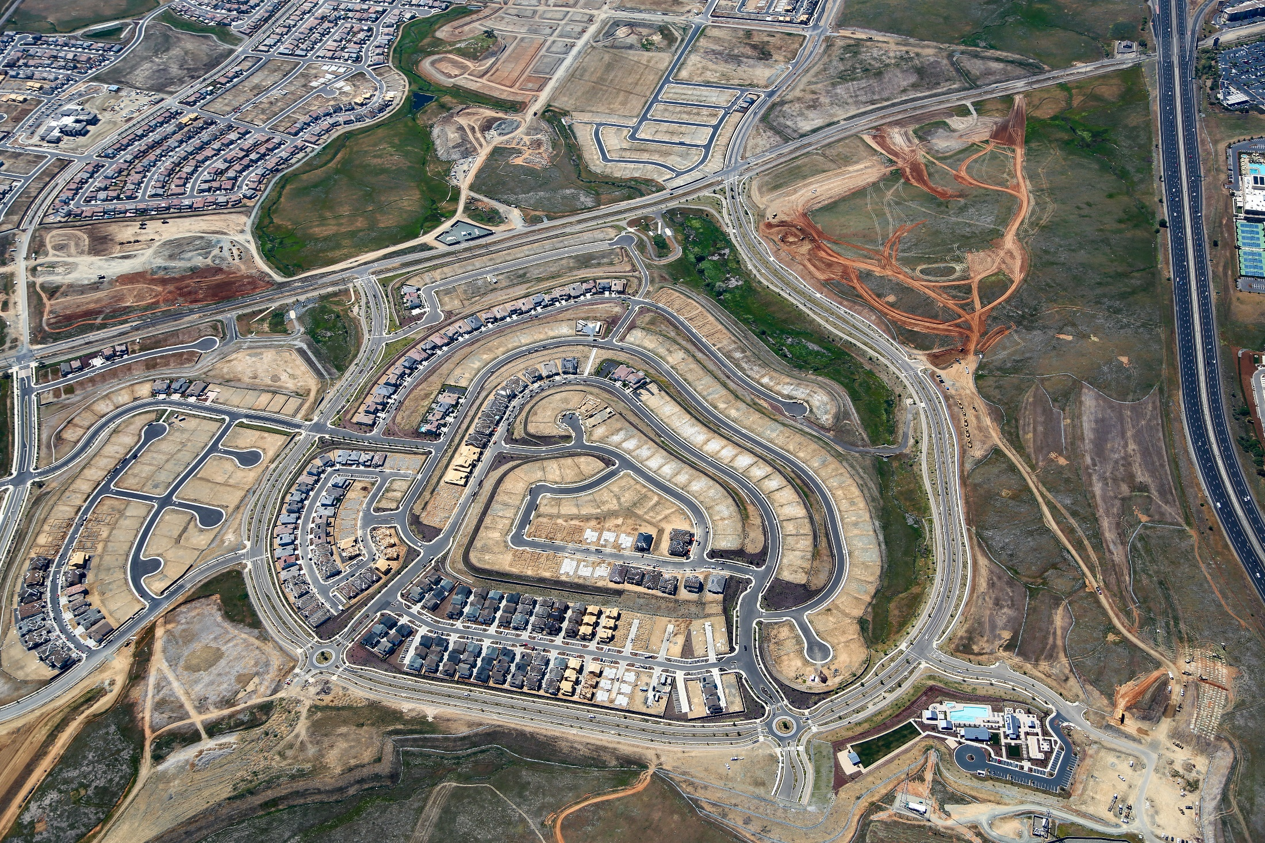
Russell Ranch Phase 1 Neighborhoods
Alder Creek Parkway
Placerville Road
The New Home Company Villages 1, 2, 3, 5, 7
Grand Prairie Road
Anthem United Villages 6, 8
Meritage Homes Village 4

Slide 26
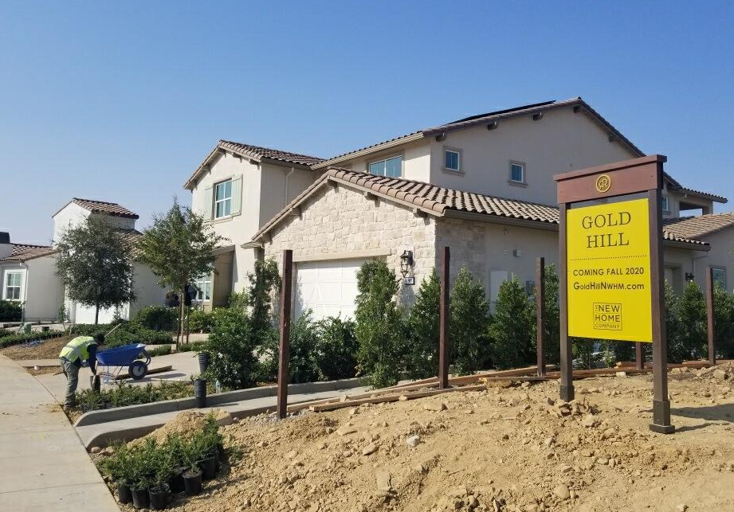
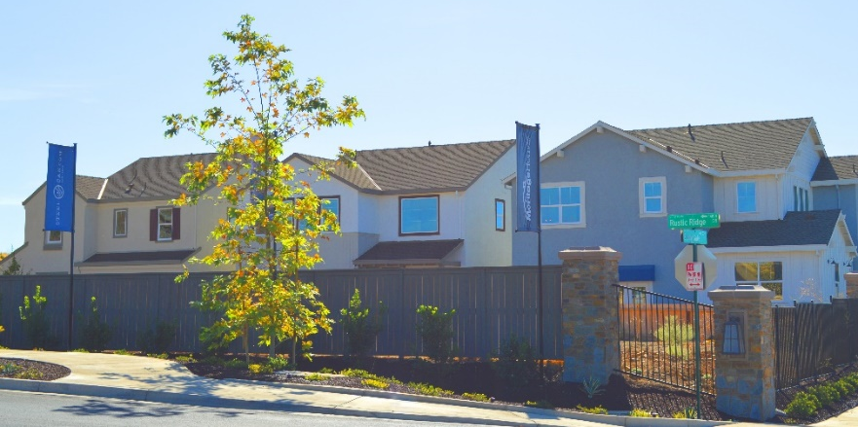
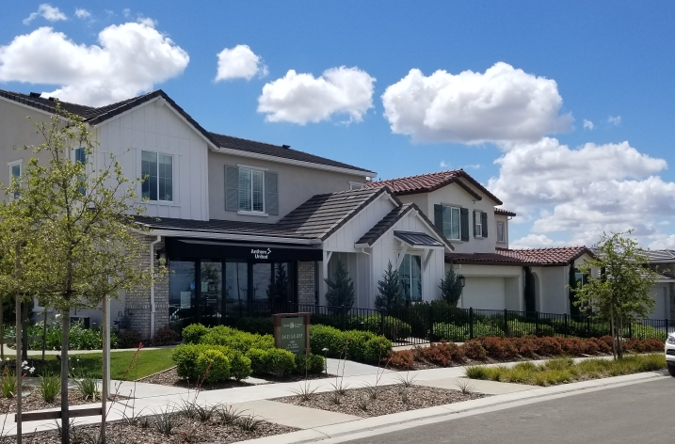
Building Activity
Russell Ranch Phase 1 Builders
  The New Home Company (Villages 1, 2, 3, 5, 7)
  Meritage Homes (Village 4)
  Anthem United (Villages 6 and 8)
New Home Company: Village 1
Meritage: Village 4
Anthem United: Villages 6 and 8

Slide 27
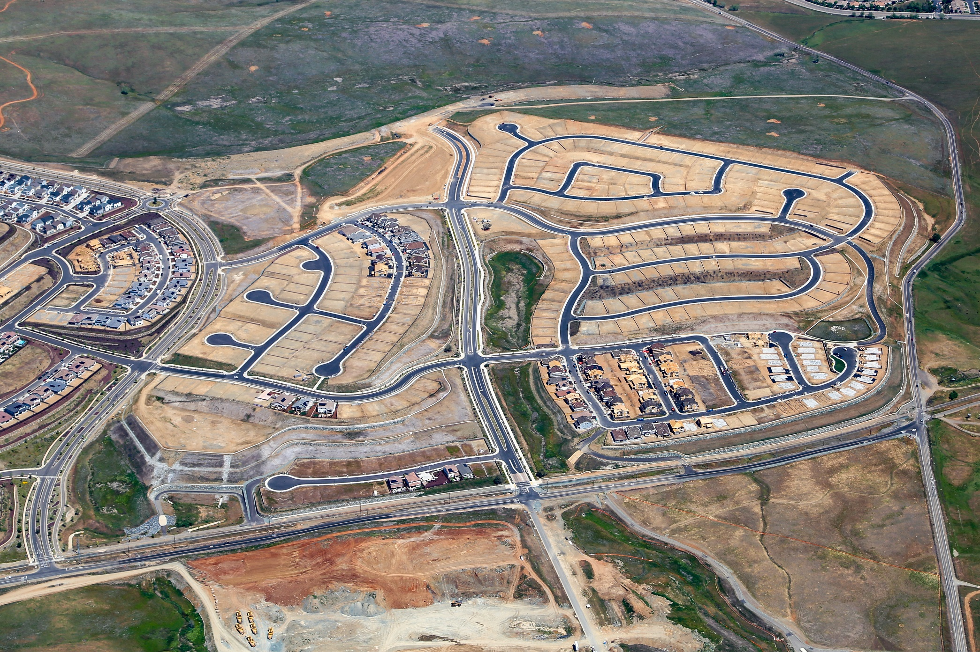
Carr Trust and White Rock Springs Ranch Neighborhoods
Rock Springs Ranch Road
Richmond American
Carr Trust/Village 1
Highway 50
Placerville Road
Alder Creek Parkway
Grand Prairie Road
JMC Homes
Villages 8, 9
Grand Prairie Road
White Rock Road
Grand Prairie Road
Mangini Parkway
Placerville Road

Slide 28
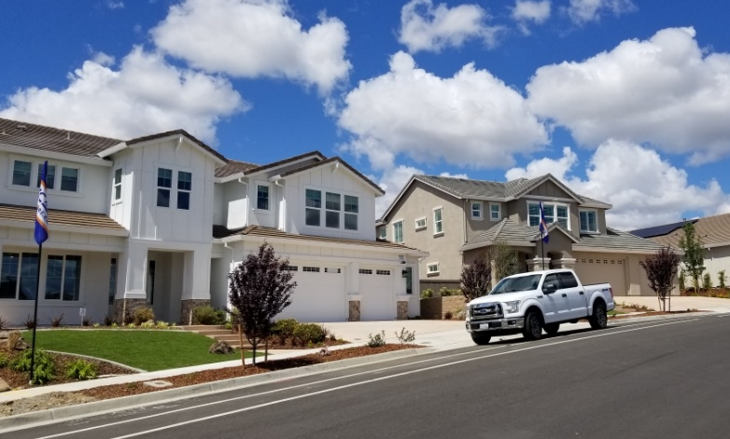
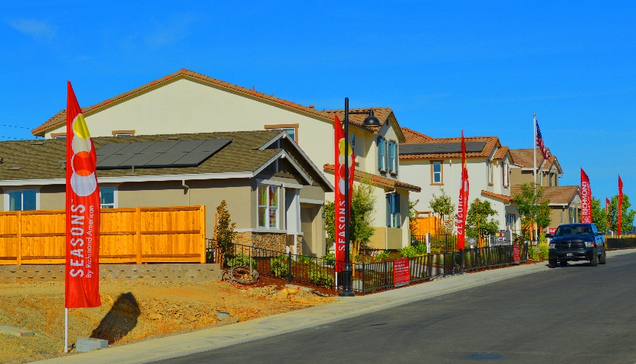
Building Activity
Carr Trust and White Rock Springs Ranch Builders
  Richmond American (Carr Trust/Villages 1 - 3)
  JMC Homes (Villages 8 and 9)
JMC Model Home Sites: Villages 8 and 9
Richmond American: Carr Trust

Slide 29
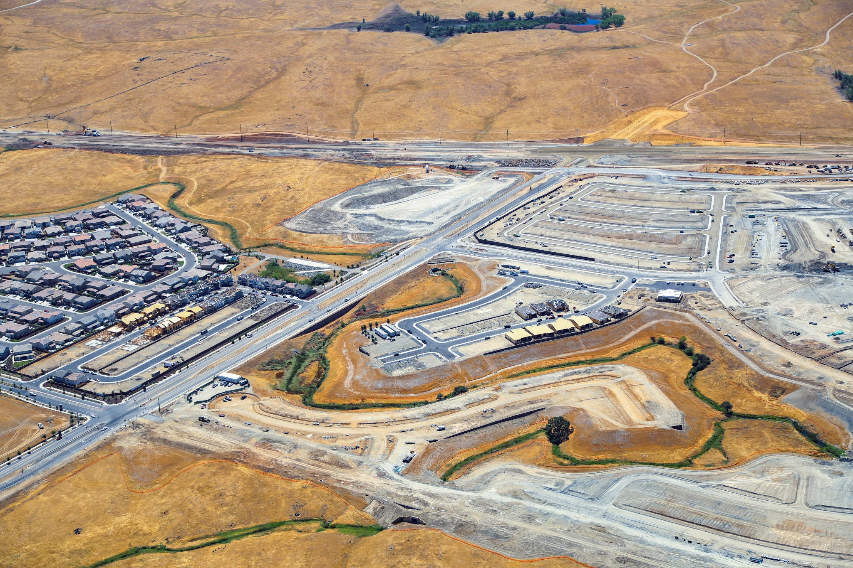
Toll Brothers at Folsom Ranch Neighborhoods
Toll Brothers
Phase 1B and 1C
Highway 50
White Rock Road
Placerville Road
Alder Creek Parkway
Grand Prairie Road
East Bidwell Street
Toll Brothers
Phase 1A
Grand Prairie Road
Mangini Parkway

Slide 30
Home Sales
Total sales 1217 (Q2: April – June 2021: 186)
Builder | April | May | June
Taylor Morrison (Azure II and Dakota II) | 4 | 5 | 10
Tri Pointe (Brookstone, Waterstone, and Creekstone) | 16 | 7 | 2
Meritage (Steel Canyon) | 5 | 7 | 0
Anthem United (Iron Ridge) | 5 | 3 | 1
New Home Company (SilverCrest and Gold Hills) | 7 | 8 | 8
Richmond American (Ladera, Mesa, and Stone Bluff) | 17 | 16 | 5
KB Homes (Enclave and Soleil) | 12 | 17 | 7
Lennar (Rockcress, Aster and Lunaria) | 5 | 4 | 6
JMC Homes (Sycamore Creek) | 1 | 3 | 5
Signature Homes (Legacy) | Completing Model Homes
Total | 72 | 70 | 44

Slide 31
Questions?
Quarterly presentations and additional project information can be found on the City’s website:
https://www.folsom.ca.us/government/community-development/planning-services/folsom-plan-area/maps-and-documents/-folder-162

