Slide 1
300 Persifer Street
Sale of Surplus Land

Slide 2
Background/Site History
Date | Actions
1961 - 2008 | City purchased site and used for Fire Station, City Hall Annex, City Library, and Army Corps offices for Folsom Lake Crossing
2009 - 2017 | Building vacant
2017 | City Council approved building demo, land use change from commercial to single-family high density, and 5 lot subdivision in keeping with Theodore Judah historic lotting pattern
September 2020 | City Council Resolution declaring 300 Persifer as surplus land for purpose of developing at least 5 for sale affordable housing units
September 2020 | Staff commenced surplus land disposition

Slide 3
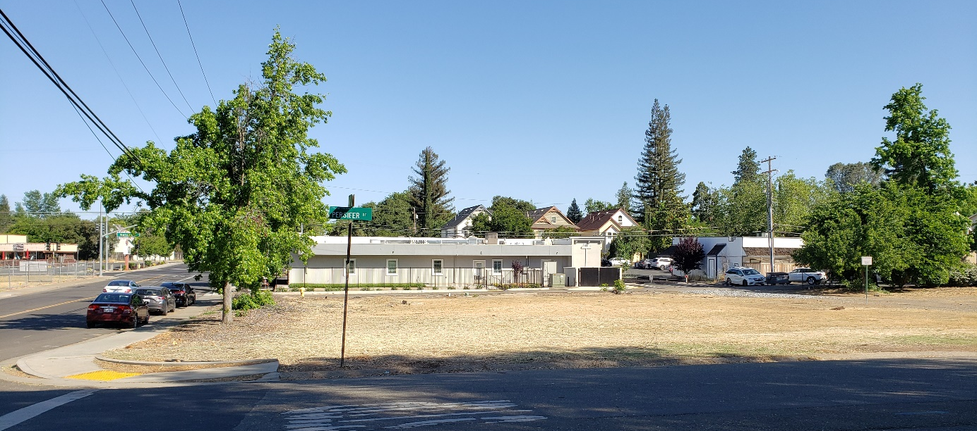
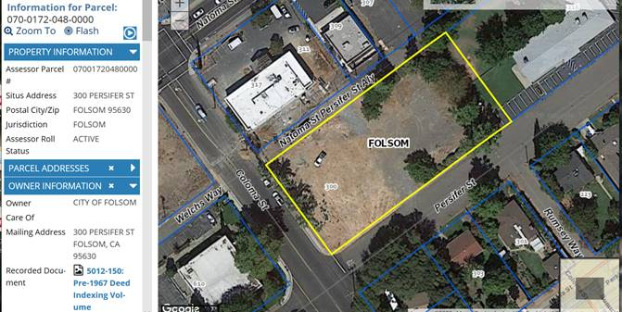
300 Persifer Street
Acreage: 0.91 acres
General Plan Designation: SFHD
Zoning Designation: R-1-M (SF Residential – Small Lot)
Historic District Persifer Dean Subarea (Design Guidelines)
Subdivide into five single family lots in the historic Theodore Judah lotting pattern (~7,000 sf, 50’w x 140’d)

Slide 4
Folsom’s Surplus Land Act Process
Date | Actions
September 2020 | City declared 300 Persifer as surplus land, staff prepared and distributed Surplus Land Notice soliciting interest (60 days)
November and December 2020 | City received two letters of interest from Habitat for Humanity and Retraining the Village
January – March 2021 | City conducted 90-day negotiation period with both parties
March 2021 | City received final proposals from both interested parties
April 2021 | City submitted summary of process and proposals to HCD
May 2021 | HCD letter confirming compliance SLA with reference to affordability preference and equity sharing agreement

Slide 5
State Review (HCD Letter 5-7-21)
Folsom land disposition process deemed in compliance with procedural requirements of Surplus Land Act
Habitat for Humanity proposed for 10 for-sale units for lower income households (6 units at 60% AMI and 4 units at 80% AMI)
Retraining the Village proposed 4 for-sale units for moderate income households (120% AMI), plus potential ADU and JADU rentals, plus 1 home for transitional homeless senior housing
City shall give priority to entity proposing greatest number of affordable units with deepest average level of affordability (Habitat for Humanity)

Slide 6
Habitat for Humanity:
10 for-sale affordable homes (2 homes/lot)

Slide 7
City Cost Analysis:
Habitat Project: 10 affordable for sale units
Estimated Total Project Cost | Cost Per Unit (10 total) | City Contribution | Habitat Funds | Funding Gap/ Funding Source
(Estimated land value = $625,000) | ~$62,500/unit | Dispose of land for $10,000
Offsite Infrastructure $751,000 | $75,100/unit |  |  | Housing grants or subsidy request
Design and Permitting $425,000 | $42,500/unit |  |  | Housing grants, impact fee reduction, and/or subsidy request
Home Construction $1,649,000 | $164,900/unit |  | $1,649,000
Total $2,825,000 | $282,500/unit | ~$61,500/unit | $1,649,000 | $1,176,000
Average City subsidy for affordable rental unit is $55,000/unit with average housing fund loan of $2.8M |  | $55,000/unit

Slide 8
Habitat Historic Land Cost
6 Habitat Projects Sacramento Region
Ave price paid $1,222/lot
Habitat offering Folsom $10,000 from budget reserves for 5 lots ($2,000/lot)

Slide 9
Project Benefits
Consistent with City Council direction (2017, 2020)
Consistent with 2021 Housing Element
  Goals, policies and implementation programs to facilitate affordable housing, accessory dwelling units and multi-generational housing, and to facilitate affordable housing development on City-owned land
Creates new type of affordable housing in Folsom:
  Historically, land costs and impact fees have been preventative factors
  Infill development utilizing existing infrastructure and services
  Provides homeownership opportunity for 10 qualifying Folsom families/individuals (builds wealth over time)
Opportunity to enhance the existing neighborhood

Slide 10
Recommend sale of 300 Persifer to Habitat with the following terms:
Property will be subdivided by the City into 5 individual residential lots (Theodore Judah lotting pattern).
Property will be sold to Habitat for a total sum of $10,000 for the purpose of creating at least 1 for-sale affordable housing unit on each of the 5 lots, with an additional smaller secondary or accessory dwelling unit on each lot.
Transfer of ownership of the property to Habitat is subject to a Regulatory Agreement and Declaration of Restrictive Covenants.
City will support Habitat’s efforts to secure future grant funding and/or fee reductions for off-site infrastructure improvements, design and permitting.

Slide 11
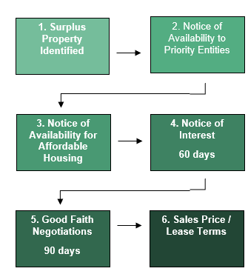
Surplus Land Act Requirements
No Offers or Agreement on Terms
If there are no agreement on terms or no offers on the surplus property, the City may sell the property without further obligations, except:
If the site is later developed as residential with 10 or more units, at least 15% of the units must be affordable to lower income and must have recorded the following affordability restrictions.

