Slide 1
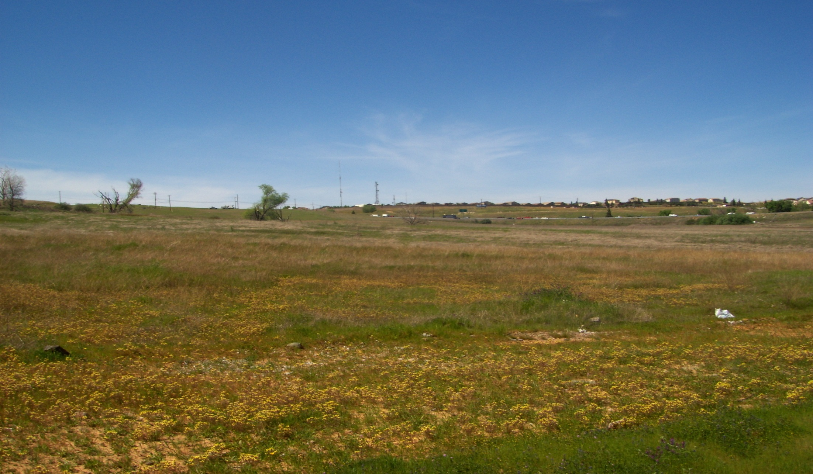
Folsom Heights Subdivision
Folsom Heights Subdivision
Small-Lot Vesting Tentative Subdivision Map Extension (PN 21-233)

Slide 2
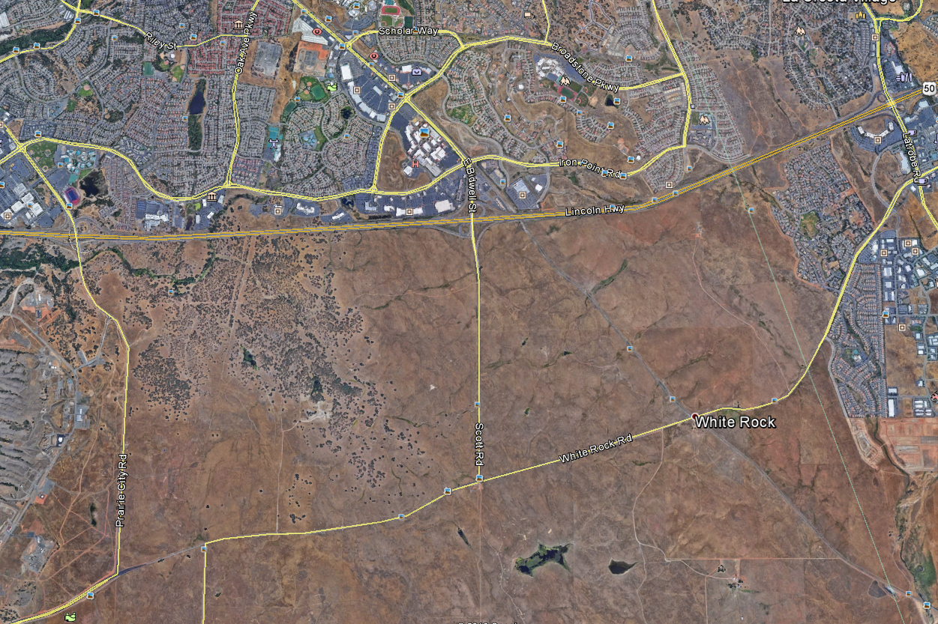
Vicinity Map

Slide 3
Project Background
July 11, 2017: City Council Approval of a Large-Lot Vesting Tentative Subdivision Map, Small-Lot Vesting Tentative Subdivision Map, Project Design Guidelines, and Inclusionary Housing Plan for Development of a 530-Unit Residential and Commercial Development (Folsom Heights) on a 189.7-Acre Site Within the Eastern Portion of the Folsom Plan Area
October 24, 2017: City Council Adopts Motion that the Prima Drive Extension Should be Constructed as an Emergency Vehicle Access (EVA) Route Only, with Accommodation for Pedestrian and Bicycle Access.
August 27, 2019: City Council Approval of a Three-Year Extension in Time for the Previously Approved Small-Lot Vesting Tentative Subdivision Map associated with the Folsom Heights Subdivision Project
August 11, 2021: Applicant Submits Timely Letter to City Requesting Three-Year Extension in Time for the Small-Lot Vesting Tentative Subdivision Map Associated with the Folsom Heights Subdivision Project
September 28, 2021: City Council Approves Ordinance No. 1317 Pertaining to Extension of Tentative Subdivision Maps (Allows Extension of Subdivision Maps up to Total of Six Years)

Slide 4
Approved Master Plan Exhibit

Slide 5
Key Project Details/Analysis
Entitlement Extension Request:
Three-Year Extension of Small-Lot Vesting Tentative Subdivision Map
Analysis:
Timely Letter Submitted by Project Applicant on August 11, 2021
Elliott Homes Purchased Property from Folsom Heights, LLC on April 5, 2021
Applicant (Elliott Homes) Fully Invested in Moving Forward with Project
Designing Civil Site Improvements with Goal of Grading by Summer of 2022
No Changes or Modifications Proposed to Approved Project
No Changes on Project Site or in Project Vicinity that Would Require Modification to any Conditions of Approval for the Project
Staff Supportive of the Three-Year Extension for the Small-Lot Vesting Tentative Subdivision Map
Planning Commission Reviewed Project at its November 3, 2021 Meeting

Slide 6
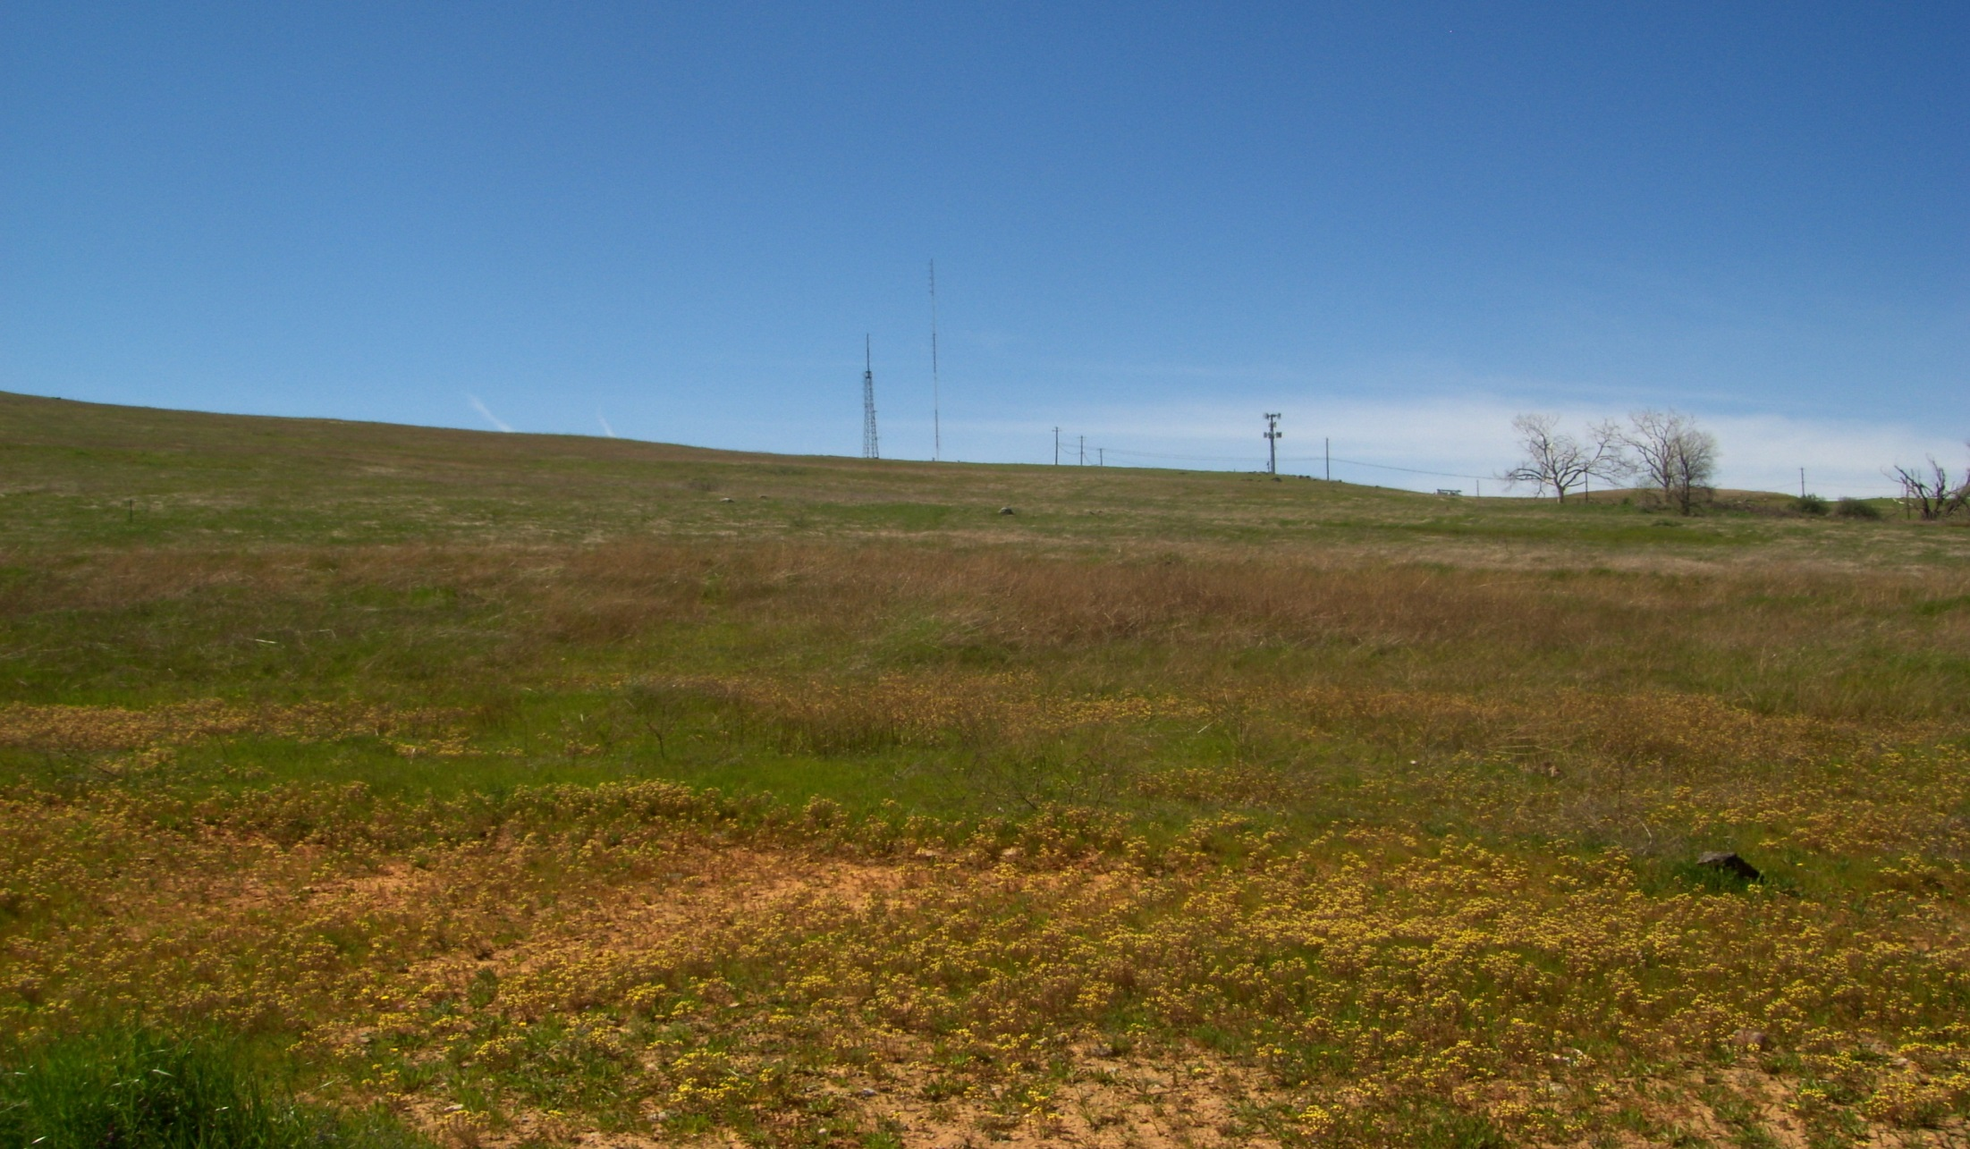
Staff Recommendation
Staff Forwards Planning Commission Recommend to City Council for Approval of the Folsom Heights Subdivision Small-Lot Vesting Tentative Subdivision Map Extension

Slide 7
Approved Small-Lot Vesting Tentative Subdivision Map

Slide 8
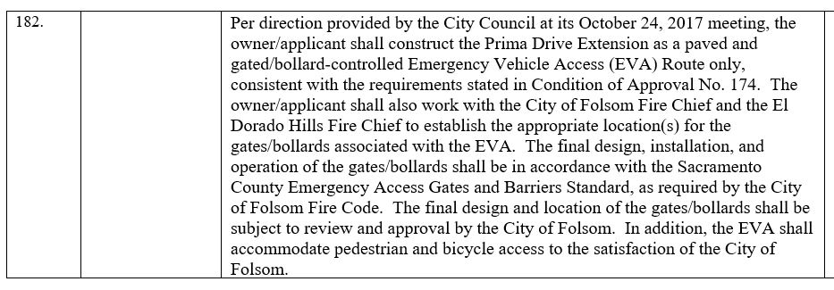
Prima Drive Conditions

Slide 9
Prima Drive Conditions

Slide 10
Park Facilities
Park Facilities
Two Large Community Parks
Five Neighborhood Parks
Park Locations Consistent with FPASP
City Council Policy on Additional Parks

Slide 11
Bicycle and Pedestrian Access to Parks and Schools

Slide 12
Trail System Modifications

Slide 13
Prima Drive Extension

Slide 14
Roadway Design

