Slide 1
Proposed Waste & Recycling Rate Increase
Public Hearing December 14, 2021

Slide 2
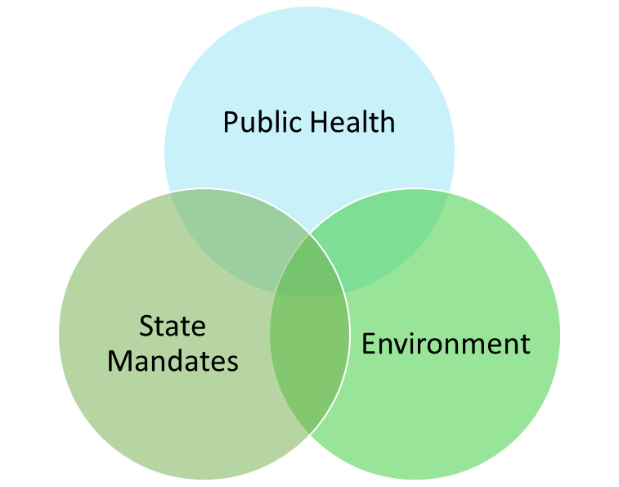
Drivers of Rate Study
Solid waste services must meet the needs of the public and environment in accordance with State Law
SB 1383 - California’s Short-Lived Climate
Pollutant Reduction Strategy
  Mandates programs to divert organics from landfill.
  Costs were unknown during prior rate study.
  Regulations completed November 2020.
  The current Solid Waste fund cannot support
  mandated programs.
Up to $10,000 per day for
non-compliance
Notes:
Good evening mayor and members of the council. Marie McKeeth, General Services Manager for the Solid Waste Division.
As our director mentioned, the rate study was prompted by a new law called SB 1383. SB 1383 is not a Solid Waste law; it is a pollution reduction law. Removing organic material from landfills is the pollution reduction strategy that is the focus of the new law. As a result, Solid Waste programs throughout the state are experiencing drastic changes that come with a large price tag, the most expensive being weekly collection of residential organics.
In 2019 the Waste & Recycling Division performed a detailed rate analysis resulting in rate increases. At that time, residential rates had not increased since 2003. Increasing expenses, a number of unfunded recycling mandates, and an unprecedented crash in recycling markets necessitated that a rate increase be implemented immediately to fund current operations.
So, despite knowing SB 1383 regulations were pending, the department proceeded with increases with the expectation that we would need to return and ask for additional increases once the SB 1383 regulations were complete.
Regulations were finalized in November of 2020 with an effective date of January 1, 2022. With just 13 months to implement changes that require massive increases to resources, the Department began planning immediately, including a rate study.

Slide 3
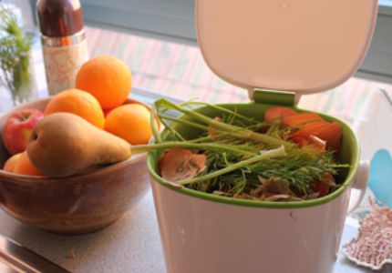
Update to Rate Model
SB 1383 Expenses
Electric Refuse Truck and Landfill Fees ($1.5M)
Notes:
During the 2019 rate study the Division developed a rate model allocating every expense and revenue to specific programs and established rates to match expenses with revenues.
For the current rate analysis, we utilized the existing rate model start with the base year of FY 21 and then adding the new expenses.
This slide shows the new expenses that were added to the rate model. The first three are primarily start up costs but include some ongoing expenses as well. The others are ongoing operational costs, including equipment, staffing, and additional processing costs of organic material.
Once the new expenses were added, rates were then adjusted to eliminate the deficit that would be created while maintaining a positive fund balance for the next five years.
*Equipment (vehicles & cans) – Ongoing annual cost of $260K for replacement at end-of-life cycle trucks (res truck 8 years, cans 10 years)
* Six drivers – to provide weekly collection to residents and businesses, and account for modifications to the bulky waste collection
* Organics processing –at the time of the previous rate study our annual cost was under $300K, now it will be close to $1M. Based on us providing clean material to the facility.
* Procurement – Requires .08 tons (160 lbs) organic waste per capita, compost equivalent is ~3700 tons, mulch ~9300 tons
Increased Landfill Fees - contract expires 6/30/22. about $600K in the first year. (Current ~$1.4M)
Electric Vehicle Pilot Program (~$900K). By 2045 all heavy-duty trucks sold in California must be electric.

Slide 4
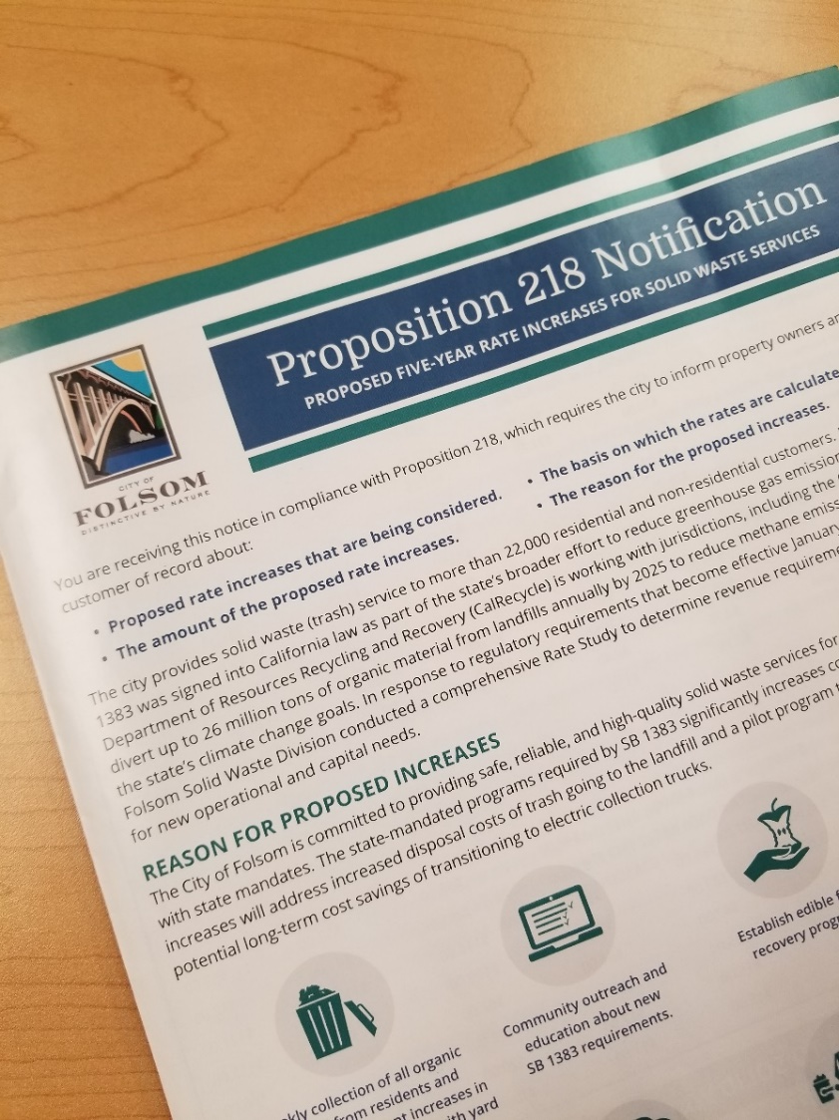
Community Outreach
Electronic Media
  Four e-newsletters sent to 9,000+ emails
  Social media: Facebook, NextDoor, & Twitter
  Dedicated web page: www.folsom.ca.us/utilityrates
  6,000+ reminders on the Waste Collection app
  Over 1,000 direct emails to customers
Printed Notices
  Notice printed on utility bills
  Flyer inserted into utility bills
  Two newsletters to 30,000+ households and businesses
  Four ads in the Folsom Telegraph
In Person
  Presented at six public meetings
    Four Utility Commission and two City Council
  Community meeting on November 8th
Notes:
Solid Waste utilities are funded almost entirely by user rates and fees so unfortunately as costs increase, rate increases are necessary to maintain service levels. The rates being considered today are the result of unfunded mandates placed on all jurisdictions throughout California.
Throughout this process the City remained committed to ensuring those impacted were informed and had every opportunity to provide input. Proposition 218 requires notifications be sent to every property owner and that a public hearing is held prior to adoption of utility rate increases.
The City of Folsom went beyond this minimum by providing information multiple times using different methods to reach everyone. Information was published electronically, in print and in person to ensure the community was informed, could provide input, and have their questions answered.

Slide 5
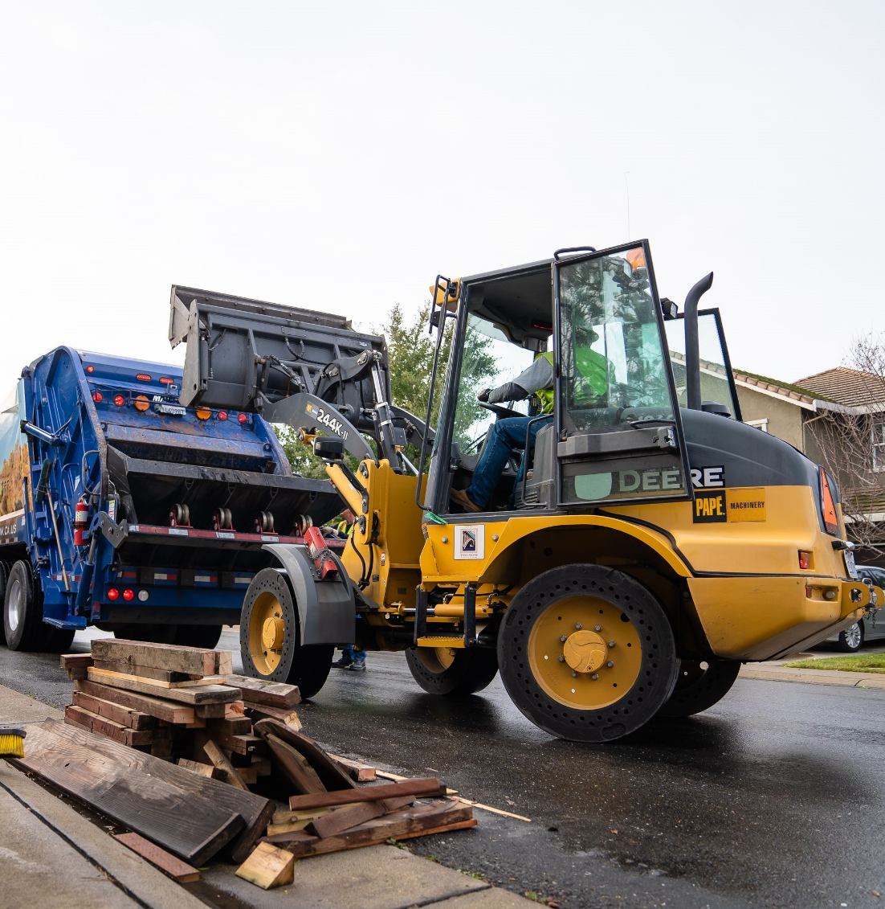
Community Feedback
Household Hazardous Waste
  Residents will illegally dispose of waste to avoid fee
  Environmental risk is too great
Bulky Waste
  Illegal dumping will increase
  Offer one per year for no cost
Notes:
In following through with our commitment to community engagement, I will review the feedback received from the community.
The number one concern we heard was regarding the proposed fee for HHW collection. The concern is that residents will harm the environment by illegally disposing of HHW to avoid the fee. In response to this feedback, I have provided the Council with an alternate rate schedule that omits the HHW collection fee. Removing this fee from the proposal has a small impact (approx .3% by year five) of on-going operational cost, but based on community feedback, the department recommends omitting this from the proposal in the interest of managing the environmental risk of improperly handled hazardous waste.
To a lesser extend, also concern that charging for BW pickups would increase illegal dumping. The intent charge a little more to those who receive a direct benefit of the program while still providing everyone a cost-effective way to responsibly get rid of bulky items. One common suggestion was to continue providing the first appointment for no charge. The proposal to charge for all bulky waste is estimated to generate approximately $300,000, or approximately 1.5% of operating costs per year by year five. Less than 10% of households use more than one pickup per year, the revenue for charging only after the first pickup would be minimal but still incur the added administrative cost of implementing the new fee.

Slide 6
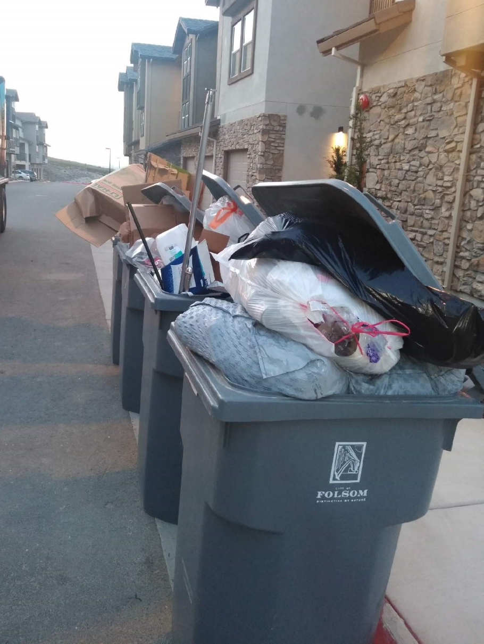
Community Feedback
Smaller cans
Increase enforcement
Impact on low-income customers
Pickup trash every other week
Support for the rate increase
Notes:
Residents would like smaller can option, not all for the same reason. Where required to store containers in the garage the primary concern is space. Others want smaller cans is to save money and encourage waste reduction.
It takes the same truck and driver the same amount of time to dump a small can as a large one. Pickup is the costliest part of the service. Less waste (by weight) is small savings in disposal. Issue with cost savings to incentivize the use of smaller cans is that contamination increases in the other cans; overfull containers. Variation in can size = more wear and tear on larger cans as they are gripped too tightly or an increase in cans dropping into the truck during service.
Smaller cans have smaller footprint (35 gallon saves 3” width and 4” depth). Considering pilot to evaluate its effectiveness.
Residents want the City to enforce rules against overfilling. Feedback that everyone pays more for those who overfill. Waste & Recycling Division will explore these options for potential operational solutions and future rate considerations.
Concern for low-income residents. Proposal maintains the current discount and increases it incrementally over the five-year period.
income eligibility by household size, 1 - $25,760, 2 - $34,840, 3 - $43,920, 4 - $53,000, 5 - $62,080
Pick-up trash weekly. This would save money. CCR requires that garbage and organics both be collected at least weekly.
Support - residents are glad to see compost service being provided in Folsom.

Slide 7
Typical Monthly Residential Bill
Notes:
Finally, the last piece of feedback I have to share is that the information sent out was confusing. In response, we did outreach that simply and clearly stated what the typical residential bill will be on January 1st if the proposal is adopted and directed residents to the rate study webpage. Message pushed out using the e-newsletter, social media, and service reminders. In addition, these next two slides are intended to clearly show how the proposal would impact the typical residential customer.
The typical residential customer has one 65-gallon trash, one 95-gallon recycle and one 95-gallon yard waste can. Currently the monthly cost for these services is $34.50.
Based on our current rate schedule, this service would be $45.75 by July 1, 2023, which would support existing services; however, it will not support the changes required by SB 1383.
Most of the proposed rate increase is a direct impact of SB 1383. To identify this as the driver behind the increase, the proposal includes SB 1383 costs as a separate line item on the bill. The typical bill with the program surcharge would go up to $46.25 per month on January 1, 2022. At $11.75 per month, this is the single largest increase in the proposal and is necessary to fund start up costs associated with purchasing new equipment.
By July 1, 2023, the proposed rates would be $10.25 higher than they would be without this increase. Since this proposal would add two years to the current rate increase schedule, the net increase being proposed over what is already scheduled is $14.25 per month by the end of the new rate proposal period.

Slide 8
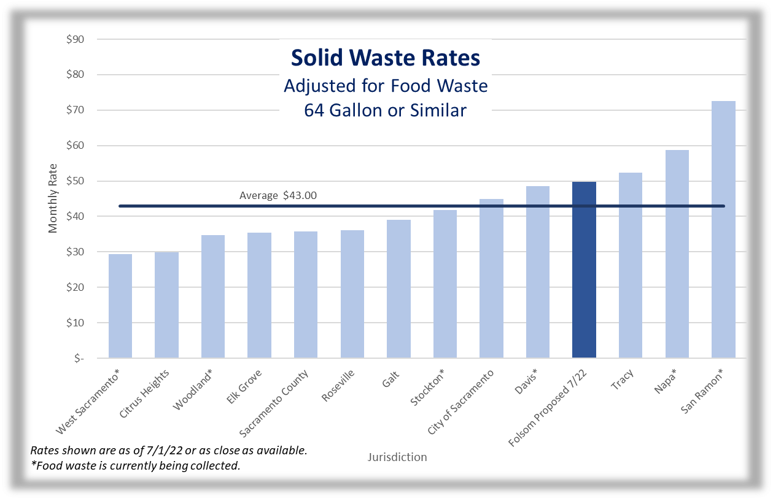
How does Folsom compare?
Notes:
Jurisdictions throughout the state are adjusting rates to meet the new mandates and many are still negotiating the rate with organics.
Folsom rate shown is for next July. This is the most appropriate number since it is our target start date for citywide collection. If future rates are published for other jurisdictions, that is what is shown, otherwise it is their current rates.
Among those jurisdictions already collecting food waste for recycling, the average rate is $47.62, which is comparable to our proposed rate of $49.75.
Case studies on CalRecycle (both franchised): Stockton increased 32.6%, San Ramon increased 29%. The proposed increase would put Folsom at $49.75 in July of 22. Currently our approved rate in next July if $39.50 so this would be an increase of 25%.

Slide 9
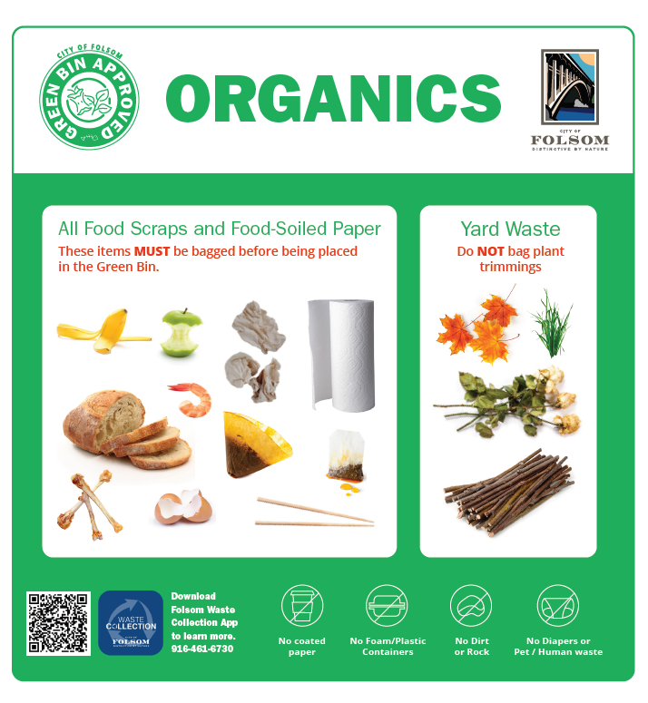
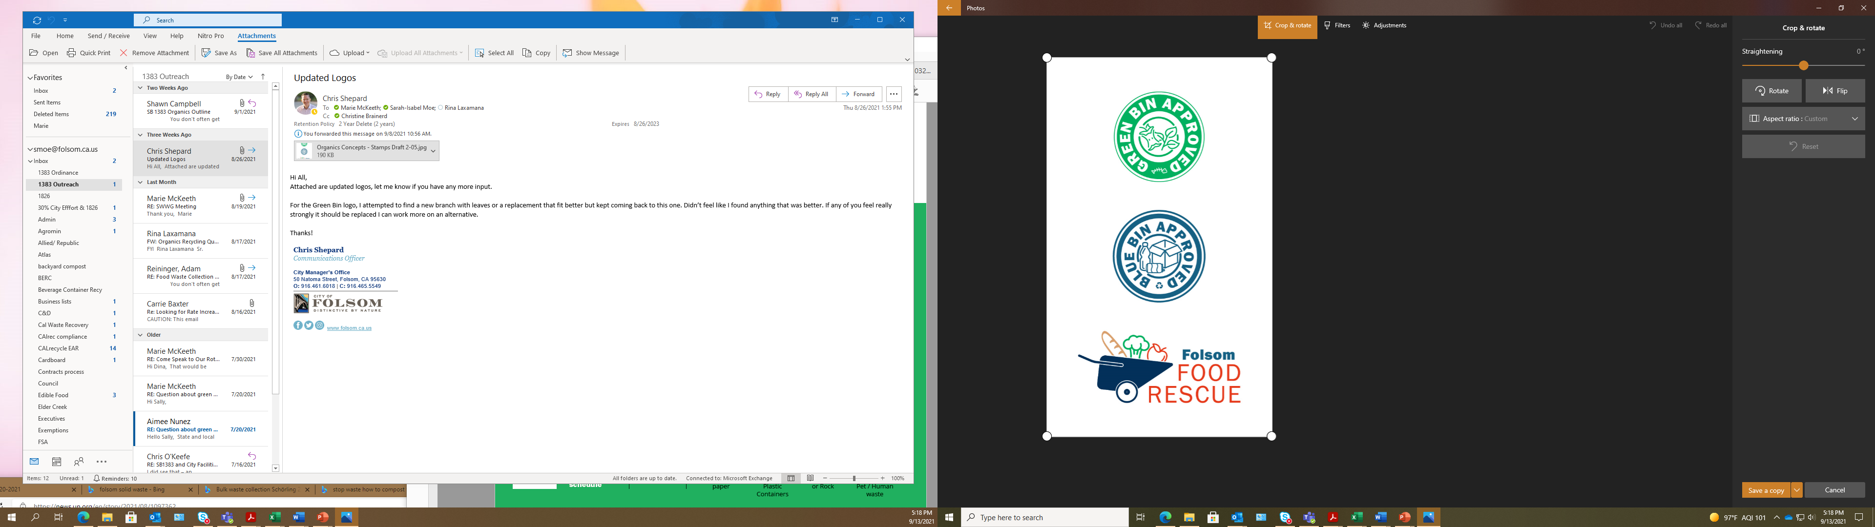
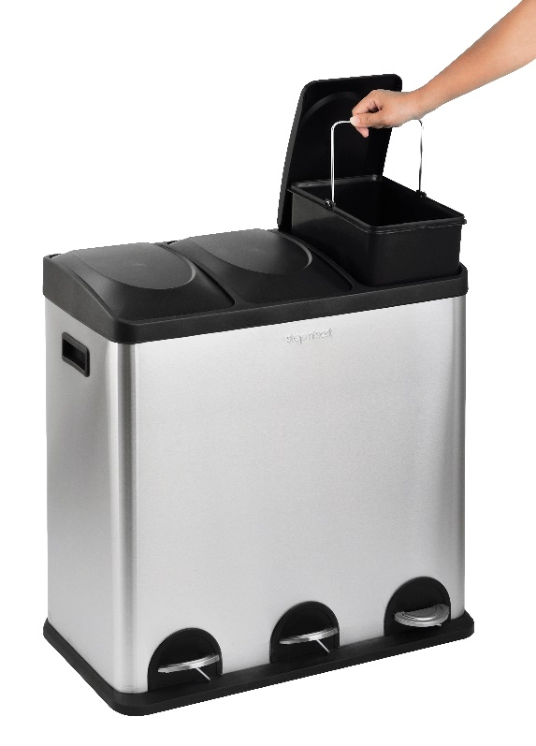
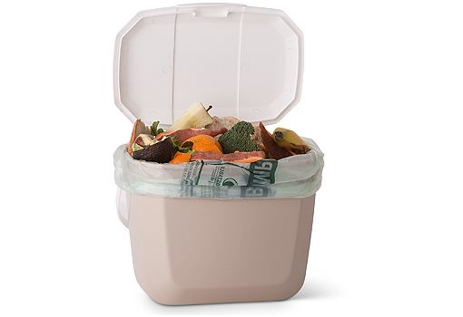
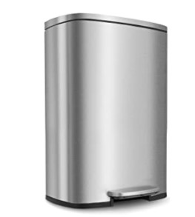
Residential Program 2022
Education & Outreach
July 1 – Green Bin Approved includes all “organics”
Un-coated food-soiled paper
No Styrofoam or coated paper
Indoor Bins & Bags

Slide 10
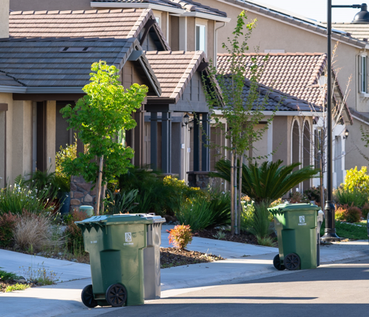
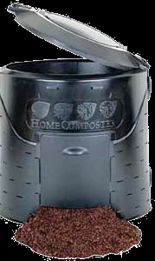
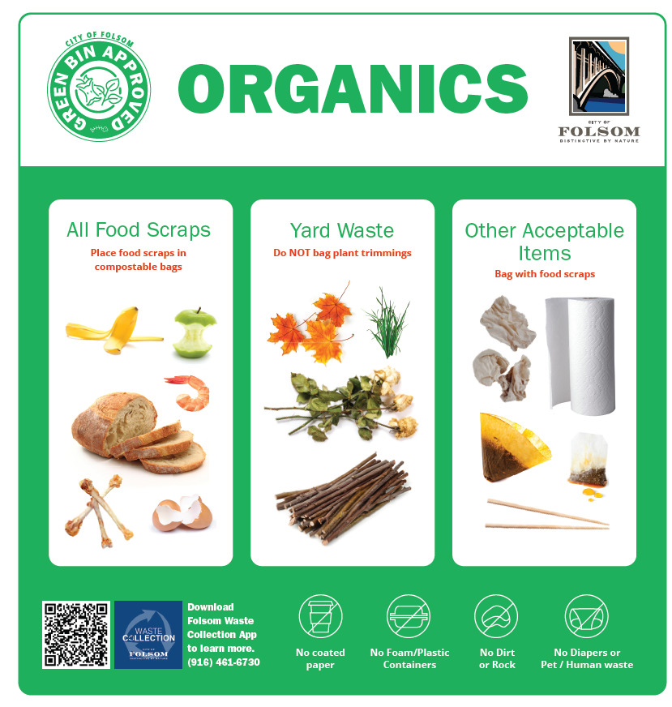
Residential Green Bins
Use same green bin as yard clippings
Same food waste, just different place
Ok to use your backyard Compost bins too
Green bin becomes weekly service
Compost giveaways

Slide 11
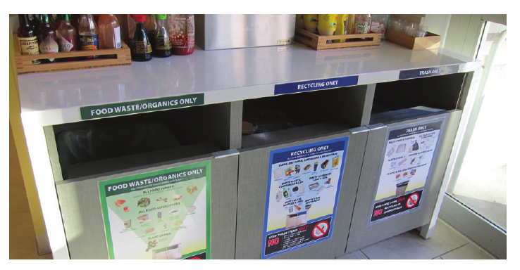
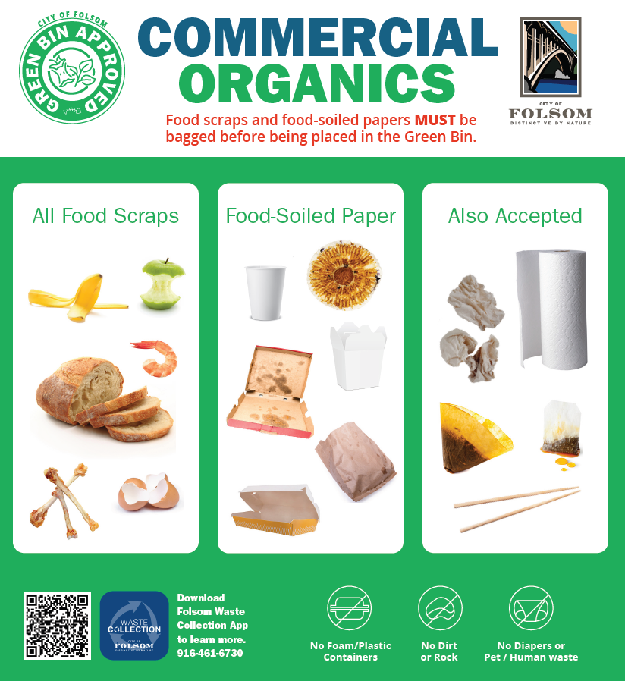
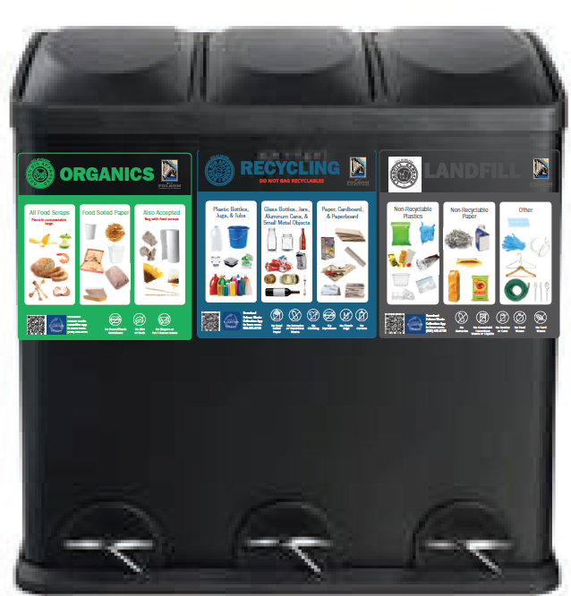
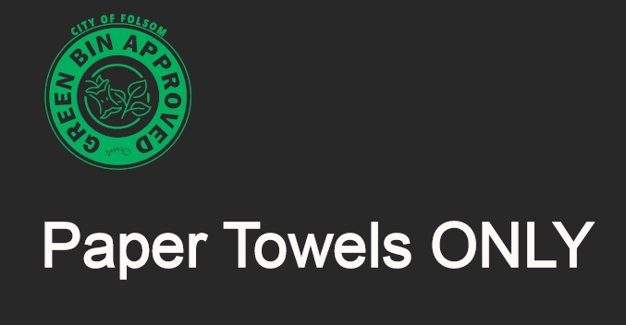
Commercial Program 2022
SB1383 applies to ALL business types as of January 2022
Place 3 bins throughout workplace, making recycling convenient
Include all food scraps and all food-soiled papers
Use compostable or clear plastic bags for organics
Employees and Custodians need to keep the 3 waste streams separate and dispose of properly
Paper towels from handwashing stations go in Green Bins

Slide 12
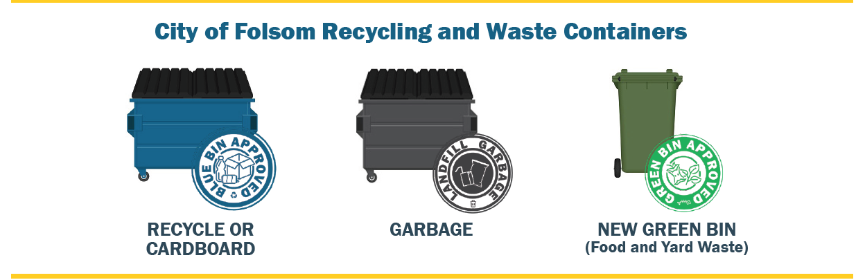
Commercial Green Bins
Green Bins will be located outside by dumpsters; drops coming early 2022.
Janitors, employees and customers need to be trained; call us.
Get a Green Bin AND use the Green Bin to be in compliance
Waivers: None to businesses that sell or produce food, or individual business in shared building. Otherwise <20 gallons, only with waste audit/photos
Edible food to be donated to Folsom Food Rescue program

Slide 13
Edible Food Rescue
Phase one: Capacity planning with food generators and food recovery organizations
Tier 1 (January 2022)
  Supermarket, Grocery store with a total facility size >10,000 sqft
  Food service provider
  Food distributor
  Wholesale food vendor
Tier 2 (January 2024)
  Restaurant with >250 or more seats, or a total facility size >5,000 sqft
  Hotel, 200+ rooms
  Health facility 100+ beds
  Large venues & events
  State agency with a cafeteria with 250+ seats
  Local education agency facility with on‐site food facility

Slide 14
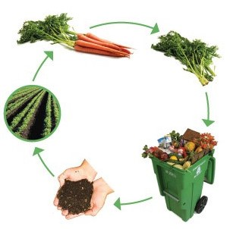
The Cycle of Benefits
to Green Bin
Facility (Agromin) makes into Compost & Mulch
Compost back to farms, gardeners and YOU.
Food grown on Farm
to your Fork

Slide 15

Questions?
Marie McKeeth, General Services Manager
Sarah Isabel Moe, Recycling Supervisor
916.461.6730
solidwaste@folsom.ca.us

Slide 16
Extra Slides

Slide 17
Weekly Service Required
14 CCR § 17331
§ 17331. Frequency of Refuse Removal.
(H) The owner or tenant of any premises, business establishment or industry shall be responsible for the satisfactory removal of all refuse accumulated by him on his property or his premises. To prevent propagation, harborage, or attraction of flies, rodents or other vectors and the creation of nuisances, refuse, except for inert materials, shall not be allowed to remain on the premises for more than seven days, except when:
(a) disruptions due to strikes occur, or
(b) severe weather conditions or “Acts of God” make collection impossible using normal collection equipment, or
(c) official holidays interrupt the normal seven day collection cycle in which case collection may be postponed until the next working day. Where it is deemed necessary by the local health officer because of the propagation of vectors and for the protection of public health, more frequent removal of refuse shall be required.
Notes:
14 CCR § 17225.53
§ 17225.53. Refuse.
“Refuse” includes garbage and rubbish.
14 CCR § 17225.30
§ 17225.30. Garbage.
“Garbage” includes all kitchen and table food waste, and animal or vegetable waste that attends or results from the storage, preparation, cooking or handling of food stuffs.
14 CCR § 17225.59
§ 17225.59. Rubbish.
“Rubbish” includes non-putrescible solid wastes such as ashes, paper, cardboard, tin cans, yard clippings, wood, glass, bedding, crockery, plastics, rubber by-products or litter.

Slide 18
Residential Rates

Slide 19
Residential Rates

Slide 20
Residential Adjustments

Slide 21
Commercial Rates

Slide 22
Rolloff and Special Event Fees

Slide 23
Impact on Subsidized Rates
Subsidized Rates
Notes:
Slide summary:
Current and proposed rates.
Percent increases with subsidized rates in orange. Note that subsidized rates increase at a higher percentage.
Amount of subsidy for each rate. No changes to MH. Slight increases for low-income subsidies.
GF obligation for subsidies showing start and end of prop 218 noticing. Prop 218 requires subsidized rate be funded by a source other than rates to other utility payers.

Slide 24
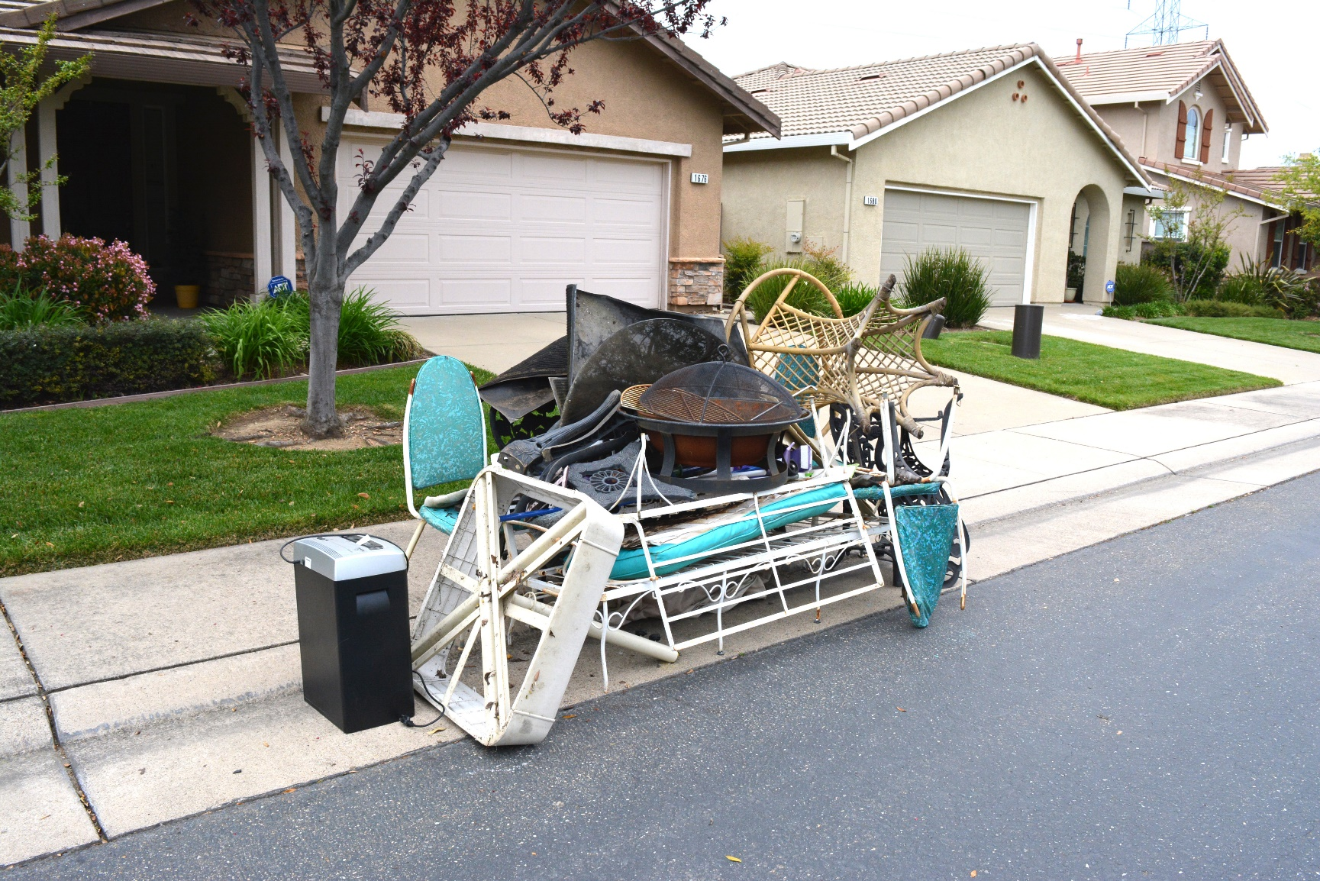
HHW and Bulky Waste Fee Options
Charge for ALL Pickups | Charge for Pickups After the 1st
Bulky Waste: $25 Revenue: $200,000 | Bulky Waste: $30 Revenue: $13,700
HHW: $15 Revenue: $44,550 | HHW: $20 Revenue: $3,400
Total Impact: $244,550 | Total Impact: $17,100

Slide 25
Proposed Maximum Rates
Notes:
Covers the cost of SB 1383 implementation primarily through an SB 1383 surcharge, but also with using moderate rate increases, an internal loan, moderate fees for all additional recycle and green waste cans, bulky waste collection and hhw pickups.
Additional increase in January 2022.
Maintains scheduled increase for July 2022 and July 2023.
Lower increases July 2024 and July 2025.
Changes from initial presentation.
Solid Waste bill is higher in the first two years ($56 on 7/1/23 as compared to $48 initially)
Lower rate by the end of the five-year period ($60 on 7/1/25 as compared to $63.50 initially)
Fund balance (initial rate proposal included a drop to $1.1M at the end of FY24
Using a combination of measures to smooth the increases minimizes the increase to the base rate and asking residents to pay a nominal fee for currently subsidized services.
Maintains a low reserve, with a drop to $1.1M until FY 26 when the reserve starts to build.
Moderate increases ensure rate studies continue to occur at appropriate intervals to sustain the Solid Waste fund.
Drawback – charging for previously subsidized services increases administrative workload.

Slide 26
Commercial Food Waste Rate

Slide 27
How does Folsom compare without food waste collection?
Notes:
This chart shows regional rates prior to adjustments for food waste.

