Slide 1
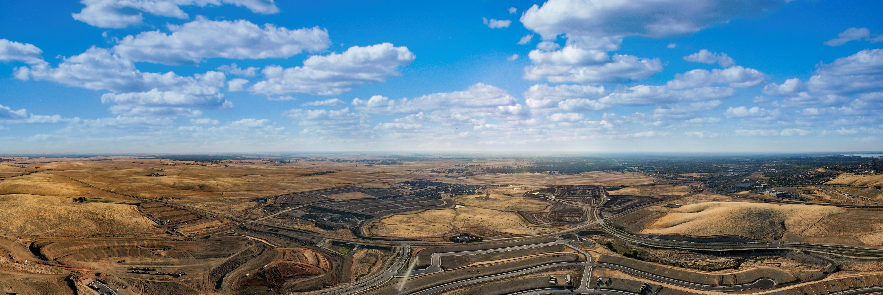
CFD No. 23 (Folsom Ranch) Amended Improvement Area No. 3 and New Improvement Area No. 7 City Council Presentation-November 9, 2021

Slide 2
CFD No. 23 - Amended IA No. 3 and New IA No. 7
Landowners within the Folsom Plan Area previously requested to form Community Facilities District No. 23 (Folsom Ranch) (CFD No. 23) in 2020.
CFD No. 23 includes six separate Improvement Areas, designated as Improvement Area (“IA”) No. 1 through IA No. 6.
Landowners have requested to amend the existing boundaries of IA No. 3 and establish a new IA No. 7.
1

Slide 3
CFD No. 23 - Amended IA No. 3 and New IA No. 7
IA No. 3 boundary to be amended to exclude property that is expected to be developed into traditional market rate single-family residences.
Property remaining within the amended IA No. 3 boundaries will only include property to be developed into active adult single-family residences.
Property removed from IA No. 3 boundaries will be designated as the new IA No. 7.
2

Slide 4
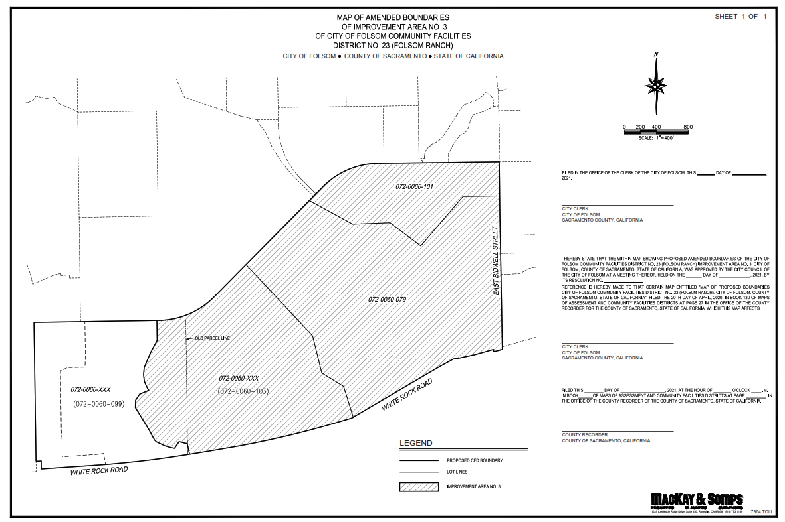
CFD No. 23 - Amended IA No. 3 and New IA No. 7
Amended IA No. 3 Boundaries
3

Slide 5
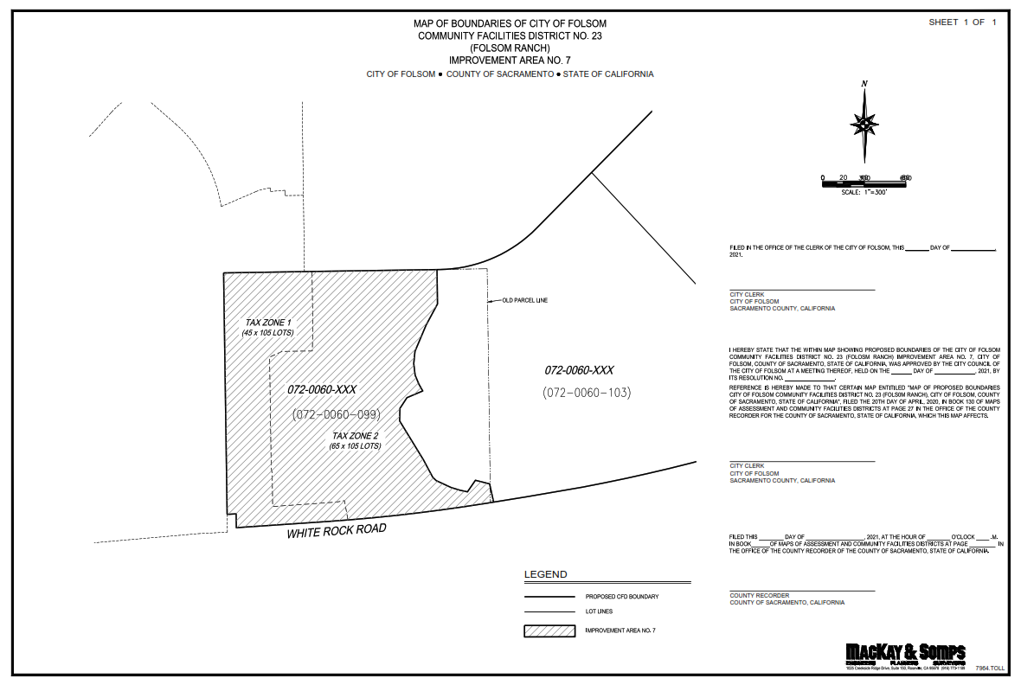
CFD No. 23 - Amended IA No. 3 and New IA No. 7
New IA No. 7 Boundaries
4

Slide 6
CFD No. 23 - Amended IA No. 3 and New IA No. 7
The City Council is being asked to approve the Amended IA No. 3 boundary map and new IA No. 7 boundary map.
Proposed development within each IA includes:
Amended IA No. 3: 919 active adult single-family residences
New IA No. 7: 211 traditional market rate single-family residences
5

Slide 7
CFD No. 23 - Amended IA No. 3 and New IA No. 7
Amended IA No. 3 Facilities Special Tax
Levied thru 2079-80 at City Council discretion.
Increased annually by 2%.
Maximum facilities special tax ranges from $490 to $890 on a single-family home.
Amended IA No. 3 Services Special Tax
Levied in perpetuity at City Council discretion.
Increased annually by the annualized change in CPI for all Urban Consumers, for the San Francisco-Oakland-San Jose area, not to exceed 4%.
Maximum services special tax is $100 per single-family home.
Amended IA No. 3 Property Tax as a % of Assessed Value
Ranges from 1.65% to 1.68%
6

Slide 8
CFD No. 23 - Amended IA No. 3 and New IA No. 7
New IA No. 7 Facilities Special Tax
Levied thru 2079-80 at City Council discretion.
Increased annually by 2%.
Maximum facilities special tax ranges from $2,350 to $3,075 on a single-family home.
New IA No. 7 Services Special Tax
Levied in perpetuity at City Council discretion.
Increased annually by the annualized change in CPI for all Urban Consumers, for the San Francisco-Oakland-San Jose area, not to exceed 4%.
Maximum services special tax is $177 per single-family home.
New IA No. 7 Property Tax as a % of Assessed Value
Ranges from 1.87% to 1.88%
7

Slide 9
CFD No. 23 - Amended IA No. 3 and New IA No. 7
Recommend Approval of:
Resolution 10747 – approving the amended boundaries, the amended Rate and Method of Apportionment, and the amended appropriations limit and maximum bonded indebtedness for Improvement Area No. 3.
Resolution 10748 - approving a boundary map, designating a new Improvement Area No. 7 and authorizing the City to levy special taxes within Improvement Area No. 7.
Resolution 10749- approving the resolution declaring necessity for incurring bonded indebtedness within IA No. 7 and calling for a public hearing.
8

