Slide 1
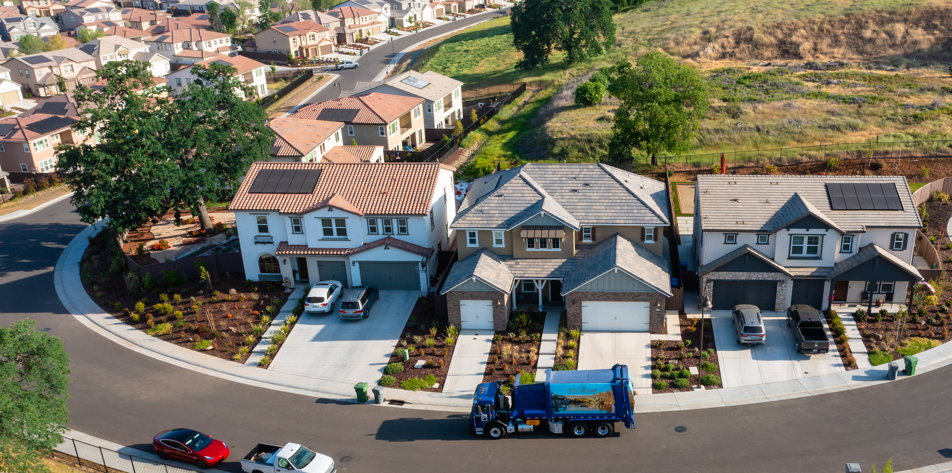
Ordinance No. 1319 Responsible Parties for Municipal Services
Notes:
Mayor, Councilmembers, Elizabeth Hanna, Revenue Services Supervisor
The topic of Responsible Parties for Municipal Services was first introduced as a scheduled presentation at the City Council meeting on October 12th. I am here this evening to review the background and analysis on this topic, and recommend the first reading of Ordinance No. 1319 - Amending Section 3.20.040 of the Folsom Municipal Code Pertaining to Responsible Parties for Municipal Services.

Slide 2
Background
Municipal Services Provided
Water, Sewer and/or Solid Waste
Current Billing Process
Residential Accounts
Commercial Accounts
Notes:
The City of Folsom provides Water, Sewer, and/or Solid Waste services to residents. As a health and safety requirement, services are not terminated or interrupted in between occupants.
With our current municipal or utility billing process, we allow both residential and commercial customers that are tenants to open utility accounts in their name.
For residential properties, rental occupants can open an accounts if the real property owner has a current business license certificate and a deposit is added to the new utility account.
For commercial accounts we allow a split bill amongst individual tenants for flat rate services provided to one parcel, in addition to sending bills for metered water service to the property manager. In some instances, will also split solid waste billing to send to an additional third-party bill pay company. This results in splitting and generating more than three bills for one parcel receiving service.

Slide 3
Background Continued
California Health and Safety Code section 5473
Folsom Municipal Code 3.20.040
Unpaid charges may become a lien on any property to the extent authorized by law
Annual direct levy process
Increased processing and administration
Notes:
We are the only agency surveyed in our region that allows for these utility services to transfer to a tenant and/or split these utility services amongst tenants on one parcel.
This is due to the fact that California Health and Safety Code 5473 allows delinquent utility charges to be collected as a direct levy on the property tax roll.
Folsom Municipal Code 3.20.040 also allows for unpaid charges to be collected on the property tax roll, and the Revenue Division administers this process annually.
As the City has grown over the years, having utility accounts in the tenant’s name has resulted in a significant increase in staff time processing and managing tenant accounts, and presented unique challenges for the City to collect delinquent payments.

Slide 4
Analysis
Proposed amendment aligns with State and Folsom Municipal Code
American River Canyon and Folsom Plan Area
Increased accuracy and efficiency
Owner authorization form
18-month transition
Notes:
The proposed ordinance amendment would identify that the owner of real property is responsible for municipal service charges. This is in accordance with California Health and Safety Code and current Folsom Municipal Code. Since property taxes are the responsibility of, and billed to, the real property owner, the best practice for these utility services is to also bill directly to the property owner.
Rental properties located in American River Canyon are serviced by San Juan Water District are already subject to this practice with the water portion of their utility bill. El Dorado Irrigation District, which will serve a future portion of the Folsom Plan Area, also adheres to this practice.
Thirty percent of the monthly turnover in utility accounts is due to changes in tenants, and the same amount of customer service time is spent identifying new account responsibility. The owner of a parcel is an official County recorded document that can be searched at any time by staff.
This amendment allows the City to provide municipal service billing more efficiently, economically, and accurately. Property owners may, if they desire, contractually arrange with their tenants for making the utility payments. The City will provide an authorization form to property owners to allow tenants to receive a copy of the utility bill, provided the services remain in the property owner’s name, and the owner shall remain fully responsible and liable for the payment of service charges as if the bill had been sent to the owner.
The Revenue Division is recommending an 18-month transition after this ordinance is approved. As new rental starts are requested, staff will provide an explanation of the change in process, what this change means to them as a customer or property owner, and how a tenant can be authorized to receive a copy of the utility bill. Additionally, it allows us to communicate with our commercial customers and property managers so the necessary steps can be taken for their transition.

Slide 5
Recommendation
It is recommended that the City Council introduce and conduct the first reading of Ordinance No. 1319
Notes:
With that, it is recommended that the City Council introduce and conduct the first reading of Ordinance No. 1319. Thank you.

