Slide 1
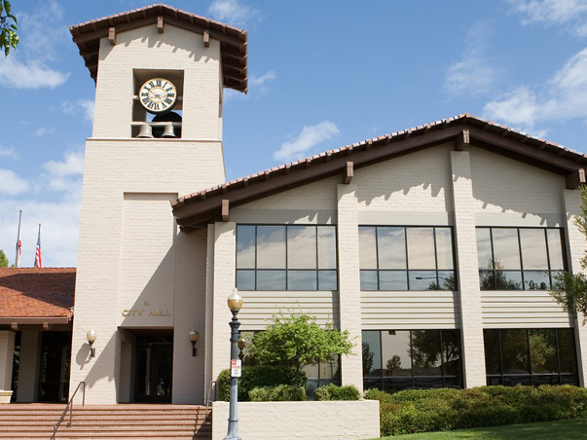
FOLSOM
®
FiberCity
Notes:
Going to talk about Folsom FiberCity® and the opportunity for the City

Slide 2


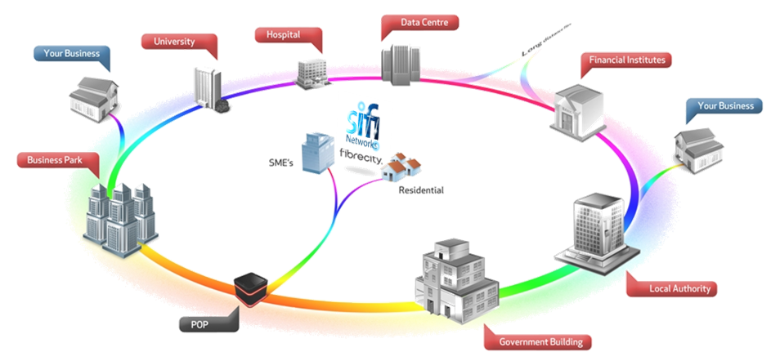
Proposal to build
FOLSOM FiberCity
®
A multimillion dollar private investment from SiFi Networks who will construct, operate and maintain a citywide fiber to the premise network to promote economic development through Open Access broadband competition, remove the digital divide and create a Smart City infrastructure that your municipality can utilize for intra-building connectivity and public benefit.

Slide 3

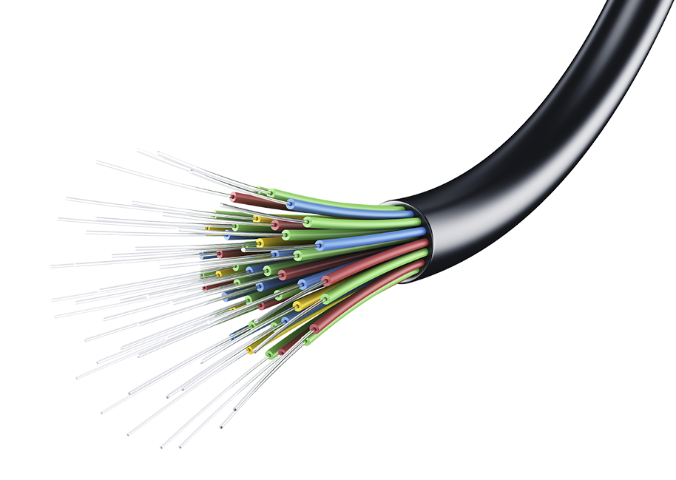

What is a FiberCity
®
10 Gigabit Symmetrical broadband connectivity to the home
Multiple service providers competing on the same network providing choice to all Residents & businesses
Ability to receive a variety of services via thousands of service providers
100% multimillion dollar private investment
$0 Taxpayer Dollars Towards Network Construction
Long term local Job Creation to help construct and maintain the network
Future ready network to support increasing data demands

Slide 4
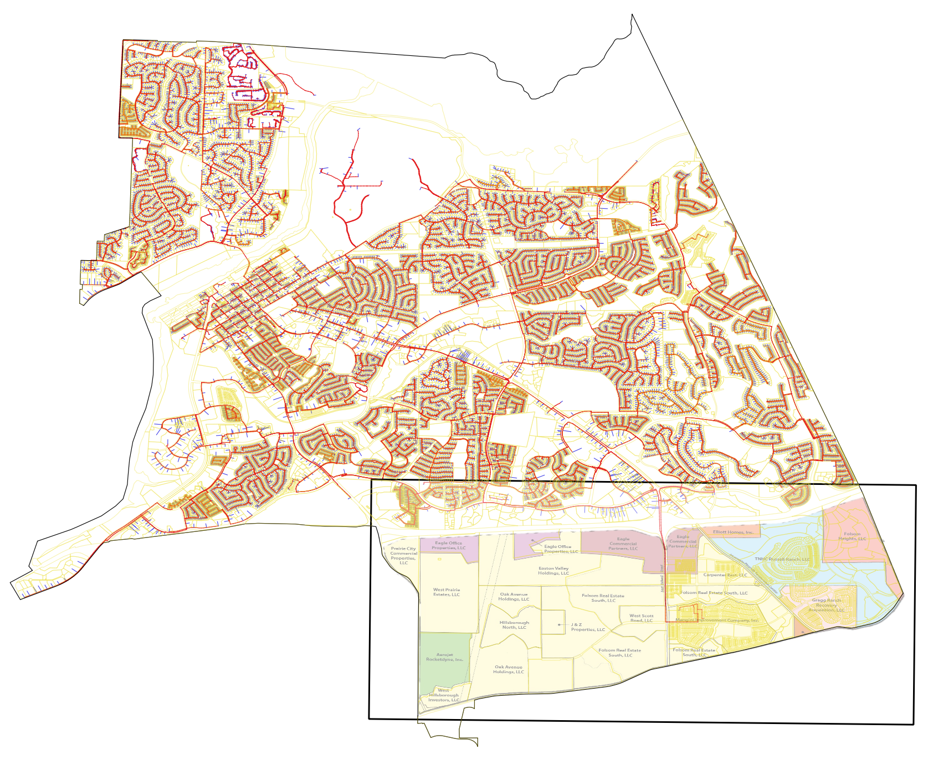
Citywide Infrastructure
Supporting growth
380 Mile Fiber Optic Network
Over 32,000 residential and business premises ready to be connected
Existing incumbent Fiber Passes *10% Homes & *19% Businesses
Network Designed to incorporate existing and future growth plans
Ready to connect municipality facilities that do not have fiber connectivity
City can promote itself as fiber ready to current & future developers
* Source: broadbandnow.com

Slide 5
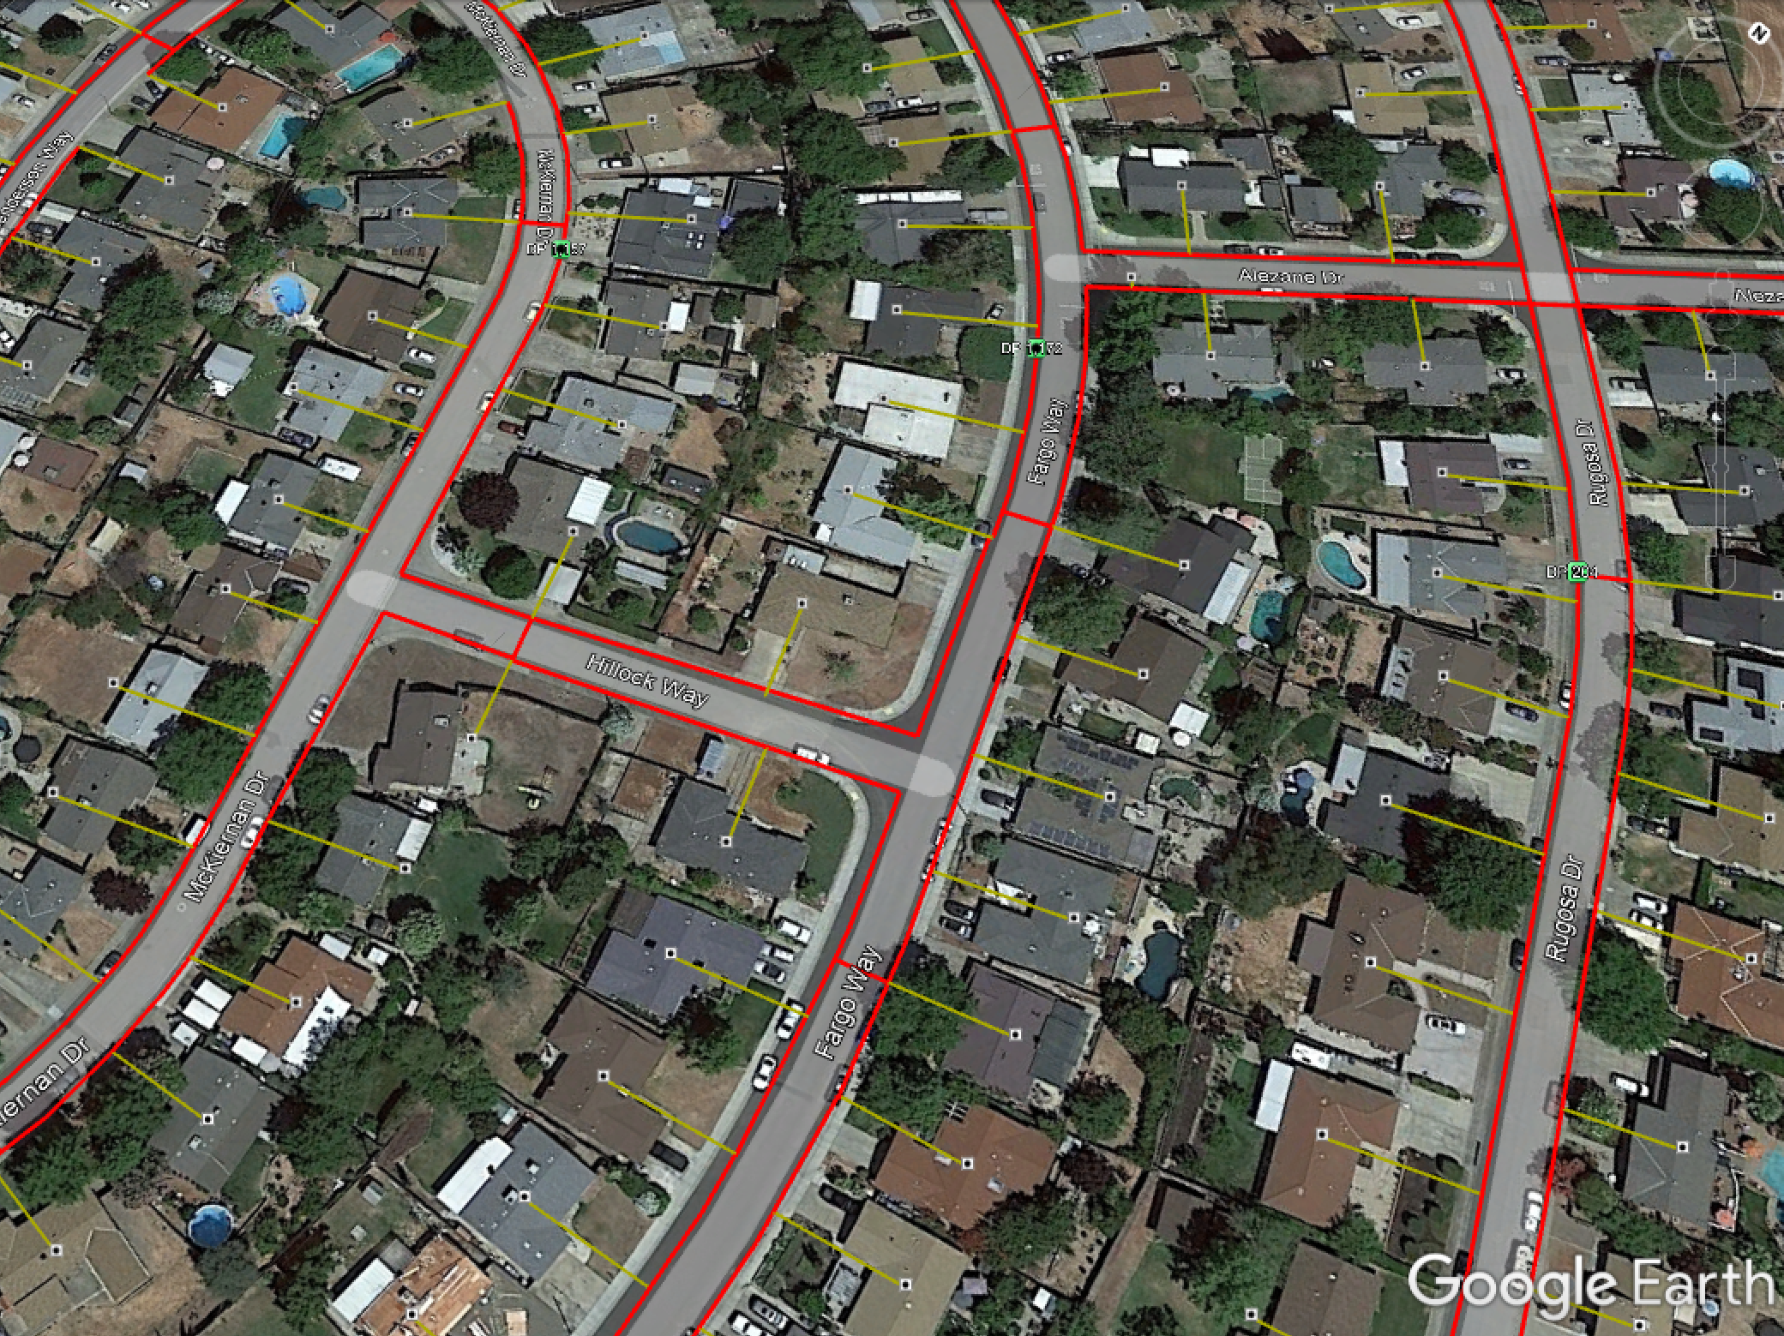
Every Premise Passed
Removing the digital divide

Slide 6
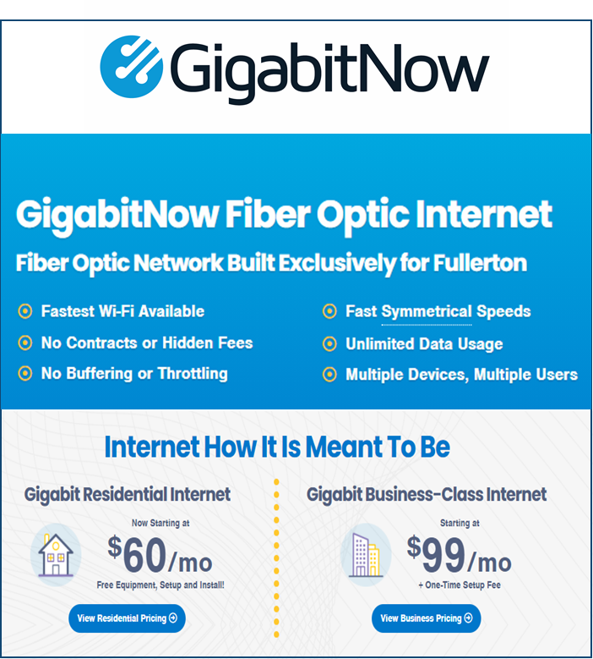
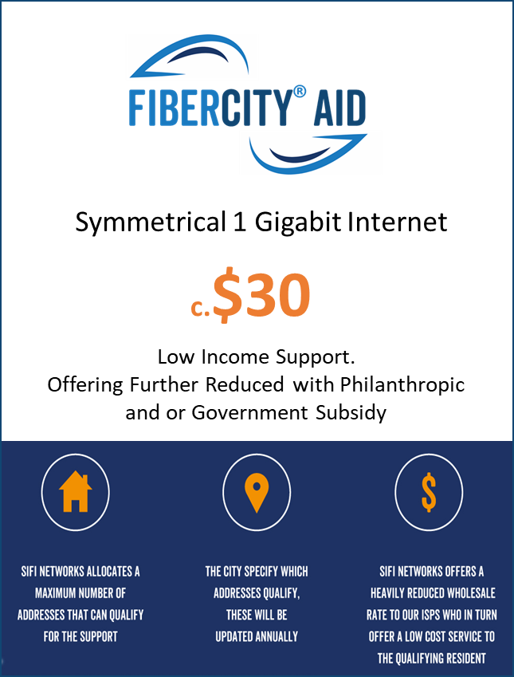
Pricing that Serves Everyone
competitive CALIFORNIA pricing

Slide 7

Business Benefit from Fiber Connectivity

Slide 8
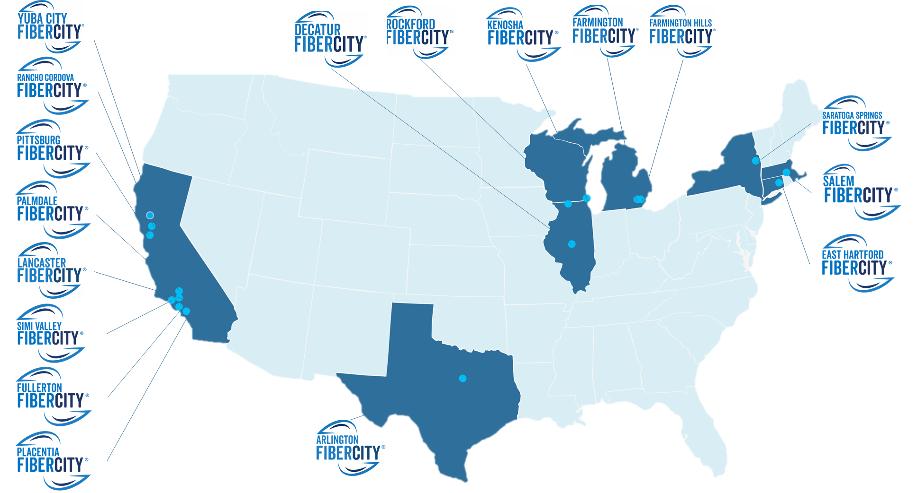
FiberCity Partnerships
®
750,000 Premises
Currently in funding, design or construction stage

Slide 9
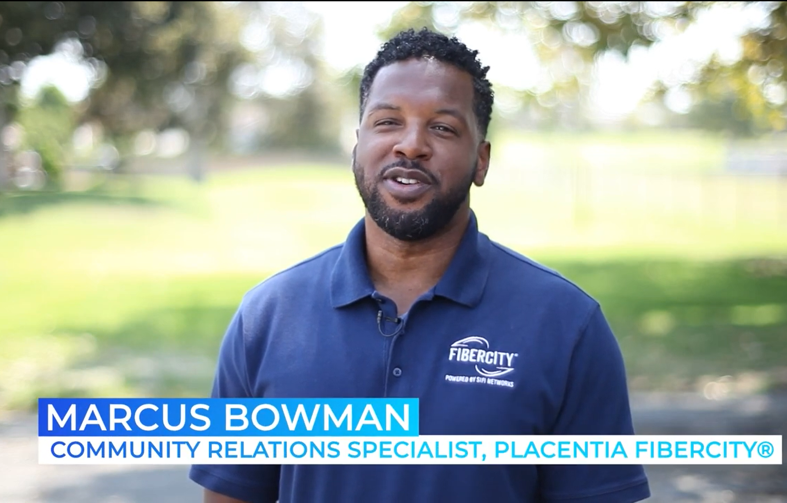
Project Awareness
Community engagement

Slide 10
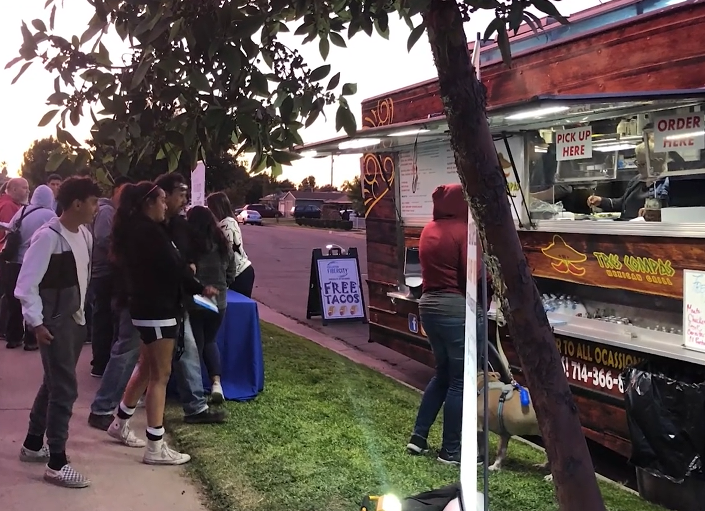
Neighborhood Interaction
Meet the service providers

Slide 11
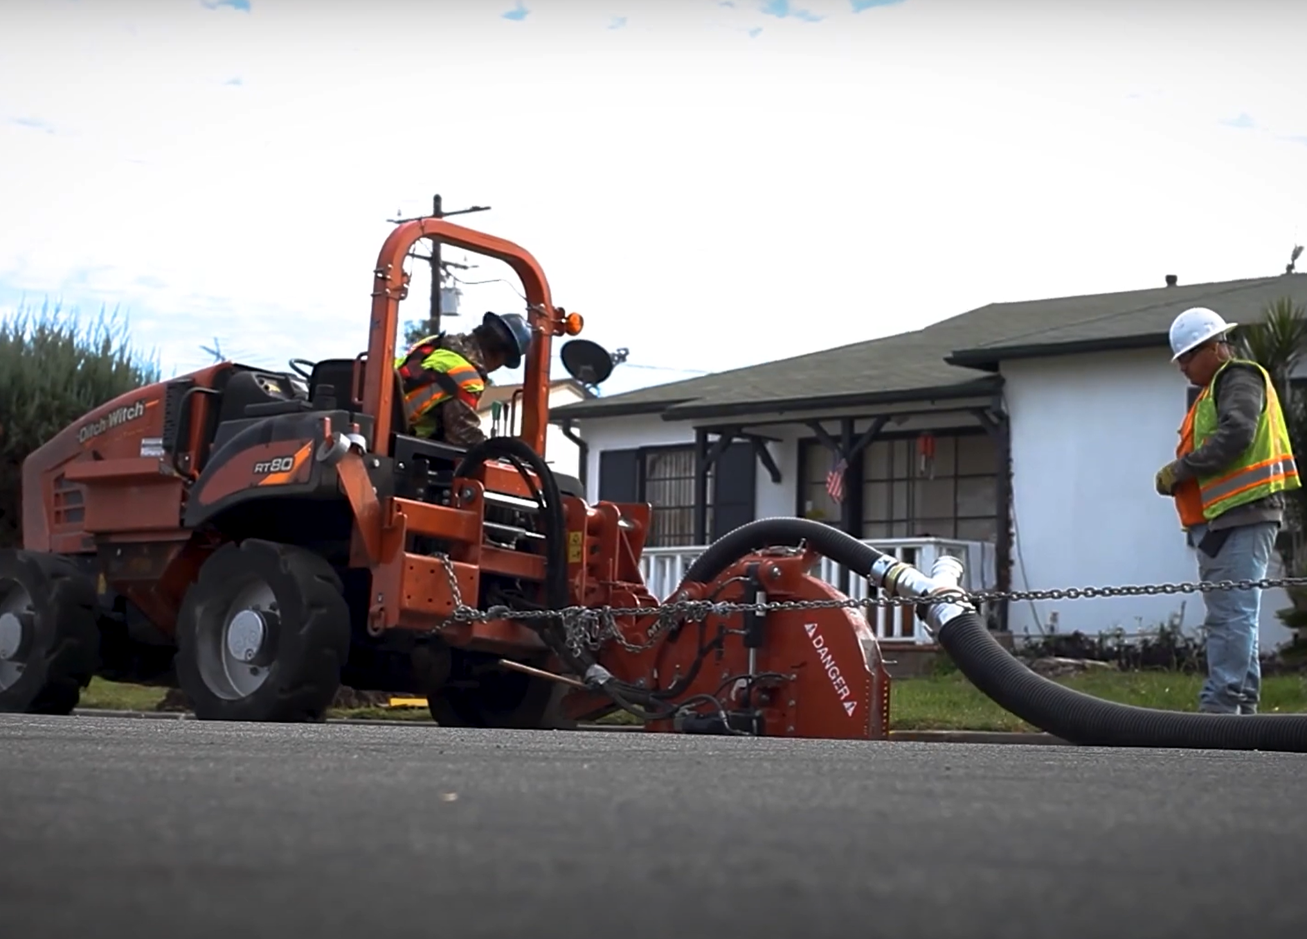
Innovative Technology
CLEAN, FAST, EFFICIENT
30 ft
Per Minute
2500 ft
Per Day
Lawn Mower Decibel range
Reduces Utility Impact

Slide 12
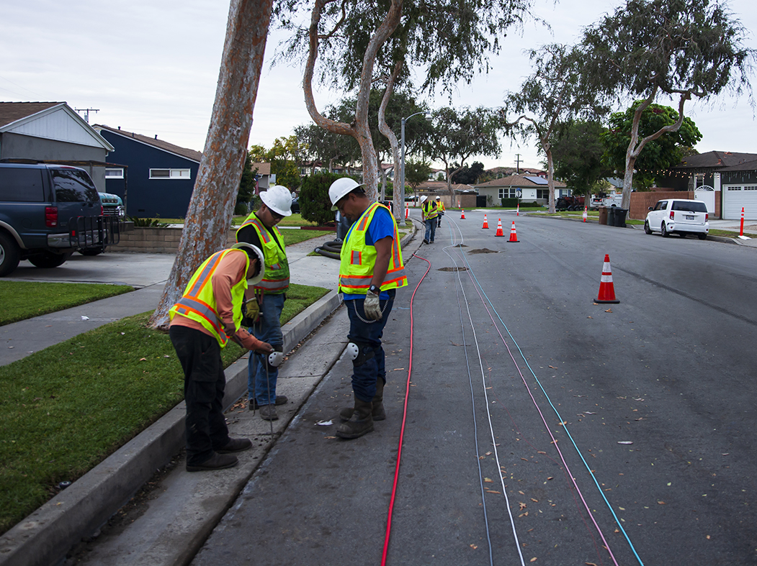
Narrow Trench
Minimal disruption

Slide 13
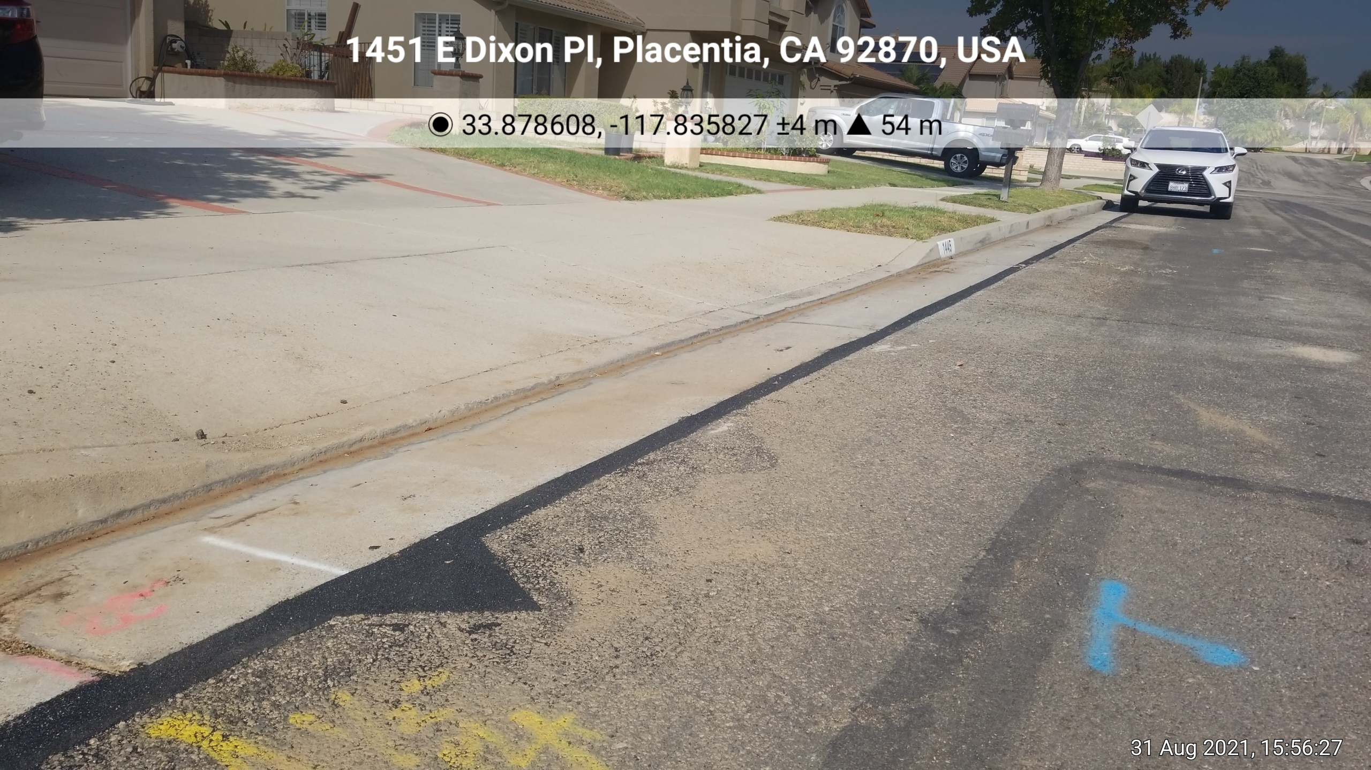
Finished Work
Mimics Roadway surface

Slide 14
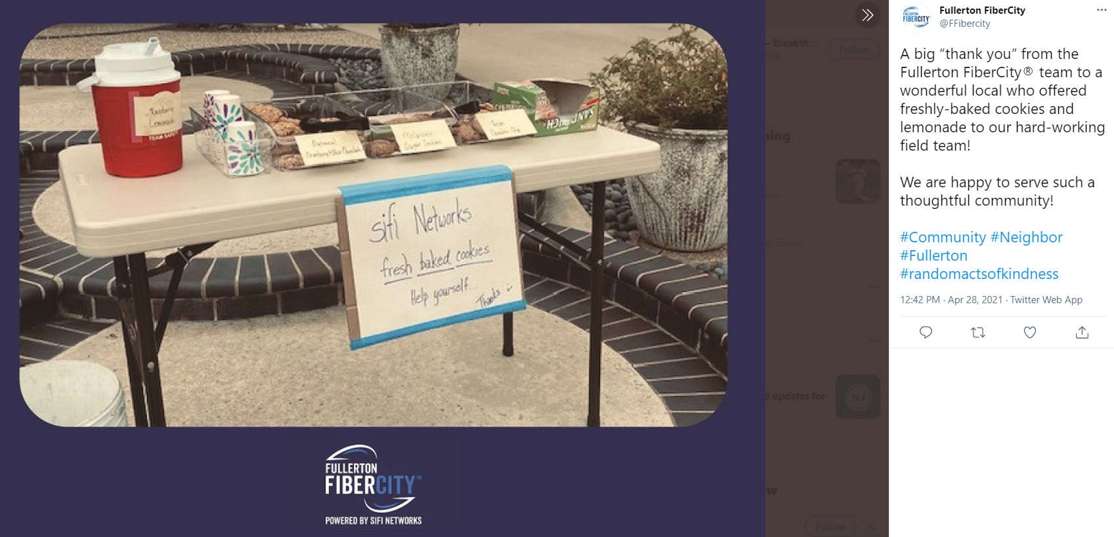
Being a Good Neighbor
Community Outreach

Slide 15
FOLSOM
Smart City
Diverse, high capacity, reliable
a Future ready network to support current and emerging technology
Every municipal location and street furniture can be connected
Municipality controls the speed of data and quality of service
More than just broadband competition
Notes:
Going to talk about Folsom FiberCity® and the opportunity for the City

Slide 16
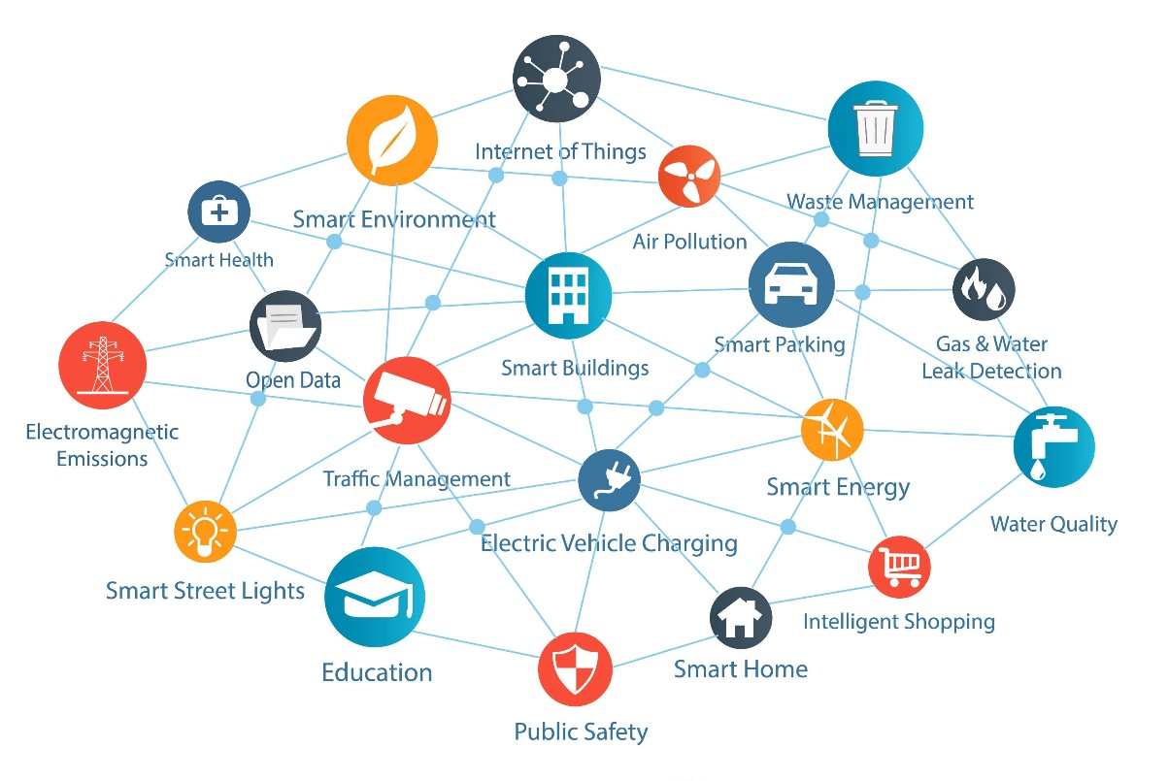
More Than Just a Gig!
Connected community

Slide 17
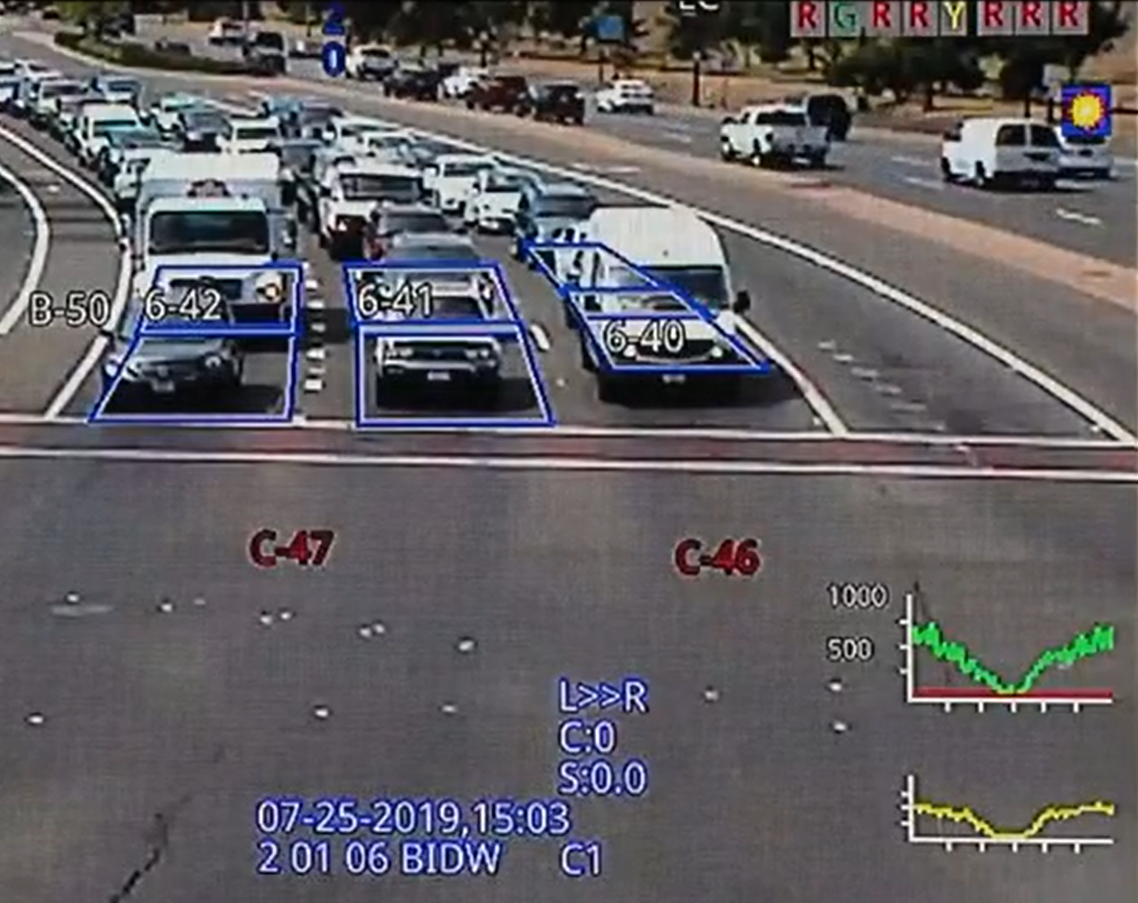
More Than Just a Gig!
Public safety

Slide 18
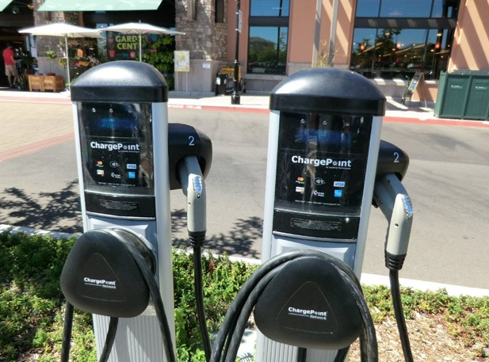
More Than Just a Gig!
attracting innovation

Slide 19
More Than Just a Gig!
Intelligent data

Slide 20
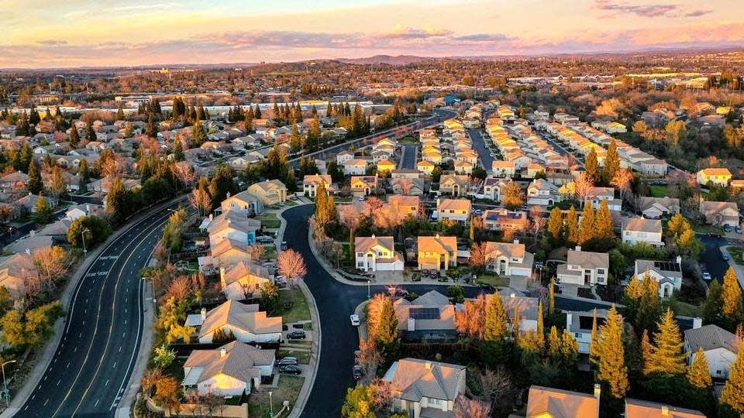
Attracts New Businesses
Closes Digital Divide
Citywide
Resilient
Reliable
Network
Job Creation
Open Access
Dig Once Policy

Slide 21
FOLSOM
®
FiberCity
Notes:
Going to talk about Folsom FiberCity® and the opportunity for the City

