Slide 1
Waste & Recycling Ordinance November 9, 2021
Notes:
Good evening mayor Kozlowski and members of the council.
Marie McKeeth, General Services Manager for the Public Works Department. With me this evening is Sarah Isabel Moe, our new Recycling Supervisor who can help answer any questions.
In response to recent regulation, the Solid Waste Division is proposing to repeal and replace the existing ordinance relating to waste collection services.

Slide 2
Overview
FMC Chapter 8.32, Garbage Collection, was last updated in 2006.
SB1383, California’s Short-Lived Climate Pollutant Reduction.
SB 1383 requires jurisdictions to adopt an enforceable ordinance requiring entities under its authority to comply with the regulations.
New title: “Waste and Recycling Collection”
Notes:
Folsom Municipal Code chapter 8.32 governs waste collection activities within the City. It was last updated in 2006 to facilitate compliance with state recycling mandates.
In 2016, Governor Brown signed into law Senate Bill 1383 setting methane reduction targets throughout the state. The primary goal of the law is to combat climate change, but the strategy to do this is to divert organic material from landfills. The decomposition of organic waste in landfills is the third largest source of methane in California.
SB 1383 regulations require specific actions by jurisdictions to ensure organic waste does not end up in landfills. Many of these requirements are inconsistent with existing programs outlined in our code, or do not even exist. The proposed updates to the municipal code clearly provides the details of collections, responsibilities, waivers, education and enforcement and other relevant topics surrounding the organics, recycling and garbage collection programs in accordance with SB 1383.
In addition, adopting an enforceable ordinance is a requirement of SB 1383 regulations.
Due to the number of changes throughout the ordinance, a complete repeal and replace is being proposed. While some changes were made to clarify existing services (outdated references, definitions, consolidate language) the majority were to ensure the city is able to comply with SB 1383.
For the remainder of my presentation, I will highlight the most significant updates.

Slide 3
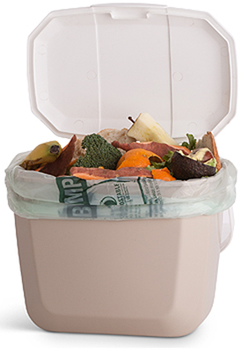
1. Mandatory Participation
All business and residents are subject to SB 1383.
All residents and businesses shall:
Accept garbage, recycling, and organics service sufficient to removed the amount generated.
Participate in the City’s organic waste collection service(s) by placing designated materials in designated containers.
Notes:
Currently residential participation in recycling and yard waste collection is optional. Even those who elect to participate may still throw yard waste or recyclables into their grey trash can at their discretion. In accordance with SB 1383, after the adoption of the new ordinance, placing items in the wrong can will be a violation of Folsom Municipal Code and subject to enforcement.
State law already requires businesses to have organics and recycling collection and SB 1383 expands on those requirements. The code revisions require containers to be used in accordance with program guidelines.
8.32.191 Sufficient service required.

Slide 4
2. Establishes Responsibility
When multiple tenants share solid waste containers, the property owner will be responsible for paying for services.
Current barrier to mandatory organics recycling compliance.
Notes:
Consistent with changes being proposed by the Finance Department to FMC section 3.20.040, the Waste & Recycling code would make property owners responsible for utility bills. This has historically been a barrier to gaining compliance with mandatory commercial organics recycling.
Section 8.32.140 (B), charges for collection

Slide 5
3. Edible Food Recovery
Food recovery organizations & services shall:
Maintain contact information for contracted food generators and recovery organizations
Maintain records of pounds of edible food from each generator and to each recovery organization per month
Commercial edible food generators shall:
Maximize edible food recovery
Contract with food recovery organization(s)
Allow for inspections
Maintains detailed records
Notes:
New sections
8.32.265 Requirements for Commercial Edible Food Generators
8.32.270 Requirements for Edible Food Recovery Organizations and Services.
Edible food recovery capacity planning and program will begin with “tier one” by 2022, including supermarkets, grocery stores with less than 10,000 square feet, food service providers, food distributors, and wholesale food vendors. “Tier two” will begin by 2024, to include restaurants with less than 250 seats or less than 5,000 square feet, hotels with food service and less than 200 rooms, health facilities with food service and less than 100 beds, large venues, large events, and schools with food service.

Slide 6
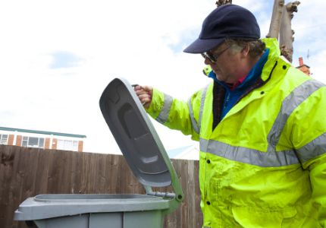
4. Inspections and Investigations
Authority to conduct random inspections and investigations to verify compliance
Requires regulated entities to cooperate and allow access
Notes:
New section
Although we have the authority to inspect under FMC 1.09.02, this section explicitly requires cooperation with random inspections.
Also, explicitly restricts access to residential interiors which may be helpful to alleviate any misconceptions. Residential inspections will be inspected when cans are set out for service.
8.32.275 Inspections and Investigations

Slide 7
5. Enforcement
Defines an education period for residential compliance
Defines enforcement procedures and give authority
Penalty amounts defined by SB 1383
Notes:
In recognition that this is a new program for residential customers, the enforcement section defines a period where the focus will be education rather than administrative penalties.
Despite the focus on education, nothing in the chapter prohibits further enforcement action if education efforts are unsuccessful.
There is no defined education period for businesses since organics recycling is already mandatory, but enforcement steps provide an opportunity to comply prior to administrative civil penalties.
Penalty amounts were revised for compliance with SB 1383.
8.32.280 Enforcement
8.32.285 Penalties

Slide 8
Questions?
Waste and Recycling Division
916.461.6730
solidwaste@folsom.ca.us

