Slide 1
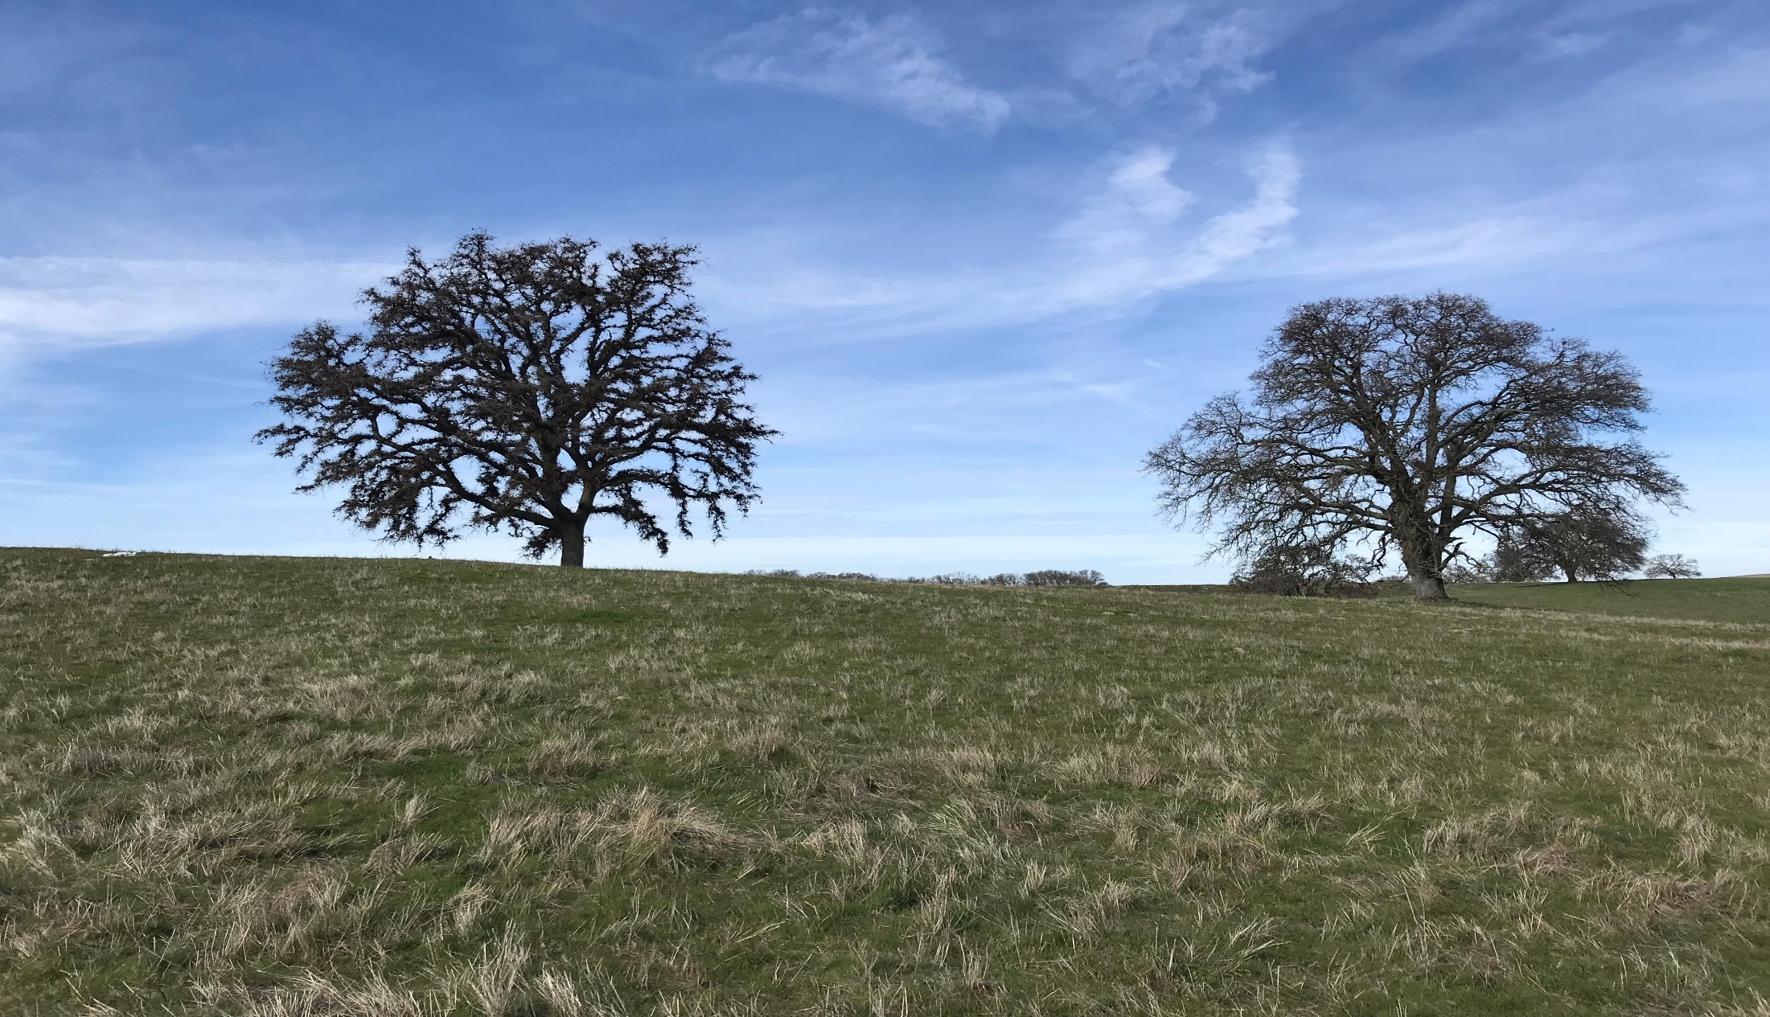
Toll Brothers at Folsom Ranch Phase 2 Subdivision
Small-Lot Vesting Tentative Subdivision Map and Minor Administrative Modification for Development of 329-Unit Active Adult Community

Slide 2
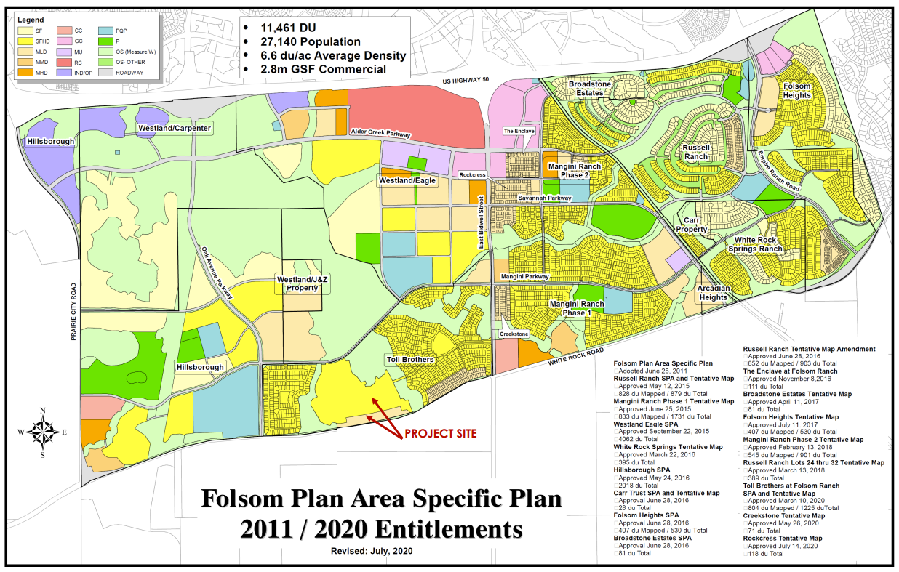
Vicinity Map

Slide 3
Project Background
March 10, 2020: City Council Approval of a General Plan
Amendment, Specific Plan Amendment, Small-Lot Vesting Tentative
Subdivision Map, Development Agreement Amendments, Planned
Development Permit, and Inclusionary Housing Plan for Development
of 1,225-Unit Active Adult and Traditional Single-Family Residential
Subdivision
October 7, 2020: Planning Commission Approval of Design Review
Application for Development of 18,600-Square-Foot Clubhouse
Building and Associated Recreational Amenities

Slide 4
Key Project Details
Toll Brothers at Folsom Ranch Phase 2 Subdivision
329-Unit Residential Development on 64.7-Acre Site
Age-Restricted Units
Detached and Attached Single-Story Homes (Design Previously Approved)
Small-Lot Vesting Tentative Subdivision Map
Create 348 Total Lots
329 Residential Lots
14 Landscape Lots
3 Open Space Lots
1 Dog Park Lot
1 Private Recreational Lot
Private Recreational Amenities
Private Gated Community with Private Streets
Project Access (East Bidwell Street and Mangini Parkway)
Minor Administrative Modification
Transfer 92 Allocated Dwelling Units to Other Locations in Folsom Plan Area

Slide 5
Project Analysis
General Plan and Zoning Consistency
Small-Lot Vesting Tentative Subdivision Map
Traffic/Access/Circulation
Parking
Noise Impacts
Walls/Fencing
Measure W and Open Space
Private Park Amenities
Oak Tree Preservation and Removal
Inclusionary Housing Plan
Minor Administrative Modification

Slide 6
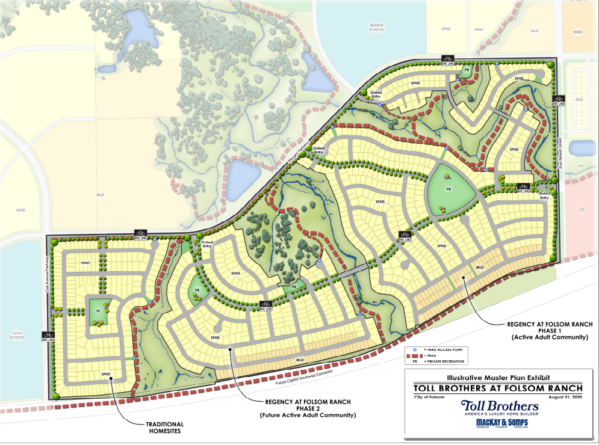
Master Plan Exhibit

Slide 7
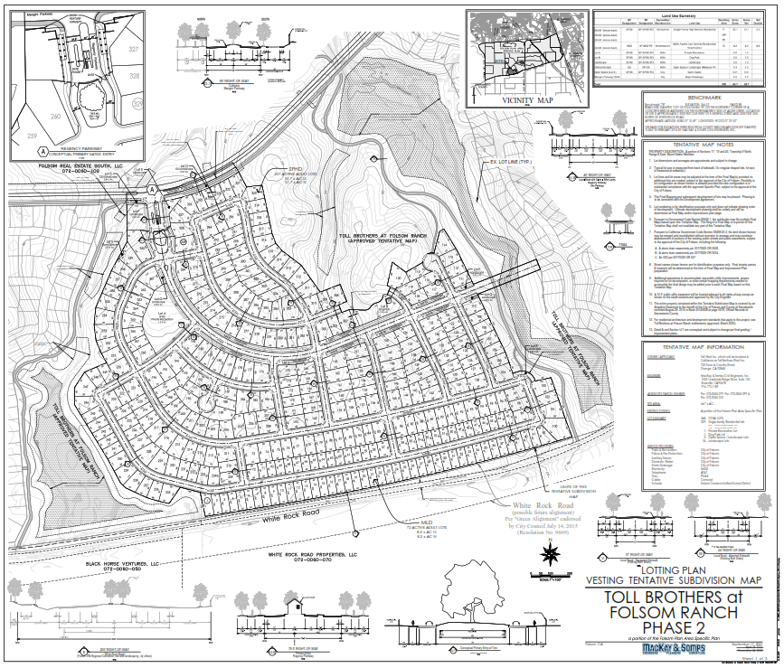
Tentative Subdivision Map
Small-Lot Subdivision Map
329 Single-Family Residential Lots (Phase 2)
Lots Range from 3,456 to 12,550 S.F. in Size
All Lots Meet Minimum Requirements for Size/Shape
All Private Streets within Subdivision
Private Recreational Amenities

Slide 8
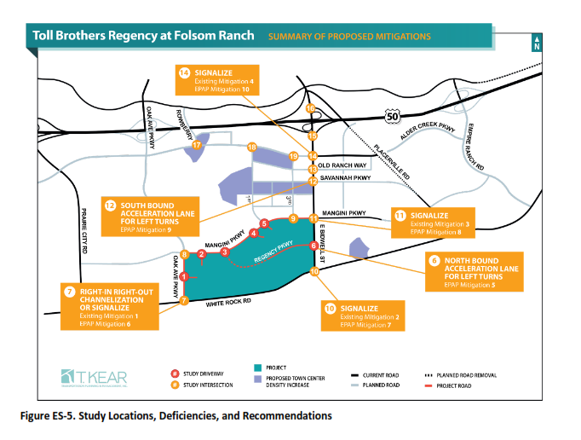
Traffic/Access/Circulation
Traffic/Access/Circulation
Transportation Impact Analysis
6,718 Daily Vehicle Trips
439 AM Peak Hour Trips/557 PM Peak Hour Trips
No New Significant Impacts

Slide 9
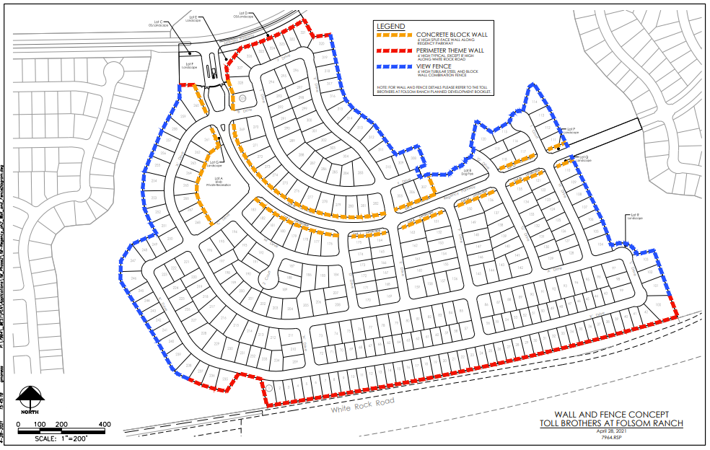
Wall and Fencing Exhibit

Slide 10
Measure W Open Space
Measure W Open Space
Existing: 83.9-Acres
Approved: 86.1-Acres
Increase of 2.2-Acres

Slide 11
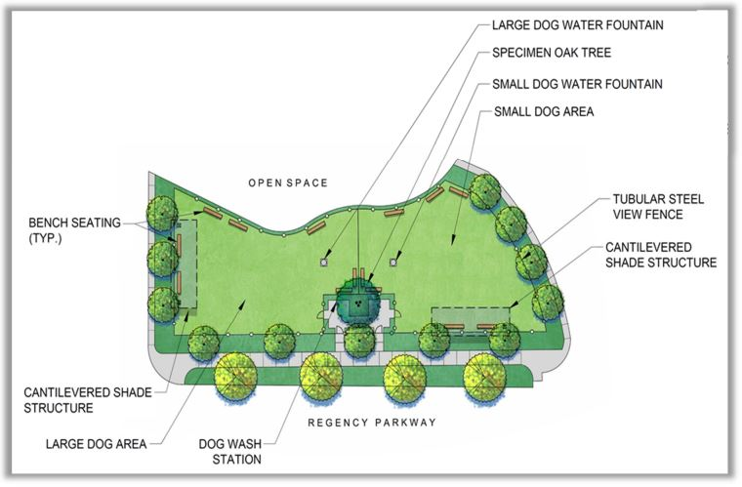
Private Park Amenities

Slide 12
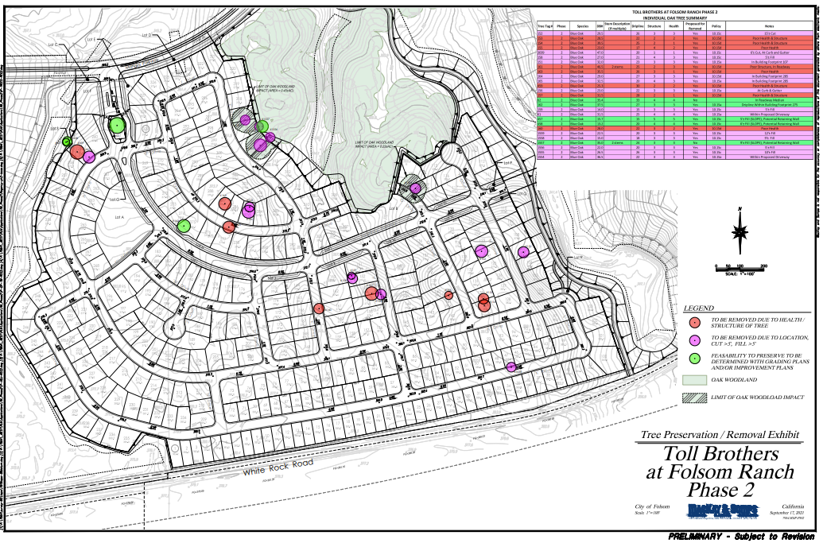
Project-Specific Oak Tree Preservation and Removal Plan
27 Total Oak Trees
14 Trees to be Removed Due to Excessive Cut-Fill Conditions (Purple Color)
8 Trees to be Removed Due to Poor Health and Structure (Pink Color)
5 Oak Trees to be Preserved (Green Color)

Slide 13
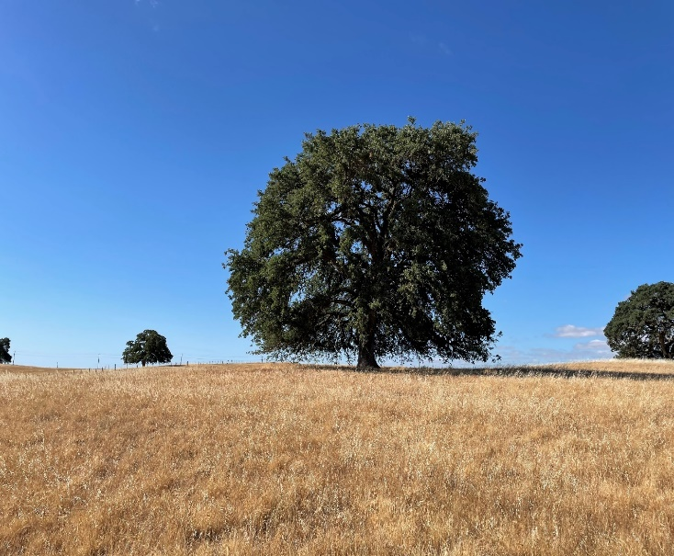
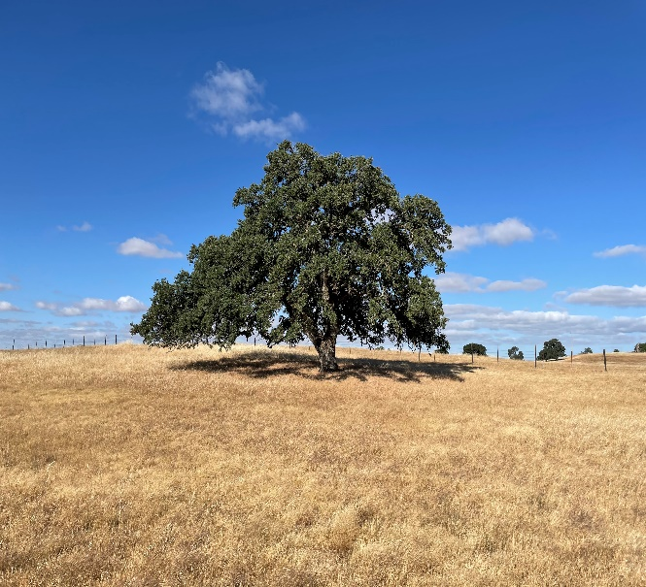
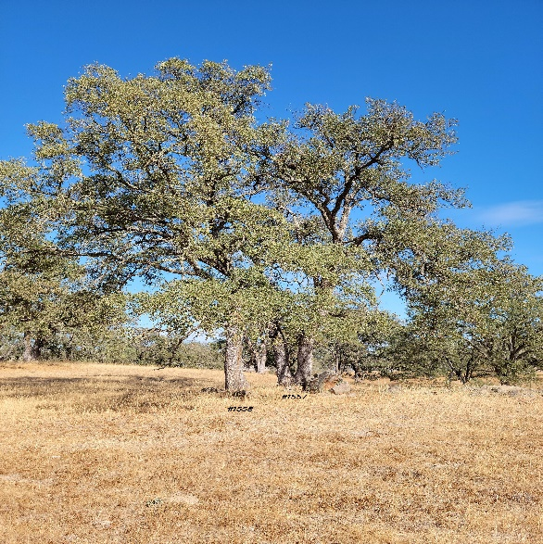
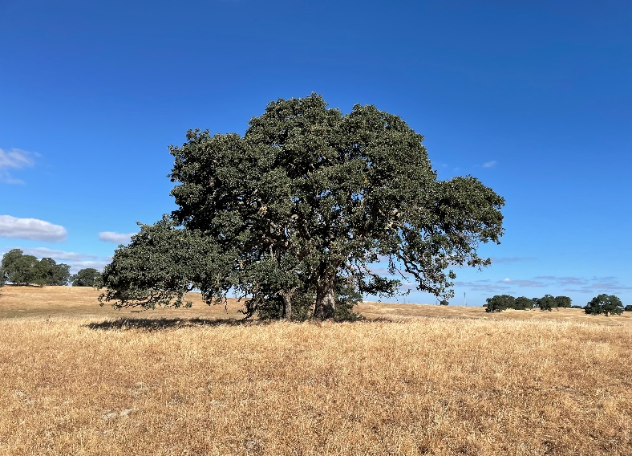
Oak Trees to be Preserved

Slide 14
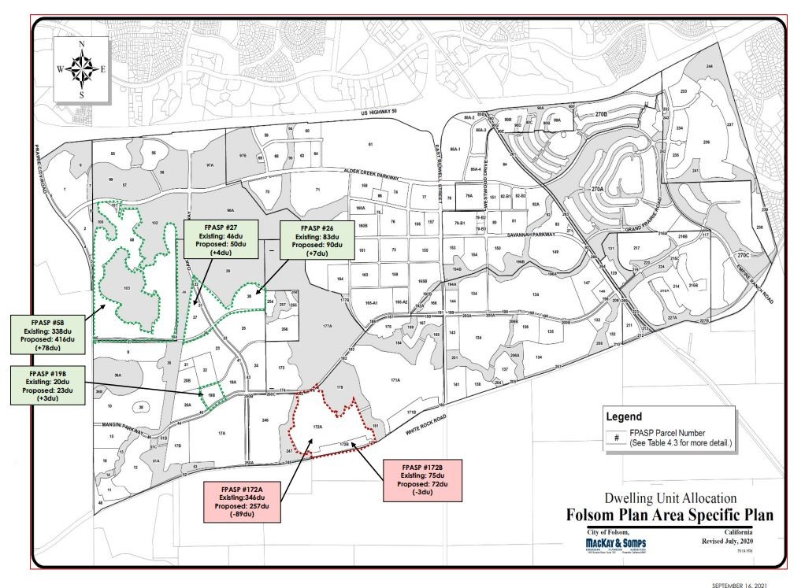
Minor Administrative Modification

Slide 15
Environmental Review
An Addendum to the Folsom Plan Area Specific Plan EIR/EIS was previously adopted by the City Council on March 10, 2020 for the Toll Brothers at Folsom Ranch project in accordance with the California Environmental Quality Act (CEQA).
Environmental Memorandum Prepared for the Toll Brothers at Folsom Ranch Phase 2 Subdivision Project Demonstrates that No New or Substantially more Adverse Impacts Would Occur Through Implementation of the Proposed Project.

Slide 16
Planning Commission Meeting
Commission Evaluated Project at its December 1, 2021 Meeting
No Members of the Public Spoke at the Meeting
Commission Focused on Number of Topics Including:
Use of Drought Tolerant Landscaping (Including Grass Groundcover)
Private Park Amenities and Use
Tree Preservation
Transfer of Allocated Dwelling Units (MAM)
Commission Voted to Recommend Approval of Project (6-1-0-0)

Slide 17
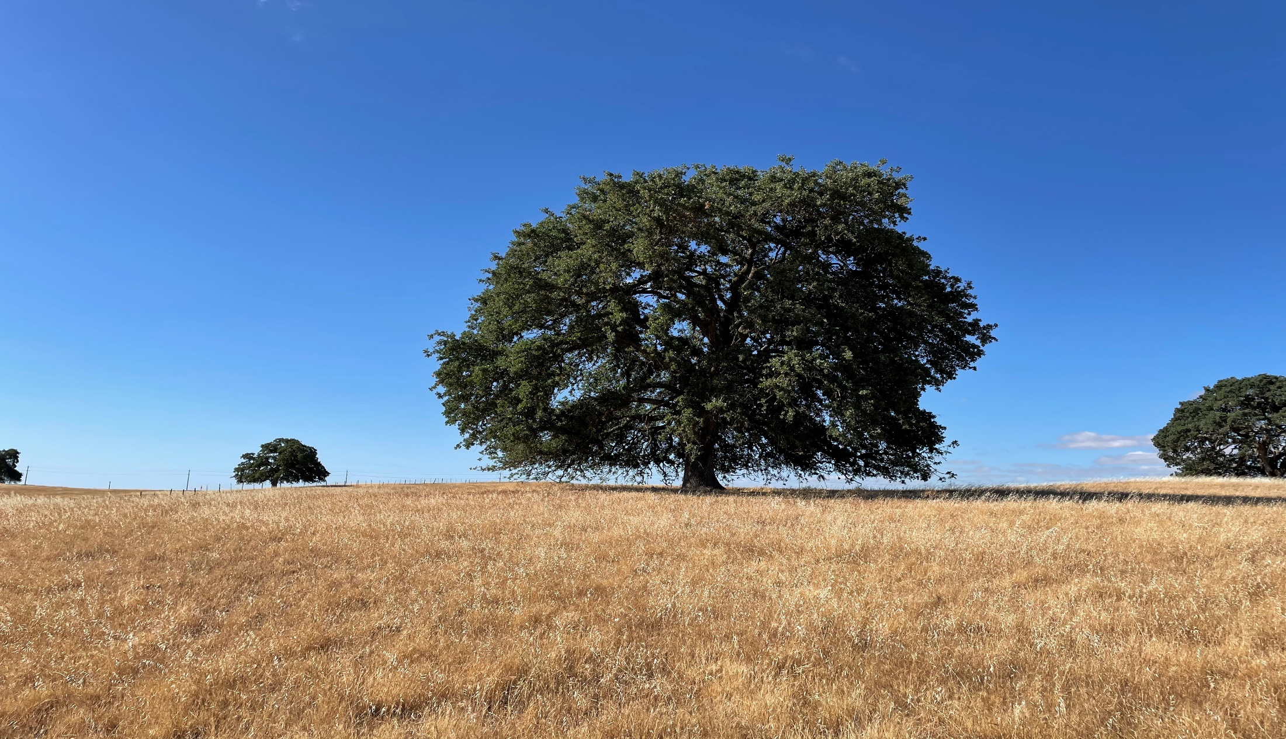
Staff Recommendation
Staff Forwards Planning Commission Recommendation to City Council for Approval of the Toll Brothers at Folsom Ranch Phase 2 Small-Lot Vesting Tentative Subdivision Map and Minor Administrative Modification

