Slide 1
City of Folsom Final Map Presentation
Doug Yoakam, Consultant
National Demographics Corporation

Slide 2
Districting Process
Step | Description
Census Data Release August 12, 2021 | Census Bureau releases official 2020 Census population data
Public Hearing #1 September 14, 2021 | Held prior to release of draft maps Educate, solicit input on neighborhoods and Communities of Interest
California Data Release September 20 & 27, 2021 | California Statewide Database releases California’s official ‘prisoner-adjusted’ 2020 redistricting data
Public Hearing #2 October 12, 2021 | Held prior to release of draft maps Educate, solicit input on neighborhoods and Communities of Interest

Slide 3
Districting Process (continued)
Step | Description
Public Hearing #3 January 11, 2022 | Held after release of draft maps Educate, solicit input on neighborhoods and Communities of Interest Discuss, revise draft maps; discuss election sequencing
Public Hearing #4 February 8, 2022 | Held after release of draft maps Educate, solicit input on the communities in the districts Discuss, determine final map; discuss, determine election sequencing
Public Hearing #5 Febrauary 22, 2022 | Adopt final map.

Slide 4
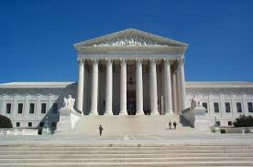
Districting Rules and Goals
1. Federal Laws
2. California Criteria for Cities
3. Other Traditional Redistricting Principles
Equal Population
Federal Voting Rights Act
No Racial Gerrymandering
Geographically contiguous
Undivided neighborhoods and “communities of interest”
Easily identifiable boundaries
Compact
Prohibited: “Shall not favor or discriminate against a political party.”
Respect voters’ choices / continuity in office
Future population growth

Slide 5
8 Focus Maps: Cline, Dooley, Goss, Bulaga, N. Ferrari, NDC 101, 101A, 101B 2 New NDC Draft Maps: NDC 201 & 202 Based on Council Consensus criteria. 1 Focus Map not compliant: Goss
February 8, 2022

Slide 6
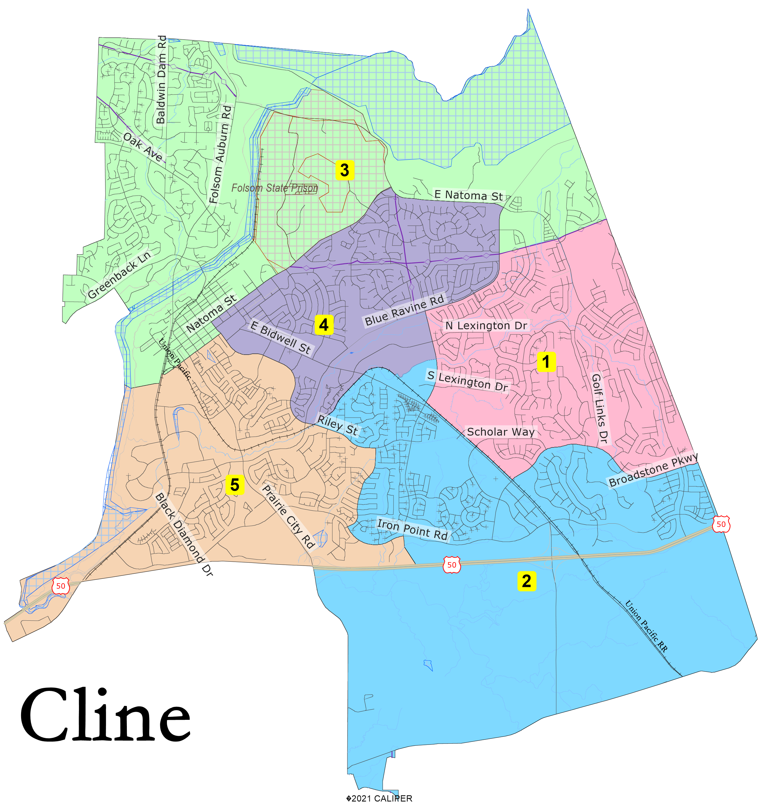

Slide 7
Cline Statistics
Public Map Cline
District |  |  |  | 1 | 2 | 3 | 4 | 5 | Total
 |  | Total Pop |  | 15,524 | 14,130 | 15,061 | 15,037 | 15,286 | 75,038
 |  | Deviation from ideal |  | 516 | -878 | 53 | 29 | 278 | 1,394
 |  | % Deviation |  | 3.44% | -5.85% | 0.35% | 0.19% | 1.85% | 9.29%
Total Pop |  | % Hisp |  | 10.10% | 10% | 11% | 15% | 11% | 11%
 |  | % NH White |  | 57% | 51% | 69% | 64% | 52% | 59%
 |  | % NH Black |  | 1% | 2% | 3% | 2% | 2% | 2%
 |  | % Asian-American |  | 27% | 33% | 13% | 12% | 31% | 23%
Citizen Voting Age Pop |  | Total |  | 9,179 | 8,183 | 11,512 | 10,645 | 9,767 | 49,286
 |  | % Hisp |  | 9% | 8% | 9% | 12% | 10% | 10%
 |  | % NH White |  | 70% | 71% | 79% | 79% | 66% | 73%
 |  | % NH Black |  | 1% | 2% | 1% | 2% | 2% | 1%
 |  | % Asian/Pac.Isl. |  | 20% | 18% | 10% | 5% | 21% | 14%

Slide 8
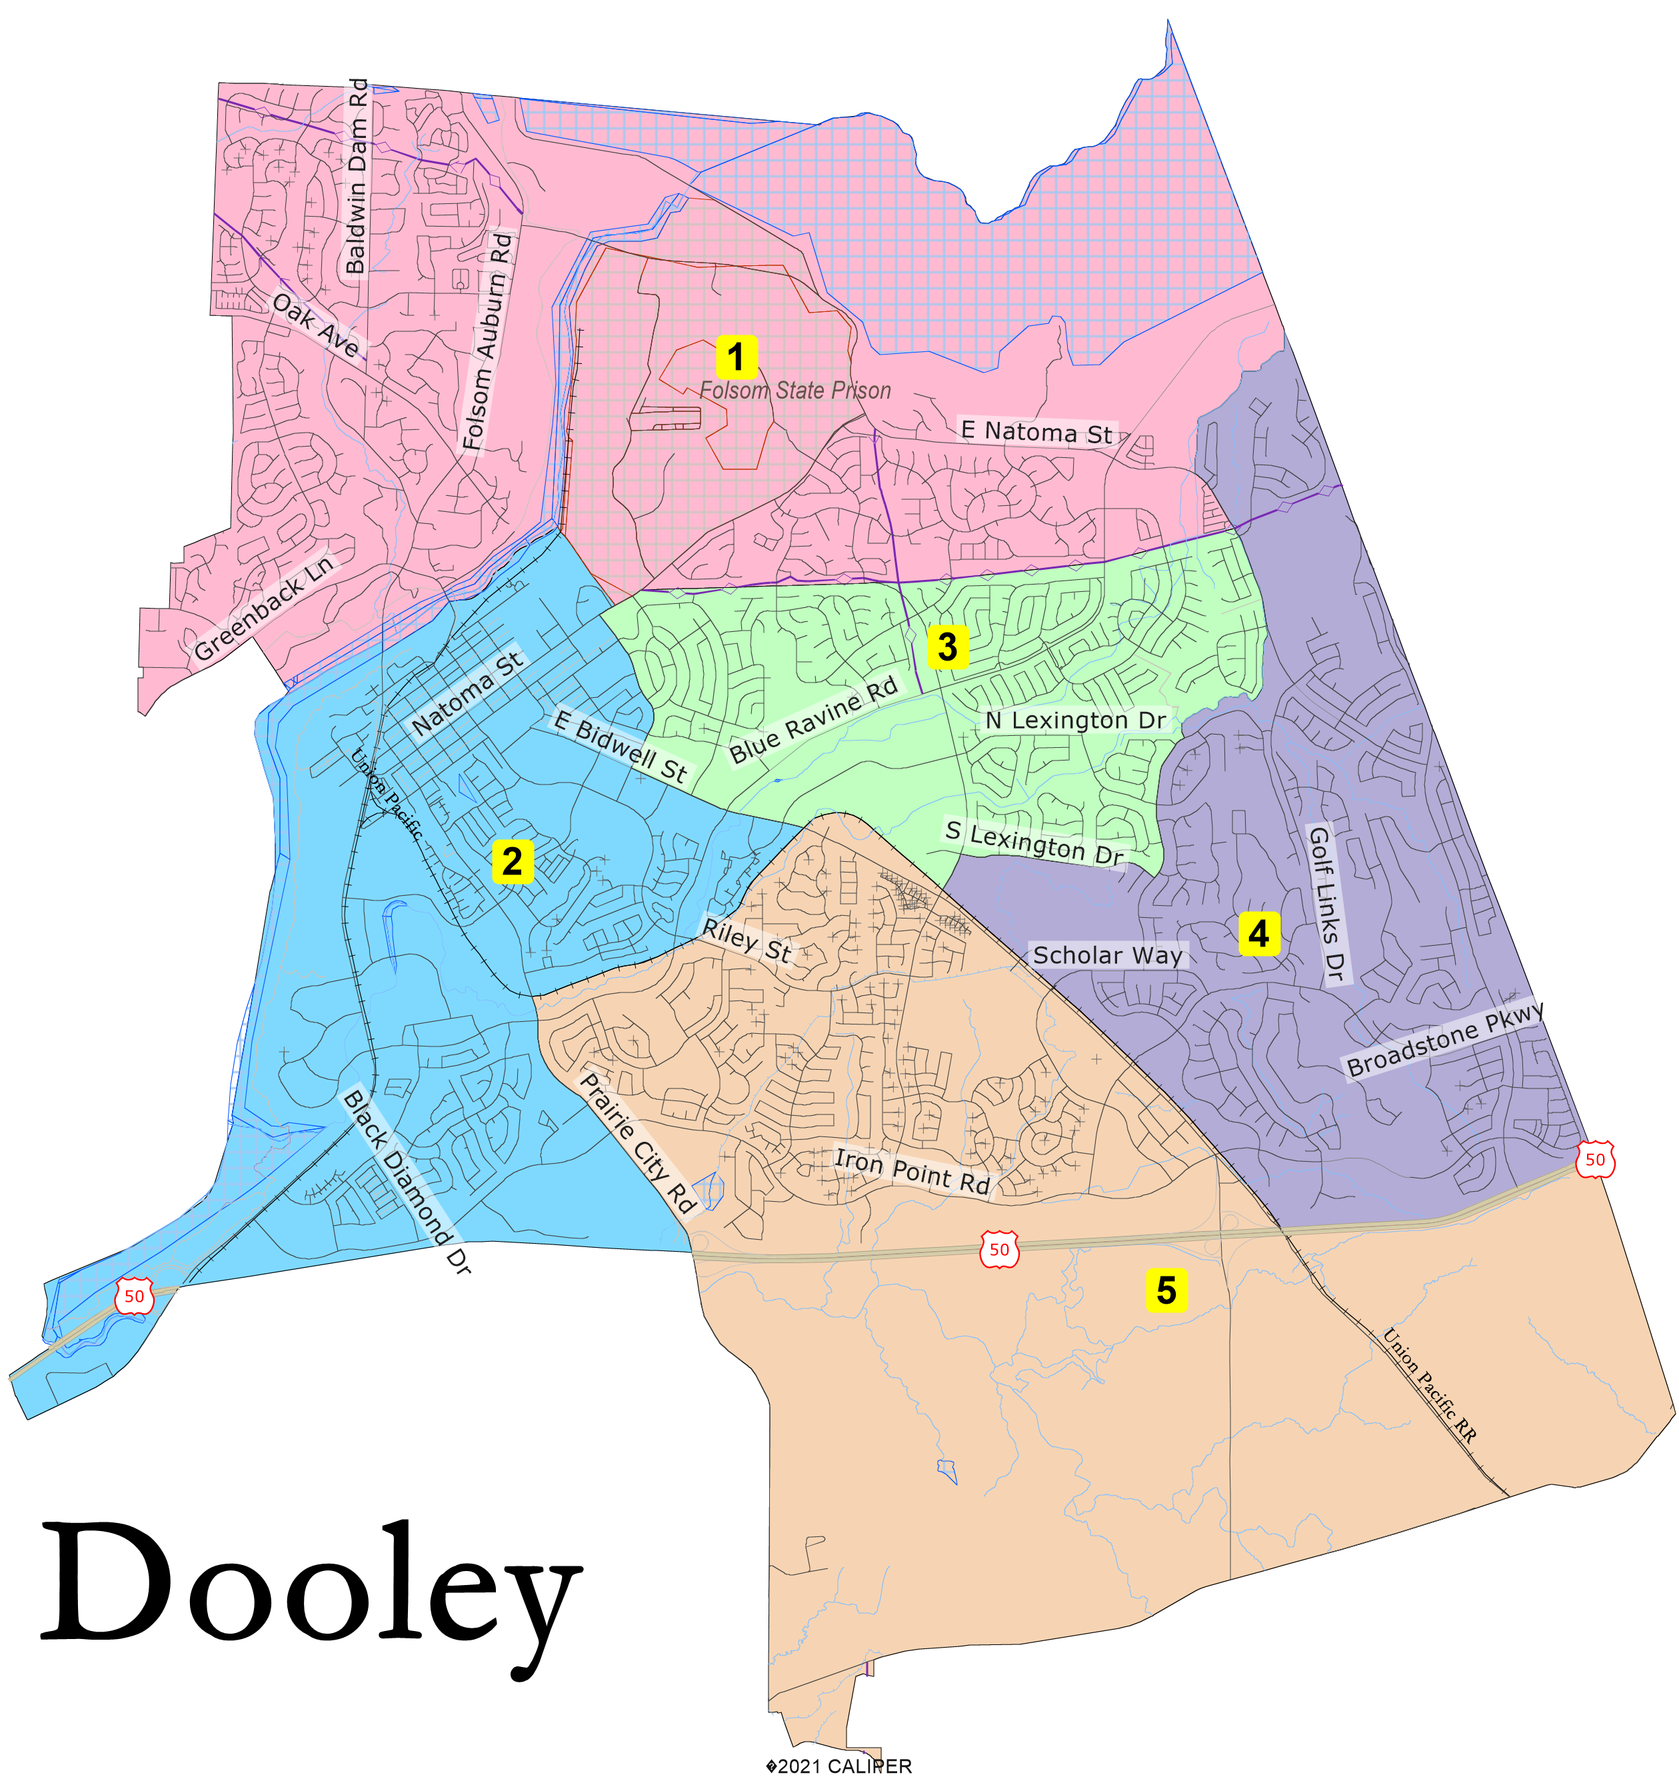

Slide 9
Dooley Statistics
Public Map Dooley
District |  |  |  | 1 | 2 | 3 | 4 | 5 | Total
 |  | Total Pop |  | 15,301 | 14,792 | 15,416 | 14,294 | 15,235 | 75,038
 |  | Deviation from ideal |  | 293 | -216 | 408 | -714 | 227 | 1,122
 |  | % Deviation |  | 1.95% | -1.44% | 2.72% | -4.76% | 1.51% | 7.48%
Total Pop |  | % Hisp |  | 11.30% | 13% | 13% | 9% | 9% | 11%
 |  | % NH White |  | 71% | 60% | 60% | 52% | 50% | 59%
 |  | % NH Black |  | 2% | 3% | 2% | 2% | 2% | 2%
 |  | % Asian-American |  | 11% | 19% | 19% | 34% | 35% | 23%
Citizen Voting Age Pop |  | Total |  | 11,881 | 10,037 | 10,315 | 7,841 | 9,212 | 49,286
 |  | % Hisp |  | 11% | 11% | 8% | 9% | 9% | 10%
 |  | % NH White |  | 80% | 74% | 76% | 66% | 68% | 73%
 |  | % NH Black |  | 1% | 2% | 2% | 1% | 1% | 1%
 |  | % Asian/Pac.Isl. |  | 7% | 12% | 12% | 24% | 20% | 14%

Slide 10
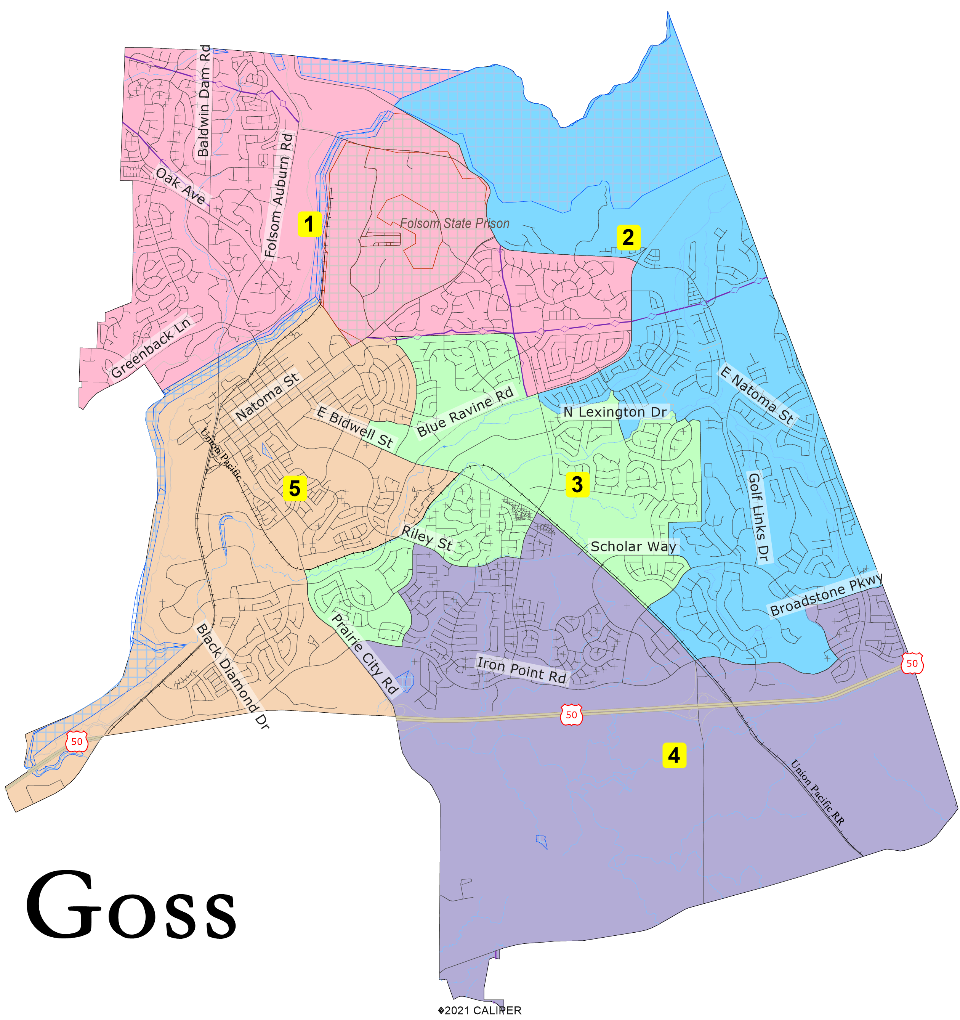

Slide 11
Goss Statistics
Public Map Goss
District |  |  |  | 1 | 2 | 3 | 4 | 5 | Total
 |  | Total Pop |  | 15,627 | 15,133 | 15,006 | 12,843 | 16,429 | 75,038
 |  | Deviation from ideal |  | 619 | 125 | -2 | -2,165 | 1,421 | 3,586
 |  | % Deviation |  | 4.12% | 0.83% | -0.01% | -14.43% | 9.47% | 23.89%
Total Pop |  | % Hisp |  | 11.80% | 10% | 11% | 10% | 14% | 11%
 |  | % NH White |  | 73% | 51% | 59% | 48% | 60% | 59%
 |  | % NH Black |  | 2% | 2% | 2% | 2% | 3% | 2%
 |  | % Asian-American |  | 8% | 34% | 23% | 36% | 17% | 23%
Citizen Voting Age Pop |  | Total |  | 12,540 | 8,565 | 9,959 | 7,067 | 11,155 | 49,286
 |  | % Hisp |  | 11% | 7% | 9% | 9% | 11% | 10%
 |  | % NH White |  | 82% | 67% | 72% | 67% | 75% | 73%
 |  | % NH Black |  | 1% | 1% | 2% | 2% | 2% | 1%
 |  | % Asian/Pac.Isl. |  | 5% | 25% | 15% | 20% | 11% | 14%

Slide 12
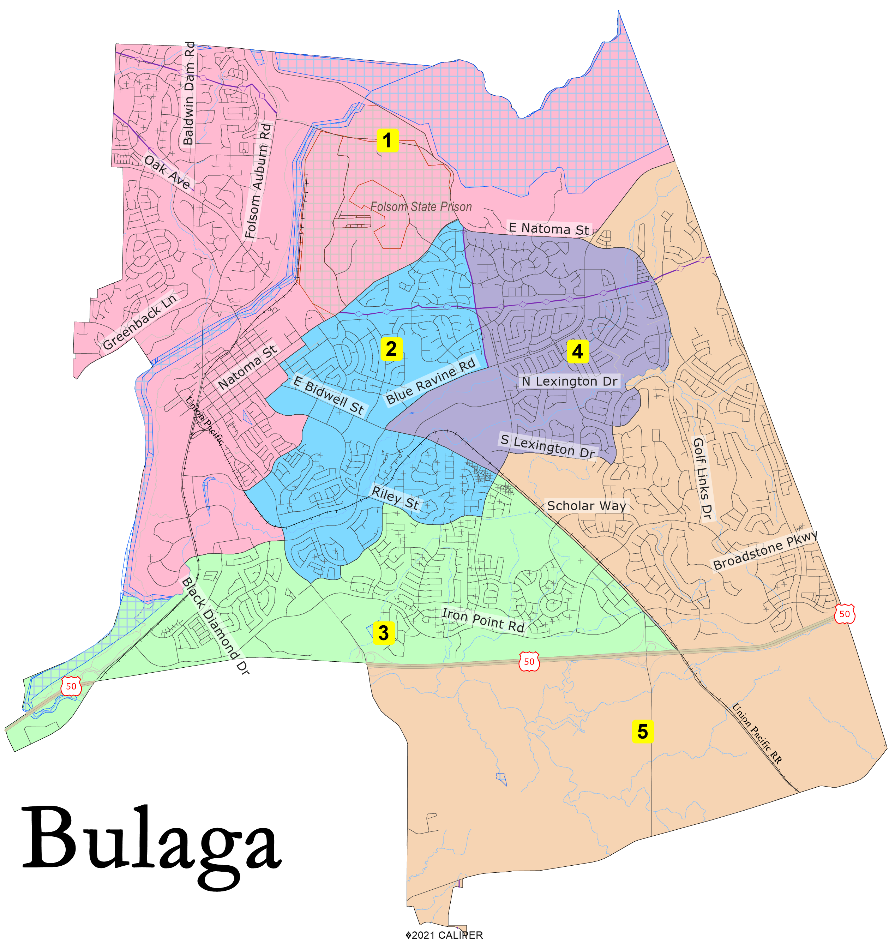

Slide 13
Bulaga Statistics
Public map Bulaga
District |  |  |  | 1 | 2 | 3 | 4 | 5 | Total
 |  | Total Pop |  | 15,091 | 14,804 | 15,206 | 14,673 | 15,264 | 75,038
 |  | Deviation from ideal |  | 83 | -204 | 198 | -335 | 256 | 591
 |  | % Deviation |  | 0.55% | -1.36% | 1.32% | -2.23% | 1.71% | 3.94%
Total Pop |  | % Hisp |  | 11.40% | 14% | 10% | 12% | 9% | 11%
 |  | % NH White |  | 70% | 61% | 52% | 61% | 50% | 59%
 |  | % NH Black |  | 2% | 2% | 2% | 2% | 2% | 2%
 |  | % Asian-American |  | 11% | 16% | 31% | 21% | 36% | 23%
Citizen Voting Age Pop |  | Total |  | 11,782 | 10,543 | 9,789 | 9,329 | 7,843 | 49,286
 |  | % Hisp |  | 9% | 10% | 11% | 9% | 9% | 10%
 |  | % NH White |  | 80% | 75% | 68% | 74% | 65% | 73%
 |  | % NH Black |  | 1% | 1% | 3% | 1% | 1% | 1%
 |  | % Asian/Pac.Isl. |  | 8% | 12% | 16% | 14% | 24% | 14%

Slide 14
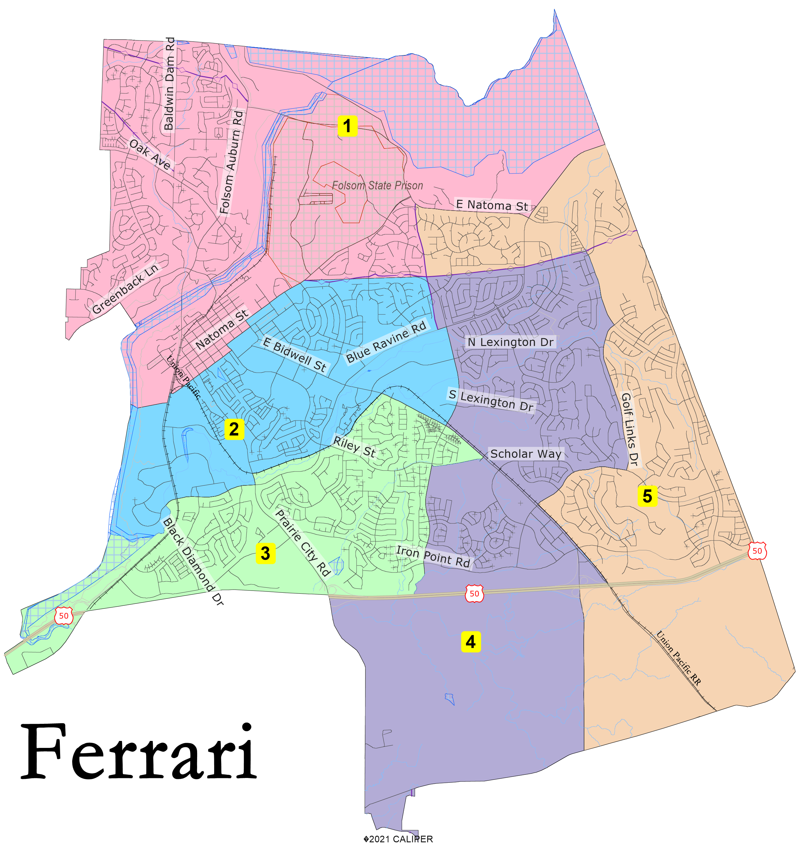

Slide 15
Ferrari Statistics
Public map Ferrari
District |  |  |  | 1 | 2 | 3 | 4 | 5 | Total
 |  | Total Pop |  | 13,903 | 14,961 | 15,486 | 15,466 | 15,222 | 75,038
 |  | Deviation from ideal |  | -1,105 | -47 | 478 | 458 | 214 | 1,583
 |  | % Deviation |  | -7.36% | -0.31% | 3.18% | 3.05% | 1.43% | 10.54%
Total Pop |  | % Hisp |  | 10.90% | 15% | 9% | 12% | 10% | 11%
 |  | % NH White |  | 73% | 57% | 53% | 60% | 52% | 59%
 |  | % NH Black |  | 2% | 3% | 2% | 2% | 2% | 2%
 |  | % Asian-American |  | 9% | 18% | 32% | 23% | 32% | 23%
Citizen Voting Age Pop |  | Total |  | 11,209 | 9,928 | 9,834 | 10,428 | 7,887 | 49,286
 |  | % Hisp |  | 10% | 10% | 11% | 10% | 7% | 10%
 |  | % NH White |  | 81% | 74% | 68% | 73% | 69% | 73%
 |  | % NH Black |  | 1% | 2% | 2% | 1% | 1% | 1%
 |  | % Asian/Pac.Isl. |  | 6% | 11% | 18% | 15% | 23% | 14%

Slide 16
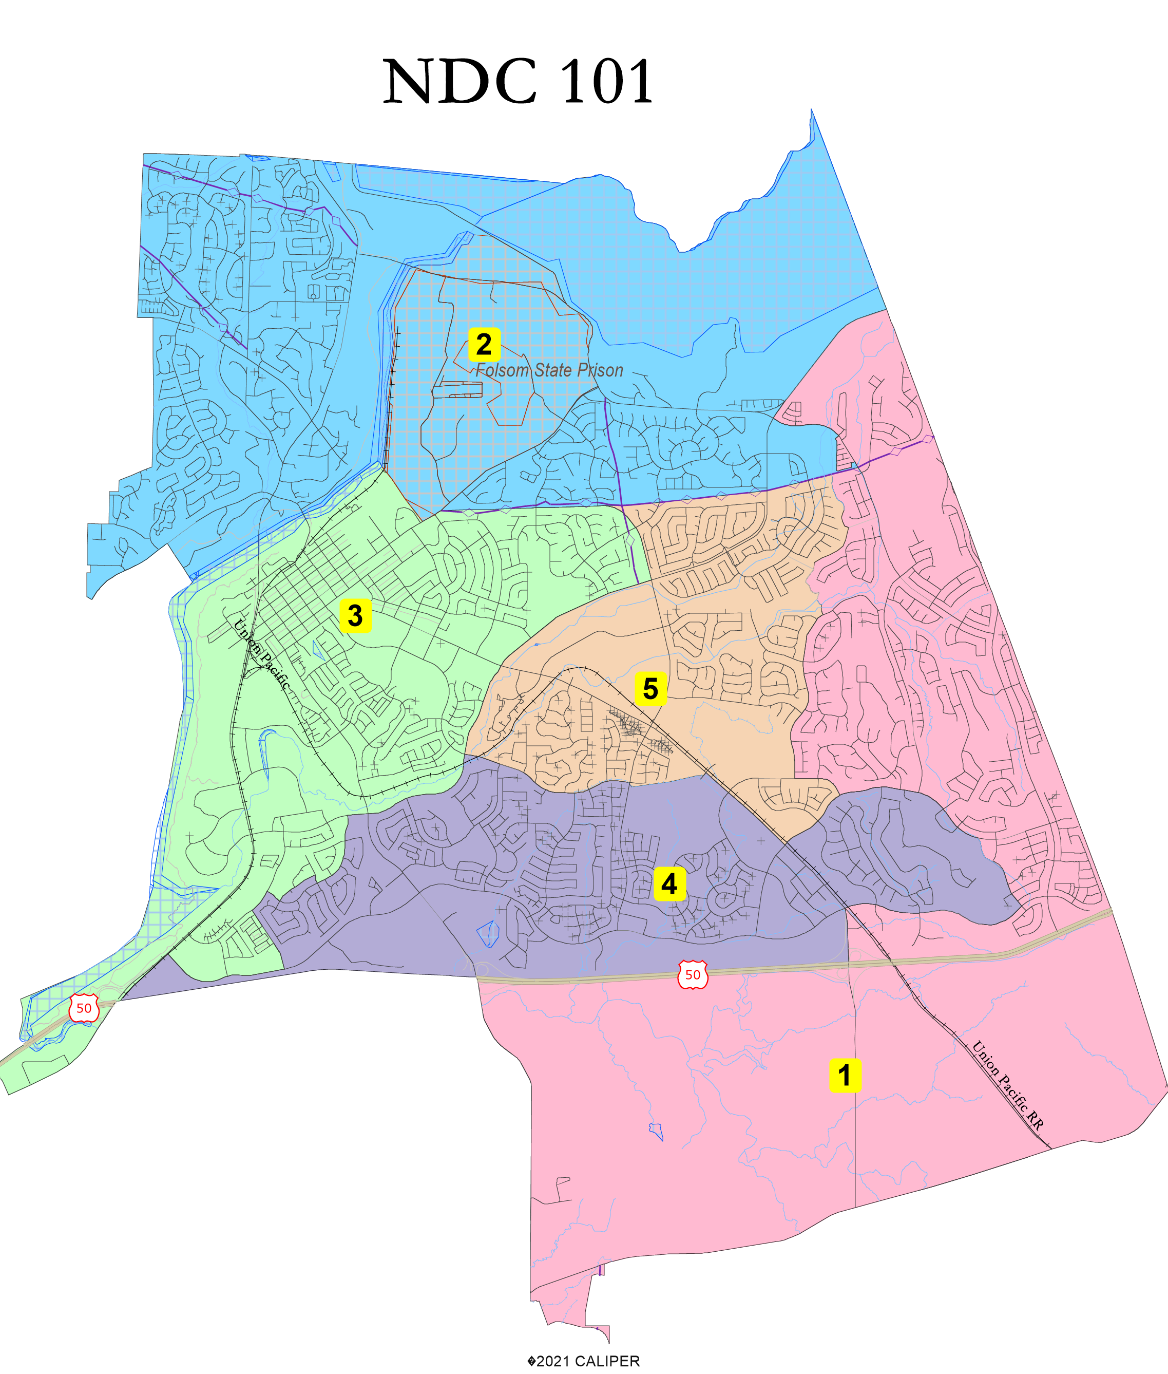

Slide 17
NDC Map 101 Statistics
District |  |  |  | 1 | 2 | 3 | 4 | 5 | Total
 |  | Total Pop |  | 14,704 | 14,747 | 15,368 | 15,273 | 14,946 | 75,038
 |  | Deviation from ideal |  | -304 | -261 | 360 | 265 | -62 | 664
 |  | % Deviation |  | -2.03% | -1.74% | 2.40% | 1.77% | -0.41% | 4.42%
Total Pop |  | % Hisp |  | 9.00% | 11% | 15% | 10% | 11% | 11%
 |  | % NH White |  | 50% | 72% | 61% | 51% | 60% | 59%
 |  | % NH Black |  | 2% | 2% | 2% | 2% | 2% | 2%
 |  | % Asian-American |  | 36% | 10% | 15% | 34% | 22% | 23%
Citizen Voting Age Pop |  | Total |  | 7,480 | 11,575 | 10,930 | 9,808 | 9,493 | 49,286
 |  | % Hisp |  | 8% | 11% | 10% | 10% | 9% | 10%
 |  | % NH White |  | 64% | 80% | 77% | 67% | 75% | 73%
 |  | % NH Black |  | 1% | 1% | 2% | 2% | 1% | 1%
 |  | % Asian/Pac.Isl. |  | 26% | 7% | 10% | 20% | 13% | 14%
NDC Map 101 Statistics

Slide 18
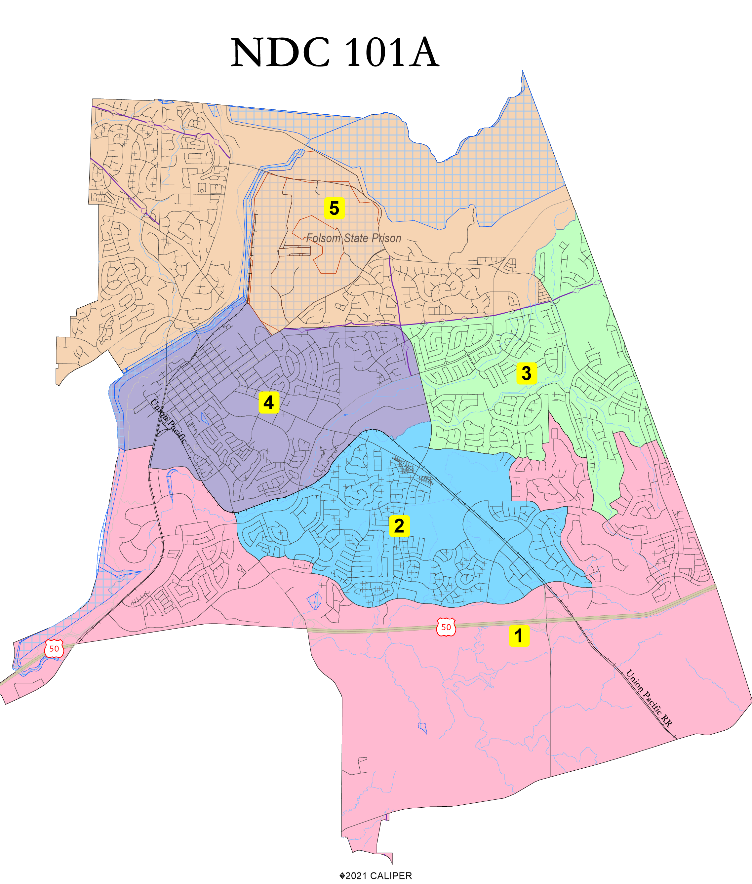

Slide 19
NDC Map 101A Statistics
District |  |  |  | 1 | 2 | 3 | 4 | 5 | Total
 |  | Total Pop |  | 14,556 | 14,668 | 15,388 | 15,125 | 15,301 | 75,038
 |  | Deviation from ideal |  | -452 | -340 | 380 | 117 | 293 | 832
 |  | % Deviation |  | -3.01% | -2.27% | 2.53% | 0.78% | 1.95% | 5.54%
Total Pop |  | % Hisp |  | 8.80% | 10% | 15% | 11% | 11% | 11%
 |  | % NH White |  | 47% | 54% | 61% | 60% | 71% | 59%
 |  | % NH Black |  | 2% | 2% | 3% | 2% | 2% | 2%
 |  | % Asian-American |  | 39% | 30% | 14% | 24% | 11% | 23%
Citizen Voting Age Pop |  | Total |  | 7,839 | 9,402 | 10,762 | 9,402 | 11,881 | 49,286
 |  | % Hisp |  | 11% | 10% | 9% | 7% | 11% | 10%
 |  | % NH White |  | 64% | 70% | 76% | 73% | 80% | 73%
 |  | % NH Black |  | 2% | 1% | 2% | 1% | 1% | 1%
 |  | % Asian/Pac.Isl. |  | 22% | 17% | 11% | 18% | 7% | 14%
NDC Map 101A Statistics

Slide 20
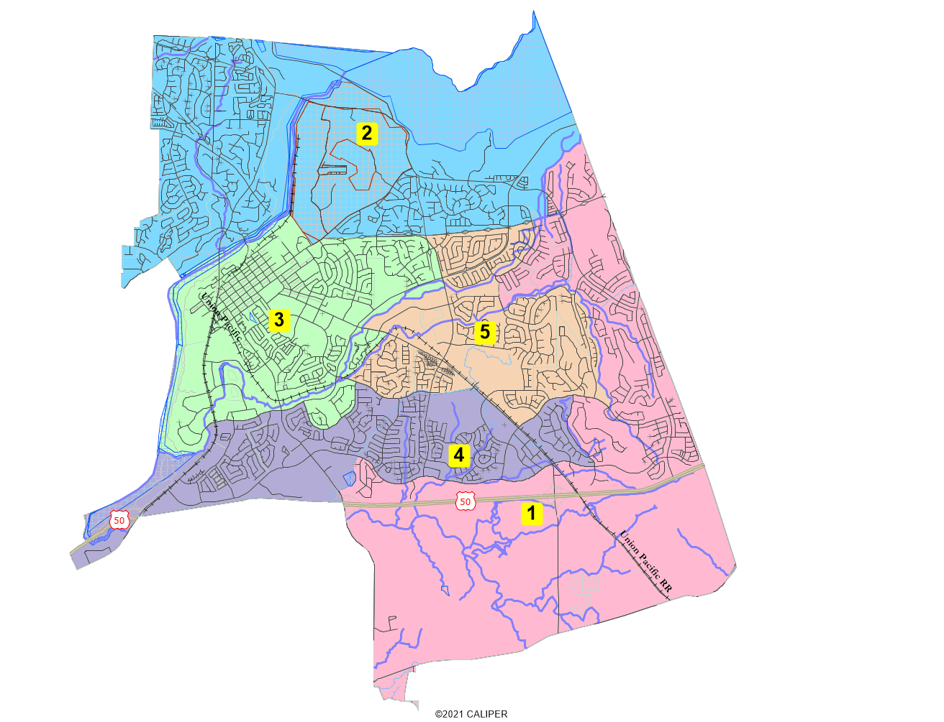
NDC Map 101B

Slide 21
NDC 101B Statistics
District |  |  |  | 1 | 2 | 3 | 4 | 5 | Total
 |  | Total Pop |  | 14,776 | 15,057 | 15,361 | 15,124 | 14,720 | 75,038
 |  | Deviation from ideal |  | -232 | 49 | 353 | 116 | -288 | 641
 |  | % Deviation |  | -1.55% | 0.33% | 2.35% | 0.77% | -1.92% | 4.27%
Total Pop |  | % Hisp |  | 8.70% | 11% | 15% | 10% | 11% | 11%
 |  | % NH White |  | 47% | 71% | 61% | 54% | 60% | 59%
 |  | % NH Black |  | 2% | 2% | 3% | 2% | 2% | 2%
 |  | % Asian-American |  | 39% | 11% | 15% | 30% | 22% | 23%
Citizen Voting Age Pop |  | Total |  | 7,486 | 11,737 | 10,730 | 9,961 | 9,371 | 49,286
 |  | % Hisp |  | 5% | 11% | 9% | 11% | 11% | 10%
 |  | % NH White |  | 63% | 80% | 76% | 70% | 74% | 73%
 |  | % NH Black |  | 1% | 1% | 1% | 3% | 1% | 1%
 |  | % Asian/Pac.Isl. |  | 30% | 7% | 11% | 15% | 12% | 14%
NDC 101B Statistics

Slide 22
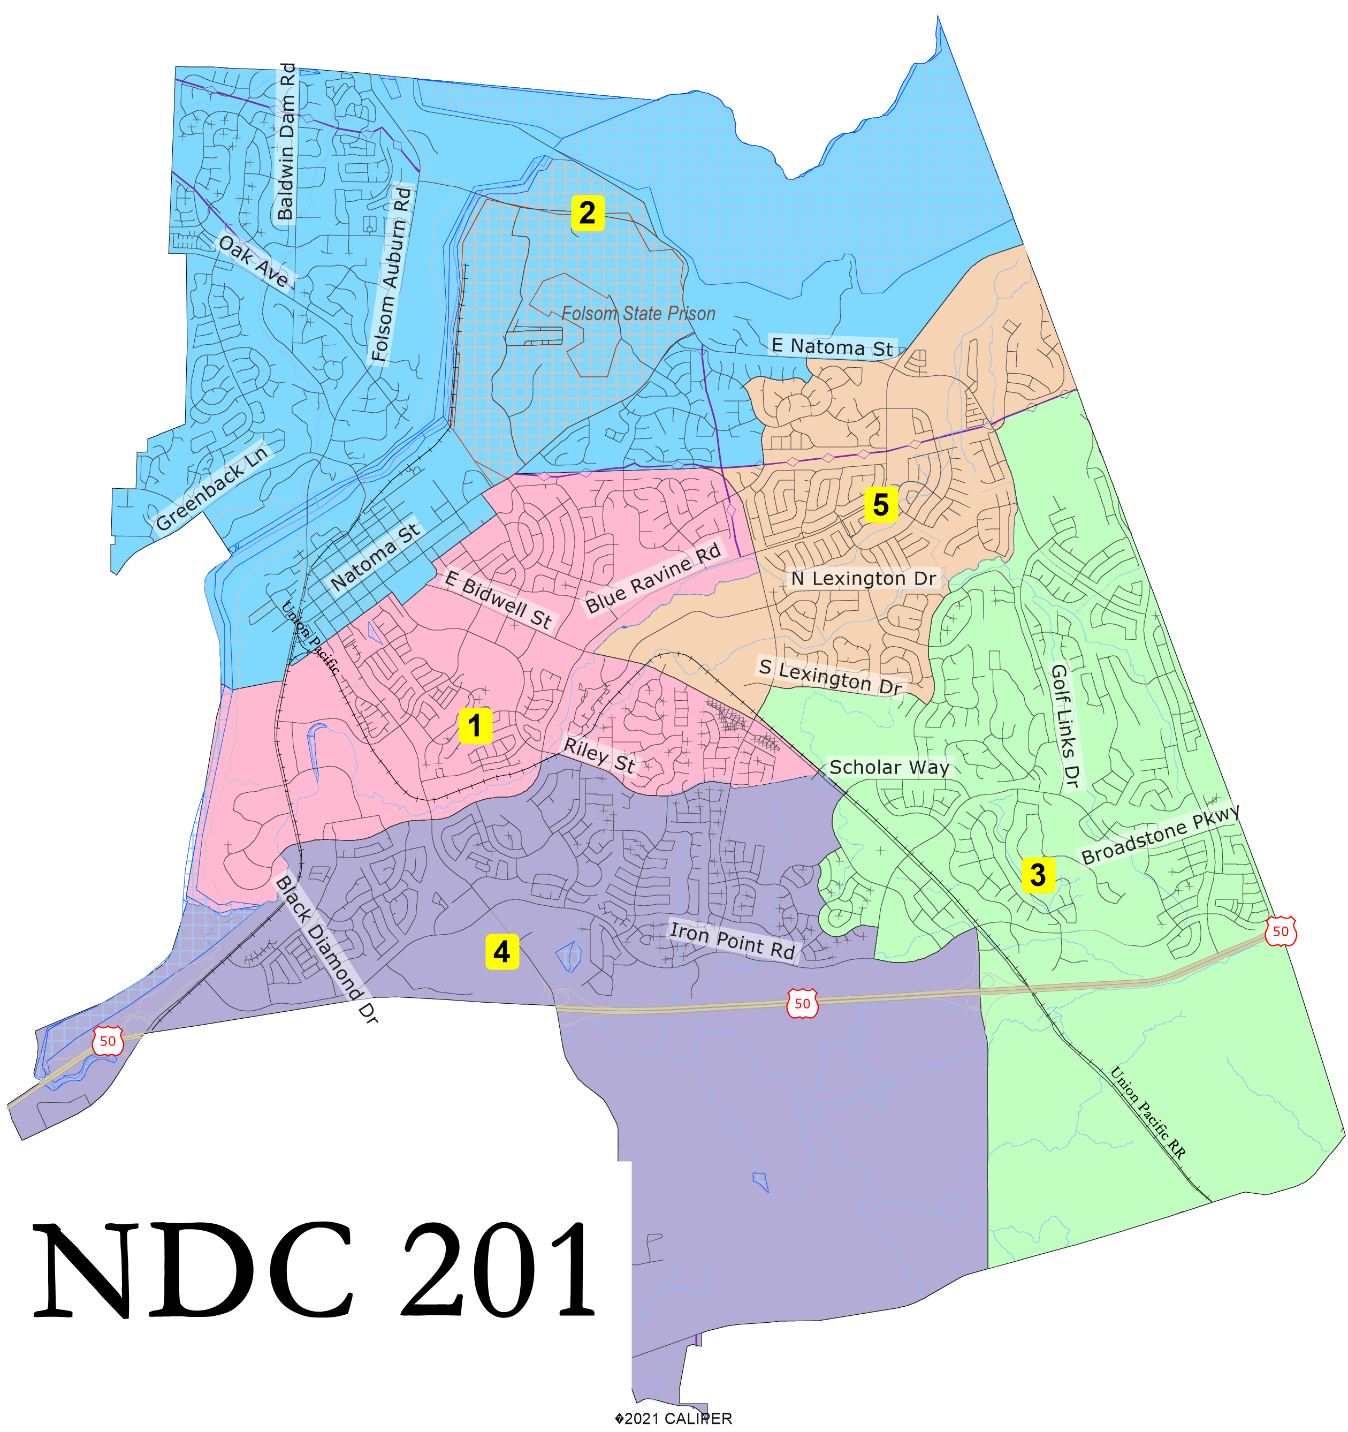

Slide 23
NDC 201 Statistics
NDC 201
District |  |  |  | 1 | 2 | 3 | 4 | 5 | Total
 |  | Total Pop |  | 14,886 | 15,033 | 14,636 | 15,352 | 15,131 | 75,038
 |  | Deviation from ideal |  | -122 | 25 | -372 | 344 | 123 | 716
 |  | % Deviation |  | -0.81% | 0.17% | -2.48% | 2.29% | 0.82% | 4.77%
Total Pop |  | % Hisp |  | 14.30% | 11% | 9% | 10% | 12% | 11%
 |  | % NH White |  | 59% | 72% | 50% | 52% | 60% | 59%
 |  | % NH Black |  | 2% | 2% | 2% | 2% | 2% | 2%
 |  | % Asian-American |  | 17% | 9% | 35% | 32% | 23% | 23%
Citizen Voting Age Pop |  | Total |  | 10,167 | 12,085 | 7,699 | 9,782 | 9,553 | 49,286
 |  | % Hisp |  | 8% | 11% | 9% | 11% | 8% | 10%
 |  | % NH White |  | 76% | 81% | 67% | 67% | 73% | 73%
 |  | % NH Black |  | 1% | 1% | 1% | 2% | 1% | 1%
 |  | % Asian/Pac.Isl. |  | 12% | 6% | 22% | 18% | 16% | 14%

Slide 24
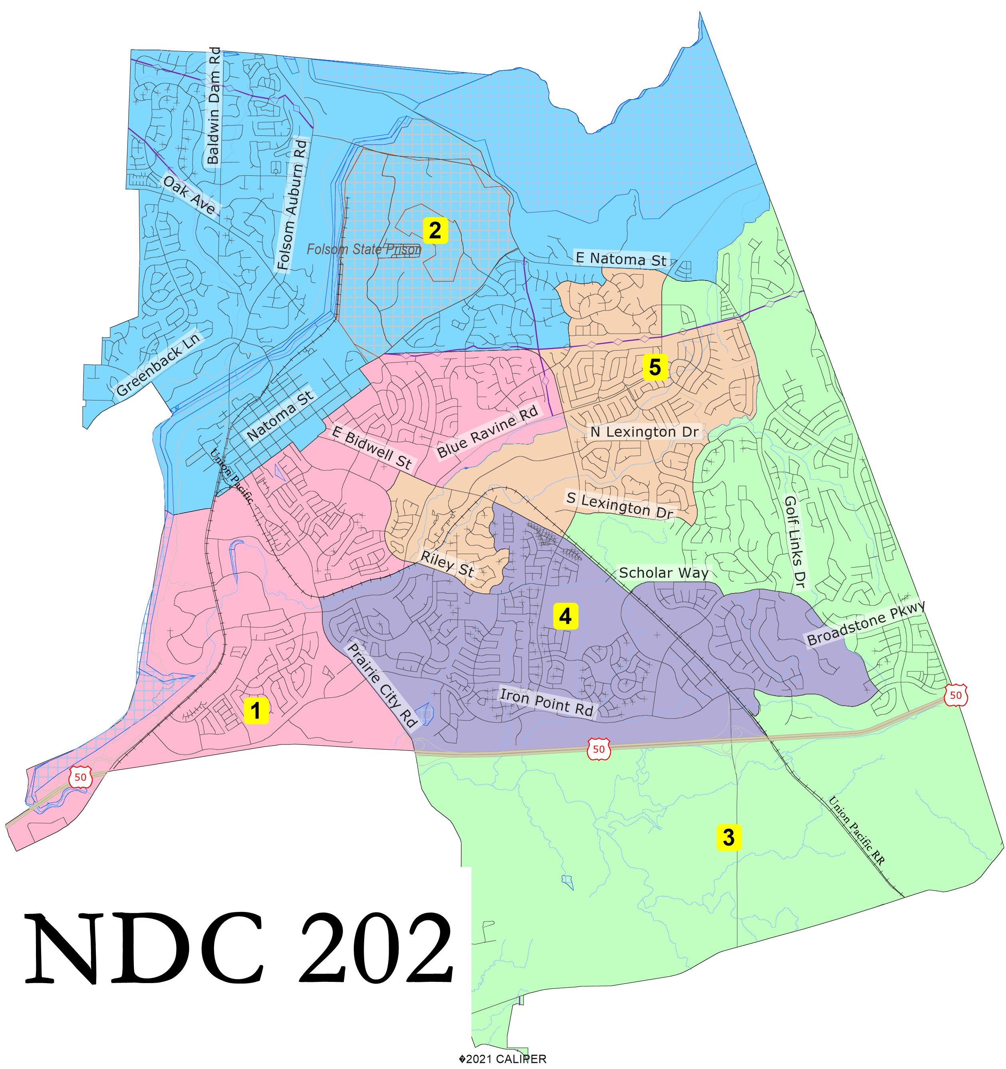

Slide 25
NDC 202 Statistics
NDC 202
District |  |  |  | 1 | 2 | 3 | 4 | 5 | Total
 |  | Total Pop |  | 15,121 | 15,343 | 14,015 | 15,259 | 15,300 | 75,038
 |  | Deviation from ideal |  | 113 | 335 | -993 | 251 | 292 | 1,328
 |  | % Deviation |  | 0.75% | 2.23% | -6.62% | 1.67% | 1.95% | 8.85%
Total Pop |  | % Hisp |  | 14.10% | 12% | 9% | 10% | 12% | 11%
 |  | % NH White |  | 58% | 72% | 51% | 50% | 61% | 59%
 |  | % NH Black |  | 3% | 2% | 2% | 2% | 2% | 2%
 |  | % Asian-American |  | 19% | 9% | 35% | 34% | 20% | 23%
Citizen Voting Age Pop |  | Total |  | 10,512 | 12,247 | 7,011 | 9,715 | 9,800 | 49,286
 |  | % Hisp |  | 11% | 11% | 8% | 9% | 8% | 10%
 |  | % NH White |  | 73% | 81% | 65% | 67% | 76% | 73%
 |  | % NH Black |  | 2% | 1% | 1% | 1% | 1% | 1%
 |  | % Asian/Pac.Isl. |  | 12% | 6% | 25% | 20% | 13% | 14%

Slide 26
Folsom Districting InformationWebsite: https://www.folsom.ca.us/government/city-clerk-s-office/by-district-elections-overview Phone Number: 916-461-6025 Email comments: attydept@folsom.ca.us

